Slide 1
Introduction
Python Academy
April 2023

Slide 2
Agenda
01
02
03
04
05
Introduction to programming
What is a programming language
Difference between
a compiler and an interpreter
What is python?
Python2 and Python3

Slide 3
Instructions

Slide 4
Installation
Programs and code
01
02
Now we download Pyhton and IDE for better development
Download Python3
PyCharm: the Python IDE
03
(Optional) VS Code

Slide 5
01
Introduction to programming
What do we talk about when we talk about programming?

Slide 6
What is Programming?
Programming is a collaboration between humans and computers
Programming is a collaboration between humans and computers.
Put simply, programming is giving a set of instructions to a computer to execute. If you’ve ever cooked using a recipe before, you can think of yourself as the computer and the recipe’s author as a programmer. The recipe author provides you with a set of instructions which you read and then follow. The more complex the instructions, the more complex the result!
…AND PROGRAMMING IS FOR EVERYONE

Slide 7
Communication or Coding
01
02
Programming
Coding
Is the mental process of thinking up instructions to give to a machine (like a computer).
Is the process of transforming those ideas into a written language that a computer can understand

Slide 8
Programming as collaboration
“A computer can be called ‘intelligent’ if it succeeds in fooling a person into thinking that it is a human.“ Alan Turing
When we give instructions to a computer through code, we are, in our own way, communicating with the computer. But since computers are built differently than we are, we have to translate our instructions in a way that computers will understand. Computers interpret instructions in a very literal manner, so we have to be very specific in how we program them. But rather than think of this as a boss-employee relationship, it’s more helpful to think about our relationship with computers as a collaboration.
The computer is just one (particularly powerful) tool in a long list of tools that humans have used to extend and augment their ability.

Slide 9
Programming as collaboration
As mentioned before, computers are very good at certain things and well, not so good at others. But here’s the good news: the things that computers are good at, humans suck at, and the things that computers suck at, humans are good at! Take a look at this handy table:
Human | Computer
Thinks creatively | No creativity (follows given instructions)
Communicates through inference | Limited hard-wired knowledge
Detects patterns to make sense of world | Calculates information quickly
Inconsistent | Consistent
Can get bored | Does not lose focus

Slide 10
02
What is a programming language
What does it mean? why are there so many? which to choose? do the same? do they do the same thing?

Slide 11
Programming language
From Wikipedia
A programming language is a system of notation for writing computer programs.[1] Most programming languages are text-based formal languages, but they may be also be graphical. They are a kind of computer language.
The description of a programming language is usually split into the two components of syntax (form) and semantics (meaning), which are usually defined by a formal language. Some languages are defined by a specification document (for example, the C programming language is specified by an ISO Standard) while other languages (such as Perl) have a dominant implementation that is treated as a reference. Some languages have both, with the basic language defined by a standard and extensions taken from the dominant implementation being common.
Programming language theory is a subfield of computer science that deals with the design, implementation, analysis, characterization, and classification of programming languages.

Slide 12
Natural languages vs. programming languages
From Python Institute
A language is a means (and a tool) for expressing and recording thoughts. There are many languages all around us. Some of them require neither speaking nor writing, such as body language; it's possible to express your deepest feelings very precisely without saying a word.
Another language you use each day is your mother tongue, which you use to manifest your will and to ponder reality. Computers have their own language, too, called machine language, which is very rudimentary.
A computer, even the most technically sophisticated, is devoid of even a trace of intelligence. You could say that it is like a well-trained dog - it responds only to a predetermined set of known commands.
The commands it recognizes are very simple. We can imagine that the computer responds to orders like "take that number, divide by another and save the result".
A complete set of known commands is called an instruction list, sometimes abbreviated to IL. Different types of computers may vary depending on the size of their ILs, and the instructions could be completely different in different models.
Note: machine languages are developed by humans.
No computer is currently capable of creating a new language. However, that may change soon. Just as people use a number of very different languages, machines have many different languages, too. The difference, though, is that human languages developed naturally.
Moreover, they are still evolving, and new words are created every day as old words disappear. These languages are called natural languages.

Slide 13
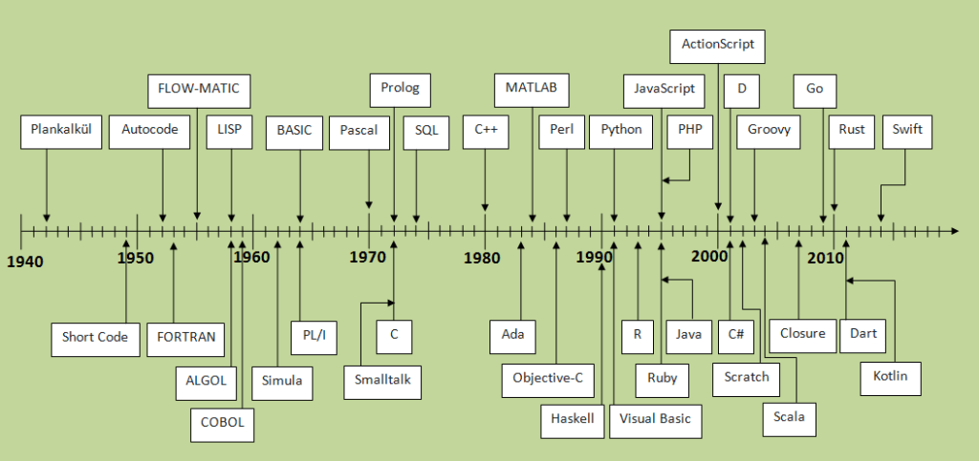
History

Slide 14
03
difference between a compiler and an interpreter
what is a compiler? what is an interpreter?
which is better?

Slide 15
Compilation vs. interpretation
Computer programming is the act of composing the selected programming language's elements in the order that will cause the desired effect. The effect could be different in every specific case – it's up to the programmer's imagination, knowledge and experience.
Of course, such a composition has to be correct in many senses:
alphabetically – a program needs to be written in a recognizable script, such as Roman, Cyrillic, etc.
lexically – each programming language has its dictionary, and you need to master it; thankfully, it's much simpler and smaller than the dictionary of any natural language;
syntactically – each language has its rules, and they must be obeyed;
semantically – the program must make sense.

Slide 16
Compilation
Interpretation
The source program is translated once (however, this act must be repeated each time you modify the source code) by getting a file (e.g., an .exe file if the code is intended to be run under MS Windows) containing the machine code; now you can distribute the file worldwide; the program that performs this translation is called a compiler or translator
You (or any user of the code) can translate the source program each time it has to be run; the program performing this kind of transformation is called an interpreter, as it interprets the code every time it is intended to be executed; it also means that you cannot just distribute the source code as-is, because the end-user also needs the interpreter to execute it

Slide 17
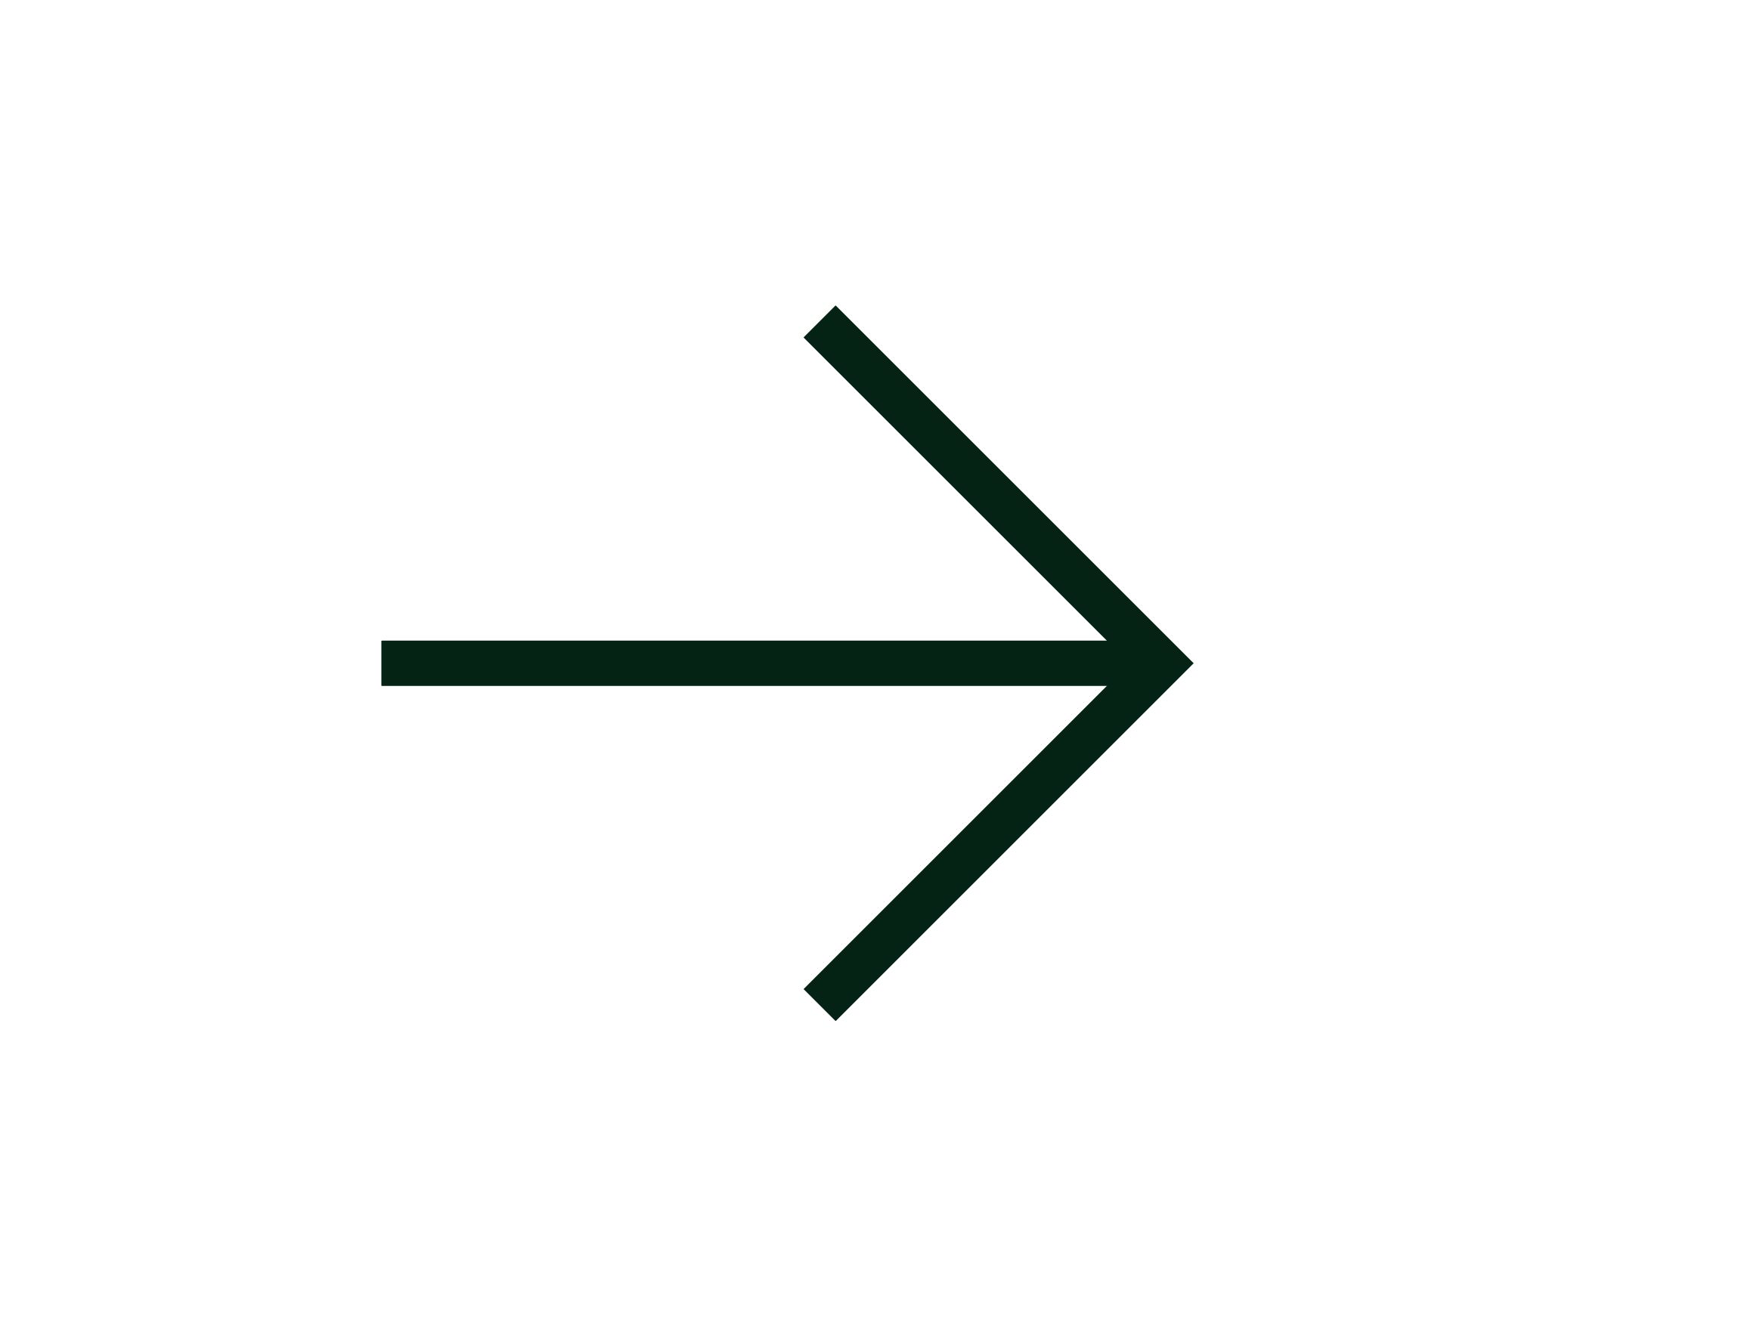
Compilation
ADVANTAGES
The execution of the translated code is usually faster;
Only the user has to have the compiler - the end-user may use the code without it;
The translated code is stored using machine language - as it is very hard to understand it, your own inventions and programming tricks are likely to remain your secret

Slide 18

Compilation
The compilation itself may be a very time-consuming process - you may not be able to run your code immediately after making an amendment
DISADVANTAGES
You have to have as many compilers as hardware platforms you want your code to be run on.

Slide 19
Interpretation
ADVANTAGES
You can run the code as soon as you complete it - there are no additional phases of translation
The code is stored using programming language, not machine language - this means that it can be run on computers using different machine languages; you don't compile your code separately for each different architecture.

Slide 20
Interpretation
Don't expect interpretation to ramp up your code to high speed - your code will share the computer's power with the interpreter, so it can't be really fast;
DISADVANTAGES
Both you and the end user have to have the interpreter to run your code.

Slide 21
04
what is python?
is it a language? is it a philosophy?
we just know it's great!

Slide 22



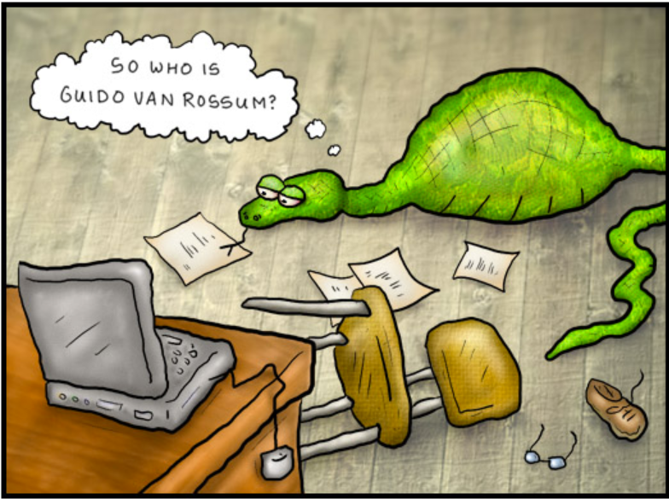
What is Python?
The most power language
Python is a widely-used, interpreted, object-oriented, and high-level programming language with dynamic semantics, used for general-purpose programming.
And while you may know the python as a large snake, the name of the Python programming language comes from an old BBC television comedy sketch series called Monty Python's Flying Circus.
At the height of its success, the Monty Python team were performing their sketches to live audiences across the world, including at the Hollywood Bowl.
Who created Python?
Guido van Rossum and the community

Slide 23
What is Python?
goals
An easy and intuitive language just as powerful as those of the major competitors;
Open source, so anyone can contribute to its development;
Code that is as understandable as plain English;
Suitable for everyday tasks, allowing for short development times.
Python isn't a young language anymore. It is mature and trustworthy. It's not a one-hit wonder. It's a bright star in the programming firmament, and time spent learning Python is a very good investment.

Slide 24
Python, why?
reasons
it's easy to learn – the time needed to learn Python is shorter than for many other languages; this means that it's possible to start the actual programming faster;
it's easy to teach – the teaching workload is smaller than that needed by other languages; this means that the teacher can put more emphasis on general (language-independent) programming techniques, not wasting energy on exotic tricks, strange exceptions and incomprehensible rules;
it's easy to use for writing new software – it's often possible to write code faster when using Python;
it's easy to understand - it's also often easier to understand someone else's code faster if it is written in Python;
it's easy to obtain, install and deploy – Python is free, open and multiplatform; not all languages can boast that.

Slide 25
Python, all roses?
But…
Of course, Python has its drawbacks, too:
it's not a speed demon – Python does not deliver exceptional performance;
in some cases it may be resistant to some simpler testing techniques – this may mean that debugging Python code can be more difficult than with other languages; fortunately, making mistakes is also harder in Python.

Slide 26
05
Python2 and Python3
why are there two versions? do we need to know about both?

Slide 27
Py2 vs Py3
Small comparison
Python 2 | Python 3
Python is not a typed language, and Python 2 version does not support typing in the statements. | Python is not a typed language, and Python 2 version does not support typing in the statements.
The strings in Python 2 are ASCII code by default and cannot be changed. To be saved as Unicode, ‘u’ has to be added in the programming statement. | The strings in Python 3 are Unicode by default and cannot be changed. Unicode has more options than ASCII code.
The newer updates release the versions with faster run time, but Python 2 is not made faster anymore. Hence organizations prefer working with other versions for faster compilation and runtime. | The newest release of Python 3 is made faster with faster runtime and faster compilation. This makes the language more preferable for beginners as well as organizations with larger coding.
Python 2 is not forward compatible and does not work with any new versions. This creates problems while working with new updates and the version release. | Python 3 is backwards compatible and does not create any errors while working in other versions. It is helpful while working on legacy projects in the system.
Modern techniques like machine learning, data science and artificial intelligence are not supported in this language. | All the modern techniques are supported in this language, and it is easy to learn and grow with Python 3 version.

Slide 28
Thank You
April 2023

