Slide 1

Allan Rodriguez
Alejandro Granada
Brayan Barrientos
Jose Navarro
Juan Zapata

Slide 2

SPRING
¿Qué es?
¿Para qué sirve?
Spring Framework
Spring boot
Spring Security
Spring Cloud
Notes:
Spring Boot makes it easy to create stand-alone, production-grade Spring-based Applications that you can run. We take an opinionated view of the Spring platform and third-party libraries, so that you can get started with minimum fuss. Most Spring Boot applications need very little Spring configuration. You can use Spring Boot to create Java applications that can be started by using java -jar or more traditional war deployments. We also provide a command line tool that runs “spring scripts”. Our primary goals are: Provide a radically faster and widely accessible getting-started experience for all Spring development. Be opinionated out of the box but get out of the way quickly as requirements start to diverge from the defaults. Provide a range of non-functional features that are common to large classes of projects (such as embedded servers, security, metrics, health checks, and externalized configuration). Absolutely no code generation and no requirement for XML configuration.
https://spring.io/projects

Slide 3
Spring
Liderado por pivotal
Open source
Plugins y soporte
Uso de APis útiles

Slide 4
Inyección De Dependencias
Código modular
Orientado a objetos
Manejo de paquetes

Slide 5
Spring para la web
Spring Boot
Spring MVC
Spring Cloud
Restful
Microservicios
Spring data

Slide 6
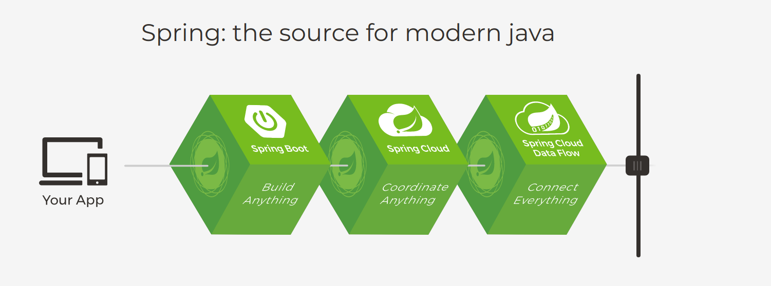
Notes:
https://spring.io/

Slide 7
¿Por qué Spring?
Libre
De fácil uso
Muy popular
Soporte Java, Groovy y Kotlin
Bueno para la nube y los microservicios

Slide 8
DEMO
https://trello.com/b/IuDGwrME/appempresariales

