Slide 1
A
PROPENSIONES ABOGADOS INTERNACIONAL · AEGIS
How to verify a certificate
What comes with every certification, how to check that a document is genuine, and what you can share with a third party without handing over more than you need to.
Certificate holders
Buyers and counterparties
Audit and compliance
Notes:
What comes with every certification, how to check that a document is genuine, and what you can share with a third party without handing over more than you need to.

Slide 2
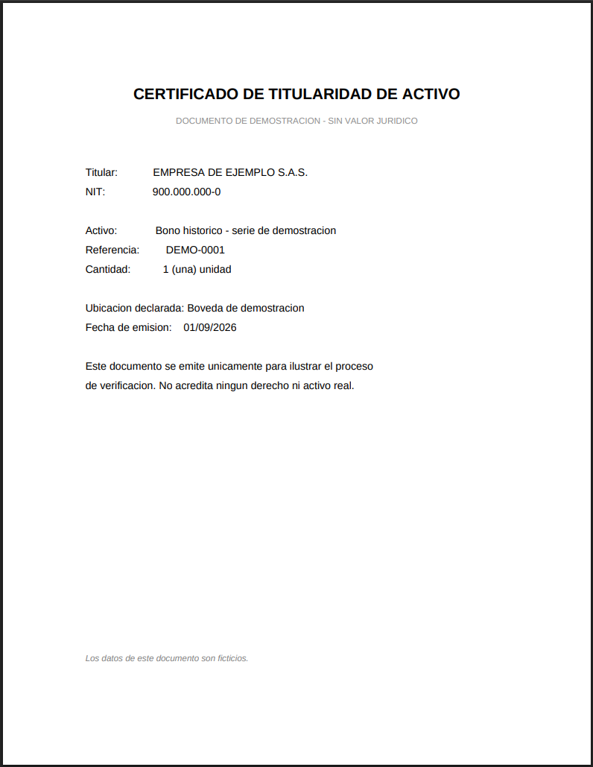
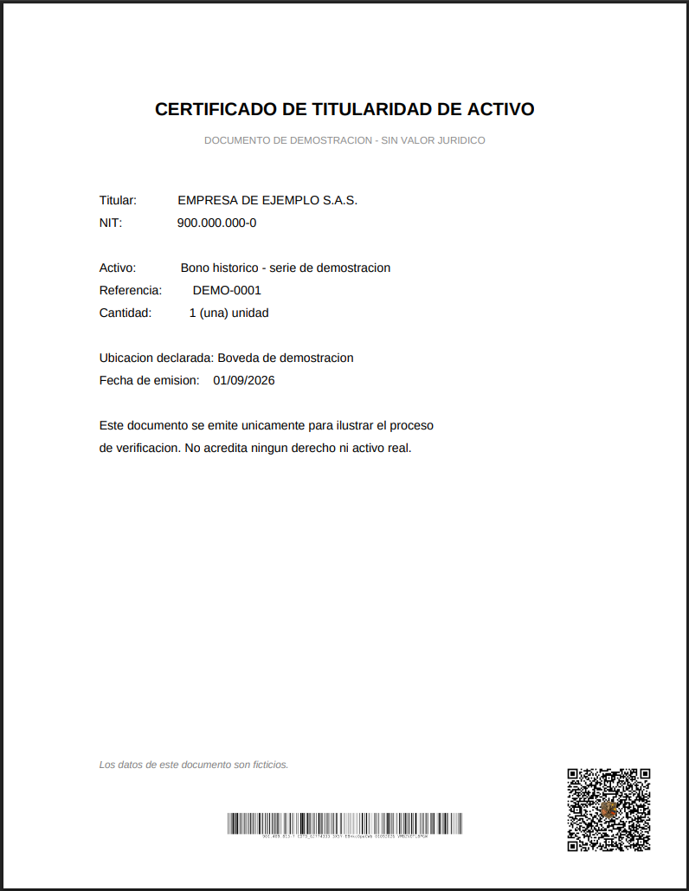
BEFORE YOU START
A certificate is three files, not one
All three say the same thing. They differ in who may see them, and in what each one carries printed on it.
For every certified document the platform keeps three versions and computes the digital fingerprint of each. Knowing which is which prevents the most common mistake: sending out the wrong one.
STAYS ON FILE
THE AUTHORITATIVE ONE
THIS IS THE ONE YOU SHARE
Original
Certified
Distributable copy
The document exactly as it was filed, with no codes on it. It never leaves the platform: only internal staff can open it.
The original with its barcode and QR stamped on. This is the file the certification refers to, and the holder's own copy.
Identical to look at, carrying an invisible watermark that lets it be recognised as a copy issued here even if it is renamed on the way.
Notes:
For every certified document the platform keeps three versions and computes the digital fingerprint of each. Knowing which is which prevents the most common mistake: sending out the wrong one.

Slide 3
BEFORE YOU START
The PDF you receive
With both codes stamped on. This is the holder's own copy.
1
The certification code, printed. Readable by a barcode scanner. It is the same text the result screen shows.
2
The QR. It carries the address of this document's verification page, built on the firm's canonical domain and not on whichever machine did the certifying.
2
1
The certified PDF, as it is received
Notes:
The PDF you receive. With both codes stamped on. This is the holder's own copy.

Slide 4
1
You go in through the firm's own site
STEP
Not through a link that arrives by email. The right door is one you type.
At propensionesabogados.com, open Platforms in the top menu and choose Certification. That link leads to the verification portal.
propensionesabogados.com
→
Platforms
→
Certification
→
geausa.propensionesabogados.com/certificates/
WHY WE KEEP INSISTING ON THIS
Always starting from the firm's own domain is what makes an impersonation fail: whoever builds a fake page can copy how the portal looks, but cannot put it under propensionesabogados.com. If an email carries a direct link, check that the domain is exactly geausa.propensionesabogados.com before typing anything.
Notes:
At propensionesabogados.com, open Platforms in the top menu and choose Certification. That link leads to the verification portal.

Slide 5
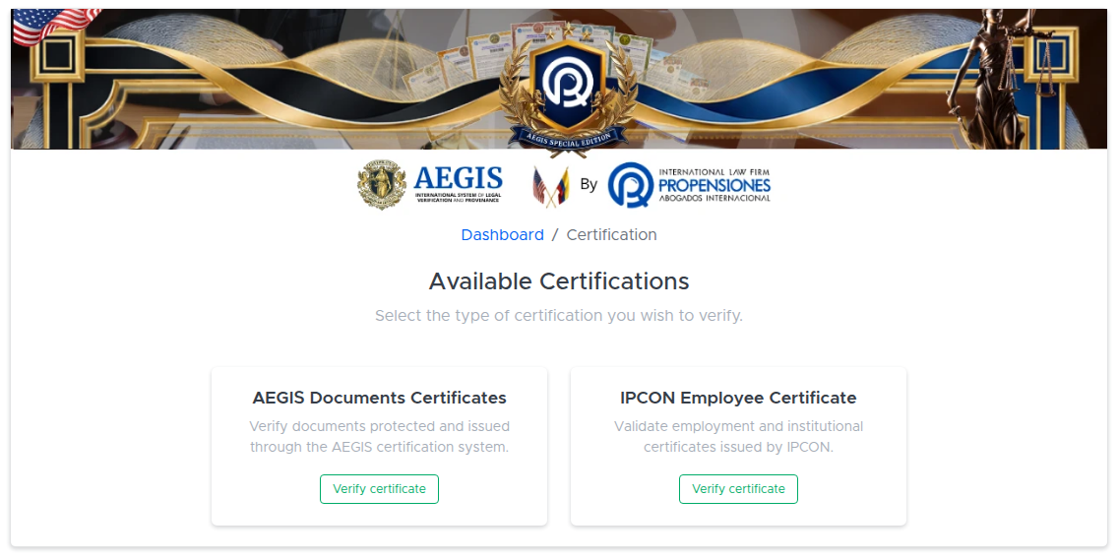
2
Pick a portal: documents or people
It depends on what is in front of you: a piece of paper, or someone claiming to represent the firm.
1
AEGIS Documents Certificates For an asset certificate, a title, or any document with a printed code and QR.
2
IPCON Employee Certificate To check the credential of someone who says they act on behalf of the firm.
1
2
Notes:
Pick a portal: documents or people. It depends on what is in front of you: a piece of paper, or someone claiming to represent the firm.

Slide 6
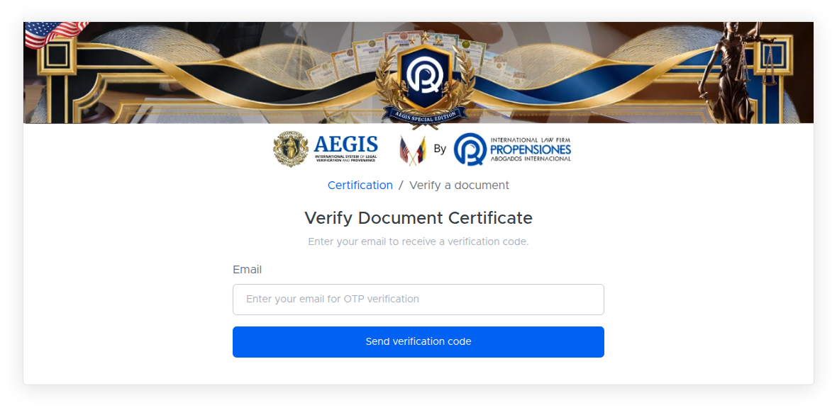
3
A code to your email before you can look anything up
Only on the documents portal. The people portal does not ask for one.
1
The address the code goes to. It has to be one you can open right now: the code lasts ten minutes.
2
Send verification code. Three sends per ten minutes to the same address. After that you wait.
1
2
Notes:
A code to your email before you can look anything up. Only on the documents portal. The people portal does not ask for one.

Slide 7
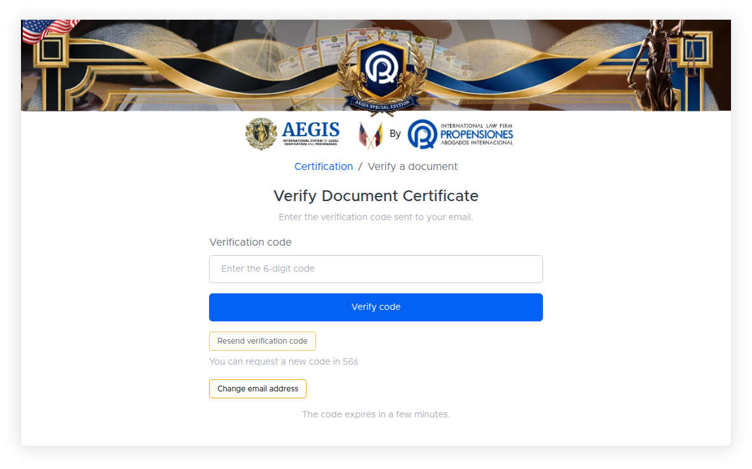
3
A code to your email before you can look anything up
Only on the documents portal. The people portal does not ask for one.
1
The six digits that arrived by email. Five failed attempts close the session for ten minutes.
2
Resend verification code. Available after a minute, in case the email is slow.
3
The code expires. If it lapses, request a new one. Do not reuse an old code, and do not forward one over WhatsApp.
1
2
3
Notes:
A code to your email before you can look anything up. Only on the documents portal. The people portal does not ask for one.

Slide 8
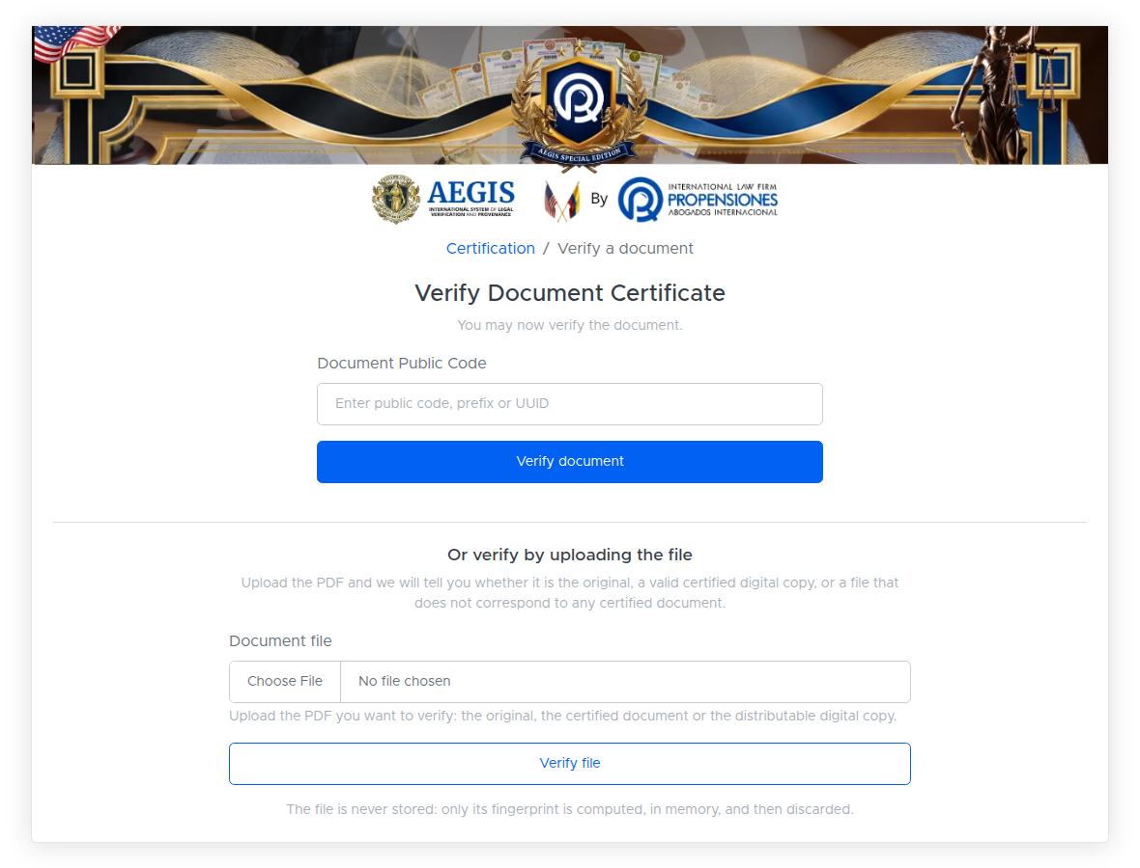
4
Two ways to check, and they are not equivalent
By code, or by uploading the file. The second answers a question the first one cannot.
1
Method A — by code. You type the public code printed on the document. It answers: «this code exists, and this is what it covers».
2
Method B — by file. You upload the PDF you were given. It answers something different and stronger: «is the file in your hands ours, byte for byte?».
3
The file is not stored. Its fingerprint is computed in memory and discarded. Uploading a document here does not deposit it anywhere.
1
WHICH ONE TO USE
If someone sends you a PDF and you want to know whether it is genuine, use method B. It is the only one that catches a document that looks right and reads wrong: a printed code can be copied off a photograph, but a file's fingerprint cannot be forged.
2
3
Notes:
Two ways to check, and they are not equivalent. By code, or by uploading the file. The second answers a question the first one cannot.

Slide 9
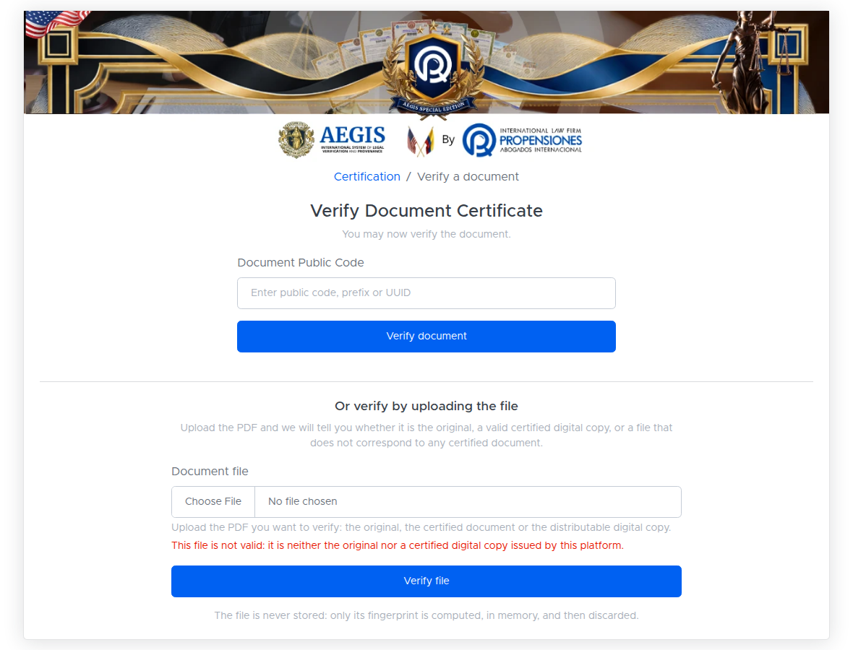
4
When the file is not ours
What the file check says about a PDF the platform did not issue.
1
What it says when the file is not ours. There is a third outcome, different from this one and from a match: the PDF carries the watermark but its content has been altered. It says so explicitly rather than passing it.
1
/verify/aegis/asset/certification/ — uploading an unrelated PDF
Notes:
When the file is not ours. What the file check says about a PDF the platform did not issue.

Slide 10
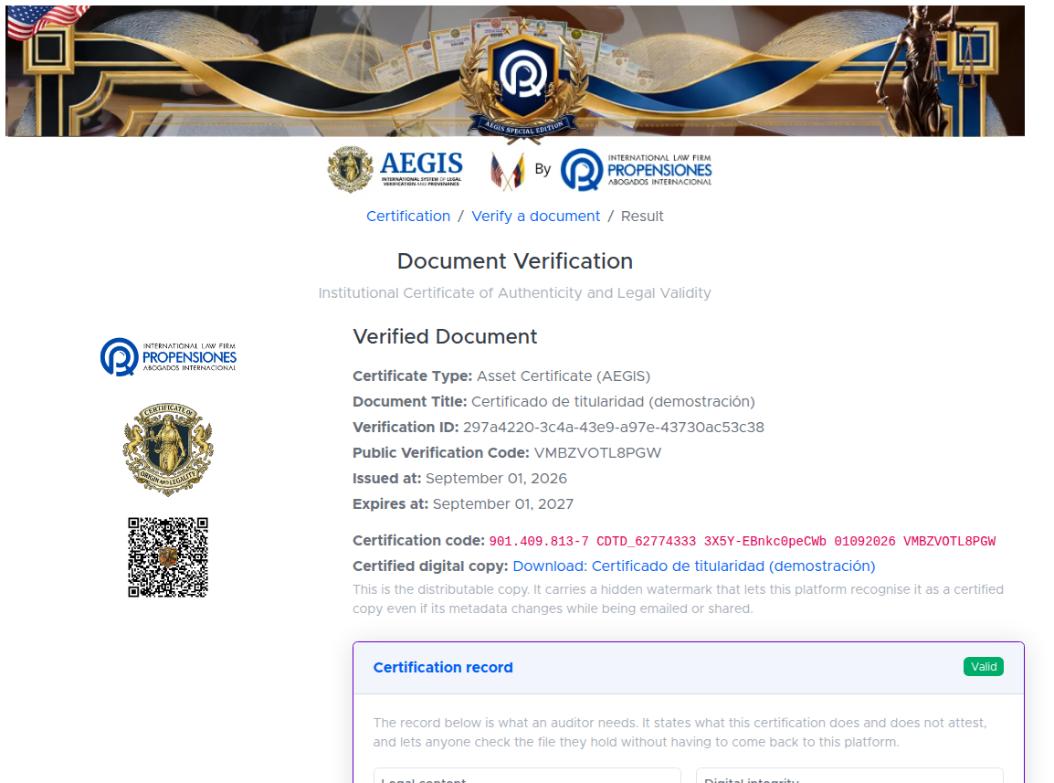
5
The result screen, read part by part
This is the screen an auditor will look at. It pays to know what each part is.
1
Public verification code. Twelve characters. This is what you quote over the phone or in an email so the other side can reach the document.
2
Full certification code. Issuer tax ID · initials and sequence · fingerprint fragment · date · public code. It is the same text printed in the barcode on the PDF.
3
Download of the distributable copy. This is the one you share. It carries the invisible watermark.
4
Status, today. Expiry and revocation are not frozen into the paper: they are checked here, which is always the live version.
1
2
3
4
Notes:
The result screen, read part by part. This is the screen an auditor will look at. It pays to know what each part is.

Slide 11
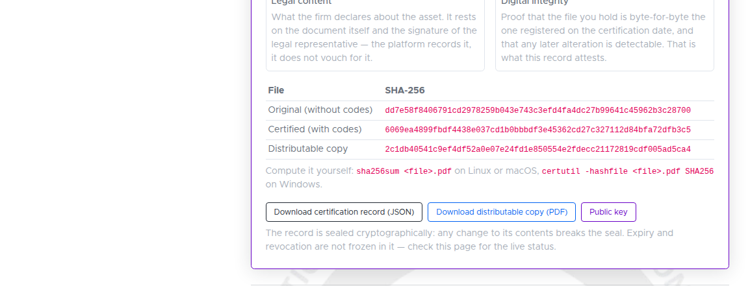
5
The result screen, read part by part
This is the screen an auditor will look at. It pays to know what each part is.
1
The three SHA-256 fingerprints. One per file. With them a PDF can be checked without relying on this platform at all.
1
How to compute it yourself. The exact command, for Linux, macOS and Windows.
2
2
3
Certification record (JSON). The document you hand an auditor: cryptographically sealed, with the fingerprints and the scope written out.
3
Notes:
The result screen, read part by part. This is the screen an auditor will look at. It pays to know what each part is.

Slide 12
WITHOUT RELYING ON ANYONE
Check it yourself, with two commands
It works ten years from now, and it works even if the platform is down.
Everything above goes through the firm's website. An auditor will want something that does not, and that is what the certification record is for: a file holding the fingerprints of all three files with a cryptographic signature over it.
# 1. The fingerprint of the PDF you hold
sha256sum certificado.pdf# Linux or macOS
certutil -hashfile certificado.pdf SHA256# Windows
# 2. Compare it against the record. If it matches one of the three,
# the file is exactly the one that was registered.
files.original.sha256
files.certified.sha256
files.public_copy.sha256
A DETAIL THAT CONFUSES PEOPLE IF NOBODY FLAGS IT
The content_sha256 of the certified file and of the distributable copy are the same, while their sha256 differ. That is deliberate: the content fingerprint ignores the watermark. It lets you prove that the copy in circulation says exactly what the certified original says, and still tell the two apart.
Notes:
Everything above goes through the firm's website. An auditor will want something that does not, and that is what the certification record is for: a file holding the fingerprints of all three files with a cryptographic signature over it.

Slide 13
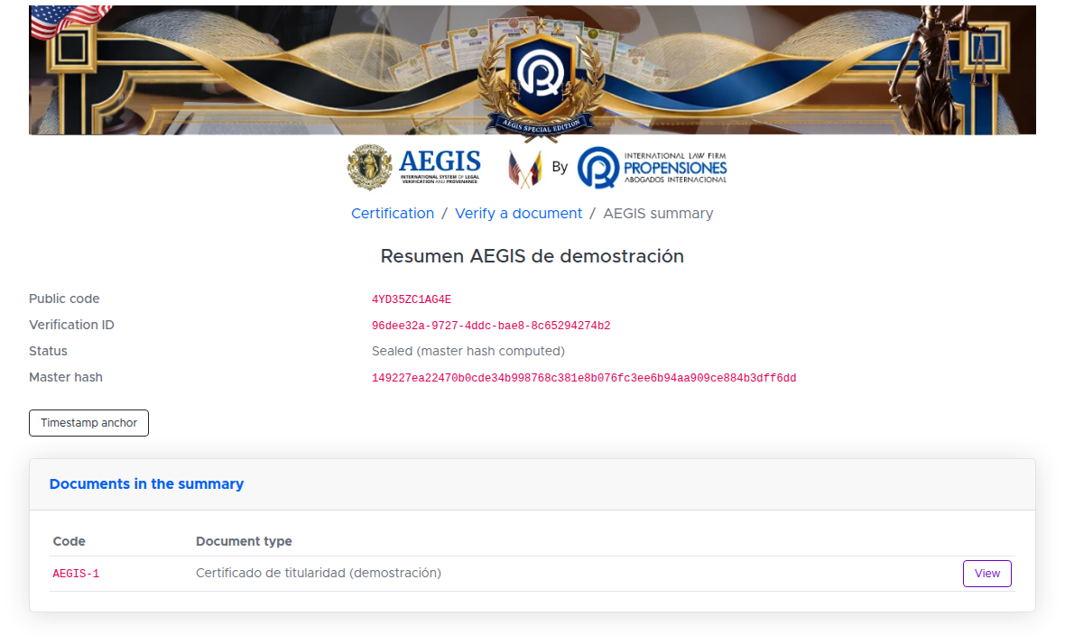
IF THERE IS A SUMMARY
The AEGIS summary and a provable date
For when several documents are grouped, and for when you need to prove when.
1
Master hash. A single figure that commits to the fingerprints of every document in the summary.
2
Timestamp anchor. Leads to the timestamp page, which is public and does not ask for a code.
3
The grouped documents, each with its own code inside the summary (AEGIS-1, AEGIS-2…).
1
2
3
Notes:
The AEGIS summary and a provable date. For when several documents are grouped, and for when you need to prove when.

Slide 14
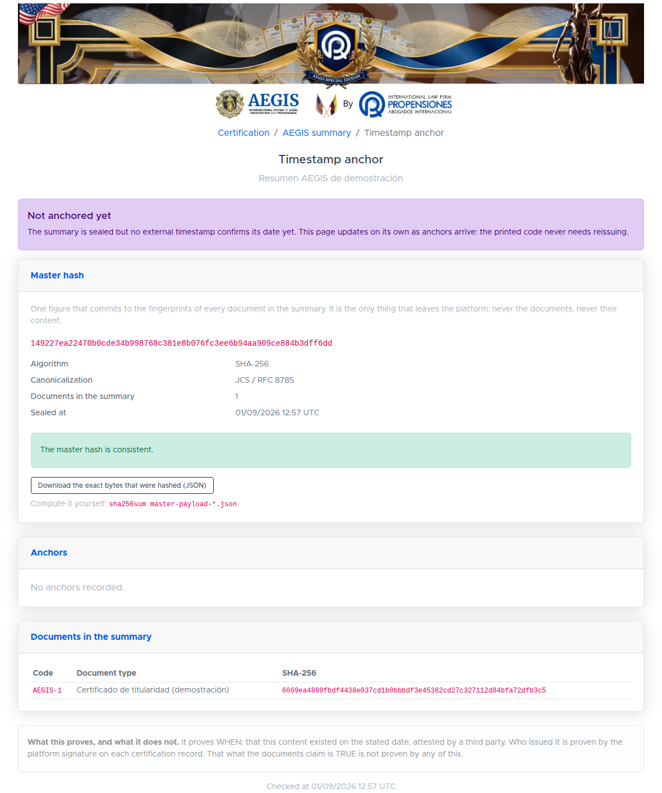
IF THERE IS A SUMMARY
The timestamp, on its own page
Public, no code needed: this is what the printed QR opens.
1
The state of the timestamp. In the example: sealed, not yet externally confirmed. This page updates itself as anchors mature.
2
The master hash, and the exact bytes that were signed. Both can be downloaded so you can recompute it yourself.
1
3
The anchors. An RFC 3161 timestamp is immediate; the blockchain one takes hours to confirm. They show up here as they arrive.
2
4
What it proves, and what it does not. It proves WHEN that content existed. That what the documents claim is true is not proven by this, nor by anything else on this page.
3
WHY THE QR DOES NOT CARRY THE PROOF INSIDE IT
The printed QR points at that page, not at the block on the chain. If it carried the proof printed on it, the paper would have to be reissued every time the anchor advances. This way a single document is issued, and it does not go stale when the confirmation lands.
4
/verify/aegis/summary//anchor/ — public page, no code needed
Notes:
The timestamp, on its own page. Public, no code needed: this is what the printed QR opens.

Slide 15
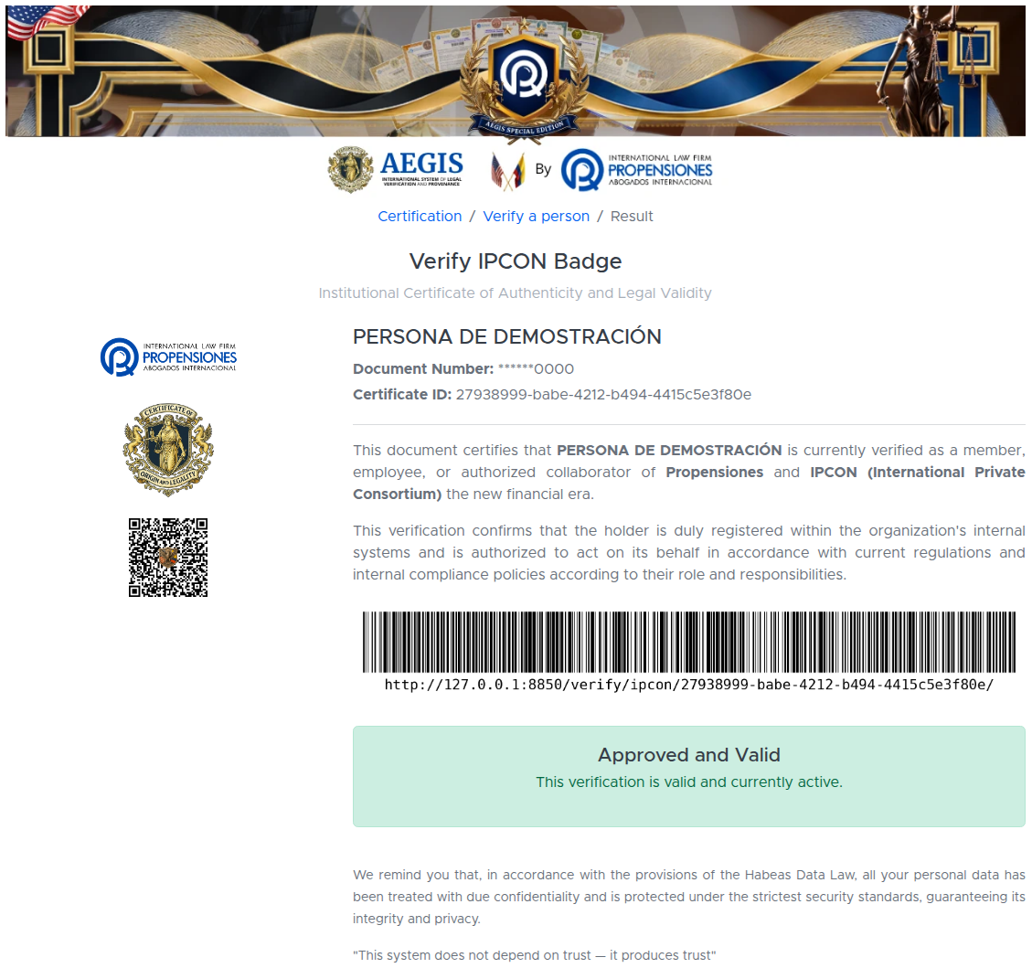
THE OTHER PORTAL
Checking the person, not the paper
For when someone says they are acting on behalf of the firm.
1
The document number comes back masked. Only the last digits. It confirms things for someone already holding the credential, without publishing the whole number.
2
The barcode carries the address of this very page: it is what the QR on the physical credential opens.
3
Approved and Valid. That is today's status. If the person leaves the organisation this page stops saying it — the printed credential has no way of knowing, this page does.
1
2
3
Notes:
Checking the person, not the paper. For when someone says they are acting on behalf of the firm.

Slide 16
WORTH KEEPING TO HAND
What to share, and what not to
WHAT
WITH A THIRD PARTY
WHY
Distributable copy (PDF)
This is the version meant to circulate. It carries the invisible mark that lets it be recognised.
SHARE IT
Public code, 12 characters
It is what the other side types to reach the document. It is printed on the PDF.
SHARE IT
Certification record (JSON)
Made for an auditor. It does not contain the document, only its fingerprints.
SHARE IT
Timestamp page link
A public page. Fingerprints and dates only, no content.
SHARE IT
Certified copy (your own, with the codes)
No need to hand it over: the distributable copy proves the same thing.
KEEP IT
Original document, without codes
It stays on file in the platform. Only internal staff can open it.
NEVER LEAVES
The six-digit code from your email
It is your session key: personal, single use. Nobody at the firm will ever ask you for it.
NEVER
Notes:
What to share, and what not to

