Slide 1

We do^{(n't)} talk about Bruno

Slide 2



Slide 3
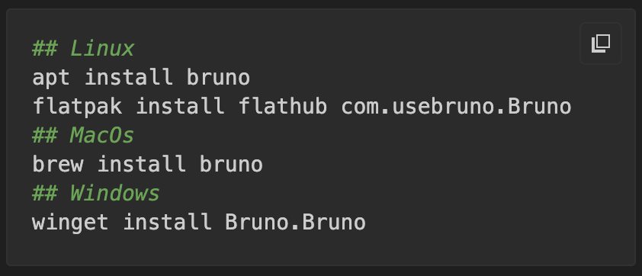

Slide 4

Open Source
100% local
Git-native
Switching is easy

Slide 5

Scripting
Automated Testing
Parent Environments
… and more

Slide 6
GraphQL, gRPC, WebSocket Support
Cookies
Proxy
Client Certificates
Protobuf Files
Export as OpenAPI.yml
Dir scoped Vars/Tests/Scripts
External Secrets Manager
Bring your own AI key
CLI
VSCode Plugin
...

