Slide 1
Gaussian Processes
Scientific Machine Learning
Sebastian Klein

Slide 2
Outline

Slide 3
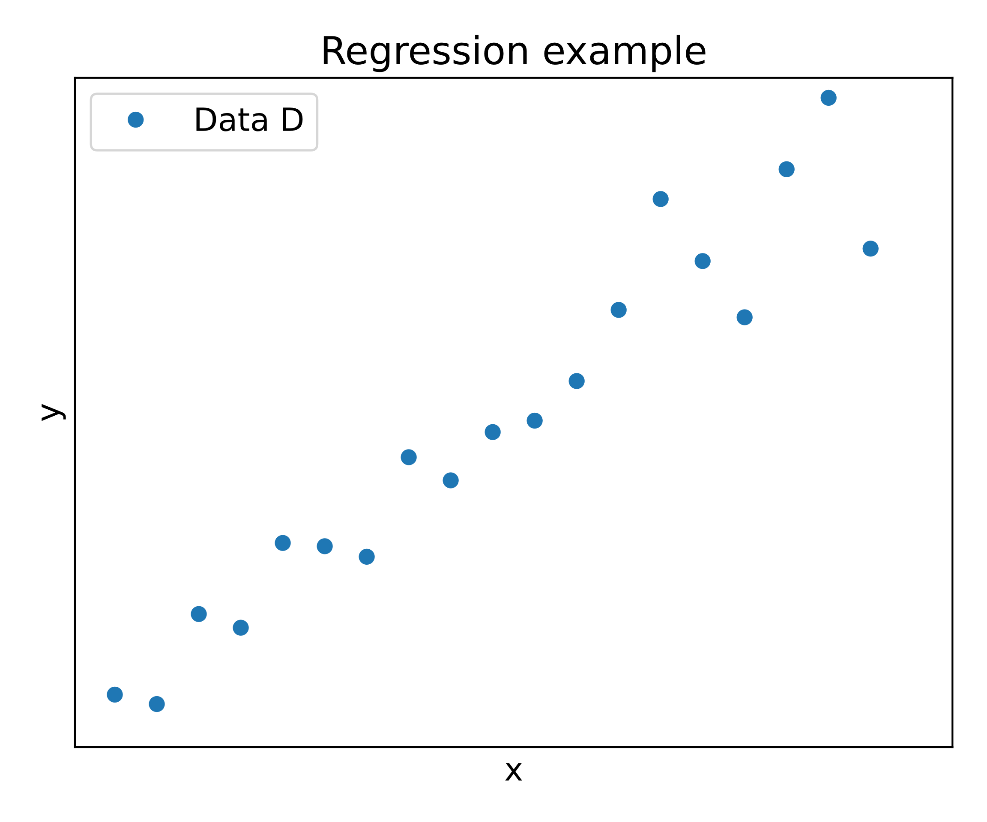
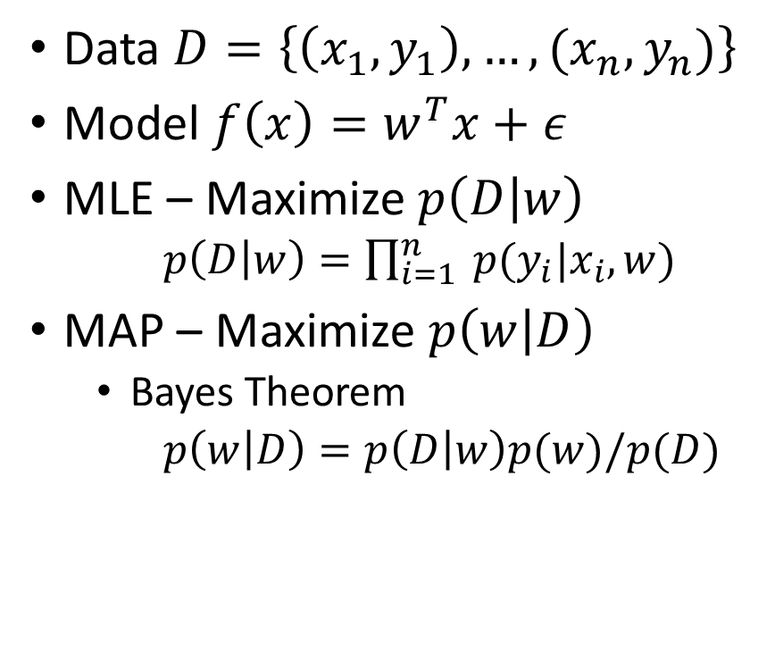
Motivation – Regression problems [1]
Data $D=\left\{\left(x_{1},y_{1}\right),…,(x_{n},y_{n})\right\}$
Model $f\left(x\right)=w^{T}x+ε$
MLE – Maximize$p\left(D | w\right)$
$p\left(D | w\right)=\prod_{i=1}^{n}{ p(y_{i}|x_{i}, w)}$
MAP – Maximize $p\left(w | D\right)$
Bayes Theorem
$p\left(w | D\right)=p\left(D | w\right)p(w)/p(D)$
Notes:
$w^{T}x+ε$ – epsilon = noise, w - model parameters
$p(y_{i}|x_{i}, w$) how likely is it that the x_i gives rise to the y_i with the parameter w
MLE - Maximum Likelihood Estimation - max probability of Data $p\left(D | w\right)$ for a parameter $w$
MAP- Maximum a posteriori

Slide 4
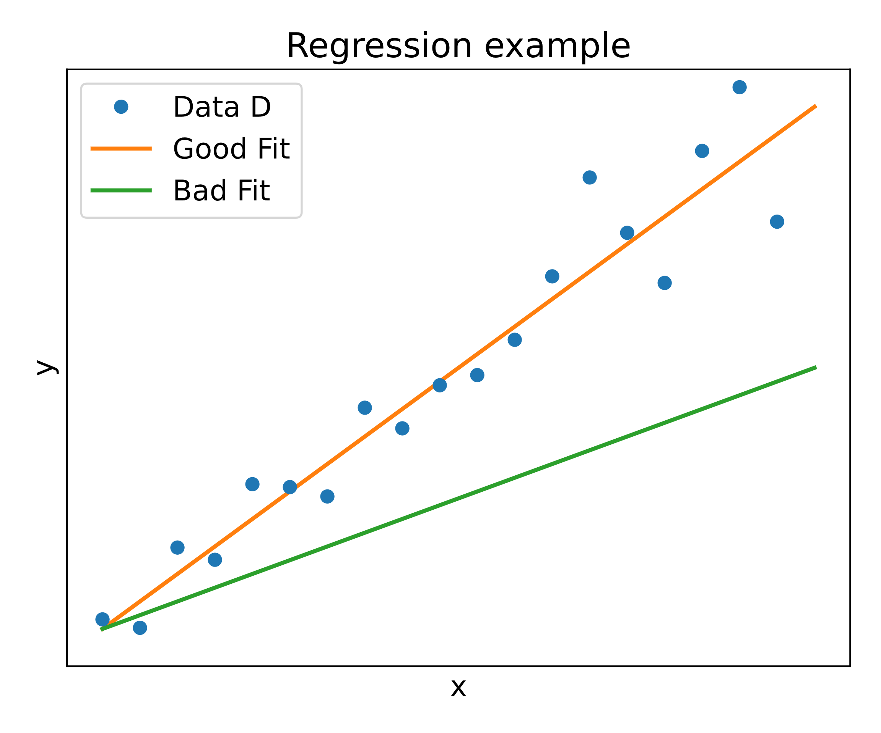
Motivation – Regression problems [1]
Data $D=\left\{\left(x_{1},y_{1}\right),…,(x_{n},y_{n})\right\}$
Model $f\left(x\right)=w^{T}x+ε$
MLE – Maximize$p\left(D | w\right)$
$p\left(D | w\right)=\prod_{i=1}^{n}{ p(y_{i}|x_{i}, w)}$
MAP – Maximize $p\left(w | D\right)$
Bayes Theorem
$p\left(w | D\right)=p\left(D | w\right)p(w)/p(D)$
Notes:
$w^{T}x+ε$ – epsilon = noise, w - model parameters
$p(y_{i}|x_{i}, w$) how likely is it that the x_i gives rise to the y_i with the parameter w
MLE - Maximum Likelihood Estimation - max probability of Data $p\left(D | w\right)$ for a parameter $w$
MAP- Maximum a posteriori

Slide 5
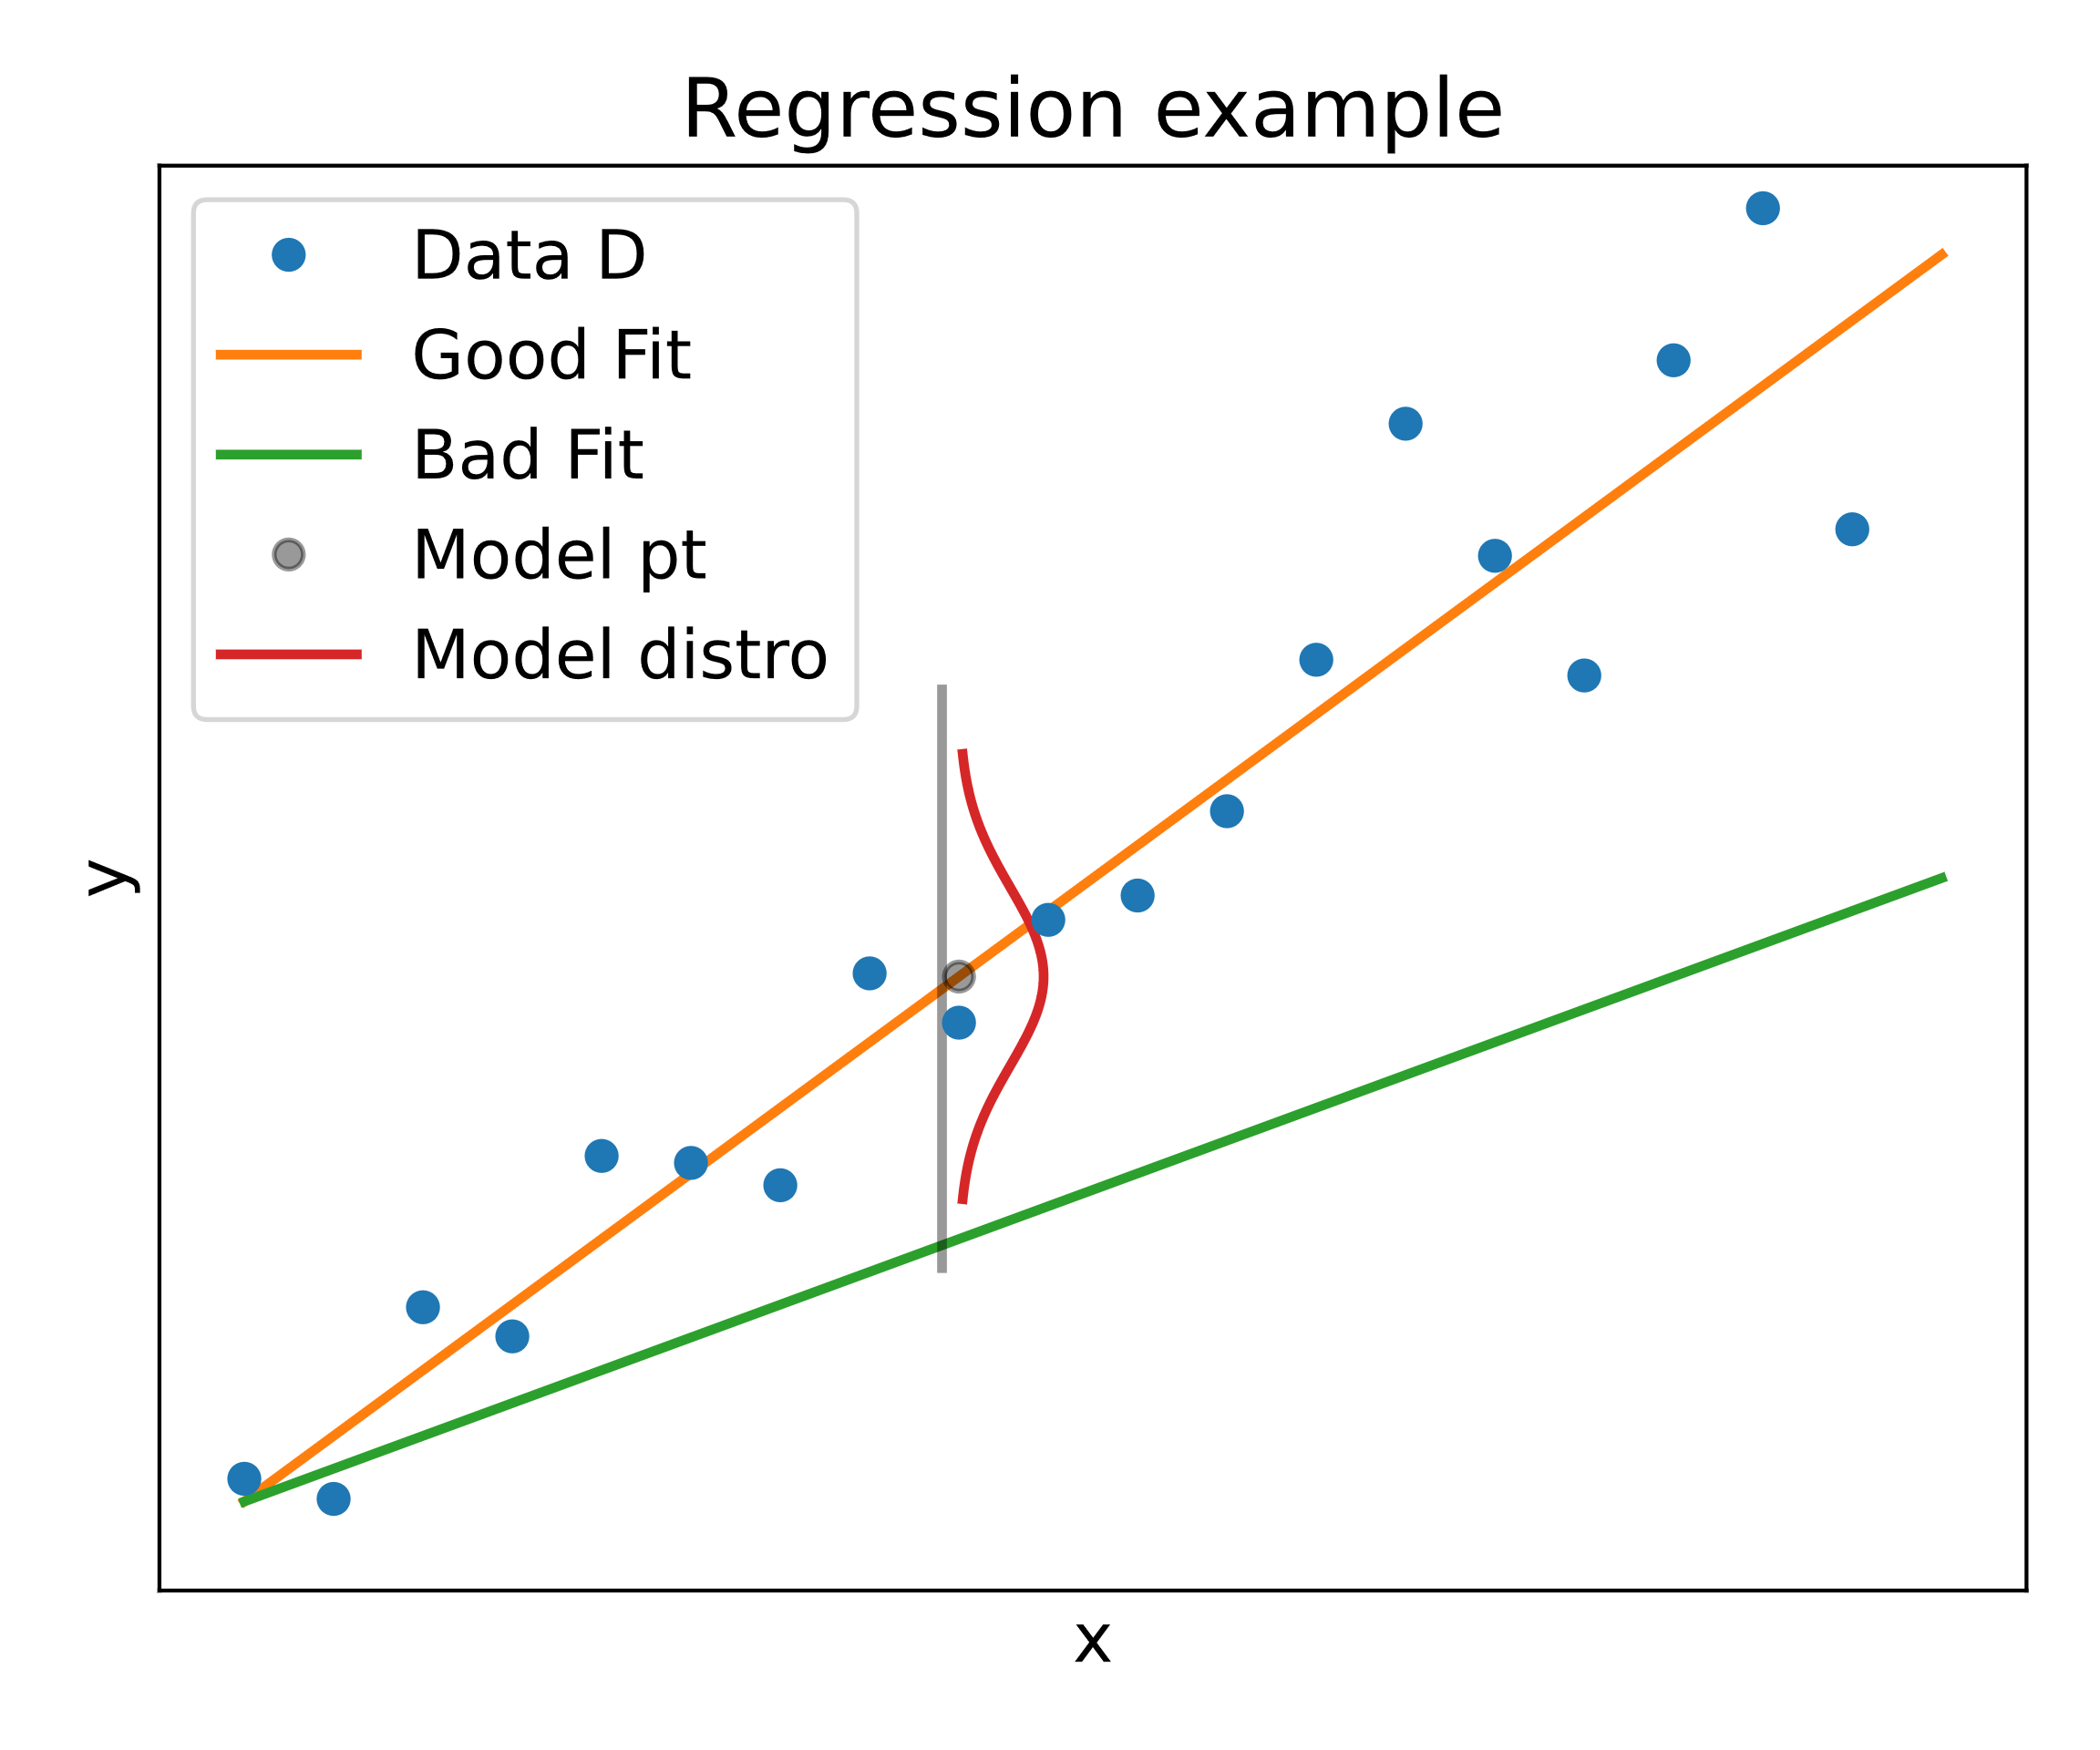
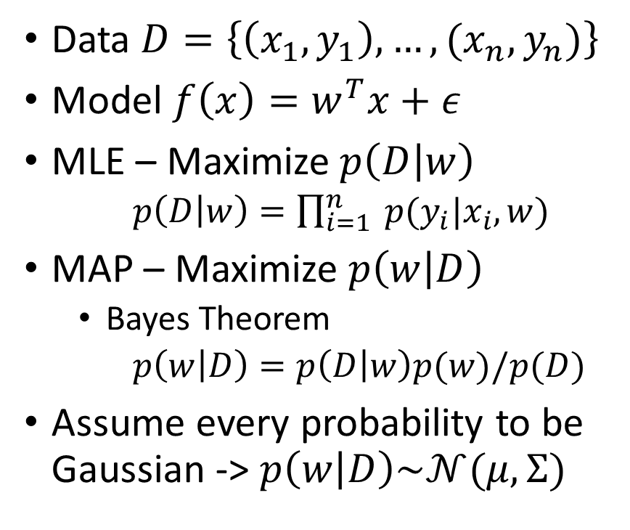
Motivation – Regression problems [1]
Data $D=\left\{\left(x_{1},y_{1}\right),…,(x_{n},y_{n})\right\}$
Model $f\left(x\right)=w^{T}x+ε$
MLE – Maximize$p\left(D | w\right)$
$p\left(D | w\right)=\prod_{i=1}^{n}{ p(y_{i}|x_{i}, w)}$
MAP – Maximize $p\left(w | D\right)$
Bayes Theorem
$p\left(w | D\right)=p\left(D | w\right)p(w)/p(D)$
Assume every probability to be Gaussian -> $p\left(w | D\right)\sim 𝒩(μ, Σ)$
Notes:
$w^{T}x+ε$ – epsilon = noise, w - model parameters
$p(y_{i}|x_{i}, w$) how likely is it that the x_i gives rise to the y_i with the parameter w
MLE - Maximum Likelihood Estimation - max probability of Data $p\left(D | w\right)$ for a parameter $w$
MAP- Maximum a posteriori
Assume Gaussian probability in MLE -> p
Last line -> How do we come to the conclusion $p\left(w | D\right)\sim 𝒩(μ, Σ)$

Slide 6
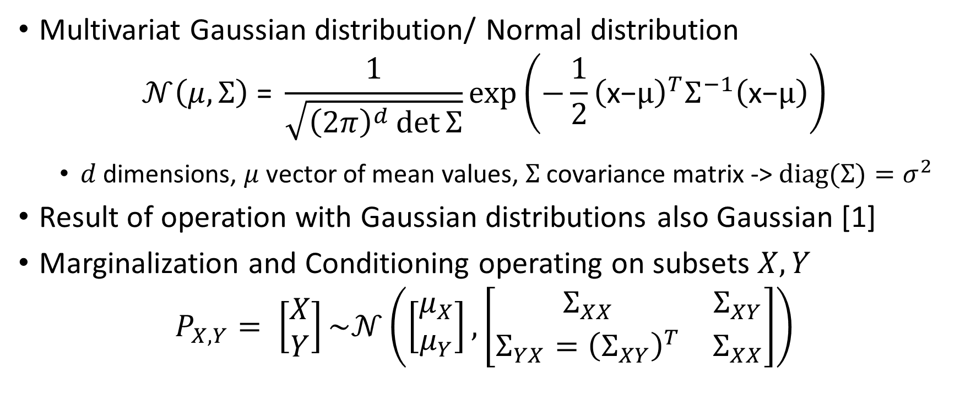
Intermezzo – Multivariate Gaussian[2]
Multivariat Gaussian distribution/ Normal distribution
$$𝒩\left(μ, Σ\right) \text{=} \frac{1}{\sqrt{{\left(2π\right)}^{d}\det{Σ}}}\text{exp}\left(−\frac{1}{2}{\left(\text{x}\text{−}μ\right)}^{T}Σ^{−1}\left(\text{x}\text{−}μ\right)\right)$$
$d$ dimensions, $μ$ vector of mean values, $Σ$ covariance matrix -> $diag(Σ)=σ^{2}$
Result of operation with Gaussian distributions also Gaussian [1]
Marginalization and Conditioning operating on subsets $X,Y$
$$P_{X,Y}= \left[\begin{matrix}X \\ Y\end{matrix}\right]\sim 𝒩\left(\left[\begin{matrix}μ_{X} \\ μ_{Y}\end{matrix}\right],\left[\begin{matrix}Σ_{XX} & Σ_{XY} \\ Σ_{YX}={\left(Σ_{XY}\right)}^{T} & Σ_{XX}\end{matrix}\right]\right)$$

Slide 7
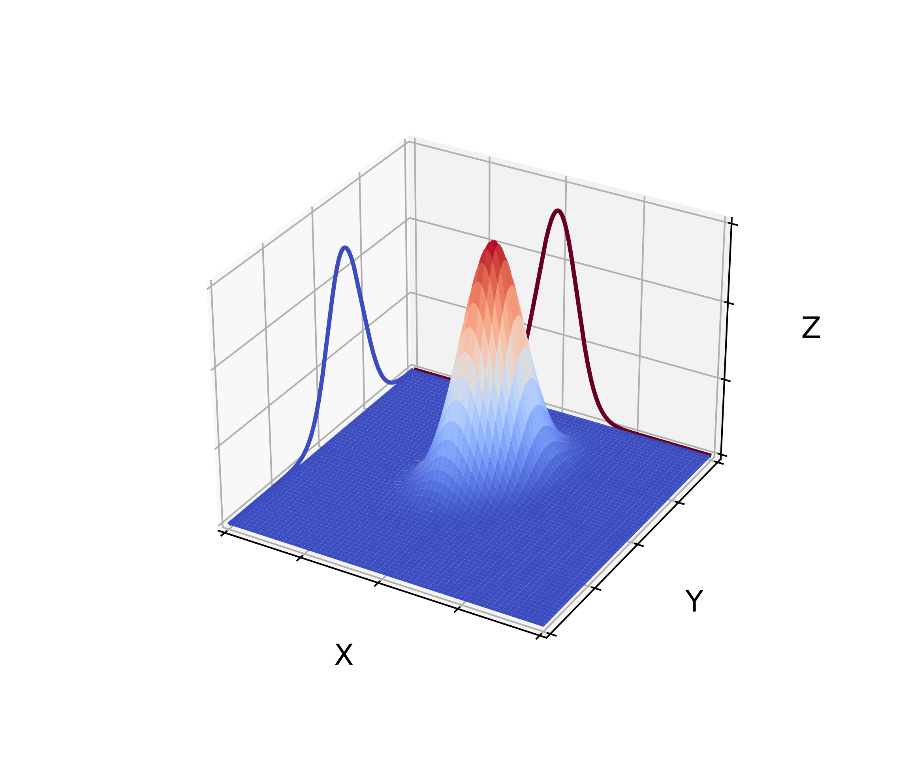
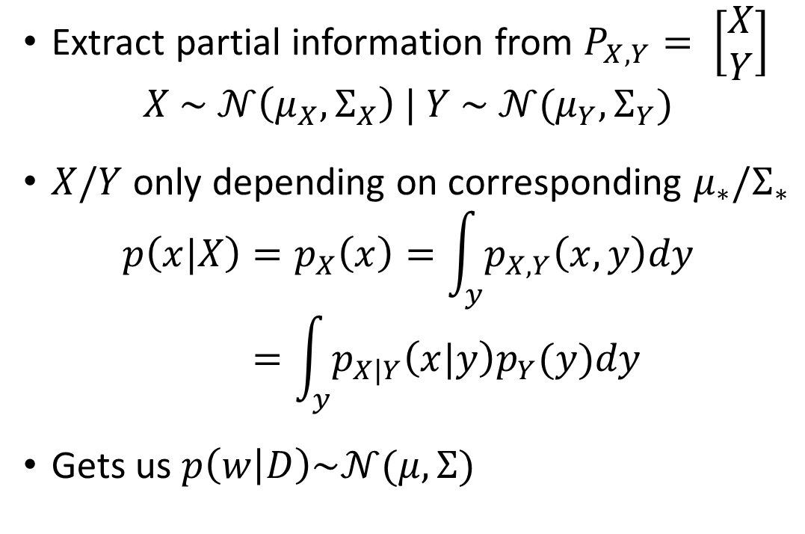
Intermezzo – Marginalization [2]
Extract partial information from $P_{X,Y}= \left[\begin{matrix}X \\ Y\end{matrix}\right]$
$$X \sim 𝒩\left(μ_{X},Σ_{X}\right) | Y \sim 𝒩(μ_{Y},Σ_{Y})$$
$X/Y$only depending on corresponding $μ_{∗}/Σ_{∗}$
$$p\left(x|X\right)=p_{X}\left(x\right)=\int_{y}{p_{X,Y}\left(x,y\right)dy} \\ =\int_{y}{p_{X|Y}\left(x|y\right)p_{Y}(y)dy}$$
Gets us $p\left(w | D\right)\sim 𝒩(μ, Σ)$
Marginal distributions of X/Y
Notes:
Marginalization tells us that the posterior distributioin p(w|D) is also gaussian distributed with some mean and some covariance matrix

Slide 8
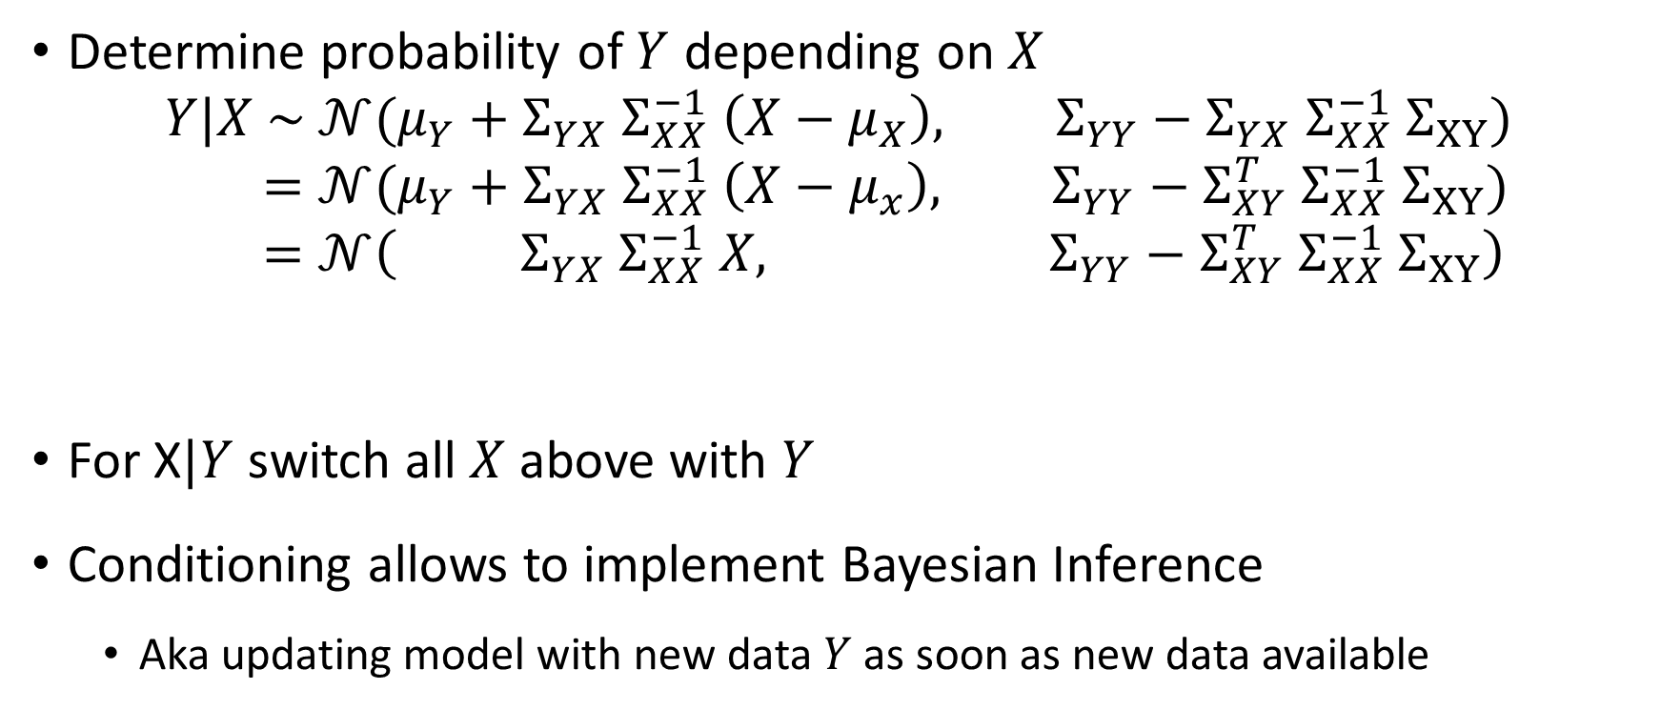
Intermezzo – Conditioning[2]
Determine probability of $Y$ depending on $X$
$$Y|X \sim 𝒩(μ_{Y}+Σ_{YX} Σ_{XX}^{−1} \left(X−μ_{X}\right), Σ_{YY}−Σ_{YX} Σ_{XX}^{−1} Σ_{XY}) \\ =𝒩(μ_{Y}+Σ_{YX}{ Σ}_{XX}^{−1} \left(X−μ_{x}\right), Σ_{YY}−Σ_{XY}^{T} Σ_{XX}^{−1} Σ_{XY}) \\ =𝒩\left( Σ_{YX} Σ_{XX}^{−1} X, Σ_{YY}−Σ_{XY}^{T} Σ_{XX}^{−1} Σ_{XY}\right)$$
For X$|Y$ switch all $X$ above with $Y$
Conditioning allows to implement Bayesian Inference
Aka updating model with new data $Y$ as soon as new data available
Mean
Covariance Matrix
Notes:
(or vice versa) conditioning
Cornerstone of GP
Last line assume $μ_{Y}=0$

Slide 9
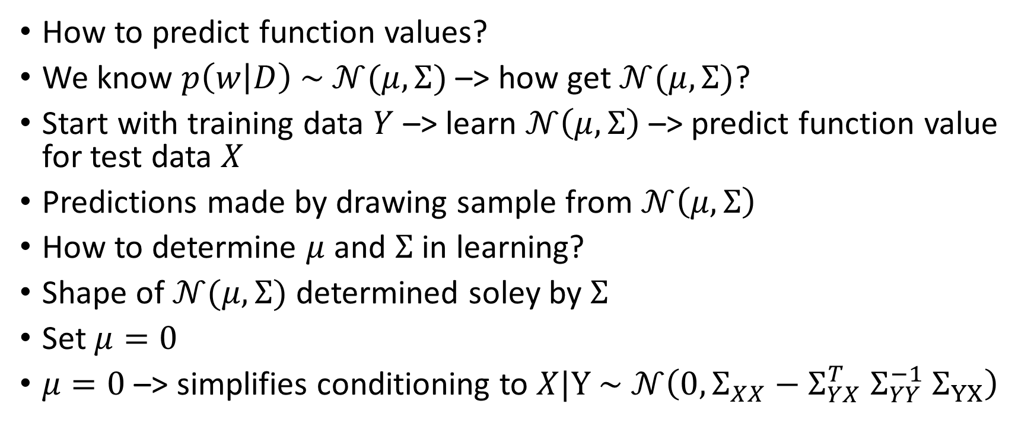
Regression as Gaussian Process [2]
How to predict function values?
We know $p\left(w | D\right) \sim 𝒩(μ, Σ)$ –> how get $𝒩(μ, Σ)$?
Start with training data $Y$ –> learn $𝒩\left(μ, Σ\right)$ –> predict function value for test data $X$
Predictions made by drawing sample from $𝒩\left(μ, Σ\right)$
How to determine $μ$ and $Σ$ in learning?
Shape of $𝒩(μ, Σ)$ determined soley by $Σ$
Set $μ=0$
$μ=0$–> simplifies conditioning to $X|Y \sim 𝒩\left(0, Σ_{XX}−Σ_{YX}^{T} Σ_{YY}^{−1} Σ_{YX}\right)$
Notes:
Later we can add back $μ≠0$

Slide 10

Regression as Gaussian Process [2]
Last result $𝒩\left(0, Σ_{XX}−Σ_{YX}^{T} Σ_{YY}^{−1} Σ_{YX}\right)$
How to determine any $Σ$? –> $Σ$ given by covariance function

Slide 11

Sources
K. Weinberger, Machine Learning Lecture: Gaussian Process (https://www.cs.cornell.edu/courses/cs4780/2018fa/lectures/lecturenote15.html)
The Multivariate gaussian distribution is written here with the normalization factor $∝\det{{\left(Σ\right)}^{−1}}$ while it should be $∝\det{{\left(Σ\right)}^{−1/2}}$
In notation of conditional normal distribution the formular for the covariance Matrix is wrong, K and K_** are switched
Görtler, et al., "A Visual Exploration of Gaussian Processes", Distill, 2019. DOI: 10.23915/distill.00017
C. Fonnesbeck, Fitting Gaussian Process Models in Python (https://domino. ai/blog/fitting-gaussian-process-models-python)

Slide 12
Work in Progress Slides

Slide 13
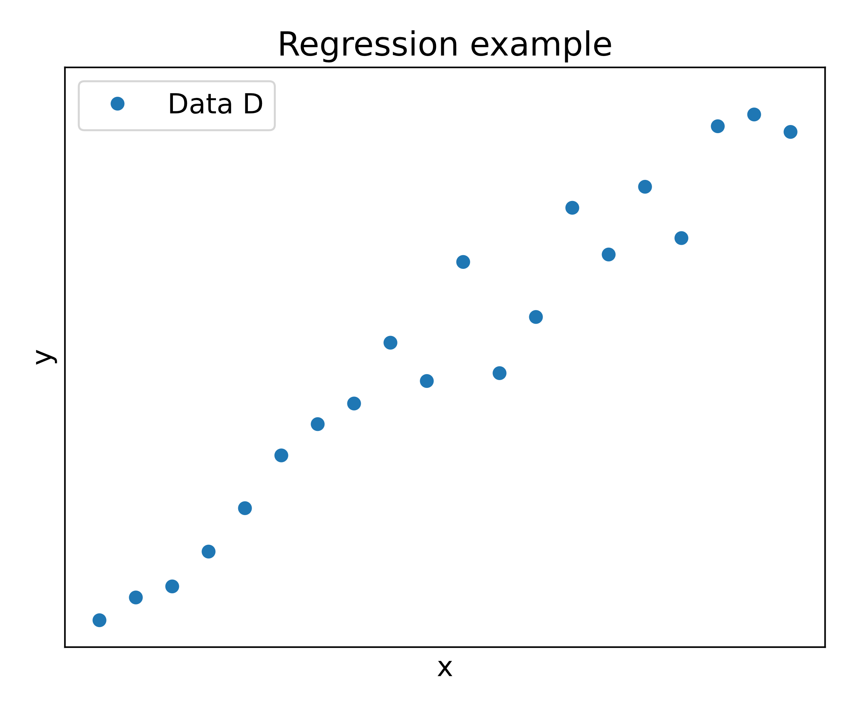
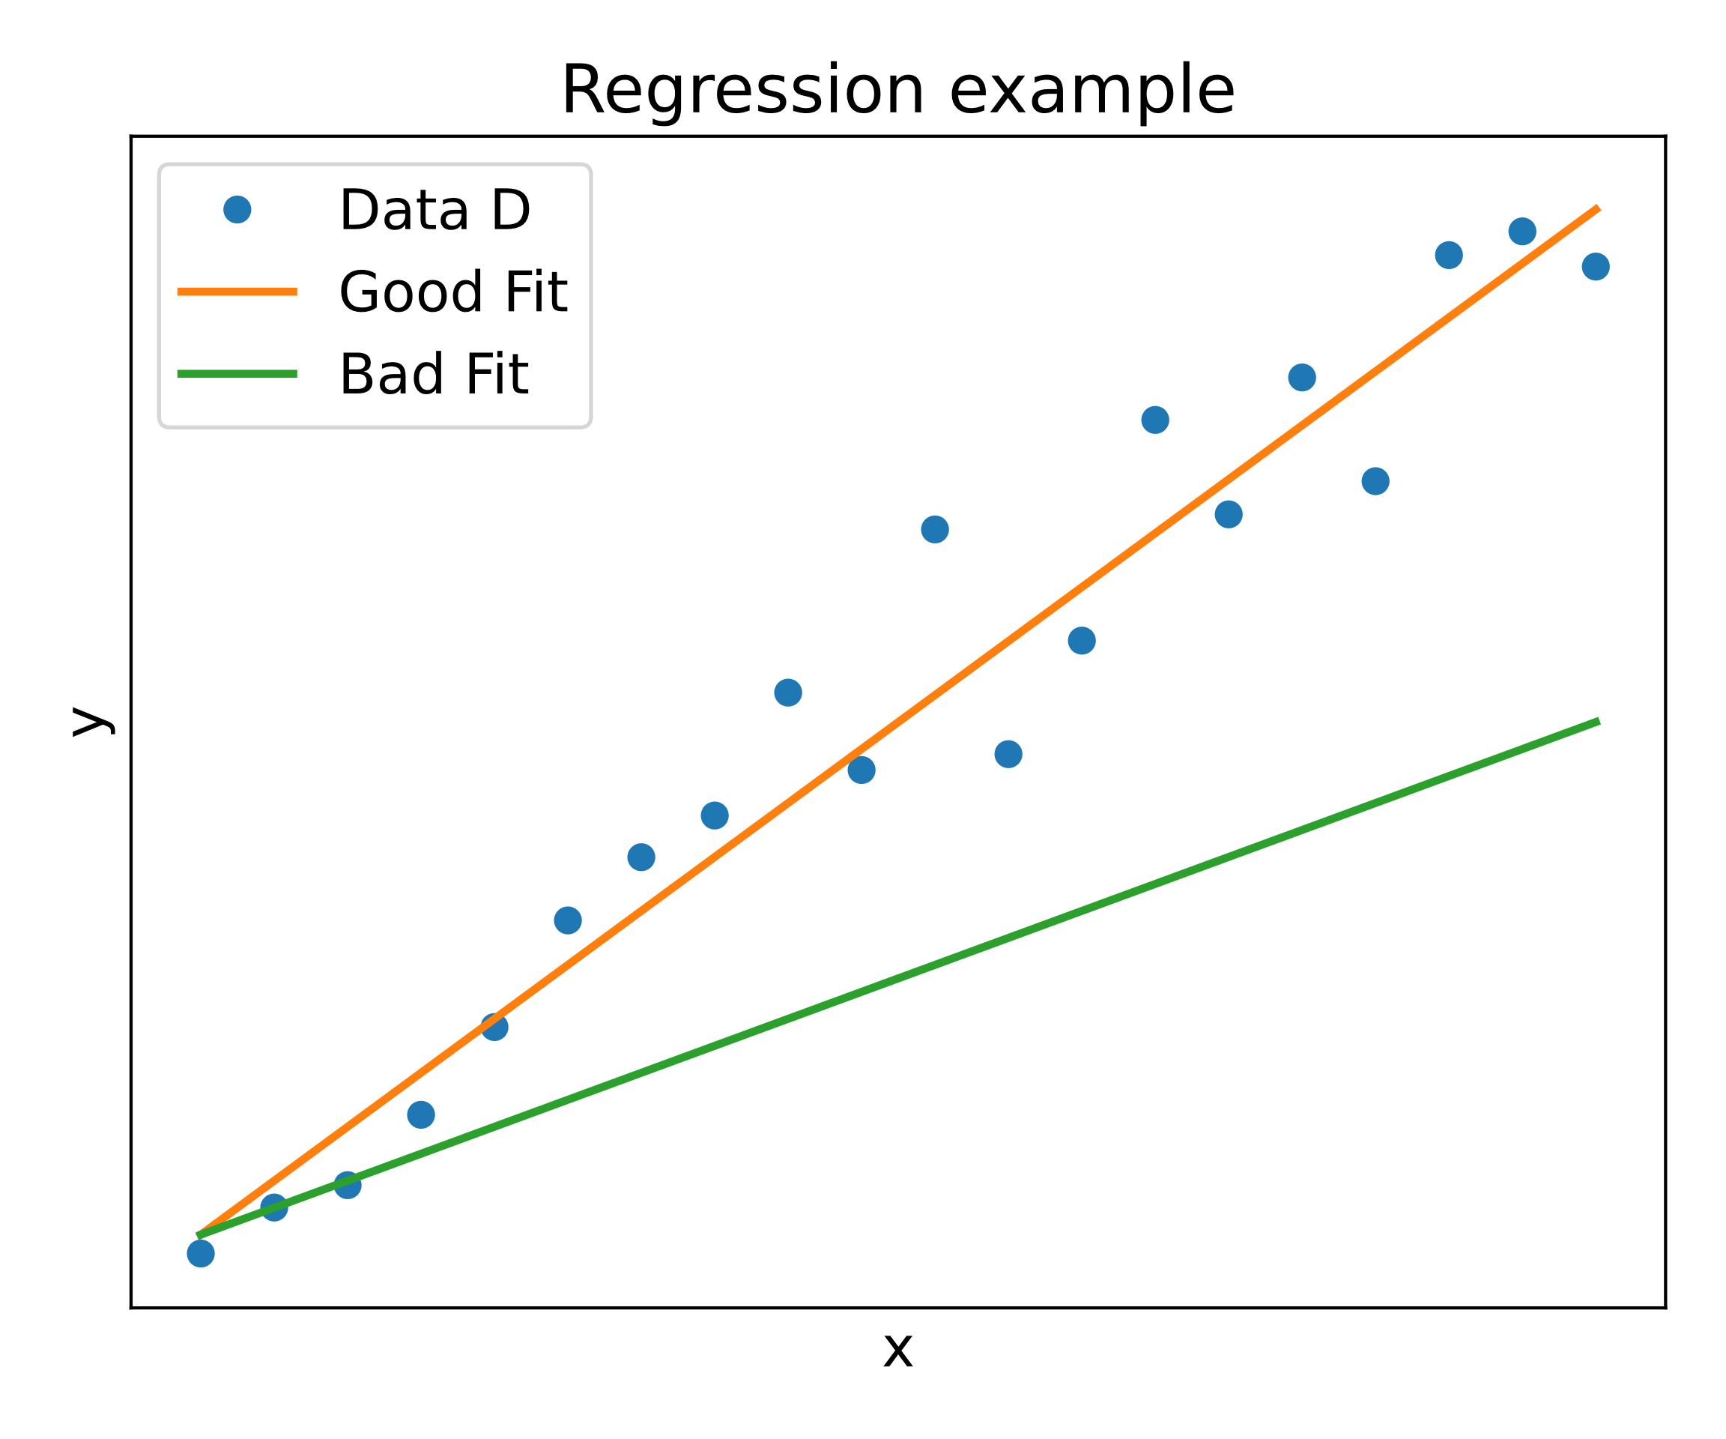

Slide 14
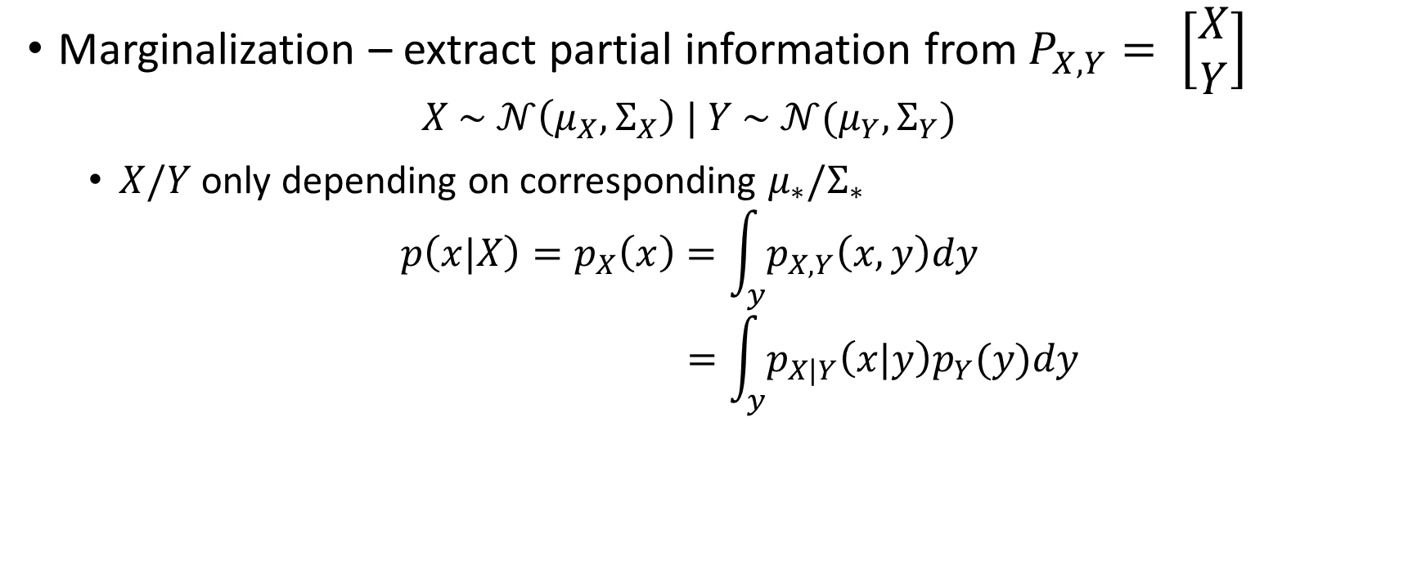
Intermezzo – Multivariate Gaussian[2]
Marginalization – extract partial information from $P_{X,Y}= \left[\begin{matrix}X \\ Y\end{matrix}\right]$
$$X \sim 𝒩\left(μ_{X},Σ_{X}\right) | Y \sim 𝒩(μ_{Y},Σ_{Y})$$
$X/Y$only depending on corresponding $μ_{∗}/Σ_{∗}$
$$p\left(x|X\right)=p_{X}\left(x\right)=\int_{y}{p_{X,Y}\left(x,y\right)dy} \\ =\int_{y}{p_{X|Y}\left(x|y\right)p_{Y}(y)dy}$$
Notes:
partial information – here full subset X or Y
Marginalize out by Expectation Value

