Slide 1
Gaussian Processes
Scientific Machine Learning
Sebastian Klein

Slide 2
Outline

Slide 3
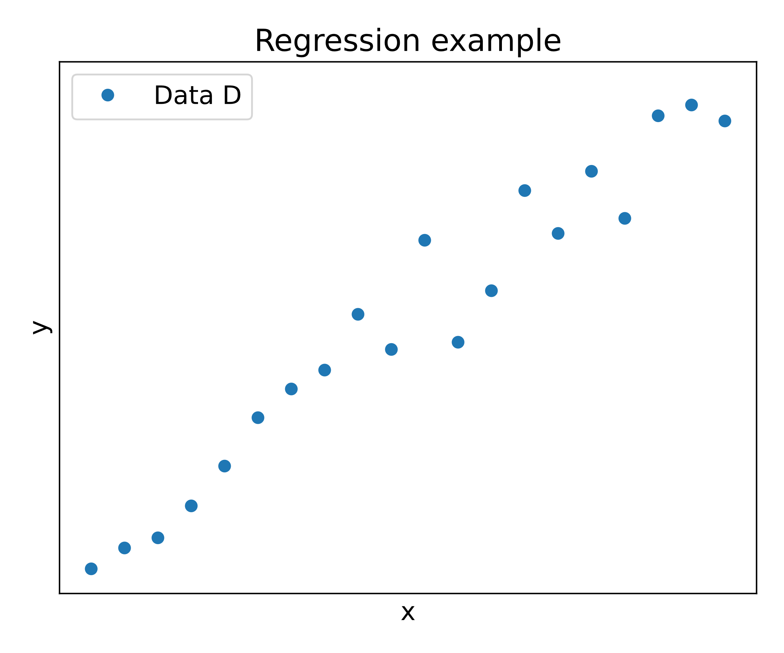
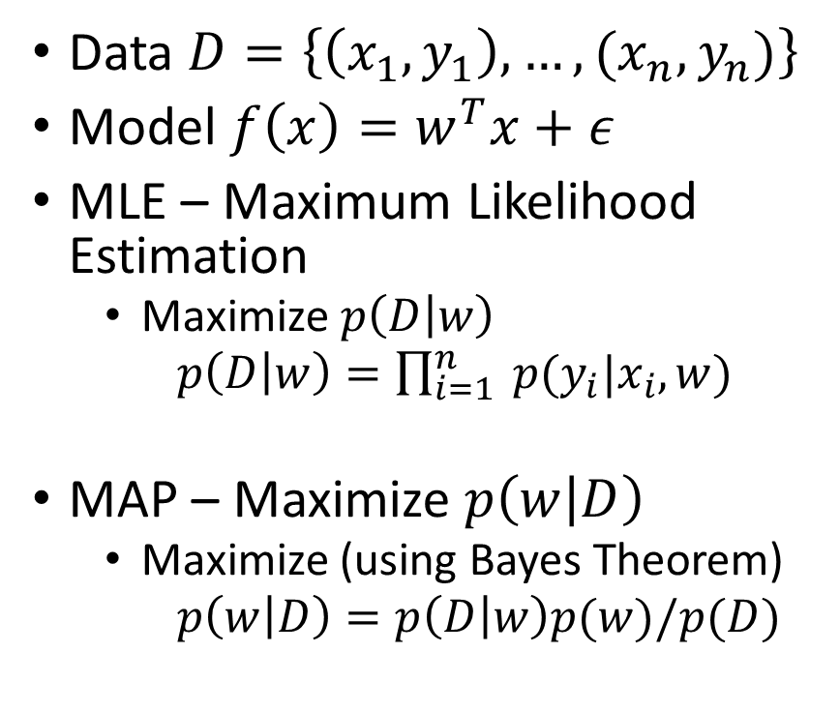
Motivation – Regression problems [1]
Data $D=\left\{\left(x_{1},y_{1}\right),…,(x_{n},y_{n})\right\}$
Model $f\left(x\right)=w^{T}x+ε$
MLE – Maximum Likelihood Estimation
Maximize$p\left(D | w\right)$
$p\left(D | w\right)=\prod_{i=1}^{n}{ p(y_{i}|x_{i}, w)}$
MAP – Maximize $p\left(w | D\right)$
Maximize (using Bayes Theorem)
$p\left(w | D\right)=p\left(D | w\right)p(w)/p(D)$
Notes:
$w^{T}x+ε$ – epsilon = noise, w - model parameters
$p(y_{i}|x_{i}, w$) how likely is it that the x_i gives rise to the y_i with the parameter w
MLE - max probability of Data $p\left(D | w\right)$ for a parameter $w$

Slide 4
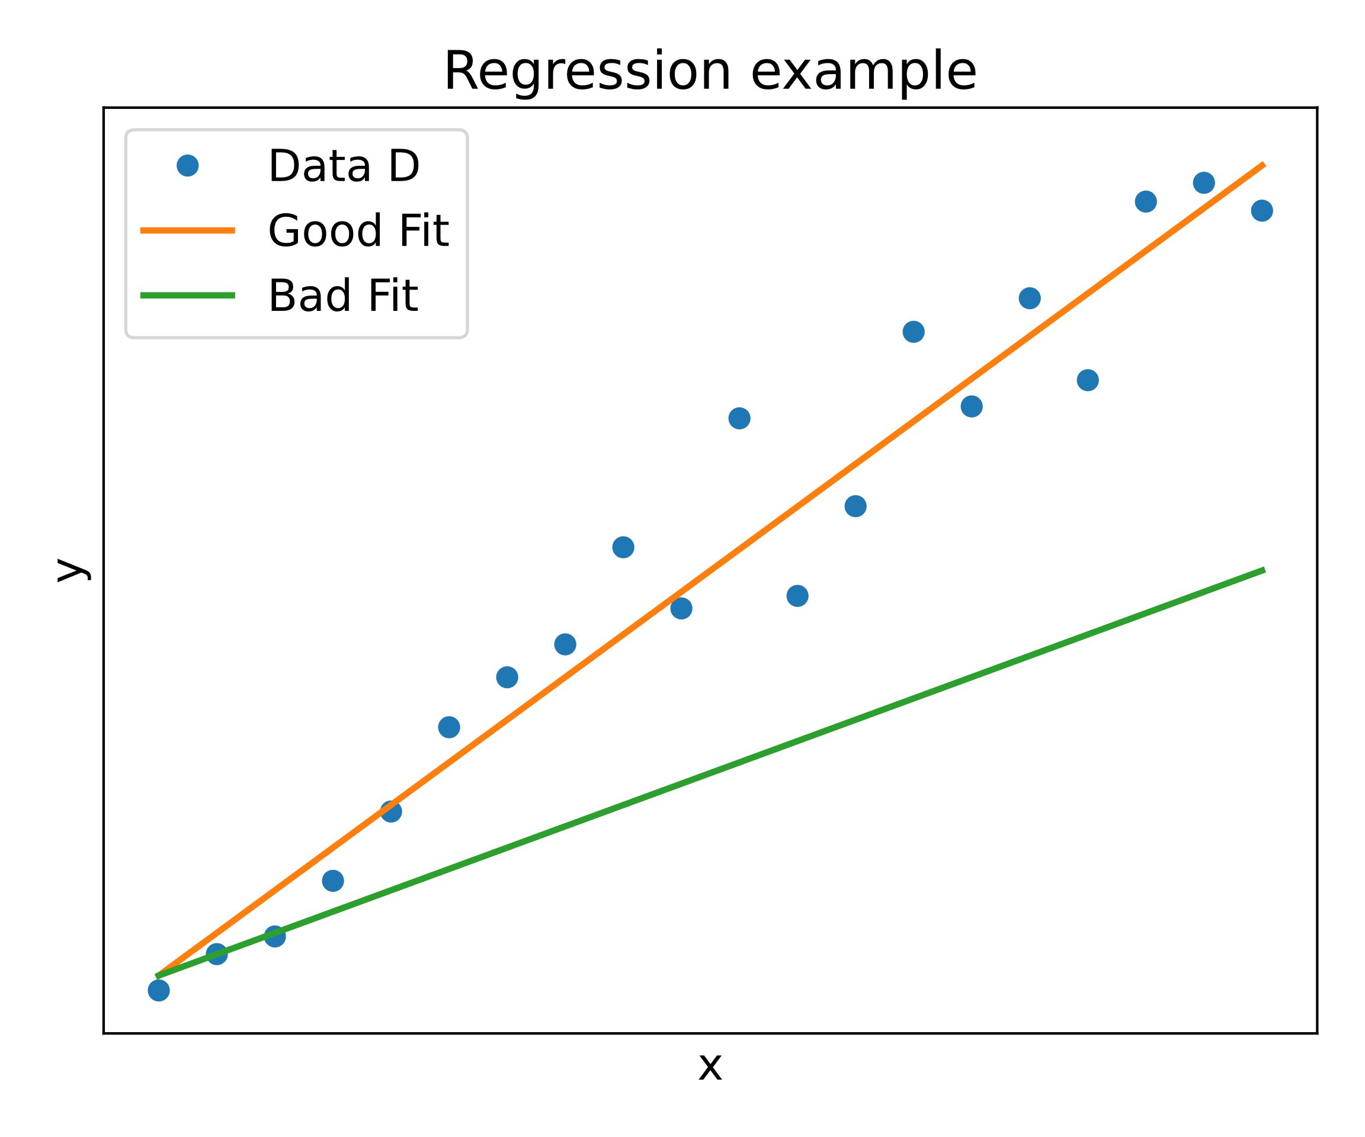
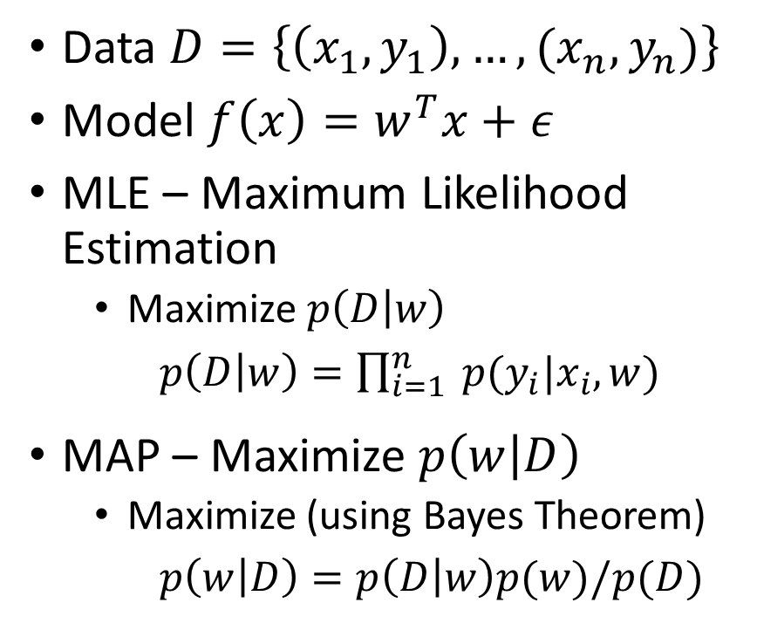
Motivation – Regression problems [1]
Data $D=\left\{\left(x_{1},y_{1}\right),…,(x_{n},y_{n})\right\}$
Model $f\left(x\right)=w^{T}x+ε$
MLE – Maximum Likelihood Estimation
Maximize$p\left(D | w\right)$
$p\left(D | w\right)=\prod_{i=1}^{n}{ p(y_{i}|x_{i}, w)}$
MAP – Maximize $p\left(w | D\right)$
Maximize (using Bayes Theorem)
$p\left(w | D\right)=p\left(D | w\right)p(w)/p(D)$
Notes:
$w^{T}x+ε$ – epsilon = noise, w - model parameters
$p(y_{i}|x_{i}, w$) how likely is it that the x_i gives rise to the y_i with the parameter w
MLE - max probability of Data $p\left(D | w\right)$ for a parameter $w$

Slide 5
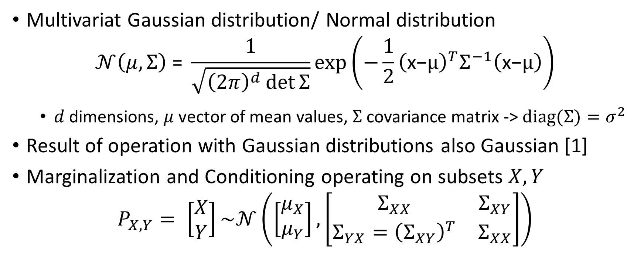
Intermezzo – Multivariate Gaussian[2]
Multivariat Gaussian distribution/ Normal distribution
$$𝒩\left(μ, Σ\right) \text{=} \frac{1}{\sqrt{{\left(2π\right)}^{d}\det{Σ}}}\text{exp}\left(−\frac{1}{2}{\left(\text{x}\text{−}μ\right)}^{T}Σ^{−1}\left(\text{x}\text{−}μ\right)\right)$$
$d$ dimensions, $μ$ vector of mean values, $Σ$ covariance matrix -> $diag(Σ)=σ^{2}$
Result of operation with Gaussian distributions also Gaussian [1]
Marginalization and Conditioning operating on subsets $X,Y$
$$P_{X,Y}= \left[\begin{matrix}X \\ Y\end{matrix}\right]\sim 𝒩\left(\left[\begin{matrix}μ_{X} \\ μ_{Y}\end{matrix}\right],\left[\begin{matrix}Σ_{XX} & Σ_{XY} \\ Σ_{YX}={\left(Σ_{XY}\right)}^{T} & Σ_{XX}\end{matrix}\right]\right)$$

Slide 6
Intermezzo – Multivariate Gaussian[2]
Marginalization

Slide 7

Sources
K. Weinberger, Machine Learning Lecture: Gaussian Process (https://www.cs.cornell.edu/courses/cs4780/2018fa/lectures/lecturenote15.html)
The Multivariate gaussian distribution is written here with the normalization factor $∝\det{{\left(Σ\right)}^{−1}}$ while it should be $∝\det{{\left(Σ\right)}^{−1/2}}$
In notation of conditional normal distribution the formular for the covariance Matrix is wrong, K and K_** are switched
Görtler, et al., "A Visual Exploration of Gaussian Processes", Distill, 2019. DOI: 10.23915/distill.00017
C. Fonnesbeck, Fitting Gaussian Process Models in Python (https://domino. ai/blog/fitting-gaussian-process-models-python)

