Slide 1
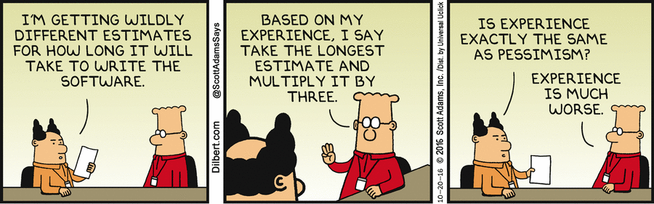
Real world effort estimation...

Slide 2
No More Guessing
Effort Estimation with Jupyter Notebook
Sebastian Kübeck
Mastodon, LinkedIn, Twitter: @skuebeck sebastian.kuebeck@aon.at https://sebastiankuebeck.wordpress.com/

Slide 3

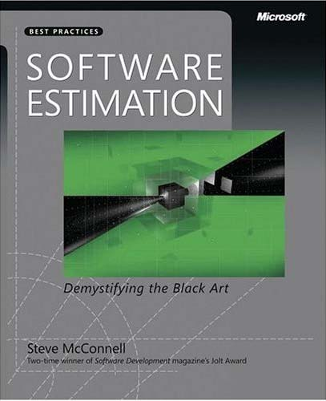
Terminology
An estimate is an approximation based on incomplete information.
An ambition is the commitment to do better than the estimate, if possible.
A target is a statement of a desirable business objective. E.g.
“We need to have Version 2.1 ready to demonstrate at a trade show in May.”
“We need to have this release stabilized in time for the holiday sales cycle.”
A commitment is a promise to deliver defined functionality at a specific level of quality by a certain date.
An offer is a conditional promise which becomes a binding contract if the offeree accepts it.
Liability

Slide 4
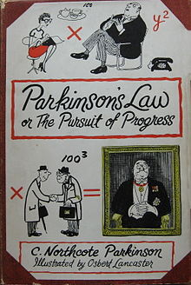
Parkinsons Law is an urban legend!
Originally, Parkinson's law is the adage that "work expands so as to fill the time available for its completion", and the title of a book which made it well-known.
However, in current understanding, Parkinson's law is a reference to the self-satisfying uncontrolled growth of the bureaucratic apparatus in an organization.
https://en.wikipedia.org/wiki/Parkinson's_law

Slide 5
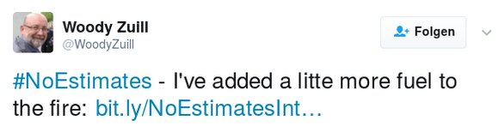
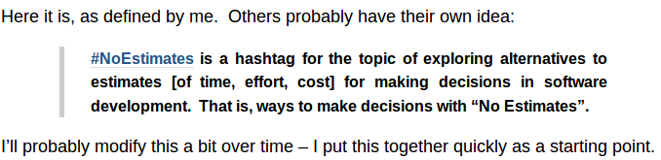
Why not drop estimation at all?
2012: First use of #NoEstimates ....

Slide 6
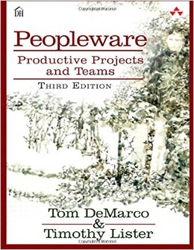
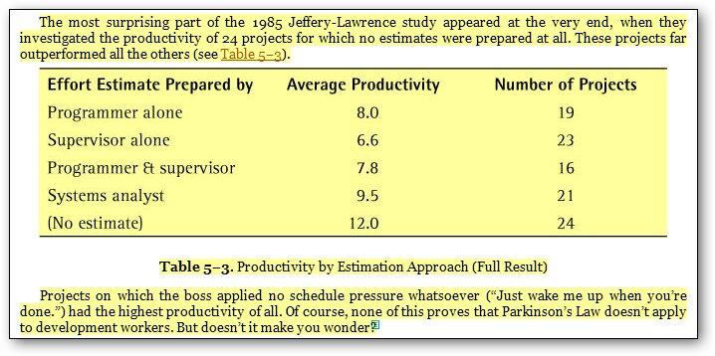
Studies: Teams that don’t estimate are more productive!

Slide 7
#NoEstimates today
2023: #NoEstimates is dead!
Reasons:
Proponents could not agree on definitions and methodology.
Truism: It is not possible to think about the future in a reasonable way without any form of estimation.
It turned out that problems with estimates have the following reasons and they can not be solved by not estimating!
  Lack of knowledge/education
  Bad management practices

Slide 8
#NoEstimates Spin-Off
Estimations based on previous Data!
Estimation is done by the computer, based on previous project data.

Slide 9

Estimation based on Previous Data
Goal: Figure out tasks, estimating task size, summing up tasks, come up with a probability distribution instead of a number.
Probability (of completion)
0,1%
50%
90%
Time, Money

Slide 10
Estimation from previous Project Data
Questions
How to I get to an offer for a fixed priced project?
How much money can I make with this projects? What are the financial risks?
When will the project be finished?

Slide 11
Estimation from previous Project Data
Environment
Scrum is used as development process.
Development is orgenaized in Teams with 4-8 people.
Work is done within fixed time IntervaIs called Sprints.
Work is split in Stories as unit of Work.
Stories are estimated in Story Points, a relative metric that’s specific to a team.
Velocity is defined as Story Points completed per Sprint.
Environment
Scrum is used as development process.
Development is orgenaized in Teams with 4-8 people.
Work is done within fixed time IntervaIs called Sprints.
Work is split in Stories as unit of Work.
Stories are estimated in Story Points, a relative metric that’s specific to a team.
Velocity is defined as Story Points completed per Sprint.
https://www.scrum.org/resources/scrum-guide

Slide 12
Story Points
A
B
Flächeninhalt A:B ≈ 3:4
...in Story Points, this is 4:3, 8:6 or 40:30, every team usees their own story points

Slide 13
Problem: The velocity is not constant!
Velocity = Story Points/Sprint
???
now
Sprint n-2
Sprint n
Sprint n+1
Sprint n+2 ...
Time
...
Sprint n-1

Slide 14
Example: Fixed Proce Project
Given:
Projekt requires 50 Story Points
The velocity distribution is the same as in the past
To be determined:
Best Case: How many Sprints does it take to complete the project in an optimal situation? How likely ist this case?
Bad Case: How many sprints do I have to sell, not to make a loss with a probability of 95%?
Worst Case: What is the maximum number of Sprints required to complete the projcet? How likely ist this case?
Expected Gain: How many Sprints do I have to sell in order to make a profit?

Slide 15
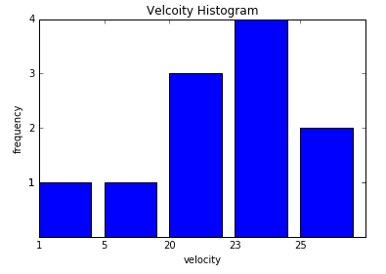
Velocity
Assumption: Velocity distribution will not change in the future

Slide 16
Edge Cases from the Histogram
Best Case
Maximum Velocity: 25 Story Points
Number of Sprints for maximum Velocity: 50/25 = 2 Sprints
Probability:
(Frequency 25 Story Points/Number of Measurements)^{Sprints}
result: (2/11)² = 3,31%
Worst Case:
Minimum Velocity: 1 Story Point
Number of Sprints at minumum Velocity: 50/1 = 50 Sprints
Probability:
(Probability 1 Story Points/Number of Measurements)^{Sprints}
result: (1/11)⁵⁰ = 8,5x10⁻⁵¹
..way too improbable!

Slide 17
Determinsitc System
Task: x, y known, calculate z.
2
x
y
3
Calculation
5
z

Slide 18
Probabilistic System
X,Y and Z are Random Variables!
Task: distribution of X, Y known, calculate distribution of Z.
X
Y
0,1%
50%
90%
0,1%
50%
90%
Calculation
Z
???
0,1%
50%

Slide 19
Monte Carlo Approximation
1. Take n random samples xn, yn from Distributions X and y.
2. Calculate zn from xn, yn.
3. The histogram of zn will approximate Distribution of Z.
xn
yn
0,1%
50%
90%
0,1%
50%
90%
Calculation
zn
0,1%
50%

Slide 20
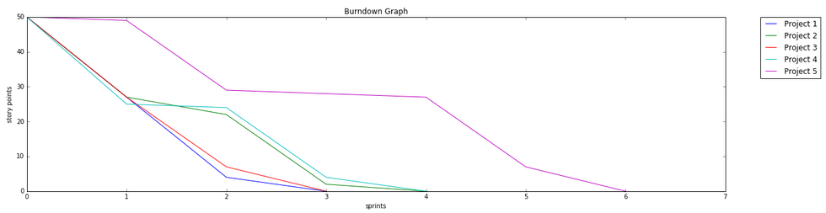
Monte Carlo Method for Project outcomes
Random numbers with above distribution
= simulated Velocity = Story Points/Sprint
Sum up simulated Velocities until 50 Story Points are reached. Note the numner of Sprints

Slide 21
Burndown Graph
Burn Down Graph for 5 possible project outcomes...

Slide 22

Monte Carlo Methode
Generieren von Zufallszahlen mit gegebener Verteilung
Numpy (Python):
numpy.random.choice(a=Values, p=Propabilities)
https://docs.scipy.org/doc/numpy-dev/reference/generated/numpy.random.choice.html
Excel:
Michael de la Maza: Monte Carlo Planning Improves Decision Making, InfoQ 2017:
https://www.infoq.com/articles/monte-carlo-planning

Slide 23
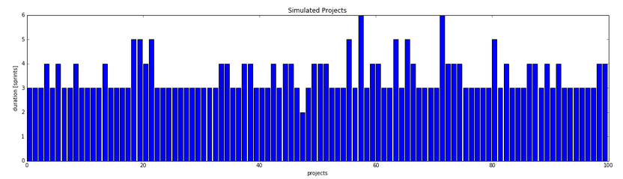
Number of Sprints required
Number of required Sprints for 1000 Project runs...

Slide 24
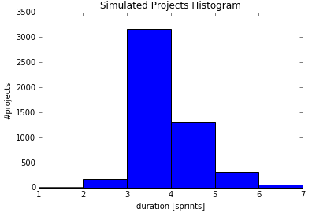
Histogramm of Simulated Projects
5000 simulated projects later....

Slide 25

Histogramm Evaluation
Average Case:
We make money starting at 50%, that means we have to sell at least
3 Sprints!
We could have calculated this immediately:
Average Velocity: 18.91
Average number of Sprintsl:
Story Points total/average Velocity
result: 50/18.91 = 2.64, rounded up yields 3 Sprints!
Bad Case:
Probability > 95% corresponds to 1 – 0.05%
From the histogramm: 6 Sprints (Probability: 99.38%)
Expected gain: 6 – 2.64 = 3.36 Sprints

Slide 26
Conclusion
Best Case:
We need at least 2 Sprints to finish the project!
However, the propability is pretty low 3.31%!
Average Case:
We need to sell at least 3 Sprints to make money!
Bad Case:
We need at least 6 Sprints to be sure that we don’t loose money with a probability of 95%!
Worst Case:
Only if we sell 50 Sprints we can be 100% certain that we don’t loose money.
However, the probability that we actually need 50 Sprint is extremely unlikely.

Slide 27
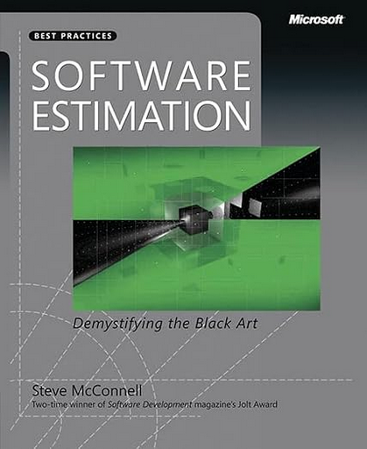
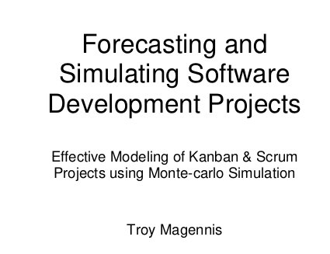
Further Reading
Magically Predictable Software Production for Projects
Ralf Westphal, 2019
https://ralfw.de/magically-predictable-software-production-for-projects/
Monte Carlo Estimation for Kanban Projects
Software Estimation: Demystifying the Black Art
Steve McConnell, 2009
https://leventov.medium.com/excerpts-from-software-estimation-demystifying-the-black-art-9cf80e2b9977
Comprehensive introduction to Software Estimation
Forecasting and Simulating Software Development Projects
Troy Magennis 2011
https://github.com/FocusedObjective/FocusedObjective.Resources/blob/master/README.md

Slide 28
Planning without prior Data
How do I deal with the following situation?
  New team or major change.
  R&D Project.
  No idea if it can be accomplished.
  Not familiar with domain, technology

Slide 29
Planning without prior Data
Solution:
Don’t estimate Effort but Value!

Slide 30
Planning without prior Data
Process (yet unnamed)
  Define goal
  Figure out how much you are willing to invest to reach this goal.
  Set up a budget based on defined investment.
  Start working until...
    goal is reached,
    it is obvious that the goal cannot be reached,
    The budget is used up.
  Continue with 1

Slide 31
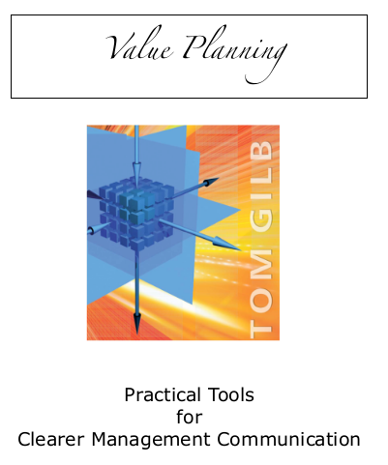
How to Estimate Value
Gilb Method
1. STAKEHOLDERS: Identify your most critical stakeholders.
2. OBJECTIVES: Identify the smart levels of their most critical value improvements.
3. STRATEGIES: Identify potential strategies for delivering planned value levels to
stakeholders, at lowest cost and risk.
4. SMALL STEPS: Decompose strategies into suitably smaller deliverable increments.
5. DELIVER VALUE: Attempt to deliver measurable value to some stakeholders.
6. LEARN: Measure results and costs; then decide if you are on track, or need to change something. Continue the process until all goals reached.
https://www.gilb.com/store/2W2zCX6z

