Slide 1
Hello, World!
python-pptx was here, hello world

Slide 2
Adding a Bullet Slide
Find the bullet slide layout
Use _TextFrame.text for first bullet
Use _TextFrame.add_paragraoh() for subsequent bullets

Slide 3
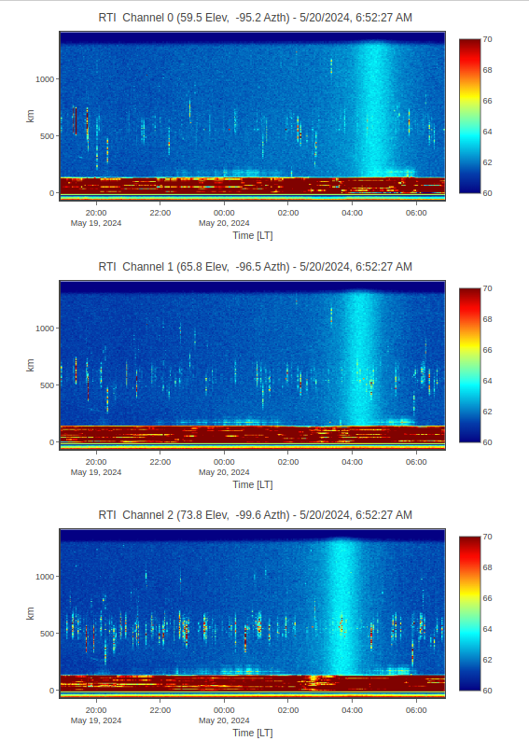

Slide 4
Adding an AutoShape
Step 1
Step 2
Step 3
Step 4
Step 5

Slide 5
Adding a Table
Columna 0 | Columna 1
Valor 0 | Valor 1

