Slide 1
Jnario
Executable Specifications for Java
Sebastian Benz, E.S.R. Labs
Birgit Engelmann, BMW Car IT

Slide 2
public class CustomerLookupTest{
@Test
public void findsCustomerById() { ...
}
@Test
public void failsForDuplicateCustomers() { ...
}
...
}

Slide 3
CustomerLookup
findsCustomerById
failsForDuplicateCustomers
...

Slide 4
Customer Lookup
- finds Customer by Id
- fails for duplicate Customers
- ...

Slide 5
public class CustomerLookupTest{
@Test
public void findsCustomerById() { ...
}
@Test
public void failsForDuplicateCustomers() { ...
}
}

Slide 6
Jnario
describe “Customer Lookup” {
fact ”finds Customer by id“ {
...
}
fact ”fails for duplicate customers” {
...
}
}

Slide 7
DEMO

Slide 8
User Story
[Title]
In order to [benefit]
As a [stakeholder]
I want [some feature]
When is it done?

Slide 9
User Story
[Title]
In order to [benefit]
As a [stakeholder]
I want [some feature]
Scenarios
Given
When
Then
[some context]
[some action]
[some outcome]
...
...
...

Slide 10
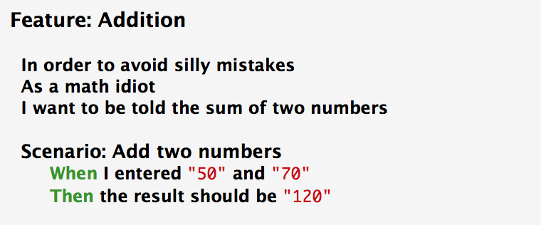
A business readable DSL...

Slide 11
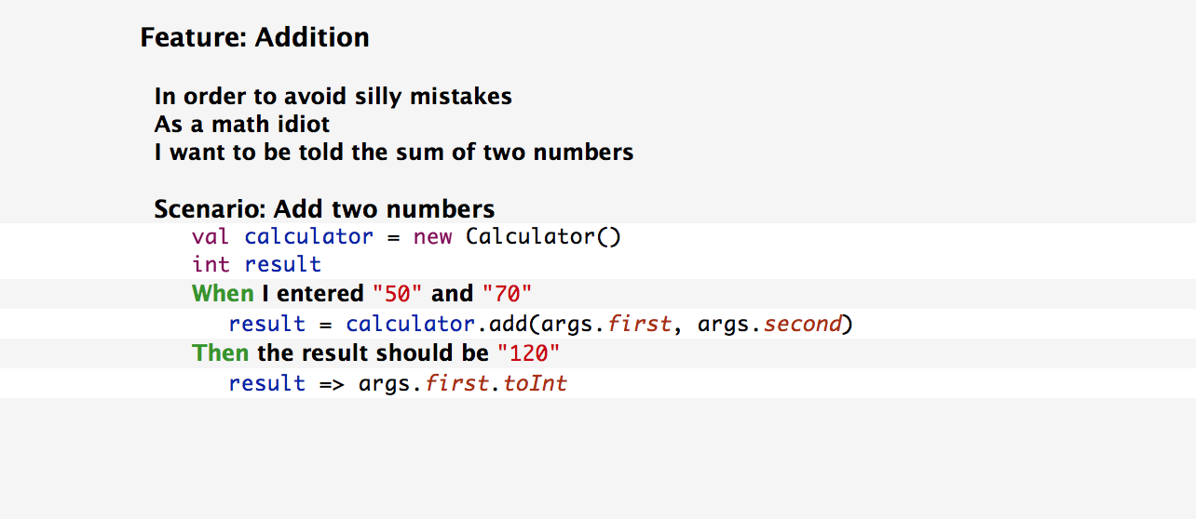
...for executable specifications

Slide 12
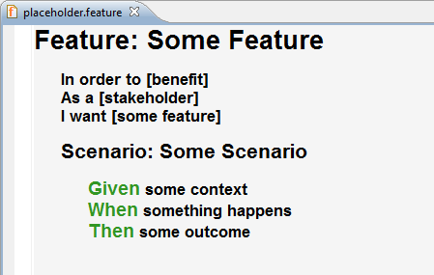
[Title]
In order to [benefit]
As a [stakeholder]
I want [some feature]
curiosity
environment
engine
camera
communication
service
string utils
Outside-In
System

Slide 13
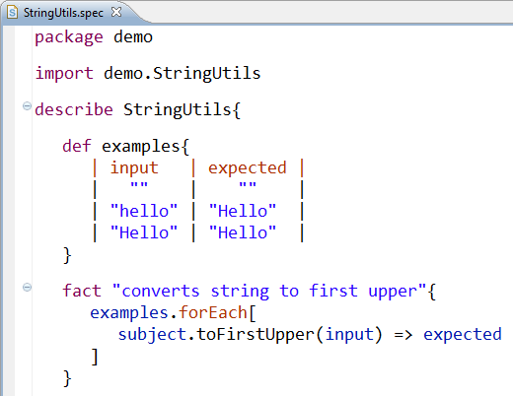
[Title]
In order to [benefit]
As a [stakeholder]
I want [some feature]
curiosity
environment
engine
camera
communication
service
string utils
Outside-In

Slide 14
DEMO

Slide 15
www.jnario.org

