Slide 1
Story
[Title]
In order to [benefit]
As a [stakeholder]
I want [some feature]
DONE?!

Slide 2
Story
[Title]
In order to [benefit]
As a [stakeholder]
I want [some feature]
Scenario
Given
When
Then
[some context]
[some action]
[some outcome]

Slide 3
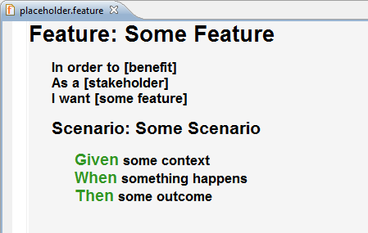
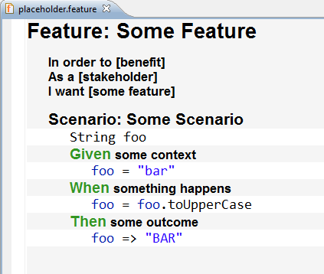

Slide 4
[Title]
In order to [benefit]
As a [stakeholder]
I want [some feature]
curiosity
environment
engine
camera
communication service
string utils
Outside-In

Slide 5
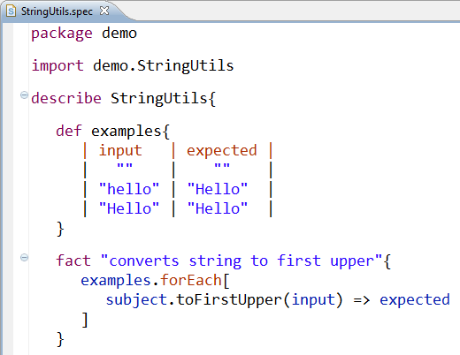
[Title]
In order to [benefit]
As a [stakeholder]
I want [some feature]
curiosity
environment
engine
camera
communication service
string utils
Outside-In

