Slide 1
TypeScript and Visual Studio 2015
Sebastian Brandes, sbrand@microsoft.com

Slide 2

About Sebastian
Tech Evangelist, Microsoft
Responsible for App + Web Dev in Denmark
10 years of Web Dev experience
Secret affair with Azure...
Twitter: @sebastianbk
Blog: https://sebastianbrandes.com

Slide 3
Agenda
What is TypeScript?
Why use it?
Demo
More demo
Even more demo
Wrap Up
Demo
Final Wrap Up

Slide 4
Large-scale JavaScript
development is hard.

Slide 5
TypeScript is a language for large-scale JS development.

Slide 6
TypeScript is a typed superset of JS that compiles to plain JS.

Slide 7
Any browser. Any host. Any OS. Open Source.

Slide 8


Slide 9
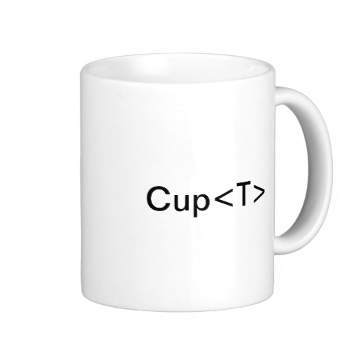
+

Slide 10

+
+

Slide 11
+
+
= TypeScript

Slide 13
Demo

Slide 14
Some Wrap Up

Slide 15
Type System
Structual typing and type inference
In practice very few type annotations are necessary
Generics, union types, tuple types
Increases accuracy and expressiveness of type system
Works with existing JavaScript libraries
Declaration files can be written and maintained separately
Types enable tooling
Provide verification and assistance, but not hard guarantees

Slide 16
Classes, Interfaces, Modules
Scalable application restructuring
Classes, interfaces and modules enable contracts in code
Aligned with emerging standards
Class and lambda syntax aligns with ECMAScript 6 proposals
Supports popular module systems
CommonJS and AMD modules in any ECMAScript 3 environment

Slide 17
More Demo

Slide 18
More Wrap Up

Slide 19
TypeScript EcoSystem
Community
https://github.com/Microsoft/TypeScript
Over 3,000 StackOverflow questions (per November 2014)
Mozilla Shumway, Turbulenz, doppio, Away3D, WinJS, etc.
Frameworks
Over 700 .d.ts library definitions on the DefinitelyTyped repo on GitHub
Covering more than 90% of popular JavaScript frameworks
Tool support
IDEs: Visual Studio, Eclipse, WebStorm, ReSharper, Sublime Text, etc.
Build and test: ASP.NET, Grunt, Node.js, tsUnit

Slide 20
TypeScript Roadmap
TypeScript 1.3
New 5x faster compiler, new language service, tuple types, ”protected”
TypeScript 1.4
Union types, const enums, let and const, template strings, symbols
TypeScript 1.5
More ES6: Destructuring, spread operator, for...of, generators
TypeScript 2.0
ECMAScript 6 parity, down-level support where feasible
Stretch gorals, e.g. async/await

Slide 21
typescriptlang.org
github.com/Microsoft/TypeScript

Slide 22
Sebastian Brandes, sbrand@microsoft.com

