Slide 1

DATA/CS 172: Python for Data Analysis
CSV files
Prof. Travis Mandel
10/16/2024

Slide 2
Announcements
Lab 12 due today

Slide 3
Agenda
CSV data

Slide 4

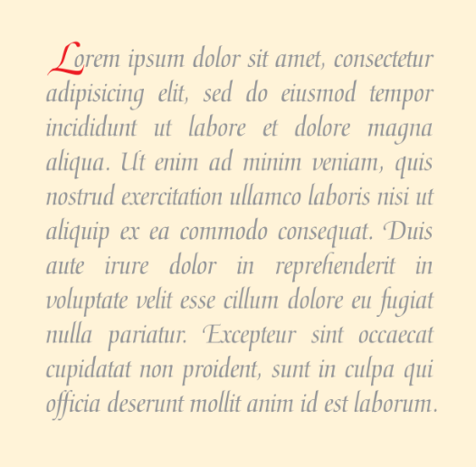
So far in this class…
We started working with toy data
Files with one number
We moved up to more realistic formats
Files with many sensor readings
Lately, we started to touch actual data
But only in text format (e.g. Brown corpus)
TODAY: Open the doors to manipulating many more real-world datasets!

Slide 5

Real World Data
Is often very complex
In some projects, custom formats are developed and used (I’ve been guilty of this)
In recent years there’s been a huge push to standardize formats
Helps share data among teams, make better use of existing tools
Two of the most popular formats are CSV and JSON
Python has special support for these formats
We’ll cover CSV today, JSON on Friday, APIs Monday

Slide 6

CSV
We parsed the CSV files…
???
Data scientists like to sound really fancy by talking about “parsing CSV files”
But CSV just stands for “comma-separated values”
Basically, CSV files consist of data separated by commas
Example CSV (demo)

Slide 7

CSV details
Each line represents a piece of data
Each piece of data is a list of field values
Like columns in a spreadsheet
Guaranteed to have the same number of fields in each line
Fields are separated by comma
Often CSV is still used even if the delimiter is changed
Why use a CSV reader instead of just split?
Handles special cases, e.g. what if field has a comma inside it?!
Although it’s not strictly required, most CSV files have a first line which indicates the name of each field. [See Demo]

Slide 8
Parsing CSV files Way #1
import csv
f = open(“filename.csv", "r")
reader = csv.reader(f)
for row in reader:
# row is now a list we can manipulate
f.close()
Problems?
Keeping track of index is very annoying
Have to remember to skip first row

Slide 9
Parsing CSV files Way #2
import csv
f = open(“filename.csv", "r")
reader = csv.DictReader(f)
for row in reader:
# row is now a dict with field names as keys
f.close()
Much better!
More readable, more flexible if column order changes
Use this one unless CSV does not have header row

Slide 10

Writing CSV files?
Writing CSV is less common in data science
Usually, CSV data comes from real-world data repositories (I like Kaggle)
However, sometimes the original dataset is too complicated and difficult to work with
Writing out a new CSV file can be useful to simplify the format
I had to do this for your lab today!

Slide 11
DictWriter
If we are writing CSV files, we want to include a header row so it is easy to read
So a DictWriter is a good choice
Works like a DictReader but in reverse
Needs to know the fieldnames when created
Also needs a special writeheader() call to write the header
Need to set lineterminator to avoid blank lines
import csv
f = open(“filename.csv", “w")
writer = csv.DictWriter(f, lineterminator=“\n”, fieldnames = [“col1”, “col2”])
writer.writeheader()
writer.writerow({“col1”: “row1col1”, “col2”: “row1col2”})
writer.writerow({“col1”: “row2col1”, “col2”: “row2col2”})
f.close()

Slide 12
Why are CSV files so widely used?
Simple format
Easy to import into spreadsheet application (Google Sheets, Excel)
Easy to read line-by-line for memory efficiency
But it has some limitations…

Slide 13
Lab out
Analyze real-world CSV data to determine if there is any bias in chocolate bar reviews! ☺
Next time: JSON files!

