Slide 1

DATA/CS 172: Python for Data Analysis
Getting Started with Python
Prof. Travis Mandel
8/28/2024

Slide 2
Today
Admin Wrap up
Getting started with Python
Variables & Values
Printing

Slide 3
Note about slides
Slides posted after class
Intended as memory-joggers, not comprehensive notes!
Good idea to take your own notes as well to aid comprehension and to help study

Slide 4
Cheating/Academic integrity
Copying another student’s solution?
Cheating
Googling for a solution to the assignment?
Cheating
Googling how to print out a number?
Not cheating – short, simple, just a memory issue
Asking AI to write a chunk of code for you?
Cheating – need to learn how to code on your own before using these tools (also functionality, style, ethical issues)
Copying an example from the book?
Not cheating
Showing/Sending someone else your solution, telling them to use it as a reference only?
Cheating
Talking at a high level with another student about a general approach to solving the problem?
Not cheating
Having a friend who a really good programmer write the code for you on a whiteboard, while you type it in?
Cheating
Giving another student who is stuck a couple high-level hints?
Not cheating
Working together with another student – talking through numerous details of how to write the assignment?
Cheating – Programs are meant to be YOUR INDEPENDENT WORK

Slide 5
Getting started with Python

Slide 6

Start up IDLE
IDLE stands for Integrated Development and Learning Environment.
Basically a fancy text editor
Colors highlight useful parts
Won’t get in your way
If you hate IDLE, could use other environments like Notepad++, Pycharm, Xcode, vim, emacs, etc.
Mostly need a way to edit the text
I think Pycharm is very nice once you get to large projects with many different scripts
Not usually the case in this class
Can’t give specific help on the features of these all of these programs
For now, follow along in IDLE

Slide 7
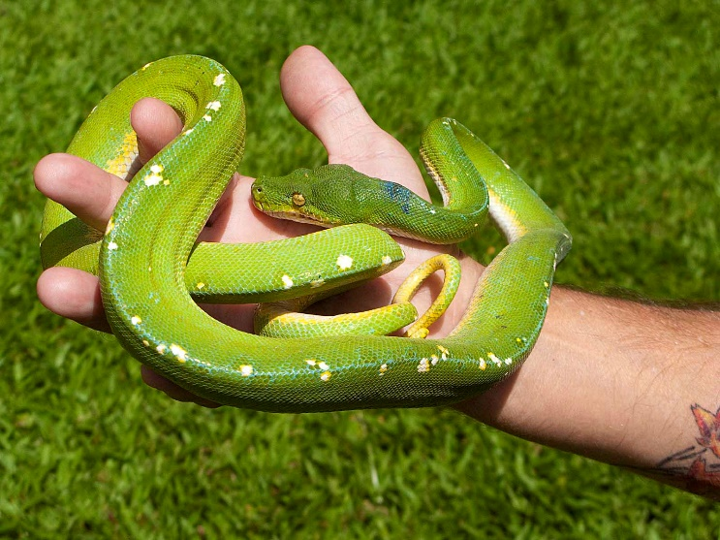
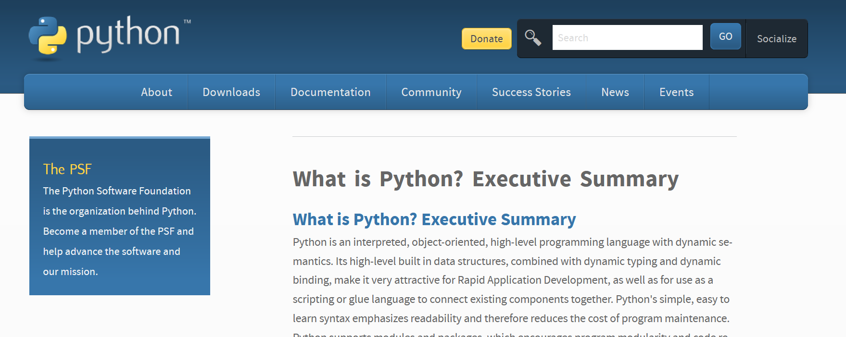
When you start IDLE…
It’s running python in interactive mode ← Important term!
As soon as you type a command and hit “enter”, the command is run and the output is shown
But, you are typing real Python code! ← Important term!
Aka text that Python can interpret and run
Note for C++ programmers: This wouldn’t really be possible in C++, because C++ is a compiled language where code must be compiled before it is run.
Python is designed as an interpreted language, which adds flexibility at the cost of speed.

Slide 8
Demo

Slide 9
Demo
“hello world”
5 * 3
a = 6
a * 2
result = a * 2
result

Slide 10

What are these weird names called (a, b, etc?)
Any guesses?
Hint: Very similar to x, y, etc. in math
Right! Variables ← Important term!
What do we call those things that we put in variables?
Values (same as math) ← Important term!
When we write a=6, that puts the value 6 in the variable a
Called assigning… ← Important term!
Variables can be assigned multiple times (demo)
Overwrite each other
First time is called defining or initializing the variable ← Important terms!

Slide 11
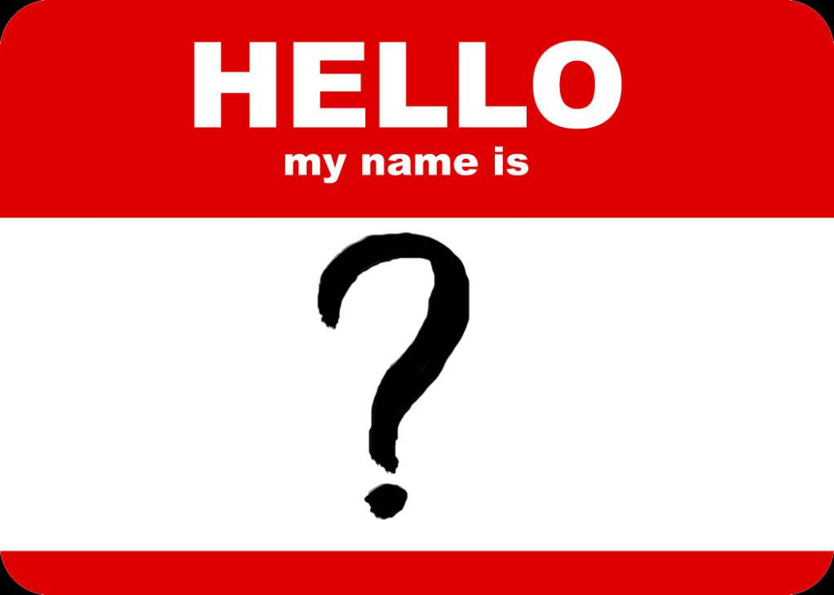
Note: Variable Names
Which is a better name?
x
number
dollars
costOfEquipment
costOfEquipmentInDollarsIncludingUtilitiesAndTax
More descriptive names better (to an extent)!
Cannot combine words with space in variable names
can_use_underscores
orCamelCase (preferred by many)

Slide 12
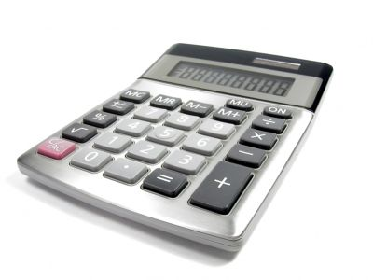
Scripts
Right now we’re using Python kind of like a calculator
What is I ask you to re-do the calculations, but change a few numbers?
As a data scientist, what if we collect more data and want to throw it in to our analysis?
Certainly wouldn’t want to retype all the commands!
Want to create a big list of commands that run all at once
Called a script or a program ← Important terms!

Slide 13
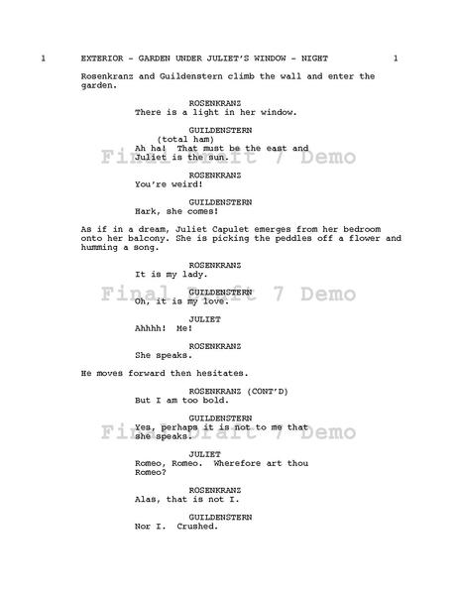
To start a script, click File→New
Type your script
Save your script File→Save
Then to run the script, hit Run→Run Module
Or just hit F5
demo

Slide 14
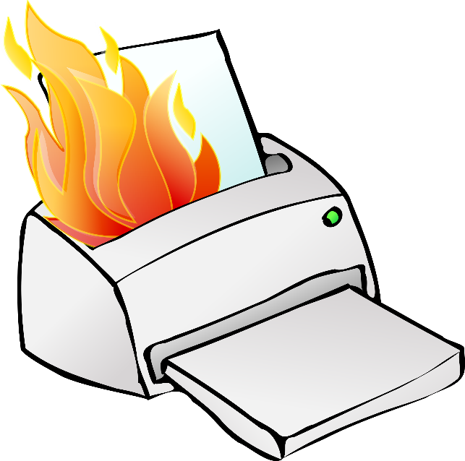
Printing
In computer science, printing usually refers to putting text on the screen, not on paper ← Important term!
In the interactive window, it kind of prints automatically
Not so when writing a script! (demo)
To put output on the screen, have to use print()
print(“hello world”)
Quotes mean print the text exactly (instead of treating it as a variable)

Slide 15
Printing with variables
totalHomes = 6 * 7
print(“The number of total homes is:”)
What now?
Idea 1:
print(“The number of total homes is:”)
print(totalHomes)
Have to print on separate line which is annoying
print (“The number of total homes is:”, totalHomes)
For CS majors: print is a function with any number of arguments
A (more advanced) way to do this is f-strings
Print(f”There are {totalHomes} homes”)
F in front, variables enclosed in curly brackets
Can be a little less typing

Slide 16
Demo of print with vars

Slide 17

Comments
Lines that start with a # are treated as a comment ← Important term!
Means you can write anything, no effect on how program runs
Useful to write notes about what the program is doing

Slide 18
Whew! That’s enough for now…
Time to get going on the rest of the first lab!
Next time: Getting started with data

