Slide 1

DATA/CS 172: Python for Data Analysis
Intro to Dictionaries
Prof. Travis Mandel
10/7/2024

Slide 2
Announcements
Program 1 due Friday

Slide 3
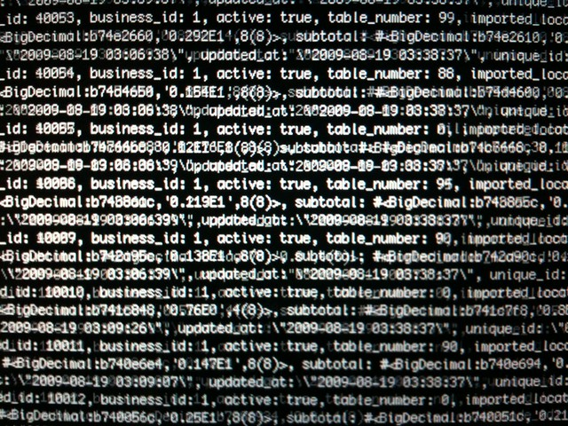
Program 1
You processed a lot of data
Hopefully, you have started on this by now!
Problem: had to use lists
You didn’t need all the data – you were interested in only a few target cuisines
Once things are read into lists, go through each target cuisine, count up, and print avg
What if I had required you to keep track of all cuisines -
Would have been a huge pain!
…. Is there a better way to organize things like this?

Slide 4

Lots of variables
If we have separate variables for each cuisine, it would be great
Problem: No idea how many cuisines or what they are
Don’t want to hardcode
Idea: Imagine a dictionary…
.. You look up a word (say “debate” or “positive test result”)
… or a cuisine
… it gives you back information about that phrase
(or sequence)
For example, the count of occurrences
This Photo by Unknown Author is licensed under CC BY-NC-ND

Slide 5

Also: Tuples are pretty cool
But no way to encode name of each element
Have to remember what order things come in
myTuple = (“john”, 96, “senior”)
…
(name, standing, grade) = myTuple
Grade is senior?!
Not mutable (cannot easily add new field)
Very cumbersome if need to store lots of stuff (e.g. more than 5)

Slide 6
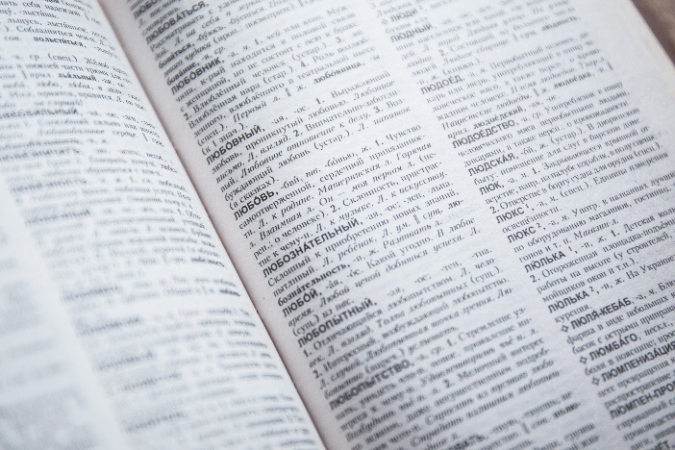
Idea..
What if we have something that maps from name to value?
That dictionary idea again!
Can use it to name a tuple…
Can use it to remember various aspects of the data
Useful for tons of stuff!
Mondays’s lab will use it for unit conversion, for instance.

Slide 7
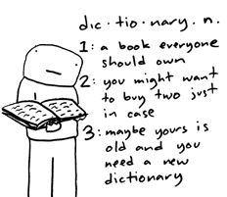
Dict
Short for dictionary
Maps from keys to values
Example: opposite colors
Red →Green
Blue → Orange
Yellow →Purple
Red, blue, yellow are the keys
Green, orange, purple are the values
Each key maps to just one value

Slide 8
Initializing a Dict
Empty dict
myDict = {}
Note the curly braces!
In contrast to square for lists and parens for tuples
Dict with some stuff in there already:
myDict = {
“key1” :”value1”,
“key2”:”value2”,
“key3”:”value3”
}
Keys often strings
Values could be any type (int, float, string, etc.)

Slide 9

Looking up something in a dict
myDict[“key1”]
This is very fast!

Slide 10
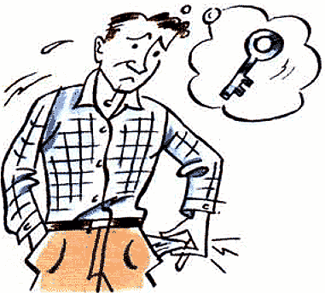
What if the key isn’t there?
Demo
KeyError
Checking if key is present?
YES! Our favorite in keyword again!
If “key1” in myDict:

Slide 11

Adding to a dict
myDict[“key1”] = value
If key exists, this will overwrite!
If not, will add the key

Slide 12
Getting all keys/values
myDict.keys()
Returns a list of keys
Note: In my opinion, not good style to rely on exact order of the keys
Order was basically randomized prior to Python 3.6
myDict.values()
Returns a list of values
Again, order not guaranteed
len(myDict) = number of keys

Slide 13

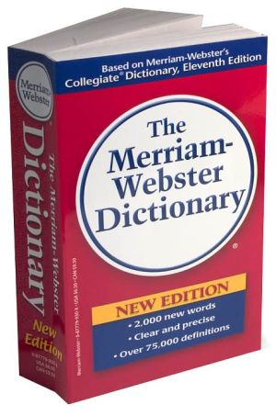
Looping over dicts
Way 1 (not the best style)
for key in myDict.keys():
value = myDict[key]
print(“Key is”, key, “and value is”, value)
Way 2 (equivalent but better style)
for key in myDict:
value = myDict[key]
print(“Key is”, key, “and value is”, value)
As before, in my opinion, not good style to rely on exact order

Slide 14
Looping over dicts: caution
What is the problem here?
desiredKey = “something”
for key in myDict:
if key == desiredKey:
value = myDict[key]
print(“Found value”, value)
Better:
If desiredKey in myDict:
value = myDict[desiredKey]

Slide 15

Functions on dicts you should NOT call!!
myDict.update({key:value})
Should just use myDict[key] = value
myDict.items()
Instead of “for (key,value) in myDict.items()”, it’s better to do:
for key in myDict: value = myDict[key]
items() creates an unnecessary intermediate step and can lead to bugs

Slide 16
Lab out
Simple practice using dicts to convert measurements
Will see more complex example on Wednesday

