Slide 1

DATA/CS 172: Python for Data Analysis
Randomness
Prof. Travis Mandel
10/14/2024

Slide 2
Reminder
Lab 11 due today

Slide 3
Agenda
Randomness

Slide 4

Right now our scripts are deterministic…
Given same data, do the same thing
Often what we want, but not always….
Want to test the system with synthetic data?
Need randomness!
Want to simulate a natural phenomenon?
Need randomness!
Want security and privacy?
Need randomness?
Want advanced analysis/ machine learning?
Need randomness!

Slide 5
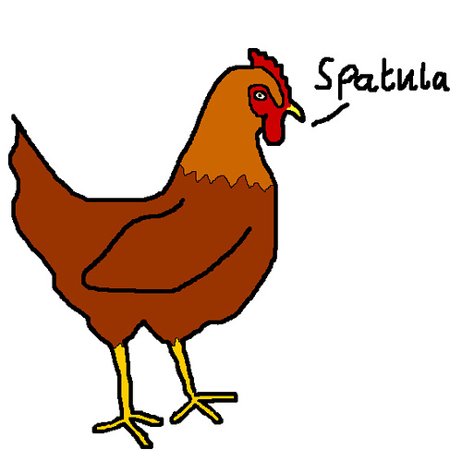
Randomness
The concept of randomness is incredibly important to data science
Without the concept of randomness, statistics wouldn’t exist!
What is randomness?
Informally: Different stuff happens each time
Slightly more formal: A set of outcomes, each assigned a specific probability

Slide 6

Coin Example
Two Outcomes – Heads and Tails
Probability of each outcome:
Heads = 50% of the time = 0.5 probability
Tails = 50% of the time = 0.5 probability
Probabilities must sum to 1 (100%)!
This Photo by Unknown Author is licensed under CC BY-ND

Slide 7
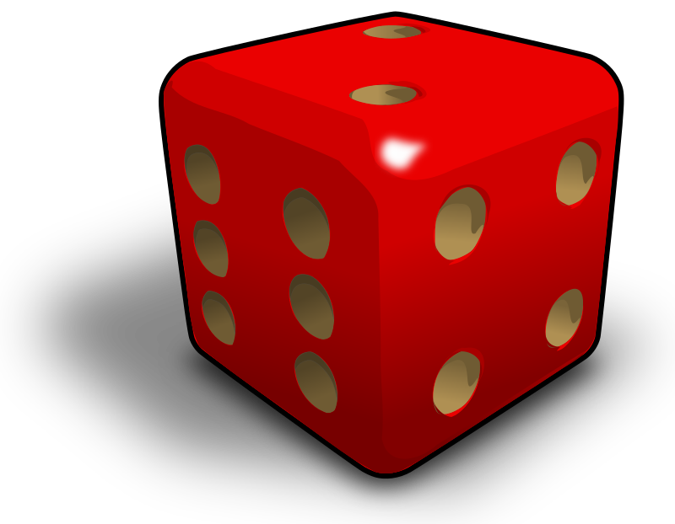
Dice example
Six outcomes 1,2,3,4,5,6
Each outcome has probability 0.16666666

Slide 8
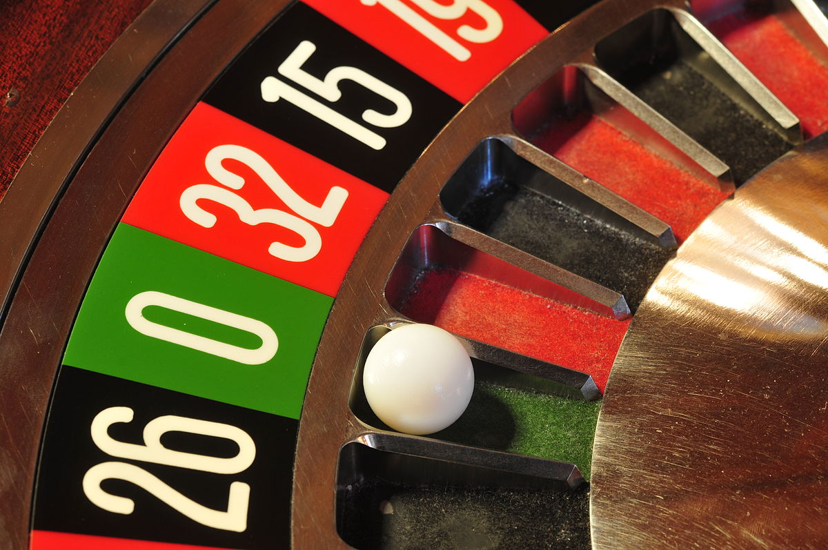
Getting a randomly-chosen int in Python
import random ← Goes at the top of your code
random.randrange(a,b)
Gives a number between a (inclusive) and b (exclusive)
Assumes all numbers have the same probability
Note: Much better style than randint
Demo -dice
This Photo by Unknown Author is licensed under CC BY-SA

Slide 9

“Pick an random element from a list”
Very common task
Could do rand.randrange(0,len(myList)) as use that as the index
This is so common Python makes it easy
random.choice(myList)
Another fun one:
random.shuffle(myList)
Note: does not return anything, shuffles the
passed-in list

Slide 10
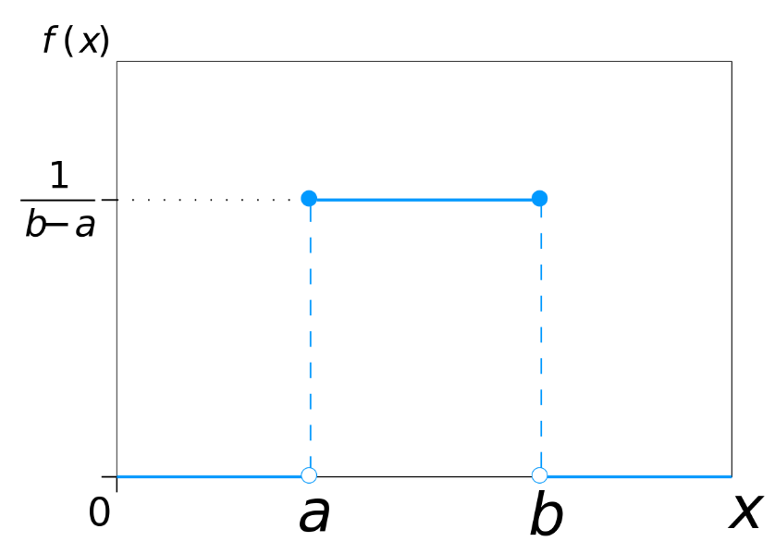
How about floats?
random.random()
Probably #1 most used random function
Returns random float between 0 and 1
Conceptually a bit more difficult to understand
Infinite set of outcomes
Called a uniform distribution, - no region is weighted higher than any other
random.uniform(a,b) – more general case
This Photo by Unknown Author is licensed under CC BY-SA

Slide 11

“Do something with 0.8124 probability”
Hmm… there isn’t a function in random that will do this directly! ☹
Any ideas?
Use random.random()!
If random.random() < 0.8124:
Do something
This Photo by Unknown Author is licensed under CC BY-ND

Slide 12

Final note
Not truly random – computers are inherently deterministic!
Called pseudorandom – to get a “random” number, takes an initial number (called a seed), then does a bunch of complex computations on it
Seed is usually clocktime (different every time)
For testing/reproducibility, sometimes want the same every time
Can use random.seed(number)

Slide 13
Lab out
Practice with randomness AND dicts of lists

