Slide 1

DATA/CS 172: Python for Data Analysis
APIs
Prof. Travis Mandel
10/21/2024

Slide 2
Announcements
Lab 13 due today
Program 2 out Wednesday

Slide 3

Last time: JSON
Like Python variables (dicts, lists, etc.)
Can represent complicated nested structures
Easy to load and dump given Python variables
Some small differences to be aware of

Slide 4

Where does JSON data come from?
Well, they could come from anywhere…
But #1 place they come from is calls to Web APIs!
What is an API?
API stands for Application Programming Interface
Sounds complicated
Reality: Basically a set of functions provided by a website
“Information hiding” again – but to a greater extent!
Request (Calling a function) ex: getDate()
Python code
Webserver (https://google.com, etc)
Response (return value) ex: 10/21
Notes:
For example, the astronauts demo was pulled live from:
http://open-notify.org/Open-Notify-API/People-In-Space/

Slide 5
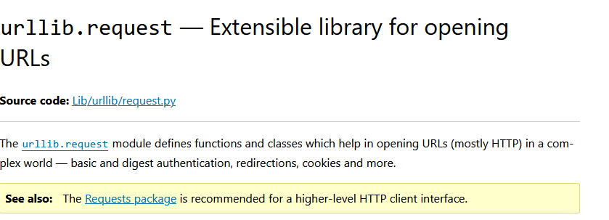
Communication over the internet
To make an API request, need to send info over the internet
Problem: Python: built in support is limited
Urllib.requests not very popular – even the documentation recommends against it
Solution:
Install module via pip

Slide 6

Installing via pip
Let’s say I want to use a library that I don’t have installed
Import requests
Need to use “pip” to install
Windows “cmd”/”Command Prompt” Mac: Terminal
Type “pip install requests”
Pip not found?
Type “where python” (Windows) or “which python” (Mac/Linux)
Might show C:\Python312 or something else
Need to run PythonDir/Scripts/pip
All else fails? See instructions on Laulima (beginning of Modules) about installing pip

Slide 7
Requests module
import requests
response = requests.get(url)
Makes a request to the URL
URL is something like https://www.google.com/careers
See demo for real-world examples
Uses HTTP or HTTPS
Hypertext transfer Protocol – a way of formatting web requests and responses
The S stands for secure – recommended where possible

Slide 8
Common HTTP Status codes
After the request, can get the status code with response.status_code
Common codes:
200 – OK
304 Not Modified
400 Bad Request
403 Forbidden
404 – Page not found
500 – Internal Server Error
Very important to always check this in case something has gone wrong!
Webserver could go down at any time
If it is a bad code, ideal to print response.text in case server has more information on the error

Slide 9
Parsing the response
Response.text gets the string text
Can load this with function (learned last time)
json.loads()
Note: Many sources suggest the following instead:
response.json()
NOT recommended in my opinion/experience – do not use
Why? If it is not JSON-formatted, will crash with a nasty error without even letting us see the text!

Slide 10
API Keys
Most APIs require you to provide a key that you obtain from them first
Every request has to send this key
Usually requires signing up (sometimes requires credit card number!)
Usually have limits or charges
Why?
Server time/resources cost $
Getting data from websites is valuable (and becoming more so)
Need to prevent cyberattacks
Denial of Service (DoS) – keep making huge number of API requests
Important note on API Keys:
API keys should NOT be hardcoded
Especially not in code anyone else is going to see (on Github etc.)
This could have disastrous consequences
Solution: store in a separate file which is not uploaded anywhere

Slide 11
Q: How can we send API Keys?
This requires sending information from Python to the server
There are three ways to do this!
Covered in next slides
Many websites may only accept 1-2 of the three ways – need to read API documentation

Slide 12
Method 1 of passing information
Params in URL
First one begin with a ?, separated by &
Each one generally specified as key=value
Example:
https://api.phonevalidator.com/api/v3/phonesearch?apikey={APIKEY}&phone={PHONE}&type=fake,basic
What exact keys/properties do I need to specify?
Need to check the documentation (these are essentially arguments to the function)
Benefits:
Easy to build url string yourself
Although, it is recommended to let requests handle this for you
Parameters = {“apikey”: “APIKEY”, “phone”:”PHONE”, “Type”:”fake, basic”}
Then add params=parameters to API call
Drawbacks:
Difficult/annoying to send large amounts of information

Slide 13
Method 2 of passing information
What if we need to send longer information to the server?
POST
Requests.post(url, data=variable)
Form-encodes variable (No JSON)
OR
Requests.post(url, json=variable)
JSON-encodes variable
Same as data=json.dumps(variable) and then setting a header (see next slide)
Which one you use depends on documentation
Similar to params variable should generally be a dict mapping name to value
Check documentation for key names
REST/RESTful API generally refers to an API that uses HTTP GTE, POST, etc to access resources via URLs in a way that satisfies certain requirements
Probably most important is that a RESTful API should generally be stateless
Re-doing the same API request should return the same result
Example: Requesting “next page” not good practice compared to “requesting page 6”

Slide 14
Method 3 of passing information
Headers!
Headers get sent with each request to the server
Generally contain initial information, such as what format the response is in, etc.
Sometimes needs API key or other information passed as a header
Similar way to specify
head = {"Content-Type": "application/json"}
requests.post(…, headers=head)

Slide 15
APIs for AI
APIs have been around for decades…
Idea started in ~2000 and has only gained steam since
APIs are a great way to access web datasets, especially ones which update frequently
Why am I just discussing APIs this semester?
AI, especially Large Language Models (LLMs)
Many of the best models too large to run on end machine
Need to be run “in the cloud”
Require APIs to integrate into your code
See the lab!

Slide 16
Lab out
Practice with APIs

