Slide 1

DATA/CS 172: Python for Data Analysis
Intro to matplotlib
Prof. Travis Mandel
10/23/2024

Slide 2
Reminders and Announcements
Program 2 out
Should be able to do now – uses your CSV, API, etc. skills
Have quite a while to work on it
Keep on top of labs

Slide 3
Today
Basics of data visualization

Slide 4
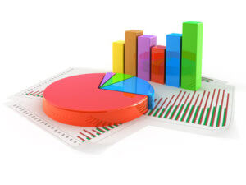
We’ve worked with many different kinds of data…
Text Data
More recently:
CSV Data
JSON Data
But we have just been able to spit out basic facts about the data
A big part of data science is how to communicate complex data to non-data-scientists….
We need visualization
Graphs, charts, etc.

Slide 5
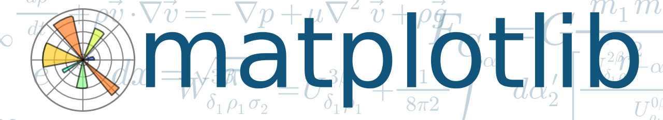
matplotlib
Python plotting library
Around since 2002, really started taking off when people started using Python for data science
There are other Python Plotting libraries
Matplotlib definitely still #1 in Python graphing
Can do many kinds of powerful plots
Chapter 15 in Crash course book
Online documentation may be more helpful

Slide 6
Installing matplotlib
Need to do this locally
pip install matplotlib
From local command line (cmd or Terminal)
Test by running “import matplotlib” in interactive mode

Slide 7
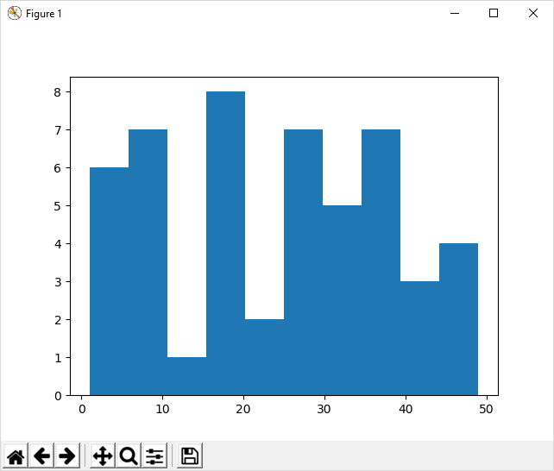
A basic histogram
Import matplotlib.pyplot as plt
So you don’t have to type the name every time – very common
plt.hist(<list of values>)

Slide 8
Showing the figure
plt.show()
Pops up a window with the figure
Script pauses until window is closed
Later commands DO NOT execute

Slide 9
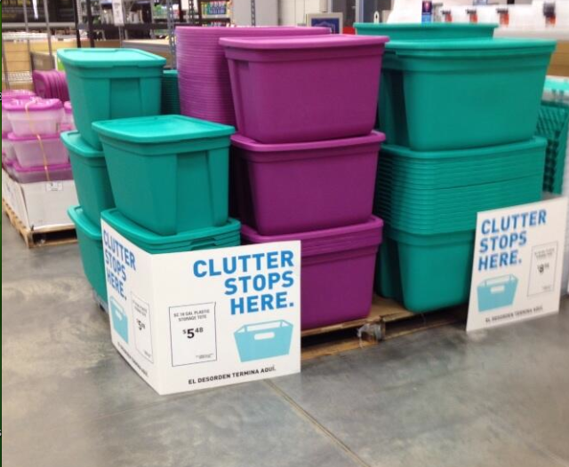
Changing number of bins
plt.hist(<numbers>, bins=<number of bins>)

Slide 10
Adding axis labels
plt.xlabel(“X Label”)
plt.ylabel(“Y Label”)
plt.title(“Title”)

Slide 11
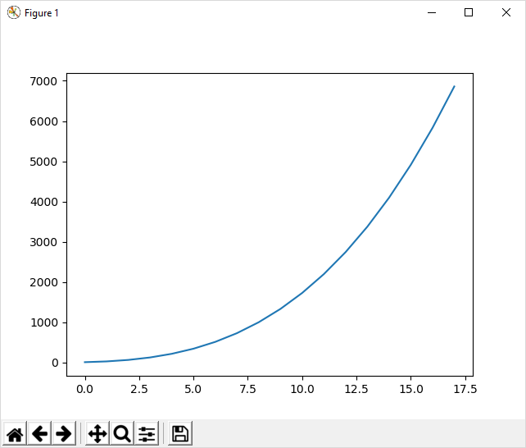
Next up: Line graph
plt.plot(yValues)

Slide 12
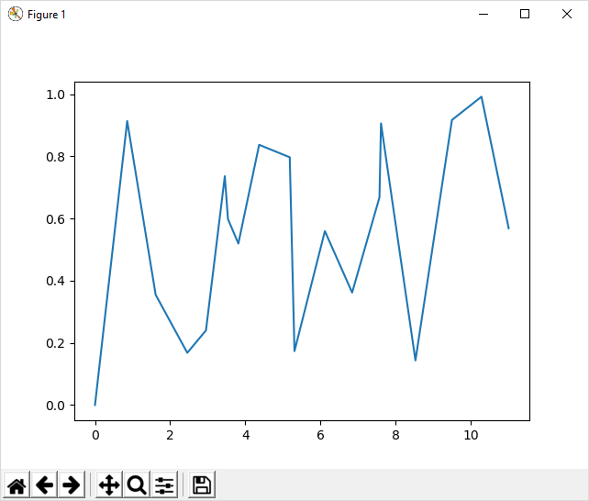
X & Y line graph
By default, xs appear at 0,1,2,3,4,5,6,7,8,9
Often not what we want!
plt.plot(xs, ys)

Slide 13
Changing axis ranges
plt.xlim([0, 100])
Sets x form 0 to 100
plt.ylim([0, 10])
Sets y from 0 to 10

Slide 14
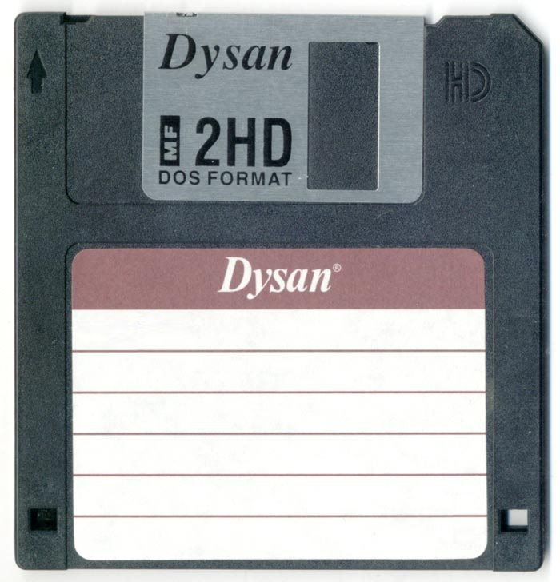
Saving figures
Can manually save by pressing the disk icon
Inconvenient
plt.savefig(“filename.extension”)
Relies on file extension
Can save in rasterized formats (png, jpg)
Or in vector graphics (svg, pdf)
Infinitely zoomable/no pixelation
Often best for papers, reports, etc.

Slide 15
Lab out
Make your first graph
Based on CSV data – refer to last Wednesday’s lecture if you don’t recall how to do this
Friday: More matplotlib!

