Slide 1

DATA/CS 172: Python for Data Analysis
Matplotlib Part III: Multiple plots and more
Prof. Travis Mandel
10/28/2024

Slide 2
Announcements
Keep on top of labs
Start on Program 2

Slide 3
Today
A few more tips with single plots
Figures and subplots

Slide 4
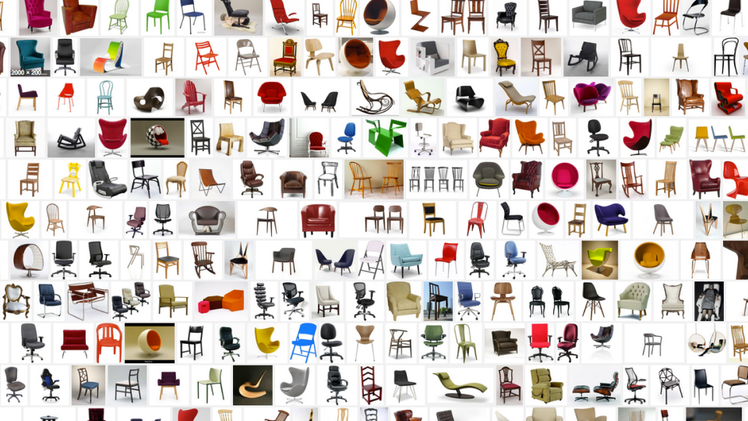
Last time, we saw how to make bar charts…
They looked pretty good (especially if we have a single type of bar)
But what if we have a lot of categories on the x-axis?

Slide 5

X rotation
Best way to fix this is by rotating the x labels
plt.xticks(…, rotation=degrees)
If you have a TON of labels, degrees=90 may be your best bet
If just a slight amount, should not go that extreme (takes up a lot of space)

Slide 6
Problem #1
With a lot of long labels, and degrees=90…
The graph is cut off!
How can we see it?
Need to add plt.tight_layout() to resize view box
Before showing/saving

Slide 7

Problem #2
If we choose a lower angle- hard to match up label to bar
Solution: Change horizonal alignment (ha keyword arg to xticks)
Default is ‘center’, but should chose left or right
Right may make more sense

Slide 8
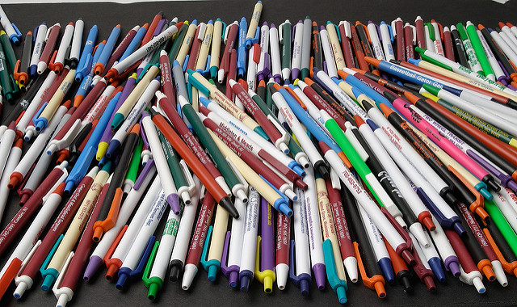
Another issue…
So far, we have called plt.show() after every graph
Or done plt.savefig on a single graph
What if we call plt.savefig on multiple graphs?
E.g. script to generate result graphs for paper
Leaves the old graph on top of the new one!
Need to use plt.cla() & plt.clf() to clear graph
This Photo by Unknown Author is licensed under CC BY-SA-NC

Slide 9
Multiple plots
Often it can be useful to present multiple graphs
Side-by-side
In a grid layout etc.
To do that in matplotlib, the outer thing is called a figure
And the inner thing is called a subplot
subplot
Axes
figure

Slide 10
How do we set this up?
Step 1: Decide what our grid is going to look like
numRows
numColumns
Step 2: create a new figure with those subplots
(fig, axes) = plt.subplots(numRows, numColumns)
Step 3: get the axis of interest
axes[rowIndex, colIndex]

Slide 11
Drawing on subplots
The subplot commands returns axes
Commands should be run on the appropriate axes object instead of plt:
Ax1 = axes[rowIndex, colIndex]
Can then run most plt.* commands on the Axes
ax1.plot(…)
ax1.bar(…)
Some of them need to be prefixed with set_
set_title()
set_xticks()
Works like plt.xticks()
set_xticklabels() [Highly Discouraged]

Slide 12
Adjusting spacing
Default spacing is pretty generous
Can be a problem if you’re trying to cut down on space (for a paper etc.)
fig.subplots_adjust(wspace=0.1, hspace=0.1)
shareaxes = true

Slide 13

Changing size of a figure
plt.subplots(numRows, numCols, figsize = (xInches,yInches))
Matplotlib assumes dpi of monitor
If we know dpi can do better:
plt.subplots(numRows, numCols, figsize = (10,8), dpi =96)
This Photo by Unknown Author is licensed under CC BY-SA

Slide 14
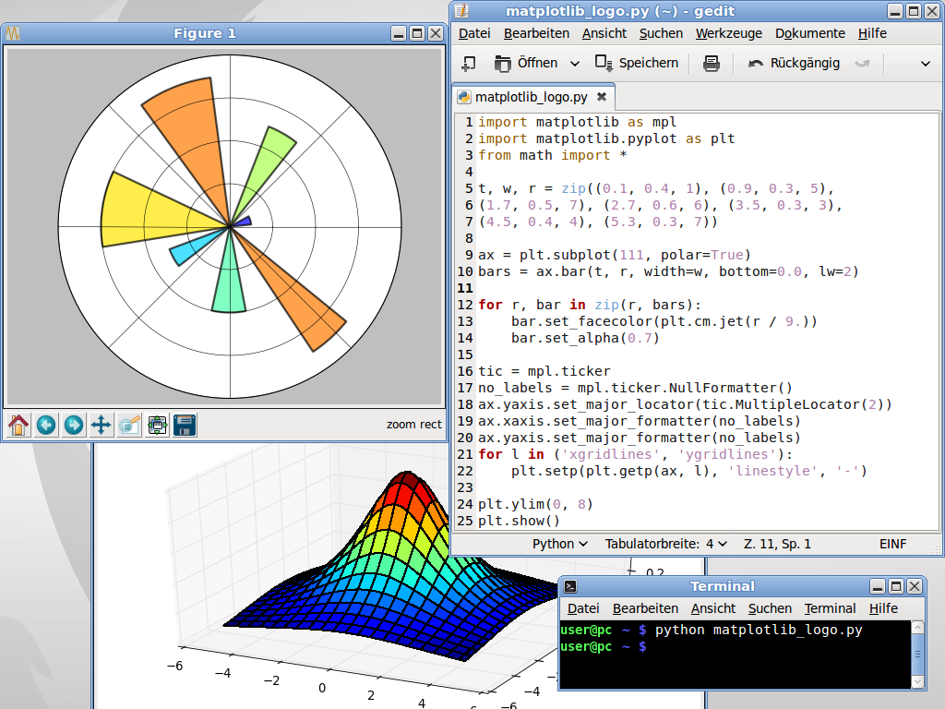
Recap
Matplotlib can do a LOT of stuff
We covered just a small fraction of what it can do
Really good for generating high-quality, customizable graphs with ease
Feel free to look up the documentation and learn more types of graphs etc.

