Slide 1

DATA/CS 172: Python for Data Analysis
Data Files in Python
Prof. Travis Mandel
8/30/2024

Slide 2
Reminder
Monday is a holiday
No class
Today is the deadline for applying to the AI research assistant position
Send me an email with transcript, a paragraph about why you’re interested, a paragraph about your experience, and what modality you would prefer

Slide 3
Today
Comment wrap-up
Basics of loading data into Python
Basics of writing out processed data with Python

Slide 4

Multi-line comments
Last time we learned comments start with #
Advanced: can (kind of) do multi-line comments with three quotes ‘’’
Demo

Slide 5

Supposed to be a class on Data Analysis with Python…
Have not touched any data yet!
LOTS more to learn about Python
Don’t worry, we’ll get to this
But since this is a data science class, we need to get started with data right away!

Slide 6

Where does data come from?
Hard coding
Usually, not good!
User typing it in by hand
Example: print(“What’s the current rainfall reading?”)
Not very common:
Doesn’t scale to a lot of data
If they type interactively, difficult to reproduce
Data files
Web APIs
Databases

Slide 7
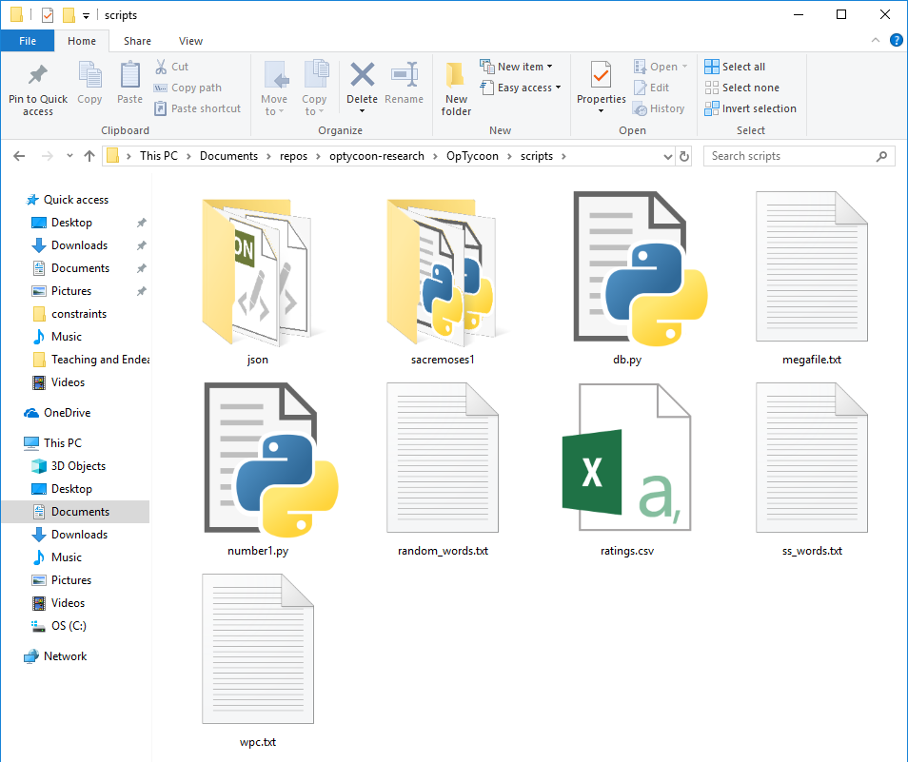
Data Files
Stored somewhere on disk
Could be in any format - .txt, .xlsx, .csv, .json, etc.
We’ll talk about more advanced formats later- for now just assume text (.txt)
Two important things
Reading: Get all the text out of the file ← Important term!
Writing: Put new stuff in the file ← Important term!
Why could writing be important in data science?
For example, processing data before handing it off to someone else
Original File → Python Script → Processed file

Slide 8
Steps to working with a file
Step 1: Open the file
Step 2: Read (or write) the contents of the file
Step 3: Close the file

Slide 9

Step 1: Open the file
myfile = open(“example.txt”, <mode>)
What is <mode>?
“r” - read
“w” – write, and if not there, create
w overwrites anything there already
“x” – similar to “w”, but give error if file already exists
“a” – append output to end of file (useful for logs)
Remember these!

Slide 10

Step 2: Reading/writing
Read the file
contents = myfile.read()
Reads the whole file into the contents variable
Probably not what we want with big files… we will soon learn better ways to read files!
Or…Write to the file
Seems similar to printing
print(“Hello file”, file=myfile)
The file= should always be the last thing in the print
There’s an old way called “write” but it is not usually a good idea
Remember: The file has to be in the right mode for what you want to do!
Doesn’t usually make sense to read and write at the same time

Slide 11
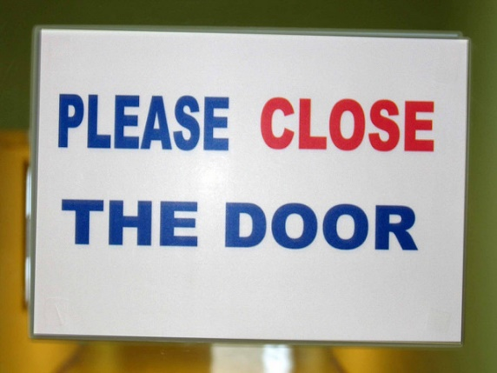
Step 3: close the file
myFile.close()
Very important: If file left open it can prevent others from accessing it!
So (in general) files should be closed as soon as possible

Slide 12
Demo

Slide 13

Another way
Forgetting to close is a nasty problem
Some people prefer to use “with” style so they don’t forget
with open(…) as f:
contents = f.read()
No need for close because can’t use f outside the indented lines!
The indent is important!
Doesn’t work in every situation, but can be pretty handy

Slide 14
Important note
What if we want to read a file multiple times?
Why would you want to do this? Sometimes it’s more efficient way to write code
But this is a bit tricky….
Idea1:
f = open()
contents = f.read()
contents2 = f.read()
Doesn’t work! See demo for solution

Slide 15
Lab 2 out!

