Slide 1

DATA/CS 172: Python for Data Analysis
N-D arrays and images
Prof. Travis Mandel
11/4/2024

Slide 2
Announcements
Stay on top of labs
Should be working on Program 2

Slide 3
Today
Multi-dimensional numpy arrays

Slide 4
Multi-d numpy, so far
Arr.shape
Indexing with arr[firstIndex, secondIndex]

Slide 5
Slicing
You can still slice on multi-dimensional arrays! Just get to pick which dimension you slice on!
Arr2d[:,1] gets everything in the second column
Arr2d[:3,:3] gets the upper left corner 3x3
Arr2d[:] is shorthand for arr2d[:,:]
Good style to put in : for the dimensions you want everything on
3
3

Slide 6
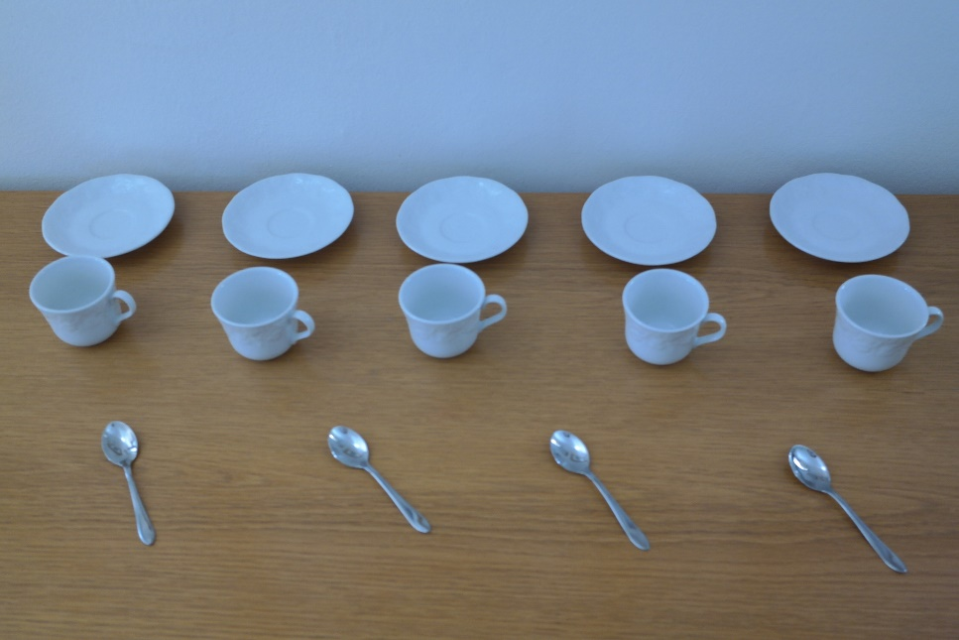
Operations
As with 1D arrays, operations apply to all elements
arr2d *2 doubles all elements
As with 1D arrays, operations across arrays work element-wise
Assuming they are the same size, arr1 * arr2 does arr1[0,0] * arr2[0,0], arr1[0,1] * arr2[0,1], etc.
As with 1D arrays, can apply operations to a slice and have it apply to all elements of that slice

Slide 7
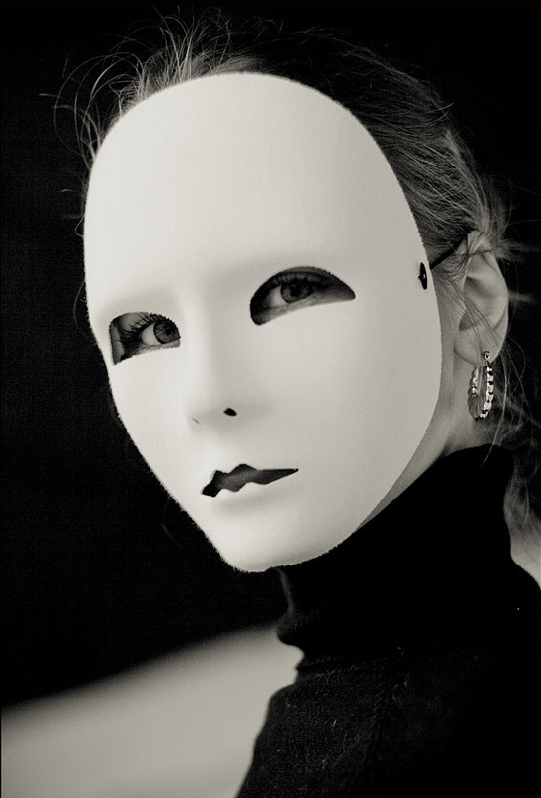
Boolean filtering/masking/indexing
Sometimes we want to apply an operation only to certain elements
Slices can help us apply to certain indexes, but not to certain values…
Can create a Boolean filter/mask
dogfilter = (arr == ‘dog’)
Array of booleans
arr[dogfilter] = ‘cat’ ← changes all dogs to cats
Can use <. <=, etc
Want to combine with logic?
Careful – and & or don’t work
Need to use bitwise symbols
& = and
| = or
~ = not
Example: ((arr > 6) & (arr < 10))
Note: need parentheses!

Slide 8

Reshaping
Frequently a library will take one shape (e.g. 1D array) when you have another shape (e.g. 3D array)
arr.reshape((newRows,newCols,…))
Defaults to row-major order: walks through first row, then second row, etc.
Does not make a copy
Shorthand for flattening down to 1D is called arr.ravel()
arr.flatten() also exists but it makes a copy (want to avoid)

Slide 9
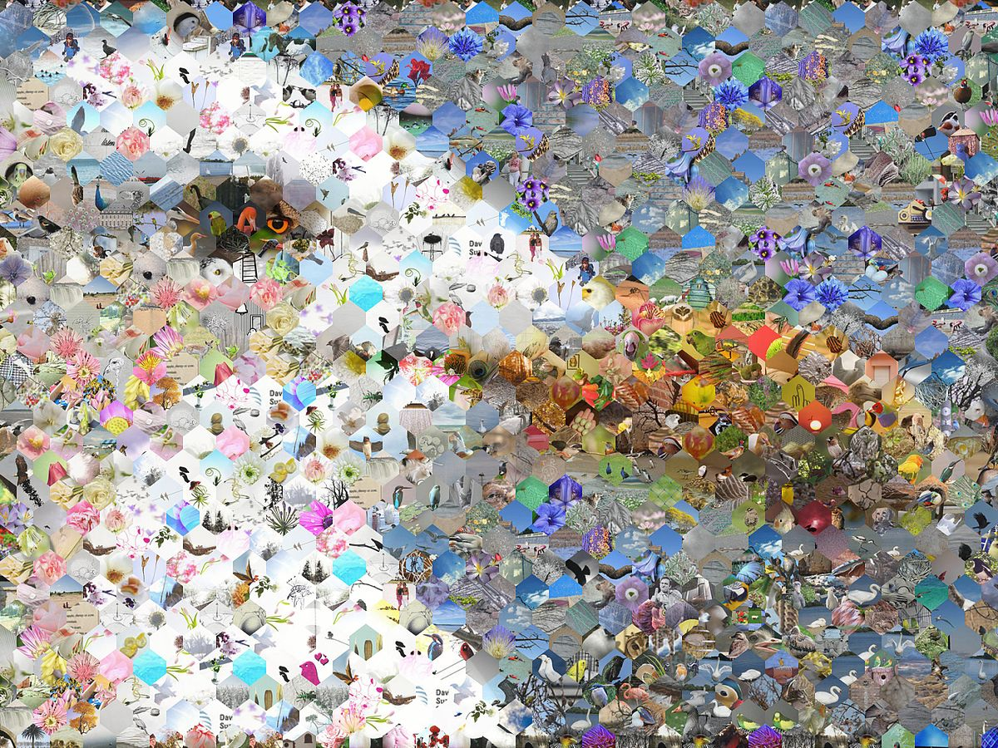
Images
So far we have talked about text data, CSV data, JSON data
What about image data?
Image data is large and has multiple dimensions
Therefore, in Python, we almost always work with images as multi-dimensional numpy arrays!

Slide 10
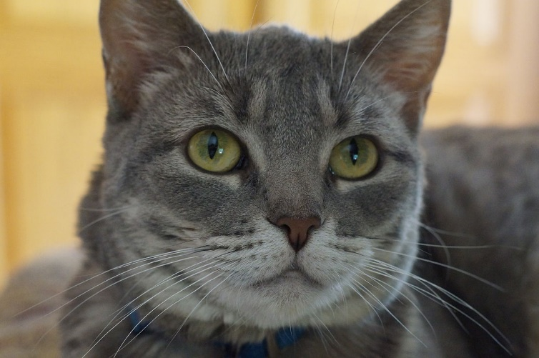
Loading images
Wait… why would we model an image as a 3D array?
To read:
import matplotlib.image as mpimg
img = mpimg.imread("cat2.png")
To show:
import matplotlib.pyplot as plt
plt.imshow(img)
plt.show()

Slide 11
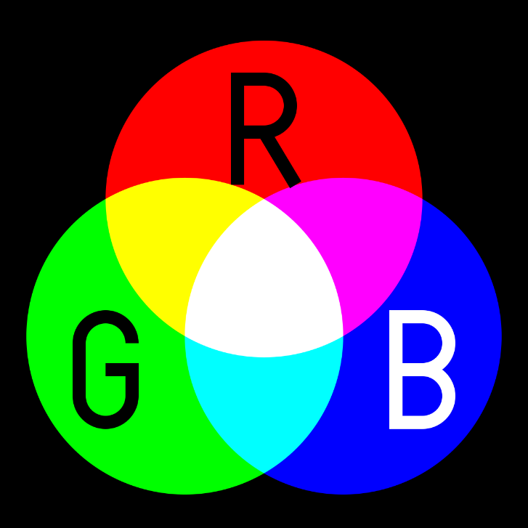
What is the shape?
Why 3d?
Red – either between 0-255 (as int) or 0-1 (as float)
Green – either between 0-255 or 0-1
Blue – either between 0-255 or 0-1
Should be in this order
Darken an image – multiply by a small value
Need to make sure it doesn’t go out of range – can be a problem with lightening

Slide 12
Lab out
Practice using numpy arrays to manipulate image!

