Slide 1

DATA/CS 172: Python for Data Analysis
Jupyter notebooks
Prof. Travis Mandel
11/6/2024

Slide 2
Reminders
Stay on top of labs
Make progress on Program 2
Office hours today 12:30-1:30pm
Teaching Demo 5-6pm (including discussion of numpy arrays!)
Will send Zoom link on Discord
Test next Wednesday
Review Friday
(Monday is a holiday)

Slide 3
Today
Jupyter notebooks

Slide 4
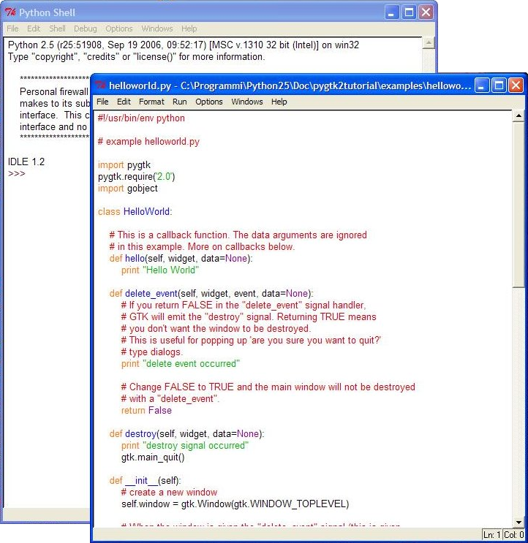
So far, we’ve been editing our code using IDEs
For example, IDLE
Makes some things nice
Easy to run code, simple, error indications
But showing graphs, etc. is a bit of a pain
Some of the data science community has gravitated towards an alternate solution
One that makes Python code easier to create, share, and run
More accessible to non-programmers
Jupyter!
The key element of Jupyter is called the Jupyter notebook
This Photo by Unknown Author is licensed under CC BY-SA

Slide 5
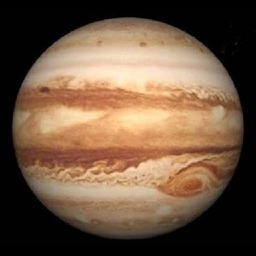
Jupyter: Many ways to access
Way 1: Install locally (not recommended)
pip install jupyter
Open command line, type “jupyter notebook”
If it doesn’t work, run similar to how you run pip
Opens up in a browser
Click New→ Notebook → Python 3
Way 2: JupyterLite
The easiest way - recommended!
NEW – started being an option in 2022
Runs entirely in the browser – nothing to install!
Go to https://jupyter.org/try-jupyter/lab/
Click on Python (pyodide) under “Notebook”
Way 3: Use Google Colaboratory
Go to Google Drive
Click New→More→ Google Colaboratory
For UH, need to enable external apps on your account
For personal account, need to install the app in Drive
Notebook will run
In either case, double click title to change filename

Slide 6




IPython
Stands for interactive Python
Write some Python code
Press shift-enter (or click or or ) to run it.
But wait, we saw interactive mode in Python the second day of class!
This seems super similar
Has some fun additional features…

Slide 7
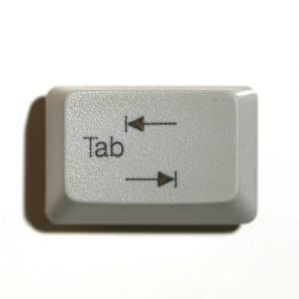
IPython feature: Tab completion
Type part of a variable name, then hit tab – it will autocomplete
Or type variable name then . and <tab>, to see what you can do with it (append to a list for instance)
For this last one, must have run code where it was initialized first

Slide 8
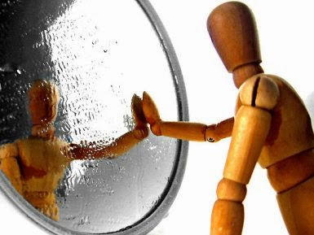
IPython Feature: Introspection
Hit ?<variable name> to see information about the variable
What type it is
The values
The length
Etc.

Slide 9
Downloading/Saving notebooks
JupyterLite: Right Click File → Download
Jupyter: File→ Save and Checkpoint
Colaboratory: File → Download ipynb
Creates a .ipynb file In the directory you ran the command from
This is a self-contained file
Also contains the output from the latest run – helpful if you want someone else to see what output you got

Slide 10


Jupyter feature: Running snippets of code
What if I want to change something above?
Need to re-run that piece of code
Jupyter “remembers” what has been done in each previously-run block
Jupyter allows you to run code blocks in any order
Warning: Can mess stuff up if run pieces of code out of order
Can be annoying/confusing
Can use up and down arrows to re-order blocks.
Can press or or to run just single snippet,
or or to run all blocks

Slide 11

Jupyter Feature: Graphs
Doing graphs in matplotlib is a bit of a pain…
Have to do plt.show() which halts execution
Or plt.savefig() which saves a figure, then have to open it up etc.
Jupyter allows us to combine graphs with code!
Can show graphs on screen right next to the section of code that generates it
No need to do plt.show() – Jupyter will auto-display results from plt.plot() etc.
Used to need “%matplotlib inline” for this, but no longer needed
Note: May take a bit longer to run (especially the first time) - * shown while processing
plt.show() will remove the annoying “Line2D” thing though
But does not stop the code from continuing!
One of the biggest reasons Jupyter is popular for data science

Slide 12

Jupyter feature: Interspersing Headings, text, and equations
Select “Markdown”,
“raw markdown,”
or “Text” then:
# Top level Heading
## Second level heading
Text
Select raw markdown to write freeform text
Often a replacement for block comments – describes what we are doing & why
Run to finalize, double-click to edit
Can include LaTeX equations
$x^2$
$\sqrt{x}$
$\frac{x_0}{x_1}$
Don’t expect you to learn Latex in this course…
But at some point you really should.. Makes formatting long scientific documents much easier
Can even include HTML tags and links (<a href=“”></a>) etc.

Slide 13
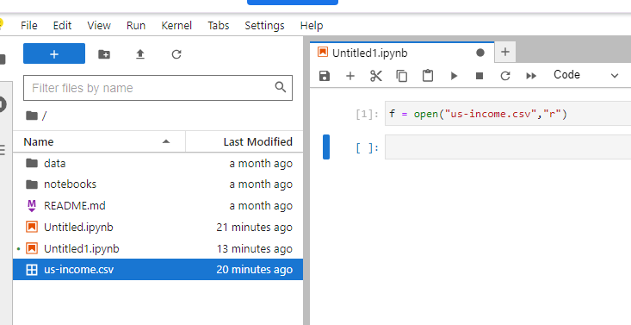
Loading data
JupyterLite:
Drag and drop to data folder (left hand side)
Then can open as normal
May have trouble with certain Firefox installs (works fine in Chrome)
Uses browser storage to save files (NOT good for larger files – there is a limit of 50MB)
Jupyter notebook:
Will look for data in the same folder that you ran the “jupyter notebook” command from
Colaboratory:
This is more difficult, unfortunately
Similar to JupyterLite, but data deleted frequently
This is due to the fact that Colaboratory is run on Google’s servers
Google Drive is another option, but requires
other code + permissions

Slide 14
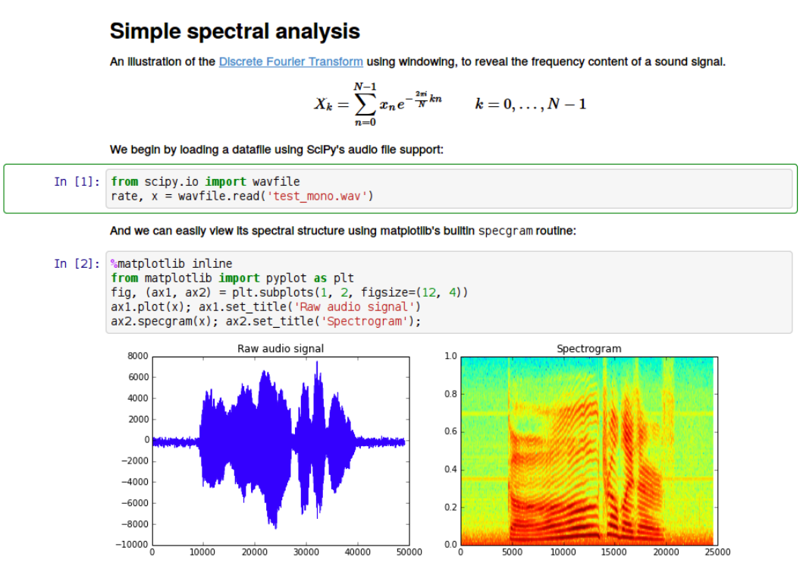
When it’s all put together
It’s effectively an interactive report!

Slide 15
Lab out
Creating a simple Jupyter notebook
Can use any method but I think JupyterLite is the easiest!
Next up: Review and Test 2

