Slide 1

DATA/CS 172: Python for Data Analysis
Understanding Types
Prof. Travis Mandel
9/4/2024

Slide 2
Announcements
Lab 1 due today
Reminder for lab 2: Careful not to hold files open too long!
Also, probably not good to open/close files more than we need to
Opening/closing a file takes time

Slide 3
Agenda
Variable Types
String basics
Type conversion

Slide 4
Variable Types

Slide 5
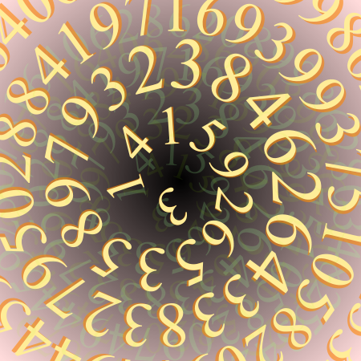
Variable Types
So far, our variables have mostly represented numbers…
Remember from math that there are different types of numbers
Integers, real Numbers, Complex Numbers, Rational Numbers etc.
In python, there are three common basic types for a variable ← Important term!
int, float, str
There are others (booleans, complex types), we’ll talk about later

Slide 6
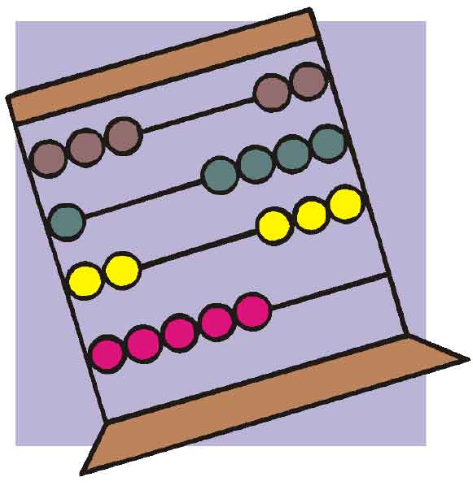
int
Short for integer
Examples:
-1
367
3000
Note: Must omit commas! 3,000 not an integer!
Basic arithmetic (+,-,*,/) work as expected
Until you start working with really large numbers

Slide 7
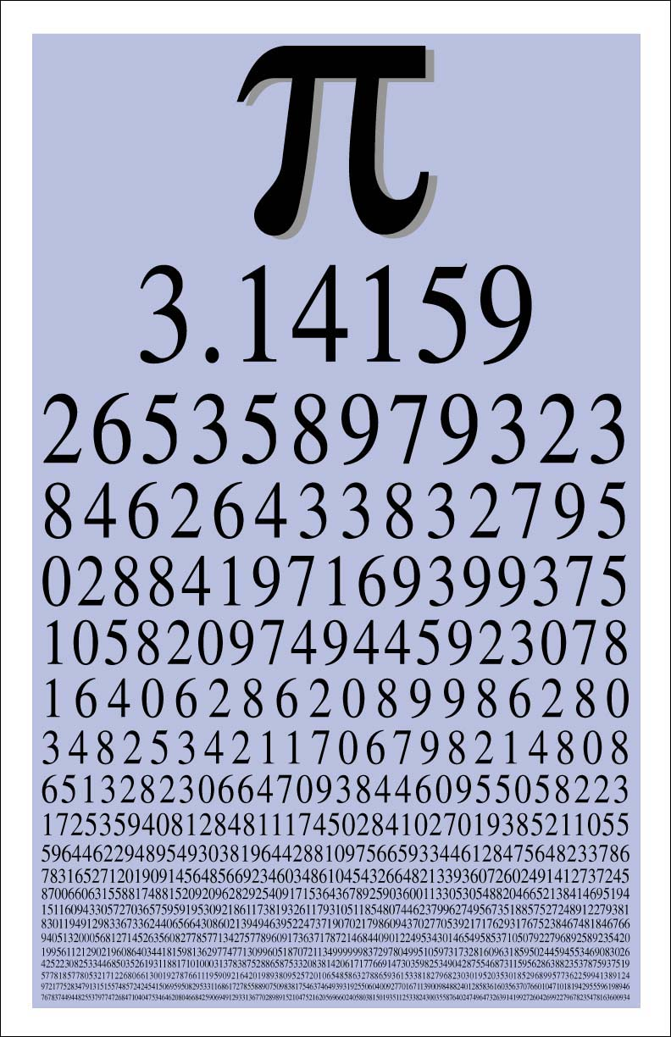
float
Short for floating-point number
Note for C++ programmers: equivalent to double
Can represent really large or small numbers
Examples:
-1.89423
367.0
0.0000000000000000000001
Infinity - float(“inf”)
Infinity is not a number – bad style to use this in code!
math.inf is just as bad
NaN – float (“nan”)
Short for “not a number”
Can sometimes result from mathematical operations
Example: float(“inf”)/float(“inf”)
Can wreak havoc but shouldn’t usually be a problem
if avoid inf
This Photo by Unknown Author is licensed under CC BY-SA

Slide 8

str
Short for “String of Characters”
Example – “hello” is a string of 5 characters
Those things enclosed in quotes
Unlike some languages, fine to enclose in single(‘) or double(“) quotes
If you have quotes inside your string, you need to be careful here
‘Here’s a string’ ← Not okay
“Here’s a string” ← Okay
‘This is a “nice” string’ ←Okay
“Here’s a “nice” string” ← Uh oh, how do I fix this?!
This Photo by Unknown Author is licensed under CC BY-SA-NC

Slide 9

Strings and special characters
Backslash allows you to escape special characters like quotes
Also allows you to put other characters in string
Line break (aka newline) - \n
Tab - \t
Can also be used with quotes
Demo
Hmm, haven’t we shifted the problem back? What if I want to put a backslash in my string?
Right - \\
Much more you can do with strings – we’ll talk about this later
If you work with text data all this will be key
This Photo by Unknown Author is licensed under CC BY

Slide 10

How does Python know which type my variable is?
Based on the value!
What type is 3?
Right! So if I write a = 3, Python knows the type of a is int!
How about a=3.14?
How about a=“hello world”?
How about a=“3.14”?
How about a=hello?
This Photo by Unknown Author is licensed under CC BY

Slide 11

Note: unlike other languages…
Python’s type system is fairly weak
Almost “anything goes”
A variable’s type is not fixed!
a=2
a=“hello”
Perfectly fine!
In a strongly typed language like C++, this would never work!
Usually bad style, but switching between floats and ints is fine
Good rule of thumb: If in doubt, add more variables
Keeps code readable

Slide 12

How to convert types?
In python, type conversion is very easy ← Important
term!
nameOfType(variableYouWantTochange)
Example:
a = “1”
b = int(a) + 2
print(b) //prints 3

Slide 13
Why convert?
Operators mean different things depending on type!
Great example: +
Demo
+ on numbers is called addition (duh)
+ on strings is called string concatenation ← Important term!
Different strings joined together
Careful: comma , seems similar but only works in print()
Demo
Another reason: data!
By default, values are read from files as strings
May need to convert them to numbers
By default, can only write strings to files
Need to use the str() cast to convert whatever we have to a string

Slide 14

Things can go wrong when converting…
int(“hello”)
Demo
We get an error: how can we handle this?
Error handling with try/except! ← Important term!
try:
int("hello")
except ValueError:
print("error converting to int!")
Often we will want to exit on errors
import sys at the top
sys.exit(exitcode) (demo)
Usually an exit code of 0 means success, anything else failure ← Important term!
This Photo by Unknown Author is licensed under CC BY-SA

Slide 15
Lab 3 out
Feel free to use lab 2 as a starting point

