Slide 1

DATA/CS 172: Python for Data Analysis
If Statements
Prof. Travis Mandel
9/6/2024

Slide 2
Reminders
Lab 1 final deadline today
Lab 2 due today
Please seek out help if you are confused about anything!

Slide 3
Agenda
Bools
Logic
If statements

Slide 4

Right now…
Our scripts run top to bottom
Every line runs every time
What about conditionals/ branches? ← Important term!
If something then do thing 1, otherwise do thing 2
Example: Data might have values that don’t make sense, if we detect one of these we should handle things differently
But what can we write for something?
Needs to be a True or False: Boolean!
This Photo by Unknown Author is licensed under CC BY-SA

Slide 5
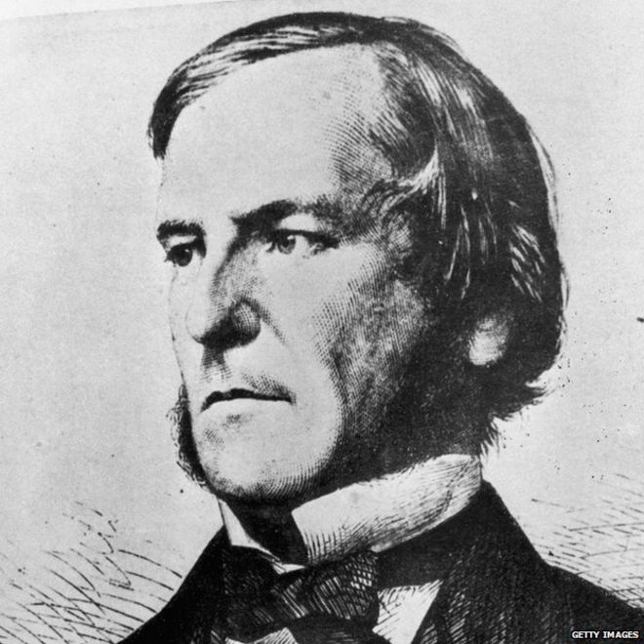
bool type in Python
Short for Boolean ← Important term!
Basis of logic, named after George Boole, one of the great grandfathers of computing
Has two values
True
False
Note the capital letter, different from most other languages!
This Photo by Unknown Author is licensed under CC BY-NC

Slide 6
Comparison operators
<
Less than
>
Greater than
==
Equals
!=
Doesn’t equal
<=
Less than or equal to
>=
Greater than or equal to

Slide 7

Single vs Double Equals
In math, there is one meaning to the equals sign
Expresses the relationship that two things are equal
In computer science, there are TWO equals signs
= used for variable assignment
a = 6 puts the value 6 into the variable a
== used for value comparison
a == 6 evaluates to True if the variable a has the value 6, False otherwise
Very important to keep these straight when programming!

Slide 8

Basic Boolean expressions: comparisons
Demo
(6 < 7)
Evaluates to True
(5 >= 6)
Evaluates to False
6 = 6
No! Assignment!
6 == 6
Evaluates to True
7 != 6
Evaluates to True
This Photo by Unknown Author is licensed under CC BY-NC-ND

Slide 9
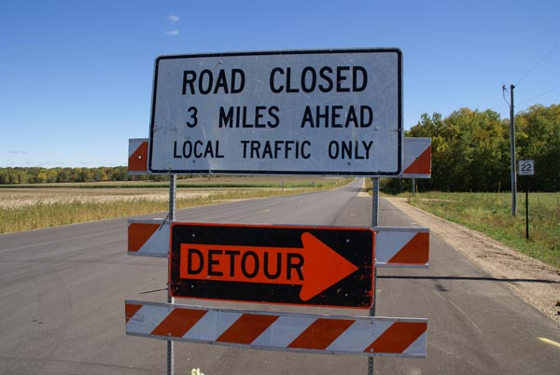
How do we use these things again?
If statements!
if expression:
#inside if
#still inside if
#outside if
Note: no parentheses or braces!
Demo

Slide 10

if/else
if expression:
#happens if expression is true
#still inside if
else: #happens if expression is false
#still inside if
#happens no matter what

Slide 11
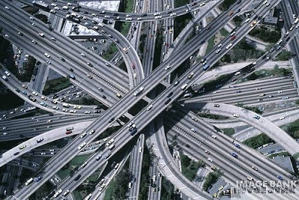
if/elif/else
if expression1:
#inside if
#happens if exp1 True
elif expression2:
#inside elif
#happens if exp1 is False and
# exp2 is True
else:
#happens if both exp1 & exp2 are False
This Photo by Unknown Author is licensed under CC BY-SA-NC

Slide 12
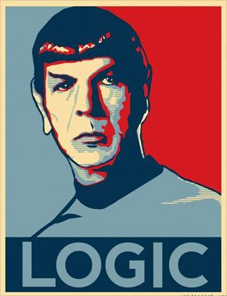
More complicated logic…
Sometimes we want to use logic (and, or, not) to combine things
Python makes it pretty easy:
And is represented by and
Or is represented by or
(x > 4 or y> 3)
demo
This Photo by Unknown Author is licensed under CC BY-SA

Slide 13

Not is a bit different
X AND Y
X OR Y
NOT X
AND and OR and binary operators (take two things)…
NOT is unary
In python, works like print() or the type converters
not(x==4 OR x == 6)
This Photo by Unknown Author is licensed under CC BY-SA

Slide 14
Saying number in range
Very common in data science (need to check if number in proper range)
In most programming languages, the only way to do it is like this:
If 10 < x and x < 20:
Python supports chained comparisons!
Can just say
if 10 < x < 20:

Slide 15
Lab out
if statements and comparisons

