Slide 1

DATA/CS 172: Python for Data Analysis
For Loops
Prof. Travis Mandel
9/9/2024

Slide 2
Announcements
Lab 3 due Wednesday

Slide 3
Agenda
For Loops
For working with files
Fixed number of repetitions

Slide 4


Right now…
Two kinds of scripts:
Run top to bottom
Branch with if statements
Can do some cool stuff, but something feels missing…

Slide 5
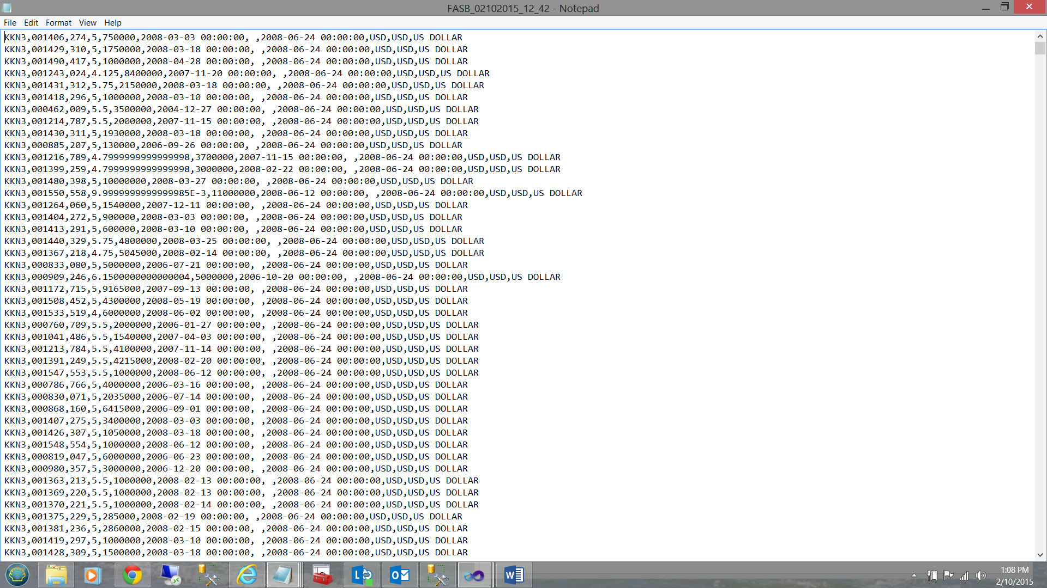
In data science…
Usually you have a file with a lot of datapoints in it
Why have all our files so far just had one thing????
It’s because we don’t have any way to repeat code!
So if I had a file with 100 datapoints I would have to copy & paste my code 100 times!
And good luck if I later decide to change something!

Slide 6

Loops
A loop let us repeats any chunk of code over and over and over…. ← important term!
Single line, or multiple lines
Way better than retyping
Excellent for data science when there is whole bunch of data we want to process similarly
print(“hello”)

Slide 7
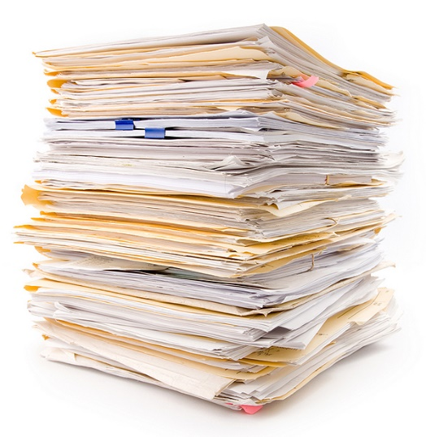

The Most Important Loop in Data Science
As a data scientist, you will often be working with files…
So far we’ve just been using read()
Which reads the entire file into a string!
What if the file has a lot of info?
It’s going to be slow/a memory hog
And a headache to get all of that info out of our giant string!
So in data science, the #1 most important loop is the loop that goes through all the lines in a file!
At least for text files… we will see similar things with other types of files later though

Slide 8
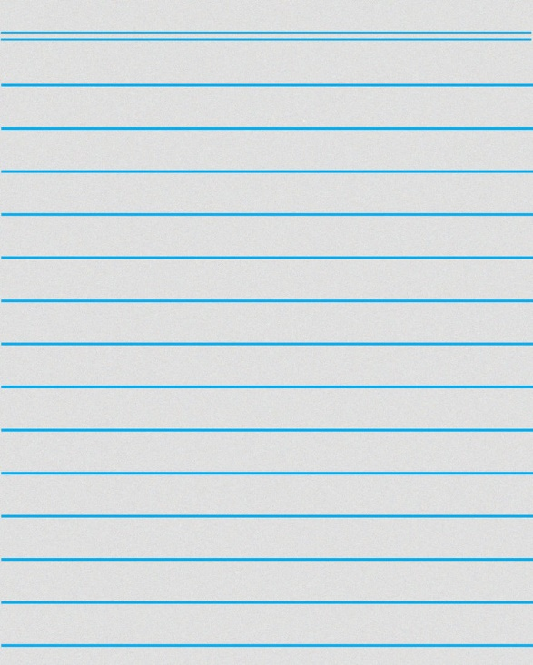
Looping through lines in Python
f = open(“filename.txt”, “r”) ← Hopefully this is familiar!
for line in f:
print(“Line:”, line)
#Still inside for loop
#outside for loop
Special loop in Python
Doesn’t read whole file into to memory, just reads a line at a time
99% of the time this is how people read text files

Slide 9
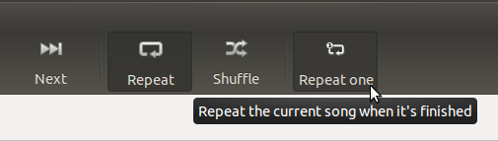
Is this the only kind of loop we need?
No!
Sometimes you want to do something twice, or three times, or four times…
For example, go through 3 files, 4 files, etc.
Being able to repeat code comes in really handy!

Slide 10
Fixed iteration for loop
for i in range(5):
print(i)
prints
0
1
2
3
4

Slide 11
Range with a start
for i in range(7,10):
print(i)
7
8
9
Comes in handy when you want to skip some initial stuff
Remember: Inclusive of first endpoint, exclusive of last!

Slide 12
Lab out
Getting started with loops

