Slide 1

DATA/CS 172: Python for Data Analysis
Nested Loops and Style
Prof. Travis Mandel
9/11/2024

Slide 2
Announcements
Lab 3 due today
Lab 4 due Friday
Friday – class will not meet
As stated in the syllabus, I will be off-island Friday (EPSCoR conference)
I will record a lecture/demo and post to Laulima (Loops wrap-up)
There will be no lab out on Friday

Slide 3
Agenda
Nesting loops and if statements
Some style notes

Slide 4
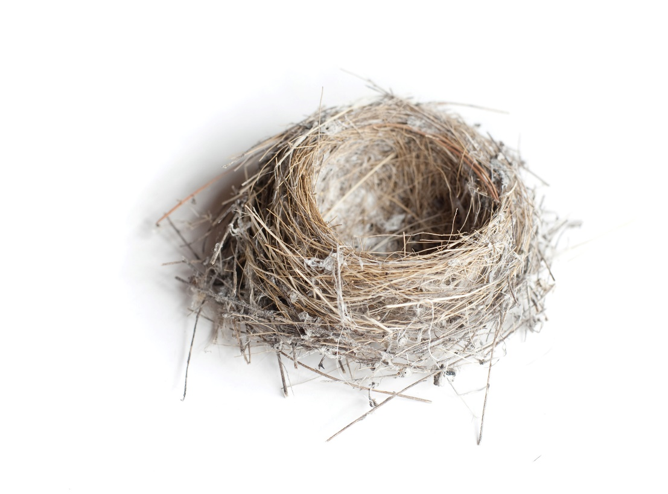
If statements within if statements
Can put one if statement inside another
Called nesting
Make sure to indent!
if x > 0:
if y > 0:
print(“x and y both positive“)
#inside both
#outside one
#outside both

Slide 5
When nesting, careful with indentation!
if x > 0:
if y > 0:
print(“x and y both positive“)
else:
print(“negative”)
if x > 0:
if y > 0:
print(“x and y both positive“)
else:
print(“negative”)
What’s the difference?
How will this affect how the code runs?

Slide 6
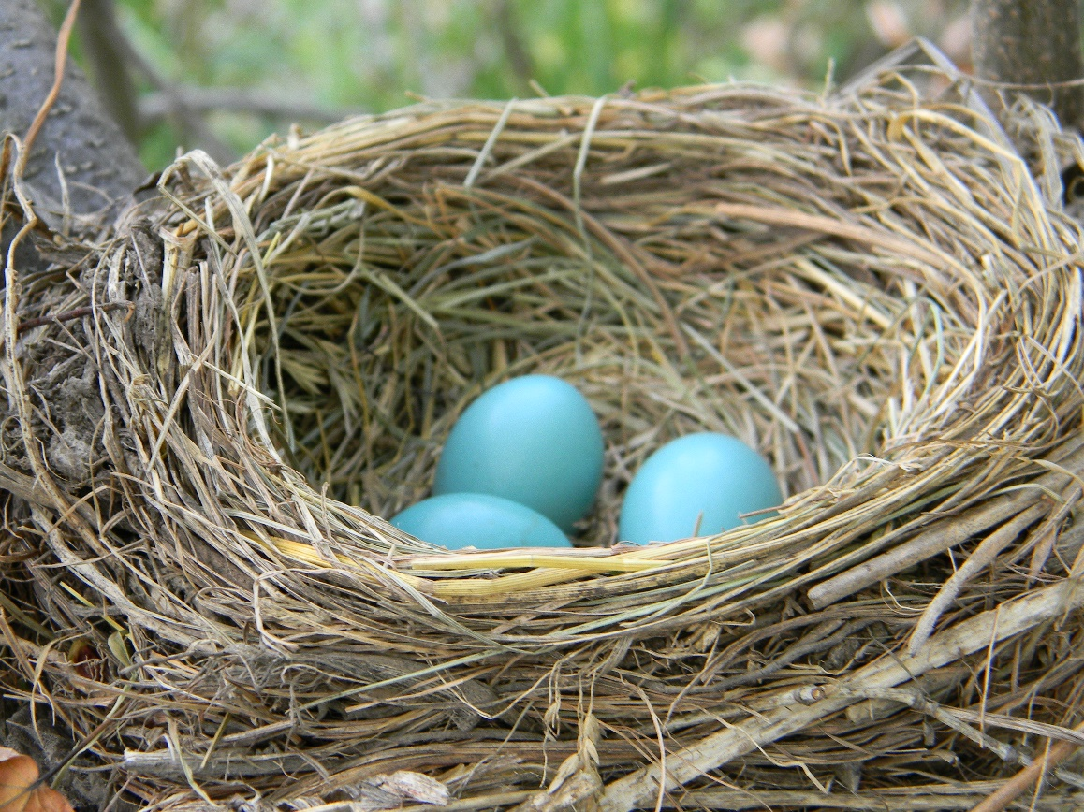
If statements within Loops
Can nest an if inside a loop
for i in range(10):
if i == 3 or i == 7:
print(“i is”, i)
This Photo by Unknown Author is licensed under CC BY-SA

Slide 7
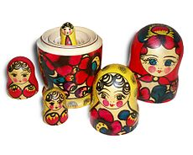
Loops within loops
for i in range(5):
for j in range(5):
print(“i”, i ,”j”, j)
#inside both
#inside i, outside j
#outside both

Slide 8
Demo
Nested loop to count all characters in a file

Slide 9
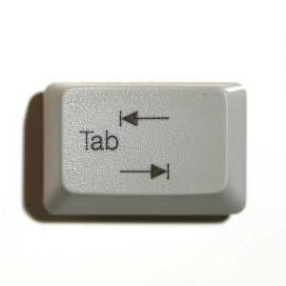
Indentation Error & Tab Error
As we can see, indentation is key in Python
Different than most programming languages
Python can give some very strange errors because of this
Indentation Error:
Python can’t figure out why you indented or unindented
Tab Error:
You mixed tabs and spaces, Python can’t figure out how to line things up
Usually only happens when switching editor/computers

Slide 10

Some indentation works, but doesn’t look pretty
Python doesn’t care about the amount of the indent, just what it is relative to other blocks
Small (one space) or large (10 tabs) is fine with python
Demo
Good style is to keep all the indents a consistent size

Slide 11

Why do we care about style in data science?
As data scientists, want to be able to share our work with others!
Want to make our code easy for other data scientists to read
Want to make it easy for others to come in and modify
Ideally, even want to make it easy for non-data-scientists to understand!
So style is super important in DS!
This Photo by Unknown Author is licensed under CC BY-SA
Style tip 1: Make sure indentation looks nice

Slide 12
Style tip 2: Careful with things we didn’t cover in class, or things we said not to do
Bad style way:
f = open(..)
f.write(“This is a test string”)
f.close()
Good style way:
f = open(..)
print(“this is a test string”, file=f)
f.close()
You may not agree with me on everything – that’s fine
A big part of being a good programmer is learning the conventions and guidelines , and following them

Slide 13
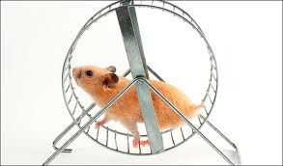
Style tip 2: Minimizing re-looping, or closing/opening files
Better way:
i = 0
j = 0
for k in range(20):
i += k
j += k
Bad style way:
i = 0
for k in range(20):
i += k
j = 0
for k in range(20):
j += k

Slide 14

Style tip 3: No “magic numbers” (or magic strings)
Bad style way:
datapointsPerYear = 10*3*365
surveysPerYear = 3*365
Better way:
daysPerYear = 365
surveysPerDay = 3
dataPointsPerSurvey = 10
surveysPerYear = \
surveysPerDay * daysPerYear
datapointsPerYear = \
dataPointsPerSurvey * surveysPerYear

Slide 15

Style tip 4: No “dead code”
Don’t leave in lines that do little or nothing
for line in f:
num = int(line) # dead code!
num = float(line)
Variables that are never used, etc.

Slide 16
Lab out
Practice with nested loops
Keep style tips in mind for labs & projects

