Slide 1

DATA/CS 172: Python for Data Analysis
Intro to Lists
Prof. Travis Mandel
9/16/2024

Slide 2
Reminder
Friday’s lecture (recording, slides, demo) is up on Laulima
Lab 5 due today

Slide 3
Agenda
List Basics
Lists and Strings

Slide 4
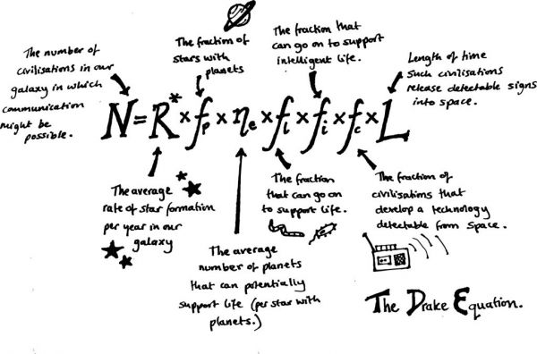
Storing data
We know how we can read a file containing multiple lines of data…
Great! But so far, no where to store that data!
What if I need to store 100 pieces of data in Python?
Could use 100 variables (Ugh!)
Could store them in a giant string (slow & painful)
Could use a file for storage (slow & painful)

Slide 5
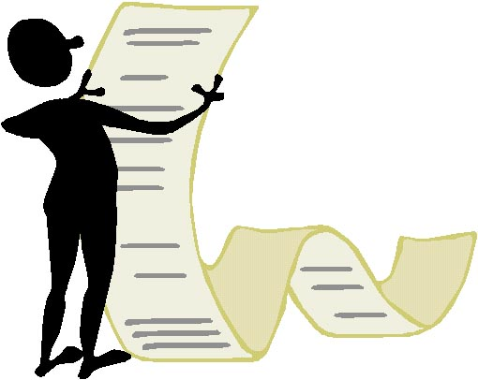
List
An ordered sequence of elements, usually all of the same type
Initialized like [3, 1, 4, 1, 5, 9]
Empty would be []
Single element would be [4]
Type of brackets matter – must be SQUARE
Very important in data science!

Slide 6
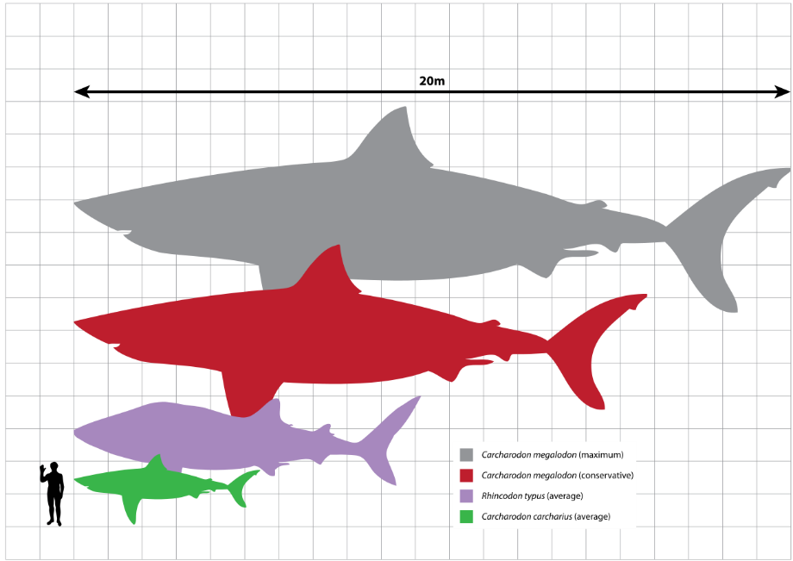
List basics
Getting the length
len(myList)
Note indicies start at 0, so the last index is len(myList)-1
Getting the ith element
myList[i] ← i is called an index (important term)
First element
myList[0]
Second element
myList[1]

Slide 7
Example
animals = [“Parrot”, “Cow”, “Horse”]
animals[0] | animals[1] | animals[2]
Parrot | Cow | Horse
animals[len(animals)-1]
len(animals) is equal to 3

Slide 8

Looping through a list
Iterating through a list refers to walking through it element by element ← Important term!
Way 1:
for item in myList:
# item is myList[0], then myList[1], then myList[2]…
Use this one if you don’t need the index!
Way 2:
for i in range(len(myList)):
item = myList[i]
Use this one if you need the index!

Slide 9

Adding to a list
myList = []
myList.append(3)
myList.append(4)
Results in [3,4]
Useful when building up a list from scratch
Often done in a loop (demo)

Slide 10

Checking if a list contains an item
One way
Do a for loop, check every item with ==
Kind of annoying given how common this is
Python offers a way to make this nicer
In keyword again!
If ‘a’ in [‘a’, ’b’, ‘c’]:
#This will happen
If ‘d’ in [‘a’, ’b’, ‘c’]:
#This will not happen
If ‘d’ in [‘a’, ’bd’, ‘c’]:
#This will also not happen
For loop not usually good style for this

Slide 11

Strings are kind of like lists!
Can index them:
s = “hello”
print(s[0]) #prints h
Can take their length
s = “hello”
print(len(s)) #prints 5
Useful for checking for invalid lines (small or 0 length after strip())
Can check if something is in them:
If “o” in “hello”:
#this will happen
If “x” in “hello”:
#this will not
Cannot append, though

Slide 12
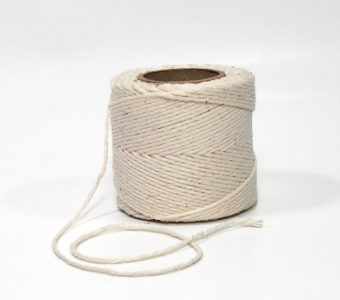
Splitting strings
Strings by default are a list of characters
Sometimes, that isn’t what I’m looking for
Example: “james,fred,george”
myString = “a,b,c”
myList = myString.split(“,”)
myList is now [“a”,”b”,”c”]
Tip: Split() without anything in the parens will split on whitespace

Slide 13
Style tip with lists
Often good to end variable name with an “s” (i.e. pluralized)
grades = [76, 83, 92, 86]
for grade in grades:
print (“You got:”, grade)

Slide 14
Lab out
Practice with some of what we talked about today
Reading data into a list, checking for errored values
Next time: More with lists (slicing, etc.)

