Slide 1

DATA/CS 172: Python for Data Analysis
Tuples
Prof. Travis Mandel
9/20/2024

Slide 2
Reminders
Program 1 out Monday
Sorry for delay
Keep on top of labs

Slide 3
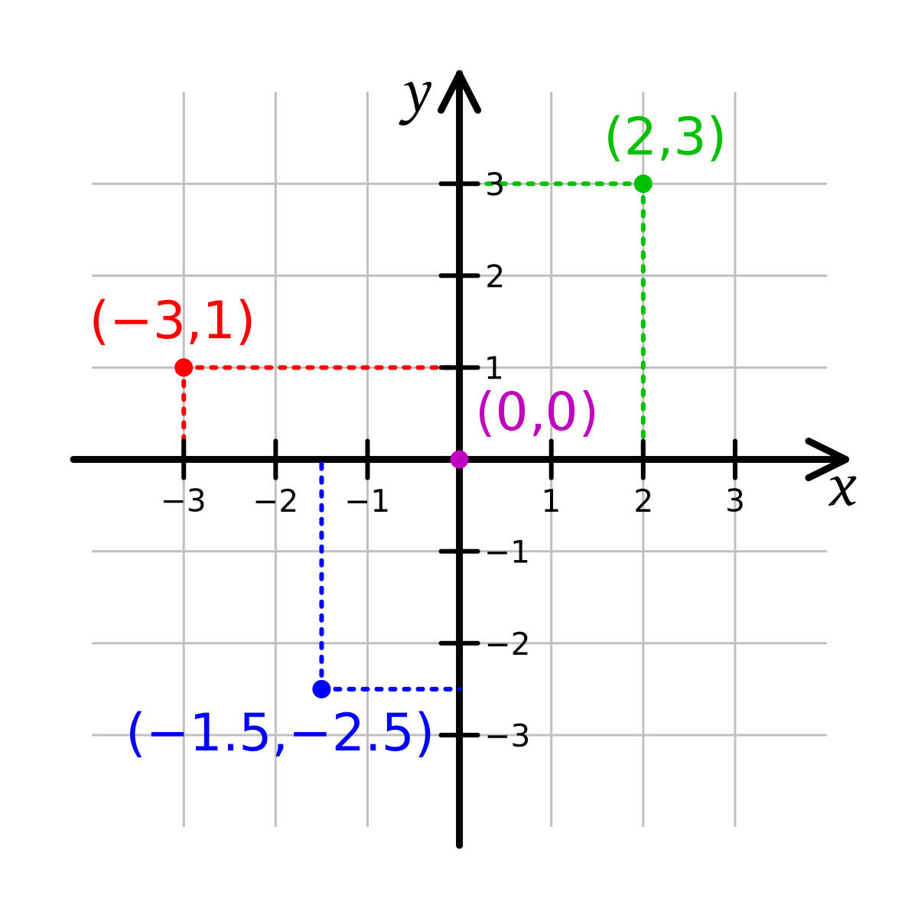
Tuples
Like lists but they can’t be changed
List: [4,7,8]
Tuple: (4,7,8)
Note: Parentheses, not square brackets
Tuples of two elements sometimes called pairs
Tuples of three elements sometimes called triples
Can have any number of elements
Tuple of zero elements: ()
Tuple of one element: (4,)
Huh?
Couldn’t be (4) as (4)+6 should be 10!
Very confusing, especially since they didn’t do this with zero elements!

Slide 4

Can do most list things with tuples
Can get the length with len(myTuple)
Can slice with myTuple[x:y]
Can get a certain index with the indexing operator
secondItem = myTuple[1]
But…
The data is locked in
Cannot assign! myTuple[1] = 6
Cannot append! myTuple.append(7)

Slide 5
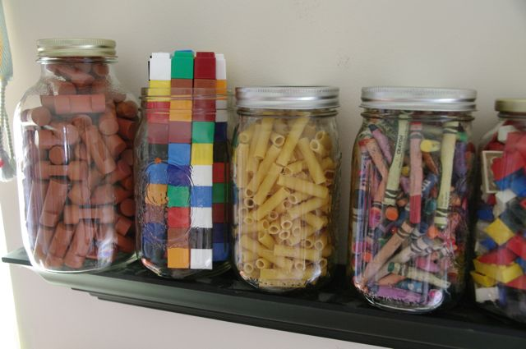
Mixed Tuples
Tuples often used to store a small number of
closely related things, often of different types.
Example:
(“John”, 93, “Freshman”)
(“Emma”, 80, “Sophmore”)
First represents name, then grade, then standing

Slide 6

Unpacking tuples
myTuple = (“John”, 93, “Freshman”)
How to unpack this? The bad way:
name = myTuple[0]
grade = myTuple[1]
standing = myTuple[2]
Ugly! Confusing! Hard to understand!
The much better way:
(name, grade, standing) = myTuple
Yes, we can have multiple things on the left hand side!
Works perfectly!
Even if you just need the name, best to do it this way so it’s clear what each thing in the tuple represents

Slide 7

Tuples or lists?
Tuples
Nothing can be added, changed, or removed (immutable) ← Important term
Most commonly used when there is a small number of items, each with different meanings
Indexing (e.g. myTuple[2]) is usually bad
Lists
Can add, change, remove (mutable) ← Important term
Most commonly used when there is a large number of similar items in a sequence
Indexing (e.g. myList[2]) is usually good

Slide 8
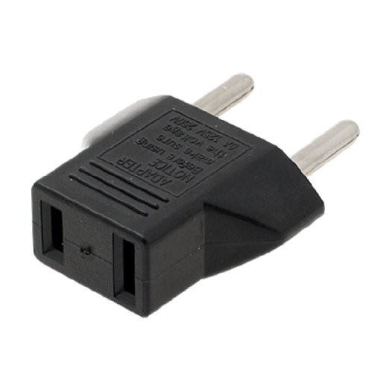
Converting between lists and tuples
Use our standard type conversion stuff!
list((1,2,3))
[1,2,3]
tuple([1,2,3])
(1,2,3)
Useful if you need to change a tuple for some reason
Convert to list, then convert back

Slide 9

Combining lists and tuples
Can have lists of tuples
Example
[(“Allan”, 3.8, “CS”), (“Paige”, 3.9, “ASTR”)]
Fine to loop through as normal:
for studentTuple in students:
(name, gpa, major) = studentTuple
#do something
A little bit shorter and nicer:
for (name, gpa, major) in students:
#do something

Slide 10
What if I have two lists, that I want to go through at the same time?
Old way:
for i in range(len(names)):
print(names[i])
print(grades[i])
Perfectly fine, but a little clunky
Can tuples help us do this better?

Slide 11

Simultaneous for loop
for (name, grade) in zip(names, grades):
print(“Name is “, name)
print(“Grade is “, grade)
Goes through the first in both, then the second in both, etc.
No need to worry about indices etc.
Zip takes two lists and zips them
zip([1,2,3,4], [5,6,7,8]) → [(1,5), (2,6), (3,7), (4,8)]
Don’t overuse – most useful here

Slide 12
Next lab out
Brief practice with tuples

