Slide 1

DATA/CS 172: Python for Data Analysis
Functions
Prof. Travis Mandel
9/23/2024

Slide 2
Announcements
Keep on top of labs
Program 1 out
You have some time to work on it
Reminder: Should be your own INDEPENDENT work, as discussed on first week and in syllabus
Functions (today’s topic) NOT required for program

Slide 3
Agenda
Zip wrapup
Functions

Slide 4
Zip wrapup
Last time we learned about zip
Takes two lists, and joins into a list of tuples
Should mention that it can take *any* number of lists, not just two
Example
zip([1,2], [3, 4], [5, 6])
→ [(1, 3, 5), (2, 4, 6)]

Slide 5

Organization
So far our scripts have been pretty short…
For real projects they will get longer!
Very important to keep stuff organized…
Also, there are many things we want to reuse!
Functions give us a way to organize and reuse code
Separated pieces of code that can be invoked on some parameters
e.g. len(x) is a function that takes an argument and returns it length
This Photo by Unknown Author is licensed under CC BY-NC-ND

Slide 6
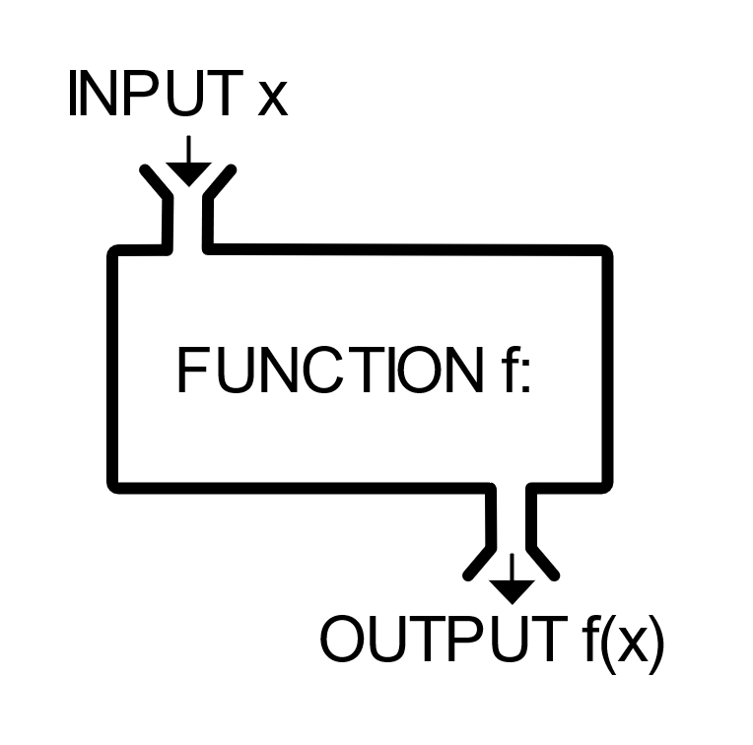
Built-in functions we have seen already
print()
open()
len()
zip()
sys.exit()
There are others…
E.g. abs(x) – take the absolute value of x
This Photo by Unknown Author is licensed under CC BY-SA

Slide 7

Components of a function
Name
Every function needs a name
Name should clearly indicate what a function does (e.g. computeAverage)
Arguments
Arguments are variables that come into the function
0 arguments
func()
1 argument
func(x)
2 arguments
func(x,y)
Return value
What does the function produce?
E.g. math.sqrt(x) returns the square root of x
Some functions don’t produce anything
E.g. writeInfoToFile()

Slide 8

Defining your own function
Functions start with the keyword def, the body of the function is indented.
def myFunc(arg1, arg2): ← Called the function declaration
return val ← Called the return statement
Calling the function
ret = myFunc(0,1) ← Called the function call
Note: Argument & return value names do NOT need to be the same in the declaration and the call
Works on order
Demo: average of two numbers

Slide 9
Returning multiple values
A pain in most other languages (e.g. C++)
Easy in Python! (thanks tuples!)
return (val1, val2)

Slide 10

When should I use a function?
Functions make code more readable and reusable
“Information hiding” – Don’t need to worry about details of how function works when I am trying to understand the general flow
Should use a function if:
A piece of code serves a coherent purpose
A piece of code is fairly complex (simply multiplying two numbers doesn’t merit a function)
Especially useful when code needs to be repeated in several places

Slide 11
Things you should NOT do with functions
Python (usually) lets functions use whatever variables they want
NOT good – functions should only use their arguments, or any new variables you make inside of them
Messy + things can go wrong here
Python lets you put whatever code you want above functions
NOT good – functions should be at the TOP of your script
Generally, the only thing above them should be import statements

Slide 12
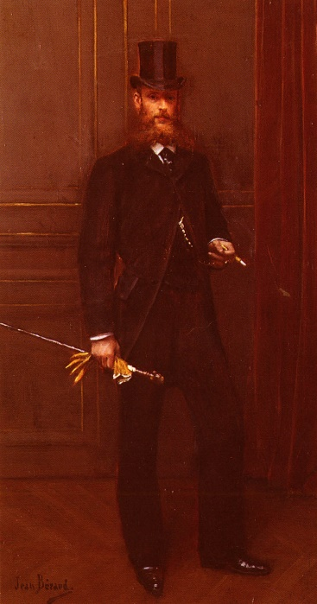
More Style notes with functions
Should have a descriptive name that indicates what it does
computeTotalPrice() instead of func1()
Arguments should be named well to indicate what they represent
Usually bad to have printing happen inside the function
Except for helping track down problems etc.
Printing should happen in the main part of your code
If you need something to print from your function, it should be returned

Slide 13
Lab out
Easing you into functions
Modify previous lab to make use of a function
Will see a bit more complex example next time

