Slide 1
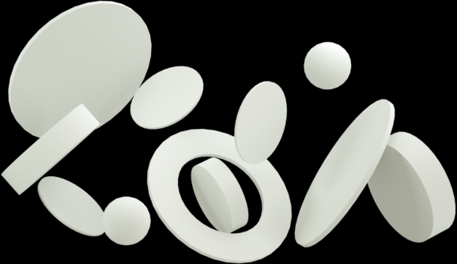



Predicting Employees who are likely to churn
Presented by Sebastian Dakey

Slide 2
Project Goal:
To investigate what type of employee is likely to churn or leave the company

Slide 3
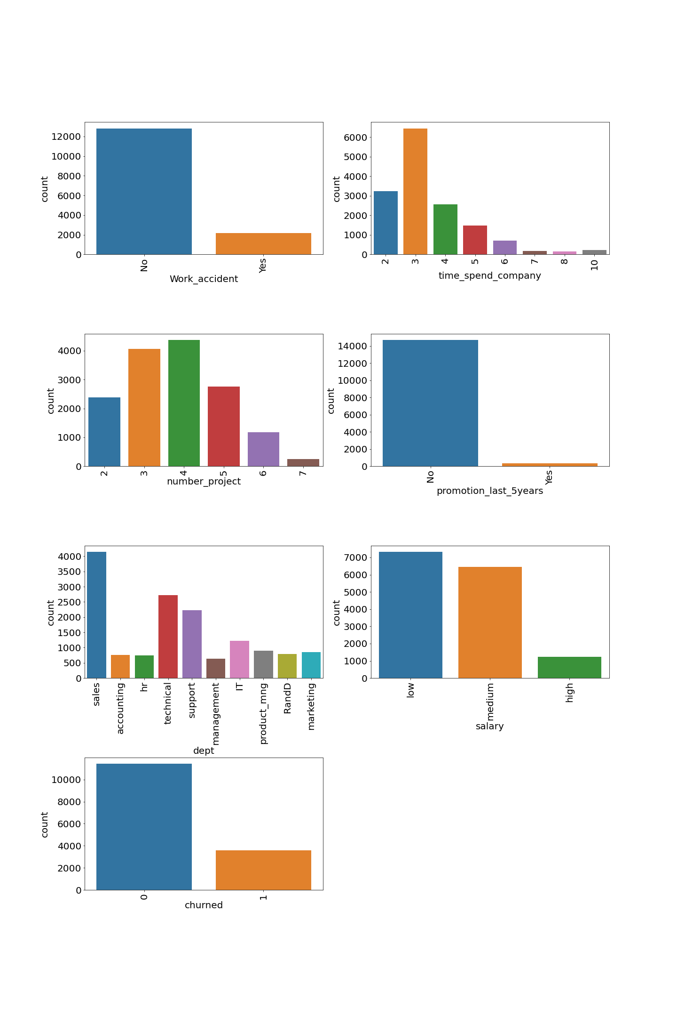
Exploratory Data Analysis
time_spend_company is right skewed. This means that majority of the employees have spent four or a smaller number of years in the company.

Slide 4
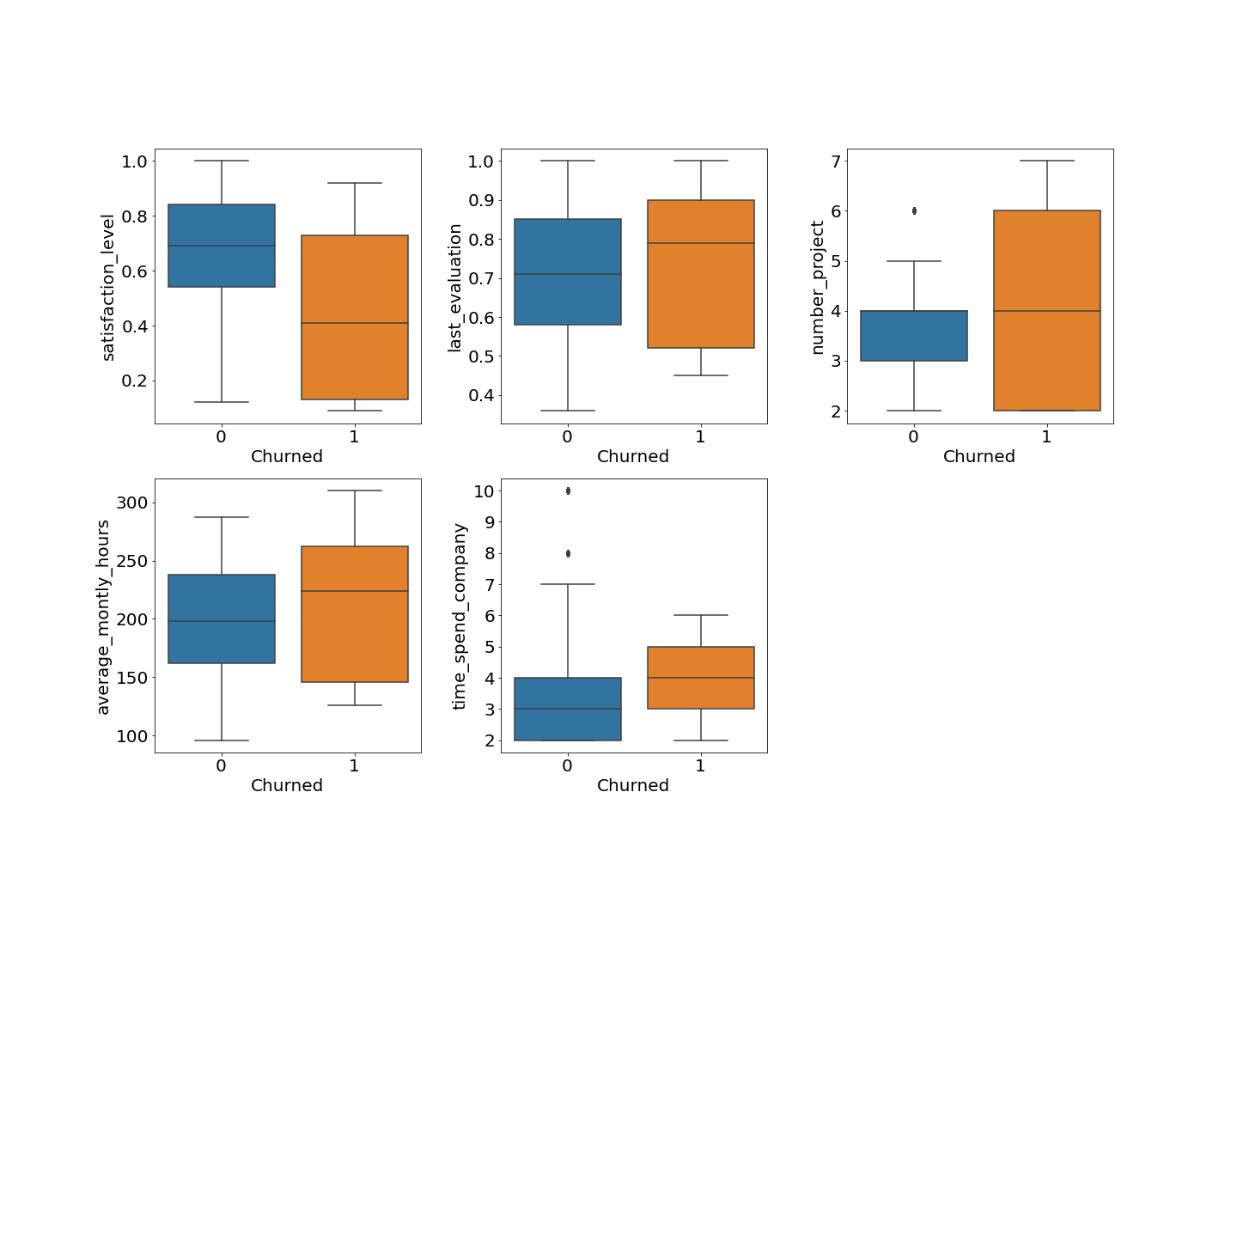
Exploratory Data Analysis
Churned employees have lower satisfaction levels
Churned employees usually work more hours per month
Churned employees spend relatively lesser number of years in the firm than those who did not churn.
Churned employees usually work on more projects than those who did not churn.

Slide 5
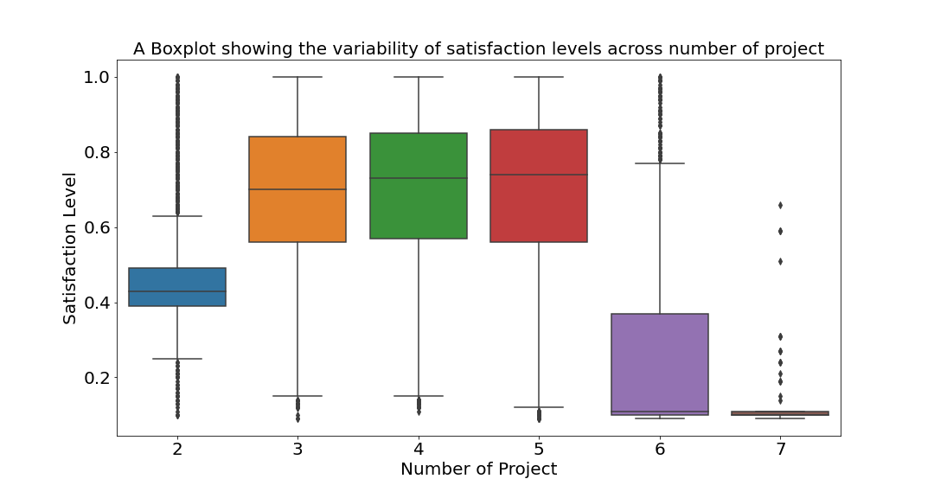
Exploratory Data Analysis
We observe that satisfaction levels are low for employees with 2 projects.
Satisfaction levels are also low for employees with 6 or more projects. This means that optimal number of projects for employees are from 3 to 5.
This is because employees who had number of projects from 3 to 5 had the most satisfaction levels.

Slide 6
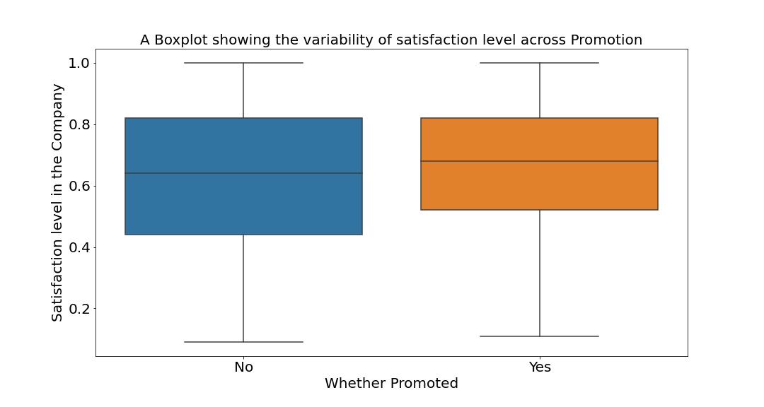
Exploratory Data Analysis
We observe that employees who are promoted have a median satisfaction level higher than those who were not promoted.

Slide 7
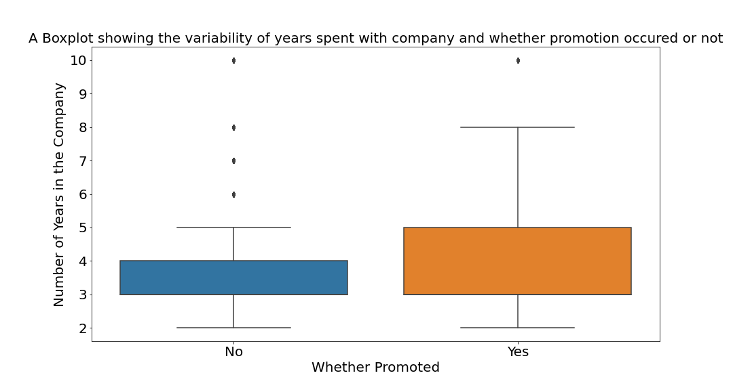
Exploratory Data Analysis
We observe that employees who were promoted tend to stay longer in the company than those who were not promoted.

Slide 8

Model Selection
76% of data were current employees
26% of data were churned employees
I chose Random Forest Classifier to handle the imbalanced target variable

Slide 9


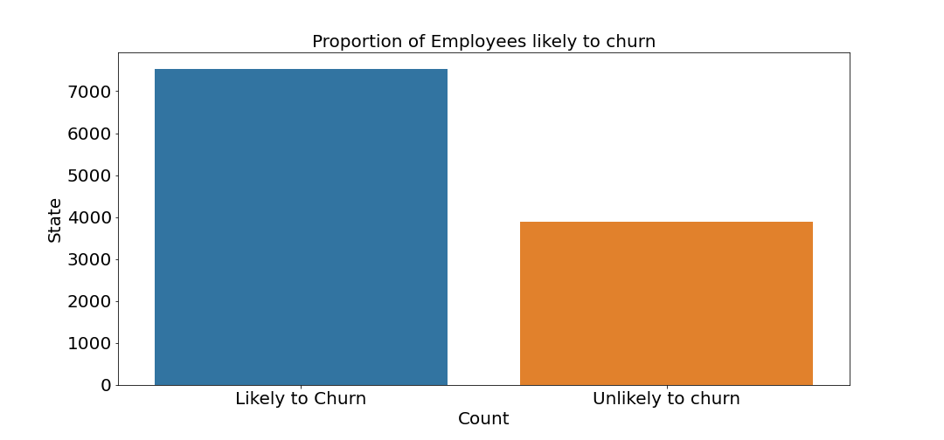
Predictions
Train & test were 70:30 respectively
Random Forest Classifier gave an accuracy score of 99%
I used the current employee dataset to predict employee likely to stay or churn
I added the predicted column to the current employee dataset and plotted the proportion of employees likely to learn

Slide 10
Insights & Recommendations
Satisfaction – Employees who are less satisfied are more likely to churn
Number of projects – Employees with 2, 6 or more project are more likely to churn
Put in policies and mechanisms to improve employee satisfaction in the workplace.
Do not overload employees with too many projects as it might lead to burnout.
Employees should be working on 3 to 5 projects for optimal satisfaction.
Management should institute promotion policies that rewards high performing employees as employees who are promoted tend to stay in the company longer and are less likely to churn.

Slide 11

Thank You

