Slide 1
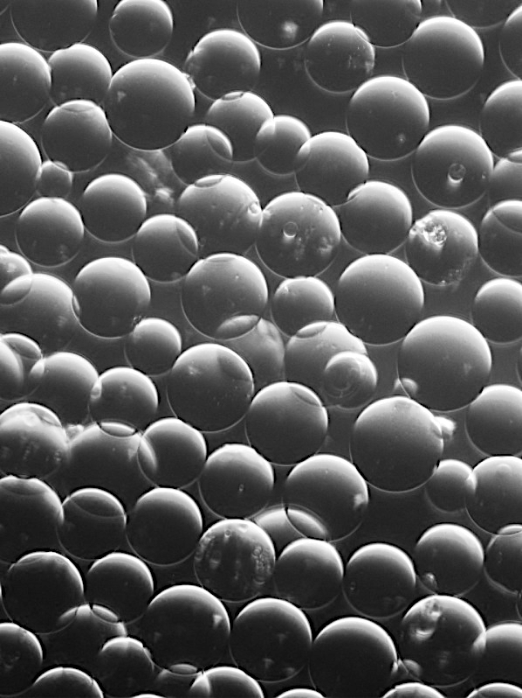
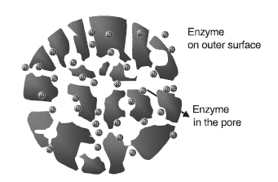
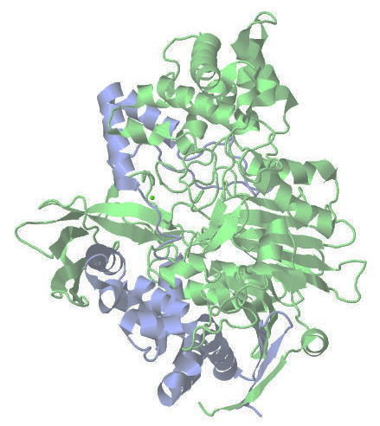

Slide 2




Slide 3

status()
new(inputs, plot_options)
save(filename)
load(filename)
plot(filename)
export(filename)
simulate(sim_type)

Slide 4


