Slide 1
VIZZU IN POWERPOINT?

Slide 2
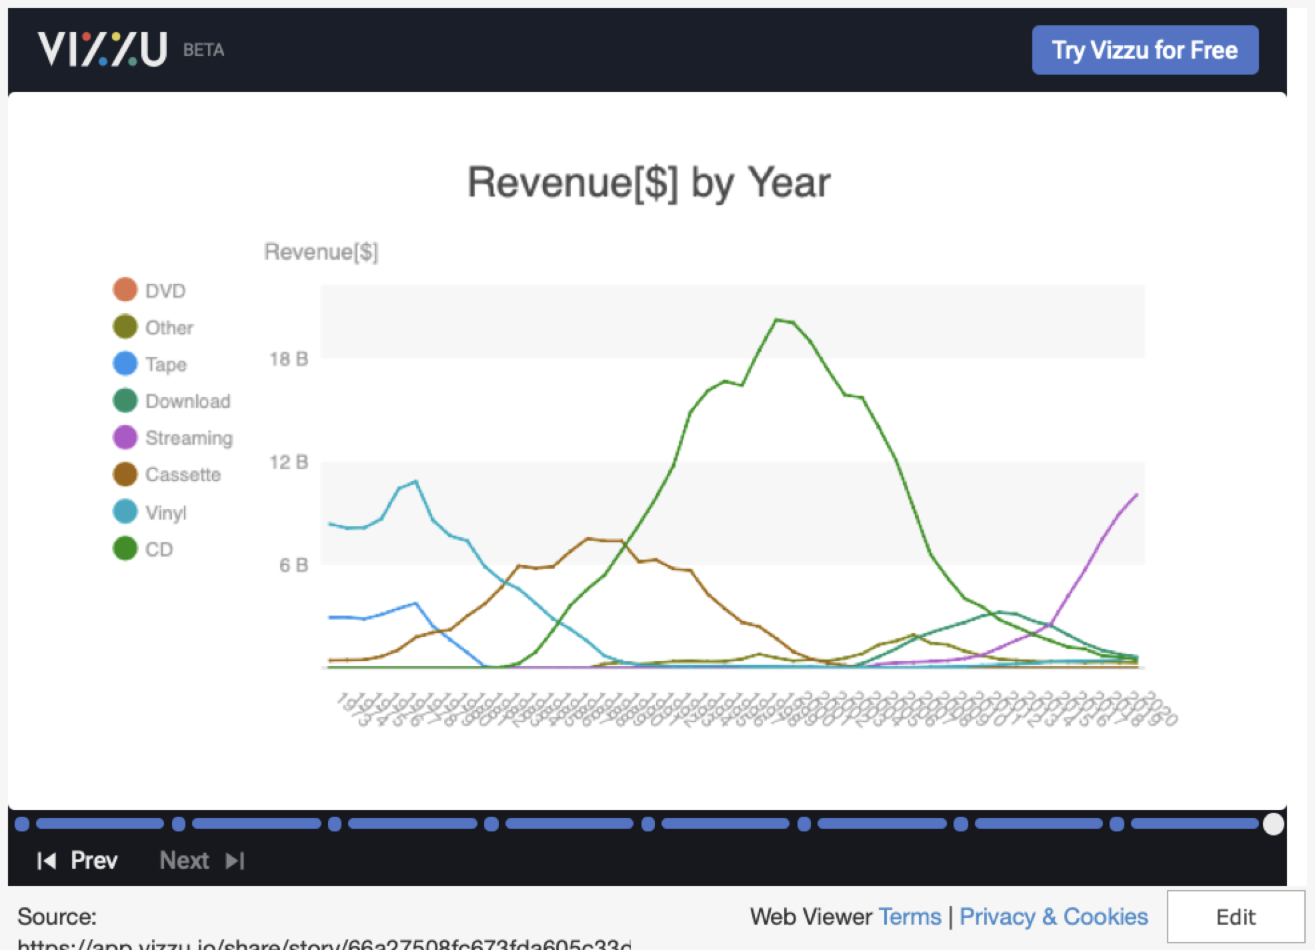
VIZZU IN POWERPOINT!!!

