Slide 1
NET CONSUMPTION OF ENERGY
Czech Republic

Slide 2
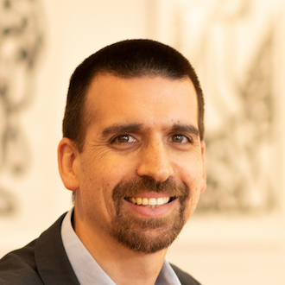
ABOUT ME
Job
uPlanner
Innovation Lead - Feb 2025 to Present
Chief Data Officer - Jan 2016 to Feb 2025
Talks
PyCon:
Colombia (2020), Argentina (2020), Chile (2021), Latam (2022), Chile (2023), US (2024)
Nerdearla, Argentina (2024)
Education
Stanford University
Master of Science (MSc), Computational and Mathematical Engineering
2010 – 2012
École Polytechnique
Ingénieur diplômé de l'Ecole Polytechnique (MSc.), Mechanics and Applied Mathematics
2005 - 2007
Universidad Técnica Federico Santa María
Bachelor of Science (BSc), Mathematical Engineering
2000 - 2004

Slide 3
CONCLUSIONS
Decrease in consumption from thermal plants.
Stable but minimal participation of renowable sources: wind, hydro & solar.
Important and stable contribution of nuclear origin.

Slide 4
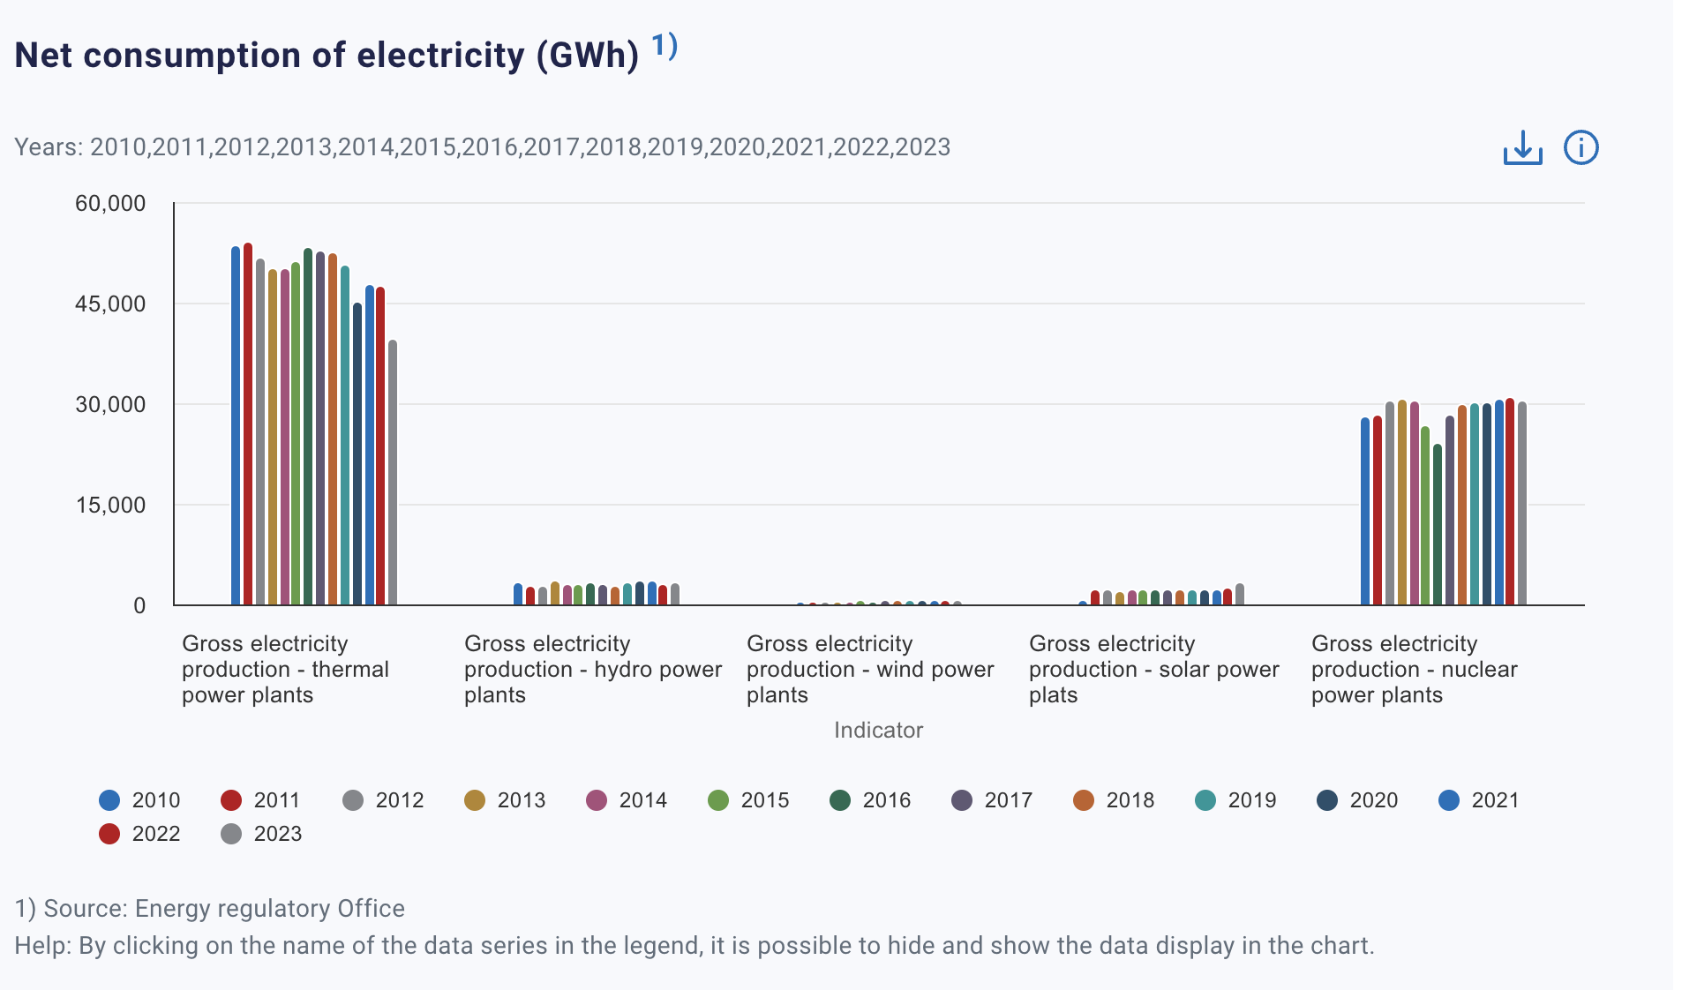
https://csu.gov.cz/energy

Slide 5
THANK YOU

