Slide 1




Architectural overview
High level use case
<<Agency / Remote Worker>>
Work on processes from remote
On demand insight on claims
Scale out to remote workers
<<Customer>>
Create new claims
View status on requests
Ask ad-hoc questions
<<Employees>>
Efficiently integrate internal workers
React more quickly on requests
Claims Handling
Request Handling
INPUT MANAGEMENT
...
OUTPUT MANAGEMENT
Business Process Automation
Automate & streamline

Slide 2
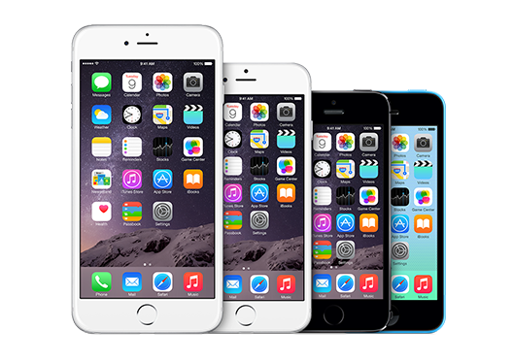

Architectural overview
High level use case
<<Customer>>
Create new claims
View status on requests
Ask ad-hoc questions
<<Agency / Remote Worker>>
Work on processes from remote
On demand insight on claims
Scale out to remote workers
Claims Handling
Request Handling
INPUT MANAGEMENT
...
OUTPUT MANAGEMENT
<<Employees>>
Efficiently integrate internal workers
React more quickly on requests
Business Process Automation
Automate & streamline

Slide 3




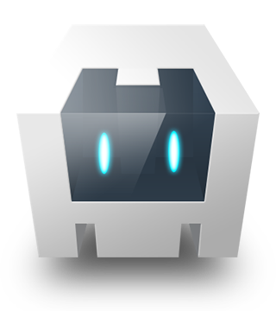



Architectural overview
Component model
RHMAP MBaaS
BPM Connector
<<Hybrid App>>
RHMAP Cloud Application
REST / HTTPS
<<BPMN>>
Request Processing Application
RHMAP SDK
AngularJS
RHMAP SDK
(REST / HTTPS)
<<BPM Engine>>
JBoss BPM Suite
ionic
Authentication API
Push API
REST / HTTPS
Apache Cordova
MBaaS
Broadcast push
notifications
Push Network
CLIENT LAYER
CLOUD LAYER
BACKEND LAYER

