Slide 1
Question: How can your team members contribute more to the project?
To: Benny Charles
To: Charlie Davis
To: Danny Engrid

Slide 2
Feedback Giver:
Feedback Receiver:
Students in this course
Giver’s team members
Me (session creator)
Instructors in this course
Teams in this course
Giver (self feedback)
Giver’s team
Students in this course
… (more options)

Slide 3
Can see response
Can see giver name
Can see receiver name
Recipient(s)
Giver’s team members
Recipient’s team members
Other students
Instructors

Slide 4
Report view:
Group by Giver → Recipient→ Question
Group by team
Group by Recipient → Giver → Question
Group by Question
… (more options)
Show statistics

Slide 5
Display to students as
Co-lecturer
Access level:
Co-owner
[ more details ]
Manager
Tutor
Custom (session-level access control)

Slide 6
Question: Select the team members who helped others in project work
Alice Betsy
Benny Charles
Charlie Davis
Danny Engrid

Slide 7
Create new:
Team peer evaluation session
or
Copy from existing sessions

Slide 8
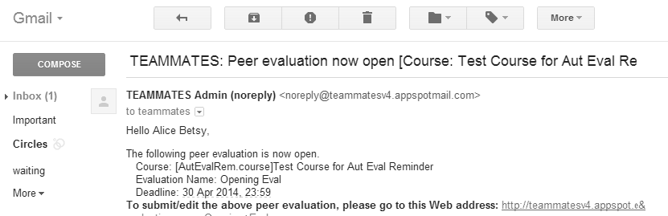
TEAMMATES: [ECON101-2013Fall] Group project peer evaluation
Hello Emily Fowler,
The following peer evaluation results are now published. Course: [ECON101-2013Fall]Introduction to Economics Evaluation Name: Group project peer evaluation Deadline: 30 Apr 2014, 23:59
To view results, click here
Regards, TEAMMATES Team.

Slide 9
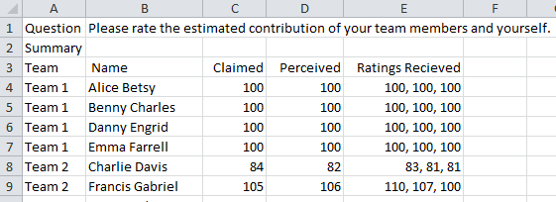

Slide 10
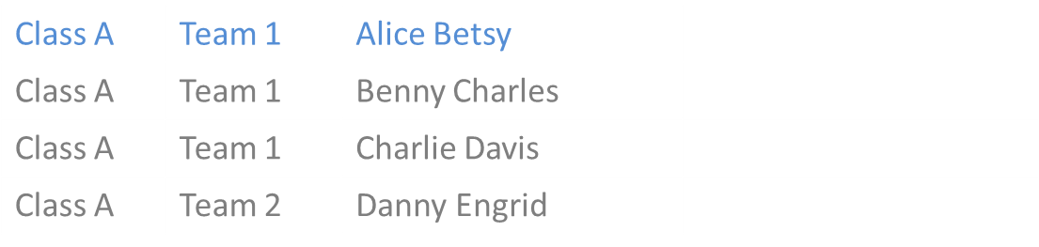
Class A | Team 1 | Alice Betsy
Class A | Team 1 | Benny Charles
Class A | Team 1 | Charlie Davis
Class A | Team 2 | Danny Engrid
Section | Team | Student | Actions
Give comment on
Give comment on
Alice Betsy
Team 1
Class A
Give comment on
Give comment on

Slide 11

https://www.flickr.com/photos/meatheadmovers
Charlie Davis
Preferred short name: Charlie
Contact after graduation: c.davis@private.mail.com
From: USA
Comments received
Good job on leading the project team Charlie. You set a fine example for other team members.
Tutor Richard
17th Oct 2013, 2.34pm
Charlie, please spend a little more time on the class assignments.
You
15th Oct 2013, 10.00am

Slide 12
Jenny Jean Jenni Jeanie
search
Students
Comments

Slide 13
Course ID: Econ101-Jan2013
Course name: Introduction to Economics
Sections: Mon morning A [85 students]
Mon morning B [90 students]
Mon afternoon A [ 60 students]
….
Total students: 849

