Slide 1
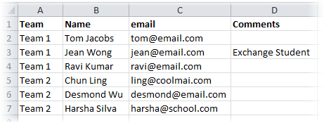
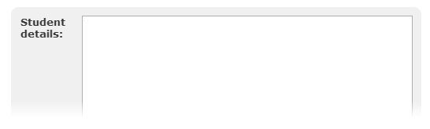
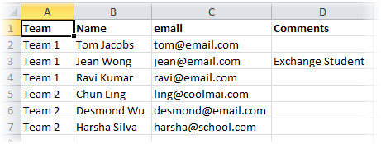
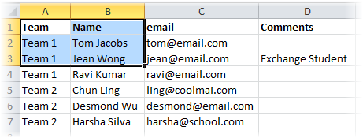
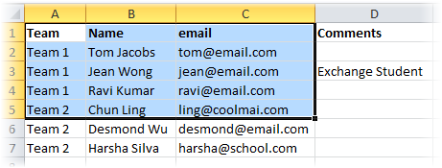
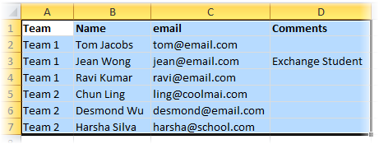
[How to enroll]
1. Copy data from a spreadsheet
2. Paste in the text box below and click ‘Enroll students’ button
Team Name Email Comments
Team 1 Tom Jacobs tom@email.com
Team 1 Jean Wong jean@email.com Exchange
Team 1 Ravi Kumar ravi@email.com
Team 2 Chun Ling ling@coolmai.com
Team 2 Desmond Wu desmond@email.com
Team 2 Harsha Silva harsha@school.com
Paste student data here ...

Slide 2
[How to enroll]
1. Copy data from a spreadsheet
2. Paste in the text box below and click ‘Enroll students’ button
Team Name Email Comments
Team 1 Tom Jacobs tom@email.com
Team 1 Jean Wong jean@email.com Exchange
Team 1 Ravi Kumar ravi@email.com
Team 2 Chun Ling ling@coolmai.com
Team 2 Desmond Wu desmond@email.com
Team 2 Harsha Silva harsha@school.com

