Slide 1
Comparison of Reinforcement Learning Algorithms & Optimal Control
J. Brüdigam, J. Ströbel, S. Hügler
Final Presentation (Practical Project)
Supervisor: Matteo Saveriano

Slide 2
Motivation
Which approaches exist to control systems and what are the advantages and disadvantages?
Model-Based Reinforcement Learning – PILCO
Model-Free Reinforcement Learning – PoWER
Optimal Control – LQR, iLQR, MPC

Slide 3
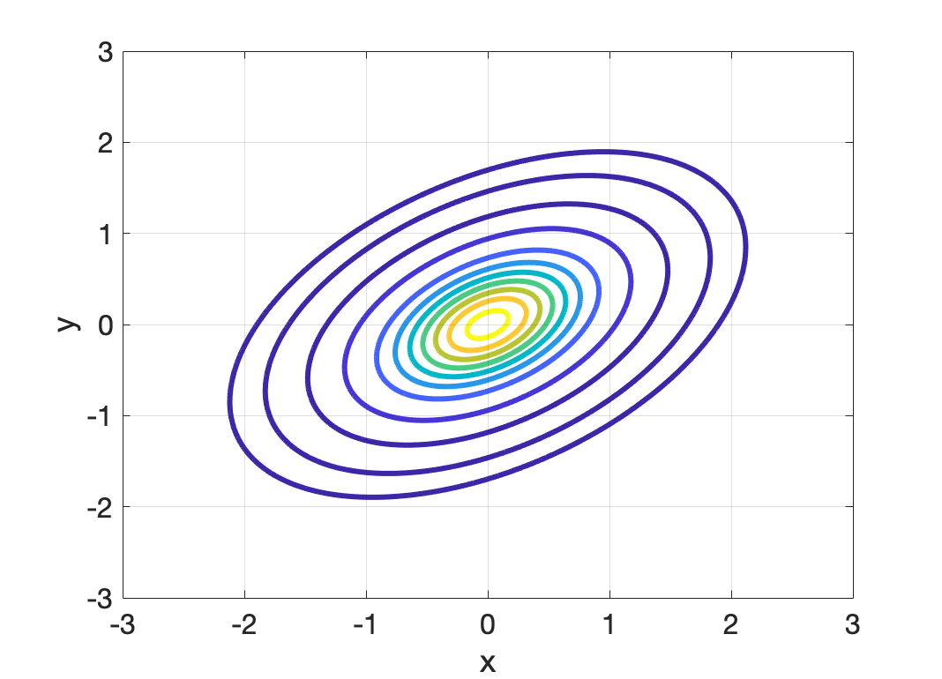
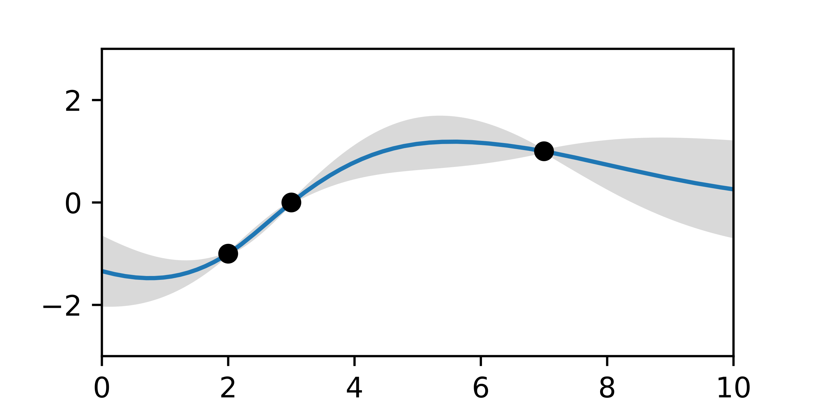
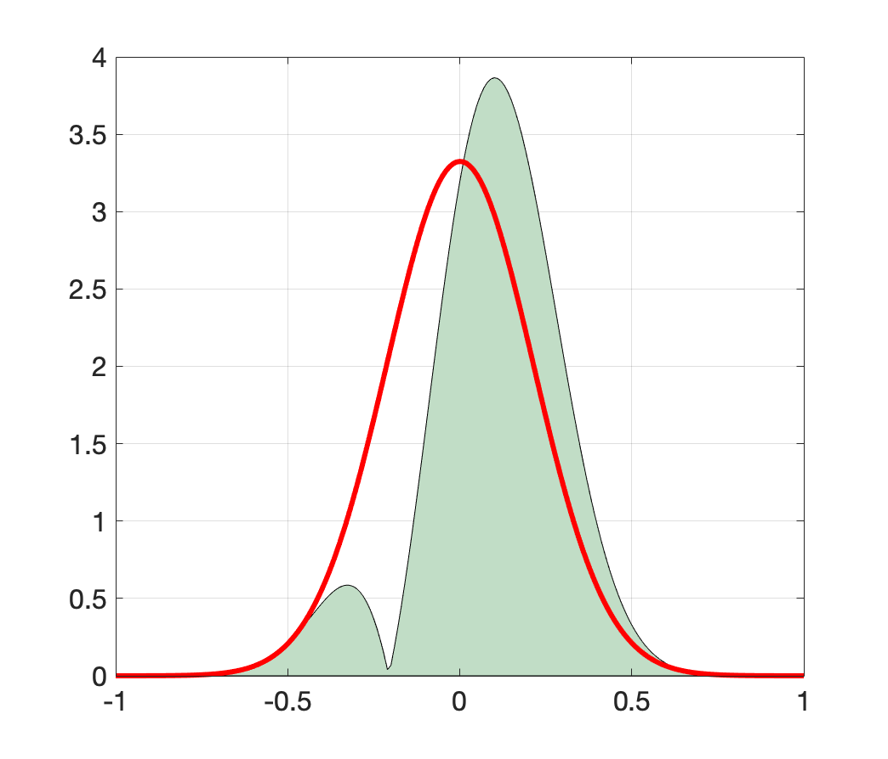


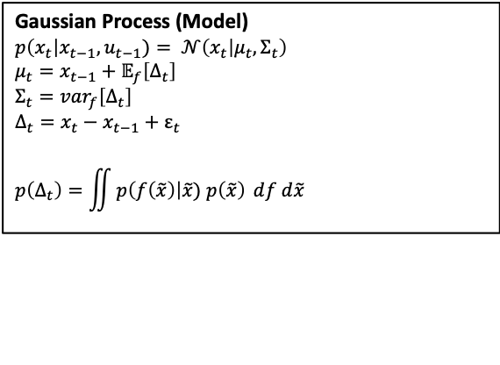
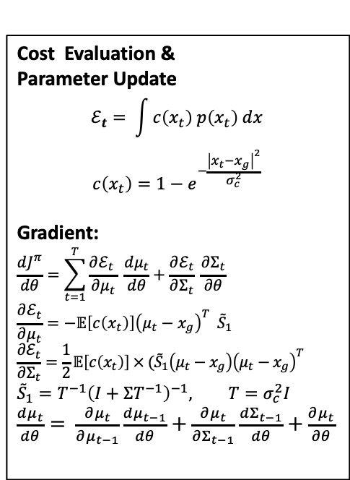








Model-Based Reinforcement Learning – PILCO
$$θ$$
Cost Evaluation &
Parameter Update
$$ℰ_{t}= \int{c\left(x_{t}\right) p\left(x_{t}\right) dx}$$
$$c\left(x_{t}\right)=1−e^{−\frac{{\left|x_{t}−x_{g}\right|}^{2}}{σ_{c}^{2}}}$$
Gradient:
$$\frac{dJ^{π}}{dθ}=\sum_{t=1}^{T}{\frac{∂ℰ_{t} }{∂μ_{t}} \frac{dμ_{t}}{dθ}+\frac{∂ℰ_{t}}{∂Σ_{t}} \frac{∂Σ_{t}}{∂θ}}$$
$$\frac{∂ℰ_{t}}{∂μ_{t}}=−𝔼\left[c\left(x_{t}\right)\right]{\left(μ_{t}−x_{g}\right)}^{T} {\tilde{S}}_{1}$$
$$\frac{∂ℰ_{t}}{∂Σ_{t}}=\frac{1}{2}𝔼\left[c\left(x_{t}\right)\right] × ({\tilde{S}}_{1}\left(μ_{t}−x_{g}\right){\left(μ_{t}−x_{g}\right)}^{T}$$
$${\tilde{S}}_{1}=T^{−1}{\left(I+ΣT^{−1}\right)}^{−1}, T=σ_{c}^{2}I$$
$\frac{dμ_{t}}{dθ}= \frac{∂μ_{t}}{∂μ_{t−1}}\frac{dμ_{t−1}}{dθ}+\frac{∂μ_{t}}{∂Σ_{t−1}}$ $\frac{dΣ_{t−1}}{dθ}+\frac{∂μ_{t}}{∂θ}$
Policy – RBF-Controller
$\tilde{π}\left(x_{t}\right)=ω_{π}^{T} k_{π}(X_{π},x_{t})$
$$p({π(x}_{t}))$$
Squashing Policy
$$π\left(x_{t}\right)=u_{max} sin⁡(\tilde{π}\left(x_{t}\right))$$
$$u$$
SYSTEM
$$x$$
$$p(u_{t})$$
Joint distribution
$$p(x_{t−1},u_{t−1})$$
Gaussian Process (Model)
$p\left(x_{t}\right|x_{t−1}, u_{t−1})= 𝒩\left(x_{t} | μ_{t},Σ_{t}\right)$ $$μ_{t}=x_{t−1}+𝔼_{f}\left[Δ_{t}\right] \\ Σ_{t}=var_{f}\left[Δ_{t}\right] \\ Δ_{t}=x_{t}−x_{t−1}+ε_{t}$$
$$p\left(Δ_{t}\right)=\iint{p\left(f\left(\tilde{x}\right)\right|\tilde{x}) p\left(\tilde{x}\right) ⅆf d\tilde{x}}$$
$$\tilde{x}$$
{..}
$$p(x_{t})$$

Slide 4
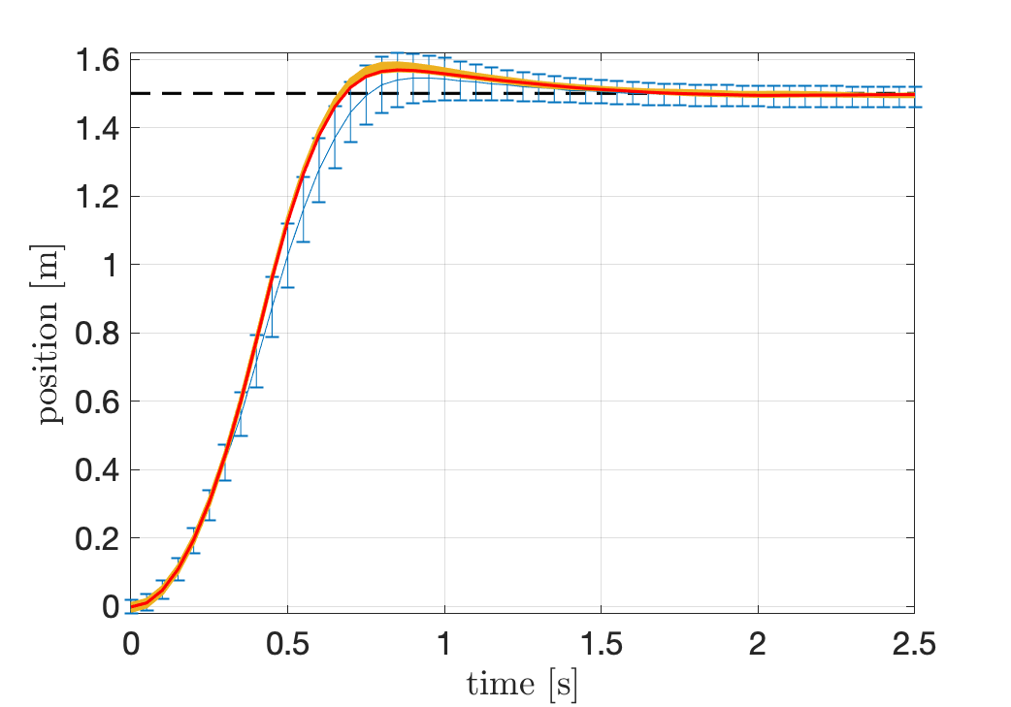
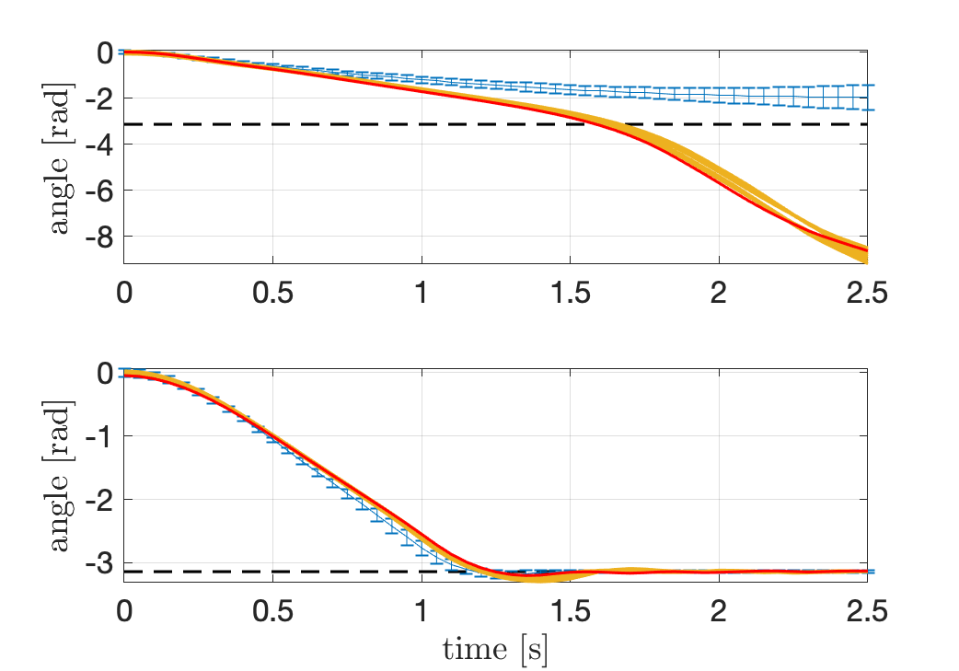
Model-Based Reinforcement Learning – PILCO

Slide 5
Model-Free Reinforcement Learning – PoWER

Slide 6
Model-Free Reinforcement Learning – PoWER

Slide 7
Optimal Control – LQR, iLQR, MPC

Slide 8
Optimal Control – LQR, iLQR, MPC

Slide 9
Conclusion & Discussion

Slide 10

References
Deisenroth, Marc Peter, Dieter Fox, and Carl Edward Rasmussen
"Gaussian processes for data-efficient learning in robotics and control." IEEE Transactions on Pattern Analysis and Machine Intelligence 37.2 (2015): 408-423.
Deisenroth, Marc Peter. Efficient reinforcement learning using Gaussian processes.
Vol. 9. KIT Scientific Publishing, 2010.

Slide 11
Back Up.

