Slide 1
webpack!

Slide 2
¿What is webpack?
1
First, let’s review the official definition of what webpack is.

Slide 3
Is a static module bundler for modern JavaScript applications

Slide 4
Stop here! I’m confused🥲
Before we start delving into this, let's review what technologies are used today to build web pages.

Slide 5



These technologies are:

Slide 6
The problem here is that…
Nobody just uses HTML, CSS and JavaScript
Maybe we want to replace JavaScript with TypeScript. Use an UI library like React to replace HTML and maybe we’ll need a Css preprocessor like Sass
And also, we’ll have to import third-party modules
Many of our dependencies might use common JS which isn’t going to work with modern es module syntax
And a lot of more problems... 😬

Slide 7

¿And do we have a solution for all these problems?
Yes! The “module bundler”. And what it does is solve all these problems.

Slide 8
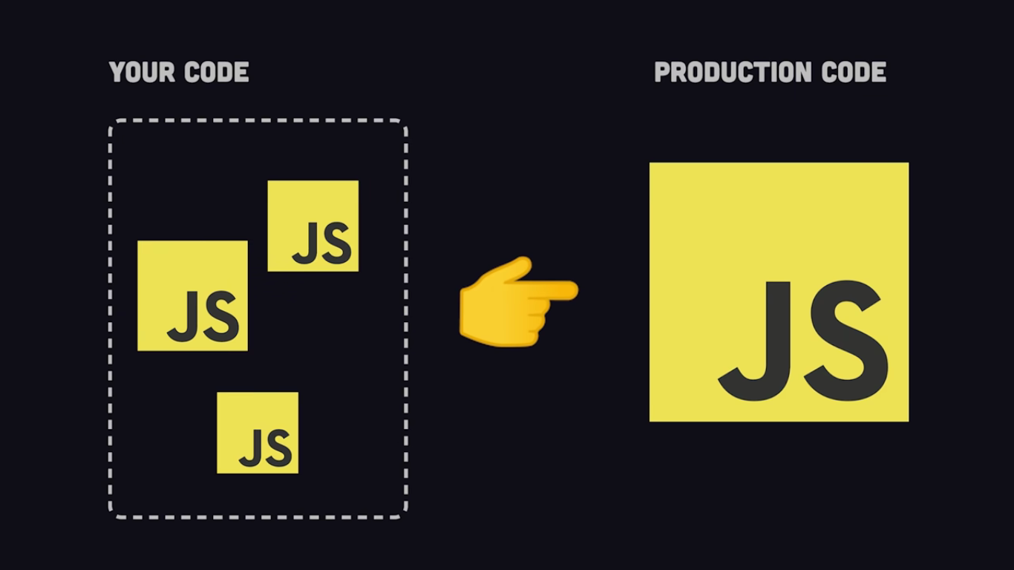
Photo: Fireship

Slide 9
Let's understand a little bit more about webpack in practice! 👏🏻

Slide 10
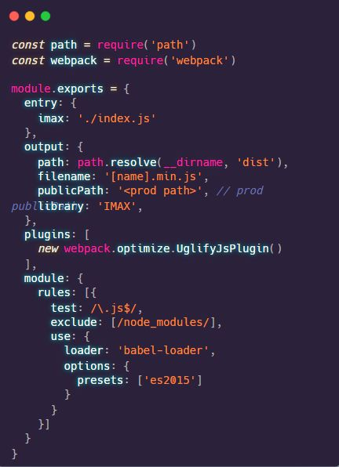

Slide 11
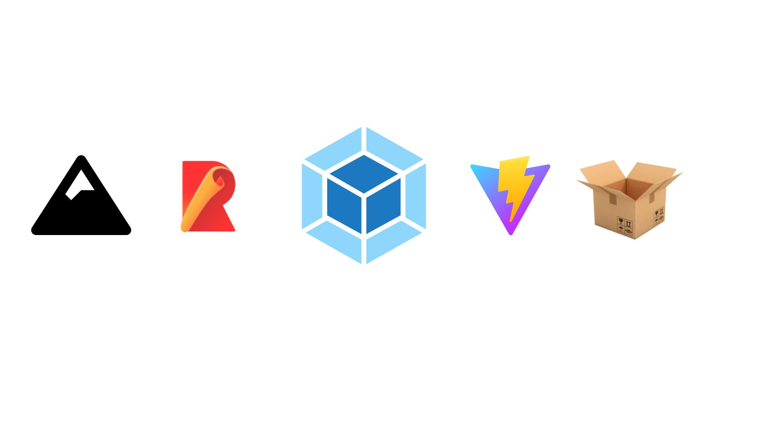
As you could see, webpack can be either a very large file or a very small file
Webpack vs other bundlers
The difference between the two boils (Webpack and Vite for this example) down to speed. Webpack is building the project from source and continuing to do incremental builds as you are developing your project. Vite, on the other hand, is loading your actual code into the browser as needed.

Slide 12



¿What is next?
Tobias Koppers
Webpack Creator
Vercel
Cloud Platform
Turbopack (alpha)
“The Rust-powered successor to Webpack”

Slide 13
Thanks!

Slide 14
Resources
🤓
You can continue studying this topic and delve into it in the following links:
https://webpack.js.org/
https://www.youtube.com/watch?v=FMNuTj89RzU&t=493s
https://www.youtube.com/watch?v=5IG4UmULyoA
Other resources:
https://vitejs.dev/-> Vite
https://turbo.build/ -> Turbopack

