Slide 1
SUPERSTORE ANALYSIS
Sebastián Bustos

Slide 2

TITLES
1. Context and Audience
2. Metadata Summary
3. Hypotheses/Questions of Interest
4. Exploratory Data Analysis (EDA)
5. Insights Found

Slide 3
Context and audience
The United States is a very large country with a vast variety of markets and products. A SuperStore in this country has a database containing all the items sold in the store from January 2019 to December 2020. This market has hired me to create visualizations to help identify sales patterns, which will assist them in making informed decisions about the SuperStore.
For this task, I was provided with a CSV file containing details such as order date, shipping date, product categories, customers, etc. The following tasks will be performed with the data:
Read, transform, and prepare data for visualization.
Conduct analysis and create visualizations to identify patterns in the Dataset.
This analysis aims to answer the client's questions with evidence, which can be useful for various businesses or other clients who view my work.

Slide 4
Metadata summary
A CSV file is available containing the following columns:
Row ID: ID of each register
Order ID
Order Date
Ship Date
Customer ID
Customer Name
Segment
Country
City
State
Region
Product ID
Category
Sub-Category
Product Name
Sales
Quantity
Profit
Payment Mode
This Dataset contains 5901 records (rows) and 20 columns, named previously. Below is an example of the first record in the Dataset:

Slide 5
QUESTIONS OF INTEREST
On which dates of the year are sales highest?
During this period, is it possible to increase production?
Which categories should be produced more and which less?
Will the payment method vary over time?
Which region had the most sales and profits?
Which category had the most sales and profits?
Check sales trends. Analyze customer behavior. Compare Sales and Profits across different variables (categories, states, cities).

Slide 6
EXPLORATORY DATA ANALYSIS
Efective visualizations

Slide 7
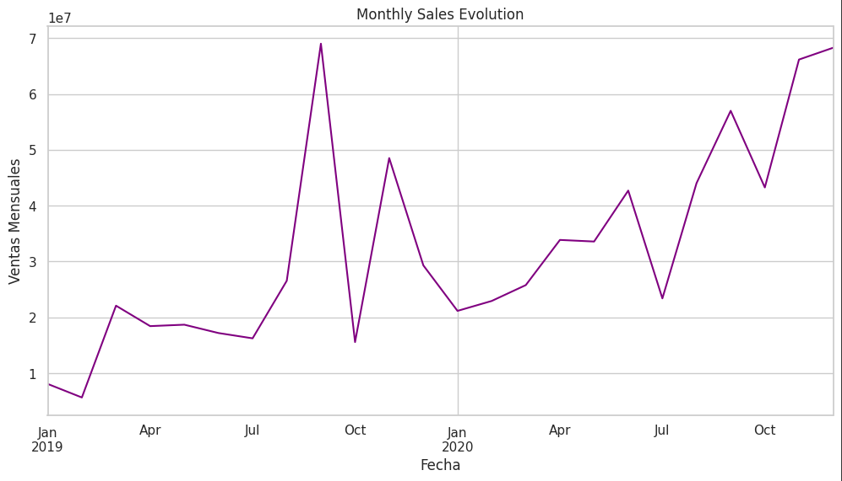
MONTHLY SALES EVOLUTION
Since this is a dataset with sales from 2019 to 2020, we don't have a large range. However, we can clearly see that between July and October, or more precisely in September, there was a peak in sales in 2019. In 2020, the peak occurred after October and continued to rise in December.
Particularly in the United States, the start of the school year occurs between the end of August and the beginning of September. This should be a factor for the increase in sales during that period in both years, significantly more in 2019.

Slide 8
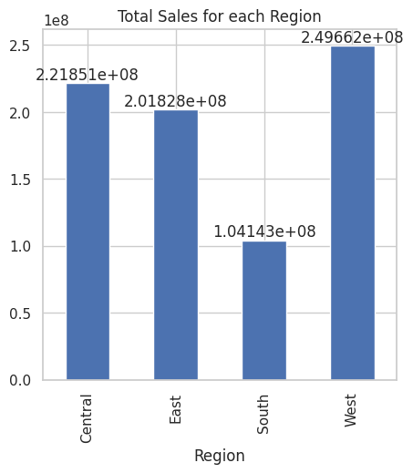
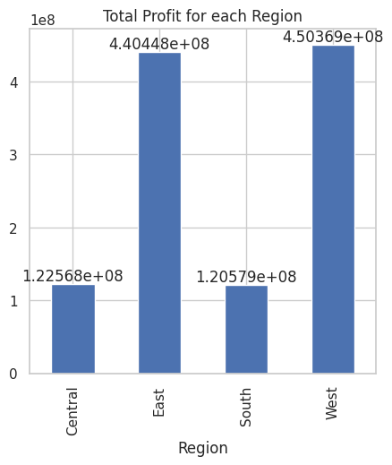
Regions which region had the highest sales and profits?
In both cases, we see a strong relationship between Sales and Profits considering the Region.
Sales:
West (32%)
Central (29%)
East (26%)
South (13%)
Profit:
West (40%)
East (39%)
South and Central (11%)
We can see that in both cases, West leads the lists. However, the second place in Sales goes to Central, while in Profit it goes to East. Could this be related to the products sold?

Slide 9
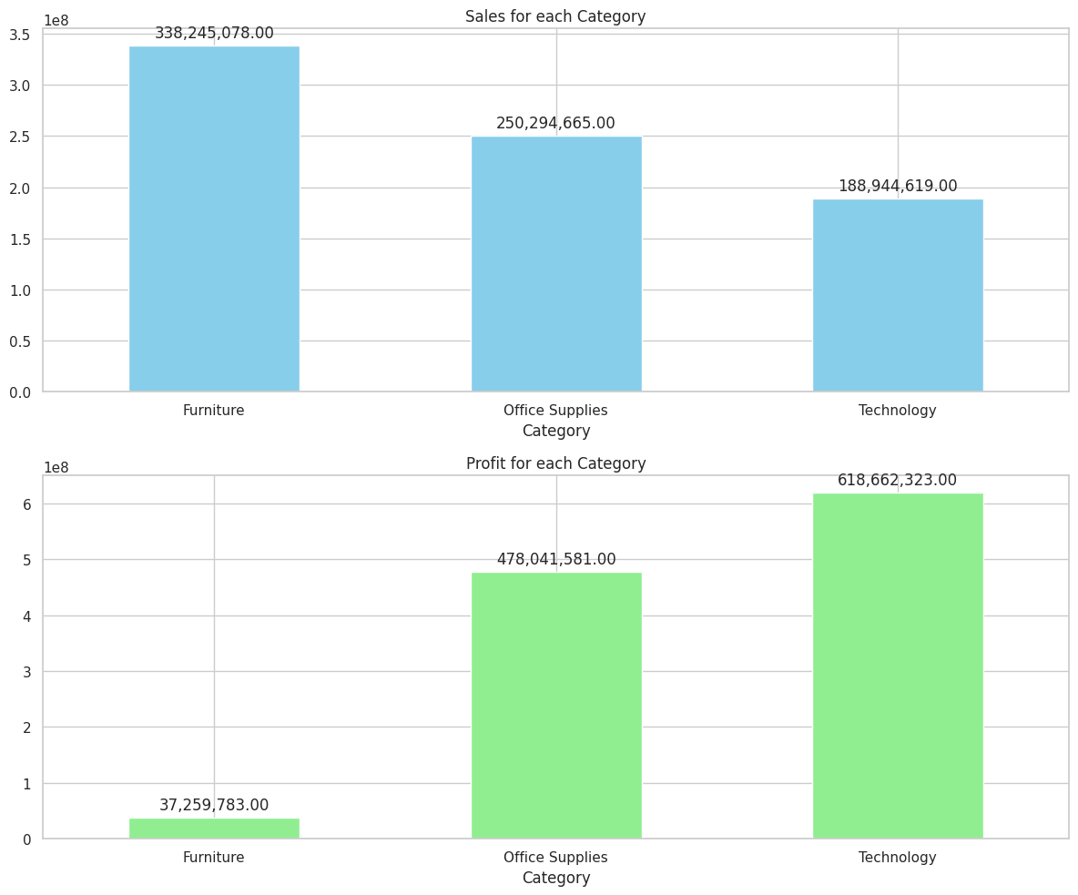
CATEGORIES which category had the most sales? Which was the profitable?
In this single chart, we can observe a comparison between Sales by Category and Profit by Category.
In terms of sales, the order from highest to lowest is Furniture, Office Supplies, and Technology. However, when it comes to Profit, the order is reversed: Technology first, followed by Office Supplies, and then Furniture.
If Furniture had more sales, why did it generate the least profit?

Slide 10
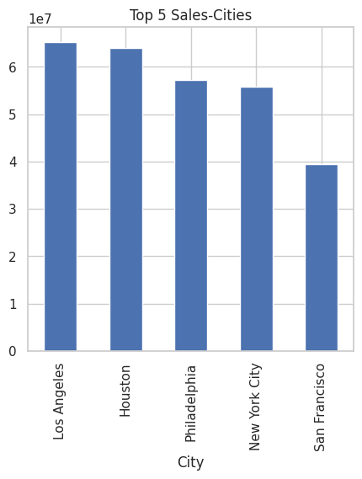
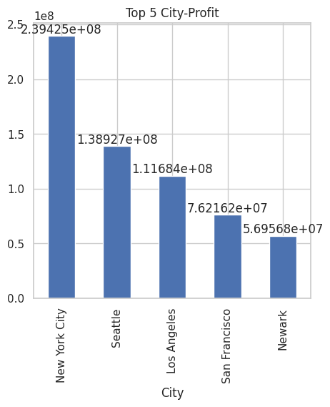
CITIES which cities had the highest sales and profits?
We can observe that Los Angeles has the highest number of sales, leading the Top 5 with a small margin over Houston. Next is Philadelphia, which is not far ahead of New York. Lastly, with a noticeable difference, San Francisco ranks last.
The most profitable city is New York City, followed by Seattle.

Slide 11
INSIGHTS FOUND
sales
The West region has the highest number of sales (32%), followed by Central (29%). South has the lowest percentage (13%).
Considering the Segment, the highest percentage of sales is held by Consumer (51%), followed by Corporate (31%) and finally Home Office (18%).
The highest number of sales occurs in Los Angeles, followed by Houston.
The state with the highest number of sales is California, followed by Texas.
Looking at the Monthly Sales Evolution chart, we can see that at the beginning of both years (2019 and 2020), there is a drop in sales. Mid-year (between July and October), there is an increase in sales in both years, with a very high peak in sales in 2019.
The most sold category is Furniture, followed by Office Supplies and then Technology.

Slide 12
INSIGHTS FOUND
PROFIT
The highest Profit is earned by the West region (40%), followed closely by the East (39%). We can conclude that the South and Central regions are the least profitable, both with 11%.
Consumer is the Segment with the highest profit percentage (51%), followed by Corporate (24%) and then Home Office (23%).
The most profitable city is New York City, followed by Seattle.
The state with the most profit was California, followed by New York.
Technology is the category with the highest volatility in its Sales-Profit relationship. It has the highest percentage compared to other categories (55%), followed by Office Supplies (42%) and lastly Furniture with only 3%.

Slide 13
Machine learning model

Slide 14


Predict quantity variable
To accomplish this task, I decided to use and train a regression model, specifically a Random Forest Regressor.
The first step was to determine which variables are valuable and which are not. Initially, all variables were used. Then, in another model, Order Date, Ship Date, and Customer Name were removed. The results were as follows:
Every variable
Without some variables:
The results for both models, with certain variables removed, are quite similar. Therefore, I conclude that these variables are not detrimental; they do not have a negative impact on the model.

Slide 15
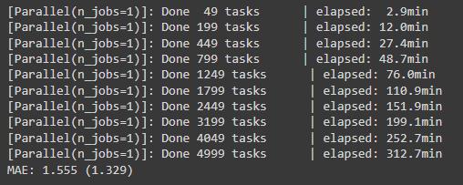
Cross_val_score
Using Leave-One-Out along with cross_val_score, I obtained the following results:
Additionally, using another model along with another cross_val_score, I obtained a Mean Squared Error (MSE) of 4.35:
I used cross_val_score for cross-validation.
I defined the metric to use as Mean Squared Error (MSE).
I applied cross-validation with 5 splits (K-Fold) using cv=5.
The average MSE obtained across all partitions is shown.

