Slide 1

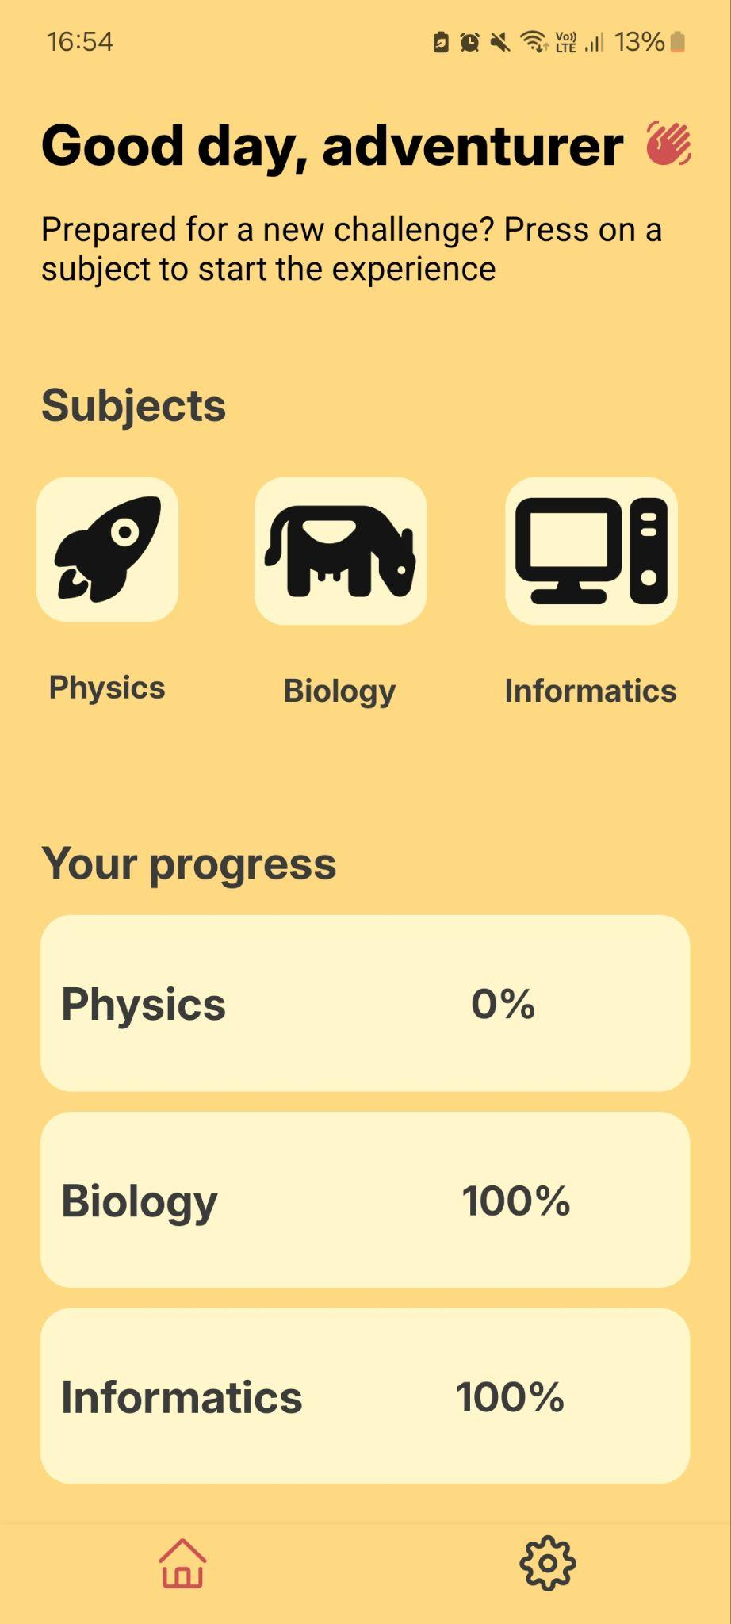
Arcanum
Interactive mobile application
to learn elementary school subjects using Augmented Reality

Slide 2
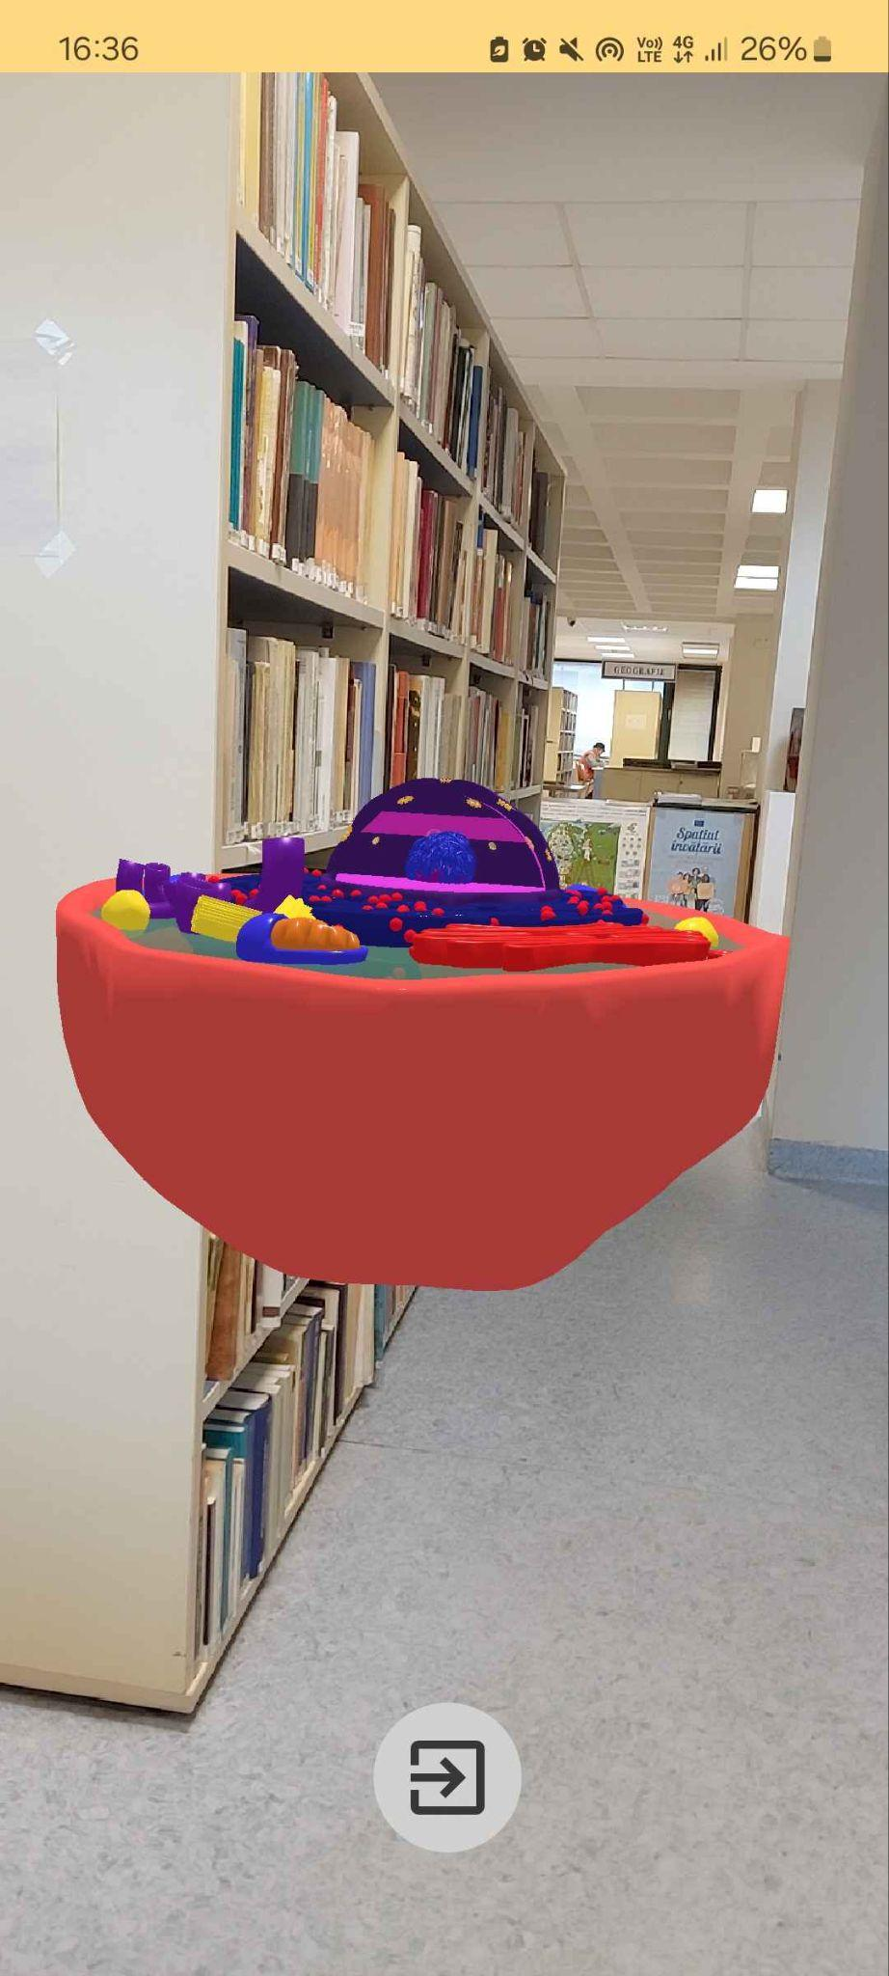
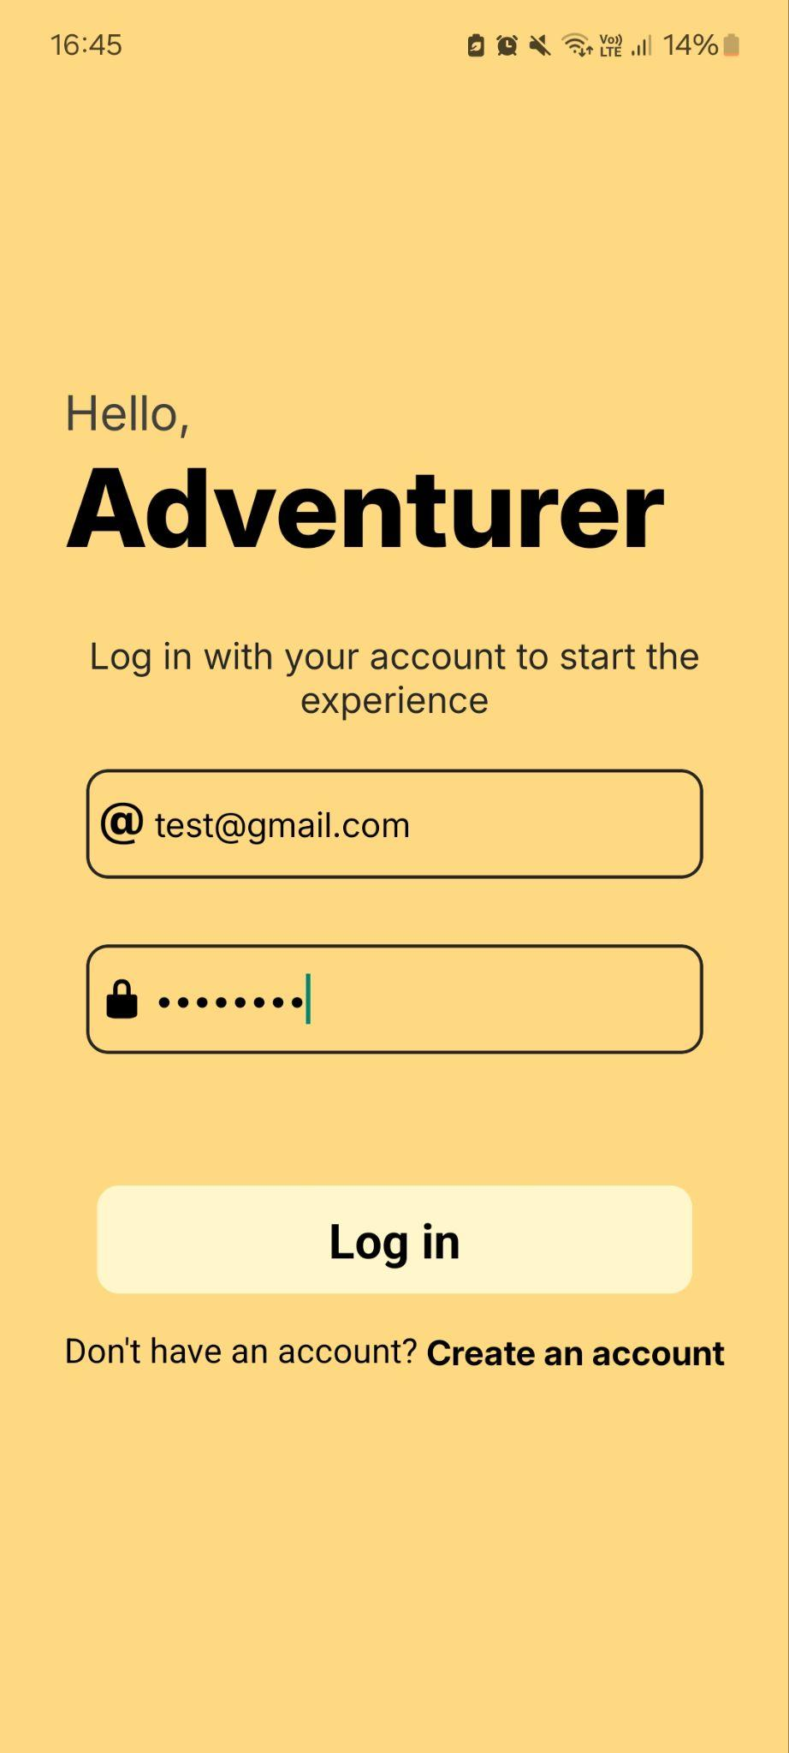
Top Features
AR Scene
Interactive home screen
Authentication system

Slide 3
App architecture
App
Database
User data
React Native
Firebase
Email, password, progress
Viro React

Slide 4
Requirements
Screens
AR Scenes
• Login Screen (auth)
• Cell Scene
• Register Screen (auth)
• Gravity Scene
• Dashboard Screen
• Binary numbers Scene
• Biology/Physics/Informatics Screens
Database
• Firebase (cloud, real time updates)

Slide 5
Thank you

