Slide 1
New Car Sales Prediction at Dealership Level
Sebastian Montero

Slide 2
Concept Definitions
Car Dealership: Entity that sells cars at the retail level.
Car Manufacturer: Entity that manufactures cars, and sells them to dealerships.
Badly Balanced Inventory: An inventory that does not match the consumer demand.

Slide 3
Problem Description
The car dealership buys cars from the car manufacturer to build their inventory.
Financing is required to support this operation, obtained from a bank or the car manufacturer.
Everyday that a car is on the floor of the dealership without being sold represents a cost to the dealership in the form of interest payments.

Slide 4
Problem Description(Continuation)
A badly balanced inventory or an excess in inventory represents a big hit to the car dealership earnings and liquidity.
Not having enough inventory is also a problem in the form of lost sales and low costumer satisfaction.
Thus the importance of an inventory that closely matches the consumer demand.

Slide 5
Proposed Solution
Develop and train a Long Short Term Memory (LSTM) Neural Network to predict car sales demand.
Neural Network: Model non linear relationships between inputs and outputs.
Recurrent: Able to use previous information to the present task.
LSTM: Capable of handling long term dependencies.

Slide 6
Main Design Considerations
Configurable: Easily change model parameters (number of layers, hidden size, input features, etc) in order to facilitate the testing of different configurations and find the best one.
Easy to evaluate: Provide the tools to analyze the results of each tested model and determine the best one.

Slide 7
Model Inputs
Base features:
Month
Monthly historical sales
Additional features considered:
Interest rates
Exchange rates
Consumer confidence
Manufacturing confidence index
Economic activity index
Energy price index
Consumer price index

Slide 8
Model Outputs
Monthly sales predictions N (1,2 or 3) months ahead
Level of prediction:
Car model level
Compared against:
Platform level
Nationwide level

Slide 9
Technologies Used to Develop Solution
MySQL DBMS
Python programming language
Tensorflow machine learning framework
Tensorboard visualization framework
Ray Tune hyperparameter optimization framework

Slide 10
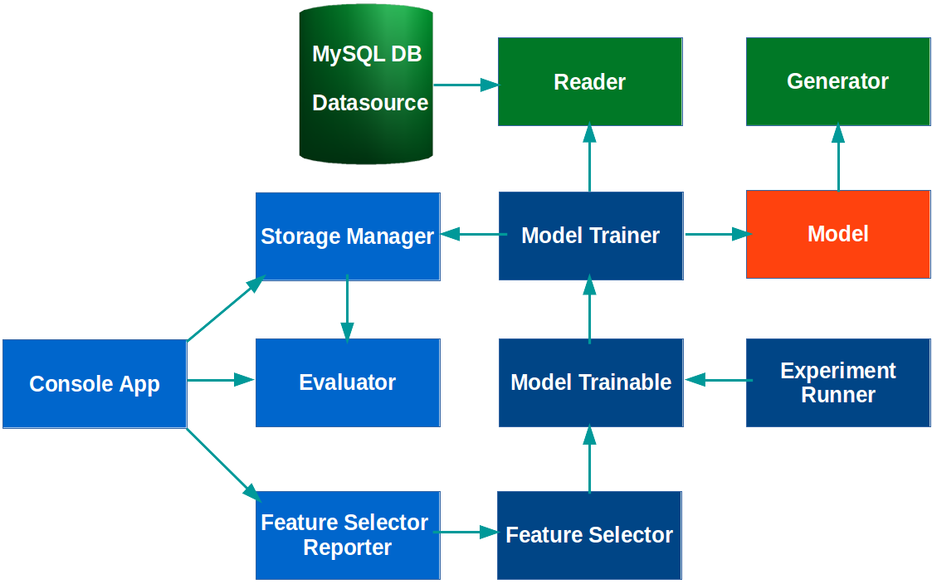
Solution Architecture
Notes:
Datasource: A database was chosen to act as the datasource, to provide flexibility when generating the inputs to the model, and make it easy to choose the input features to use.
Reader: Queries the database to retrieve the data used to train and test the model, performs all the preprocessing(normalizations and transformations) of the data and divides the data in windows to enable the rolling window analysis. It’s easily configurable in terms of input features to retrieve and the window size to use.
Model: Creates the model to be trained, which I’ll explain in more detail later. An object which details the specifics of the model(number of layers, size of layers, optimizer, etc) to be created is used to facilitate its configuration.
Model Trainer: The main responsabilites of the Model Trainer class are training and testing the model, and storing the results for later evaluation. It performs these tasks by creating the model, using the Reader object to retrieve the data for each window, training it and testing it on this data, and then moving to the next window. For each window the Reader object returns a Generator object, which basically creates a tensorflow datasource that the model can use as input. It makes use of the Storage Manager class to persist the results.
Model Trainable: This class enables the Model Trainer class to be used in hyperparameter optimization experiments which will be explained in more detail later.
Experiment Runner: Enables the configuration and running of hyperparameter optimization experiments, more details later.
Feature Selector: Automates the process of feature selection using the Forward Selection Algorithm, more details to come.
Evaluator: Provides functionality to evaluate the results produced by a model. It enables to plot predictions vs real values, plot absolute and relative errors, calculate mean absolute and relative errors, etc.
Feature Selector Reporter: Enables the retrieval and display of feature selector run results, facilitating their analysis.
ConsoleApp: It’s a console application that makes it easier to search for and view the results of experiments and feature selector runs. It uses the Storage Manager class to perform the search, and leverages the Evaluator and Feature Selector Reporter class to display the results.

Slide 11
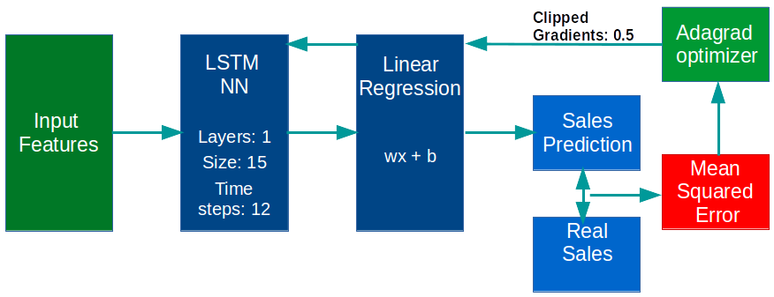
Model
Notes:
Size: Size of the hidden state. Tensorflow’s num_units is the size of the LSTM’s hidden state (which is also the size of the output if no projection is used). To make the name num_units more intuitive, you can think of it as the number of hidden units in the LSTM cell, or the number of memory units in the cell.
Time steps: number of steps through which network is unrolled i.e. each element of this list corresponds to the input at respective time step of our unrolled network. This denotes how many continuous time steps are considered for a single optimization step.
Linear Regression Layer: The output of the LSTM Network is passed through to a linear regression layer to generate the sales prediction value.
Mean Squared Error: The mean squared error function takes in the predictions and the real sales to calculate the loss to be optimized.
The optimizer being used is the Adagrad Optimizer, the gradients are clipped to avoid the gradient explosion problem.
End: Now lets talk about the practical considerations regarding the training of the model.

Slide 12
Model
Notes:
Size: Size of the hidden state. Tensorflow’s num_units is the size of the LSTM’s hidden state (which is also the size of the output if no projection is used). To make the name num_units more intuitive, you can think of it as the number of hidden units in the LSTM cell, or the number of memory units in the cell.
Time steps: number of steps through which network is unrolled i.e. each element of this list corresponds to the input at respective time step of our unrolled network. This denotes how many continuous time steps are considered for a single optimization step.
Linear Regression Layer: The output of the LSTM Network is passed through to a linear regression layer to generate the sales prediction value.
Mean Squared Error: The mean squared error function takes in the predictions and the real sales to calculate the loss to be optimized.
The optimizer being used is the Adagrad Optimizer, the gradients are clipped to avoid the gradient explosion problem.
End: Now lets talk about the practical considerations regarding the training of the model.

Slide 13
Input Preprocessing (Reader)
Month: Sine and cosine functions are applied to the month(1-12), in order to express its cyclical nature.
Energy price index and Consumer confidence index: Rate of change vs previous month and start of year. Interested in steepness of increase, decrease more than absolute value.
Rest of the features: Scaled between [-1, 1], so that all the features values are within the same range.

Slide 14
Input Feature Selection (InputFeatureSelector)
The algorithm used to select the input features was Forward Selection:
First evaluate all features subsets that consist of one input feature, to find the best individual feature.
Next find the best subset of two components, using the one chosen on the first step and one of the remaining features.
Continue this procedure adding one feature at time.

Slide 15
Input Feature Selection Results
The metric used to evaluate the different models was the sales absolute mean error overall the test windows.
The selection process determined that the best subset of input features are:

Slide 16
Model Evaluation (Reader, ModelTrainer)
Due to the limited amount of data and its temporal nature the method used to evaluate the model was Rolling Window Analysis:
A window size is chosen based on the minimum amount of observations required to train the model(36).
Starting at the beginning of the time series, a window size of periods is used to train the model, then a prediction for the next time step is made, and used to evaluate the model.
The window is shifted one period and the process is repeated.
Notes:
Has the added advantage that it’s how the model would be used in practice, as new observations come in the model is retrained to make future predictions

Slide 17
Learning rate decay(ModelTrainer)
The technique used to dynamically adapt the learning rate is as follows:
The model is evaluated after each epoch of training.
If the error didn’t improve then a counter is increased, if it did improve the counter is reset to zero.
If the counter surpasses a certain threshold(3), then the learning rate is decreased by a configurable amount.

Slide 18
Hyperparameter Optimization(ExperimentRunner)
Ray Tune Framework makes it easy to configure and run train experiments on the model, providing flexible trial generation(grid search, random search, conditional parameter distributions)
Coarse to fine search approach
Optimized parameters:
Dropout Keep Probability
Number of Layers
Size of layers

Slide 19
Hyperparameter Optimization Results
The optimization process yielded the following results:

Slide 20
Overfitting Reduction Techniques(Model, ModelTrainer)
Dropout: During each training phase a randomly selected number of neurons are ignored.
Prevents strong co-dependencies between neurons
Model averaging approximation
“Early stopping”: The model is periodically evaluated during training, the best one so far is preserved.
Able to retrieve model before overfitting began

