Slide 1
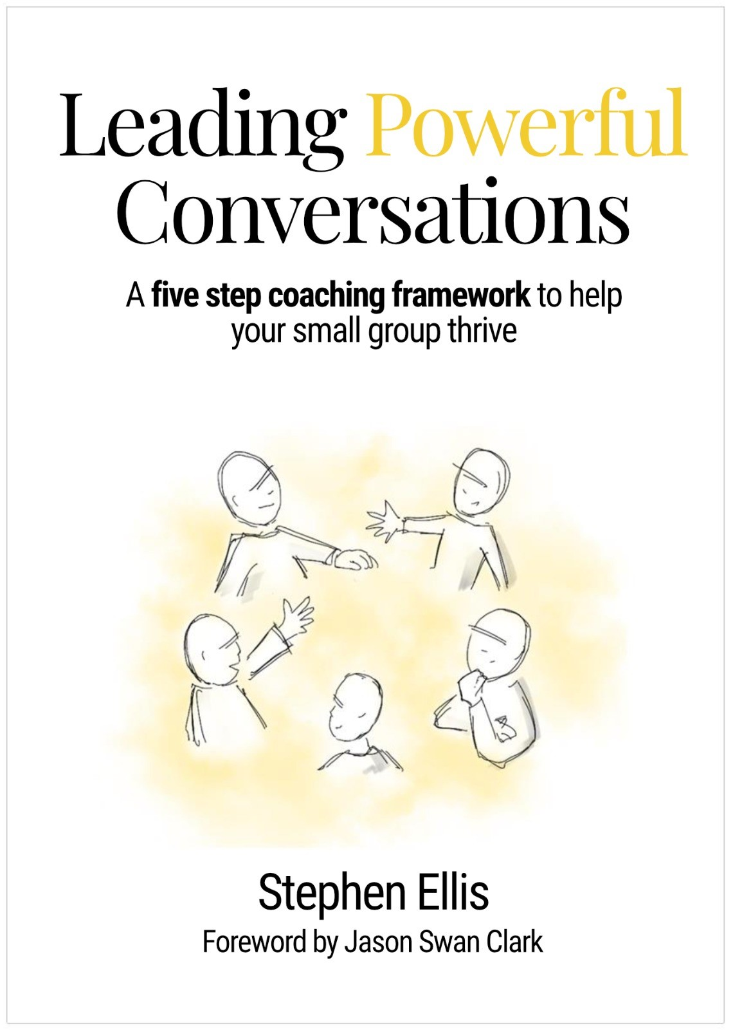
Available to buy on Amazon
Paperback £7.99

Slide 2
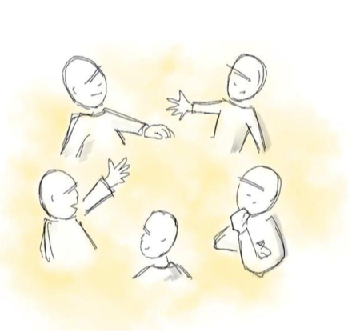
What is a powerful conversation?
A powerful conversation is an intentional conversation which supports a group of people to work through their thinking/challenges, using a series of coaching type questions, while collectively listening to the Holy Spirit and praying together.
‘The purpose of a man’s heart are deep waters, but a man of understanding draws them out’ Proverbs 20:5

Slide 3
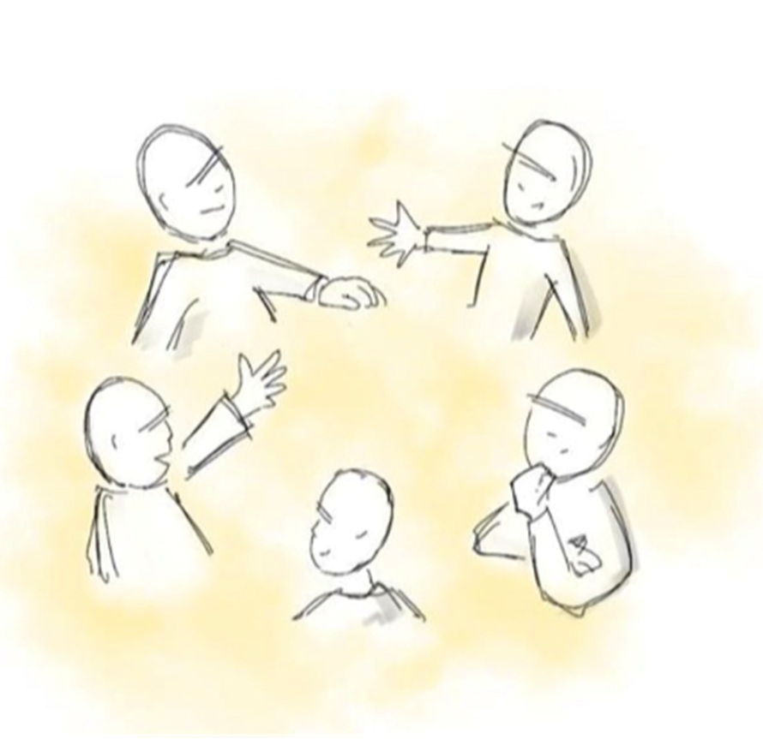
7 principles of a group powerful conversation.
1.Every member is uniquely gifted to serve God.
2. New learning is built on existing knowledge.
3. Good questions enable others to think more deeply and learn creatively.
4. Listening is a key foundation for good conversations.
5. The Holy Spirit is already present to guide.
6. Insights need to be aligned with action.
7. Accountability and prayer create momentum.
‘As iron sharpens iron, so one man sharpens another’. Proverbs 27:17
(Refer to chapter 1 for more in depth explanation).

Slide 4

5 Stages of a small group powerful conversation.
(Refer to chapter 2 for more in-depth explanation)

Slide 5
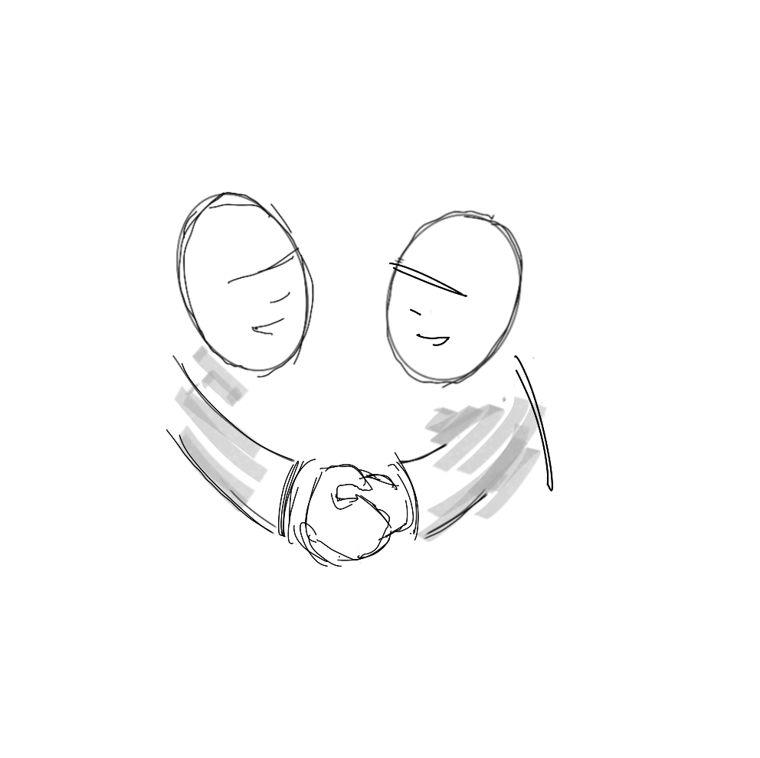
1. Check-In!
This stage is about finding out how the members of your group are. It’s essentially a reality check upon which the leader can sensitively build. Examples of questions which can be used in this stage are:
What are you celebrating?
What’s gone well for you this week?
(Refer to chapter 3 for more in-depth explanation)

Slide 6
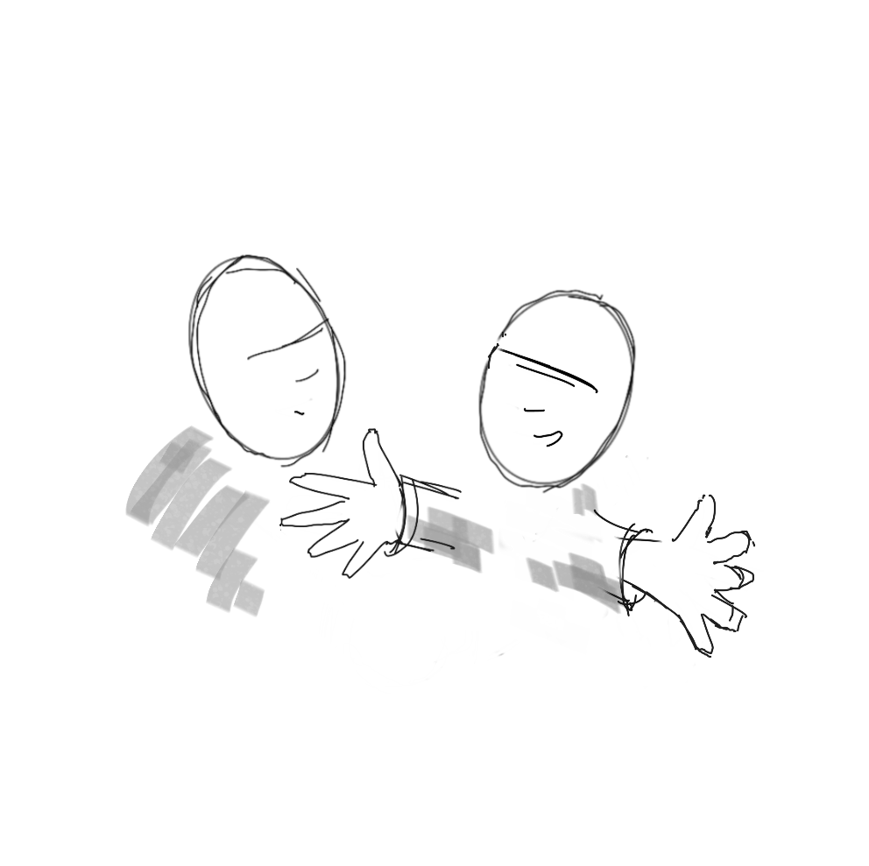
2. Share
This stage is about lifting the group’s mood sharing what they know about the subject of conversation. Examples of questions which can be used in this stage are:
What rested on you when you read the passage or listened to the podcast/talk?
What would you like to explore further and why?
(Refer to Chapter 4 for a more in-depth explanation)

Slide 7
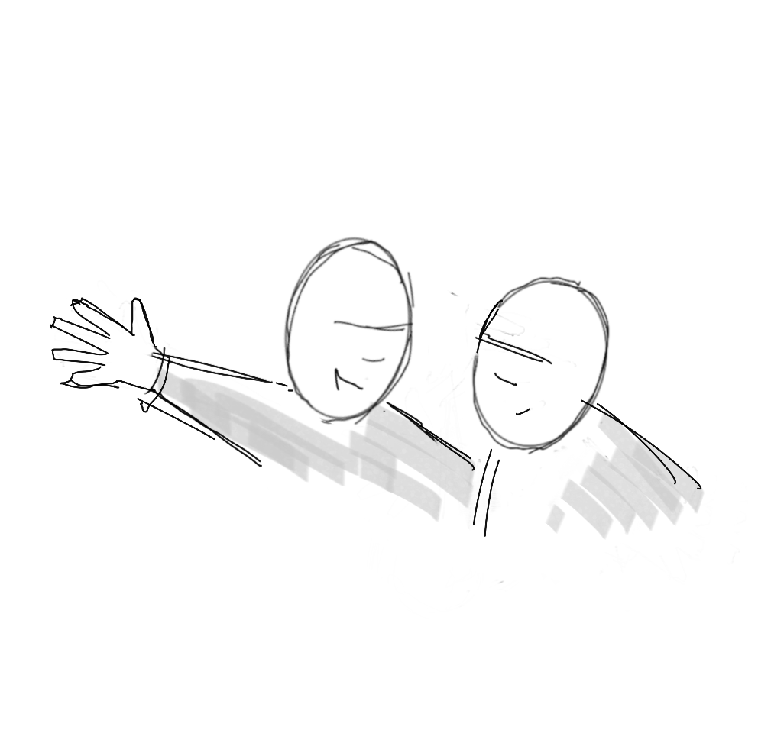
3. Explore.
This stage will ask the group to explore and go deeper with the main biblical principles and their application. Examples of questions which can be used in this stage are:
What are the main biblical principles in this passage, video, podcast etc.?
How do these principles apply to us today?
(Refer to chapter 5 for a more in-depth explanation)

Slide 8
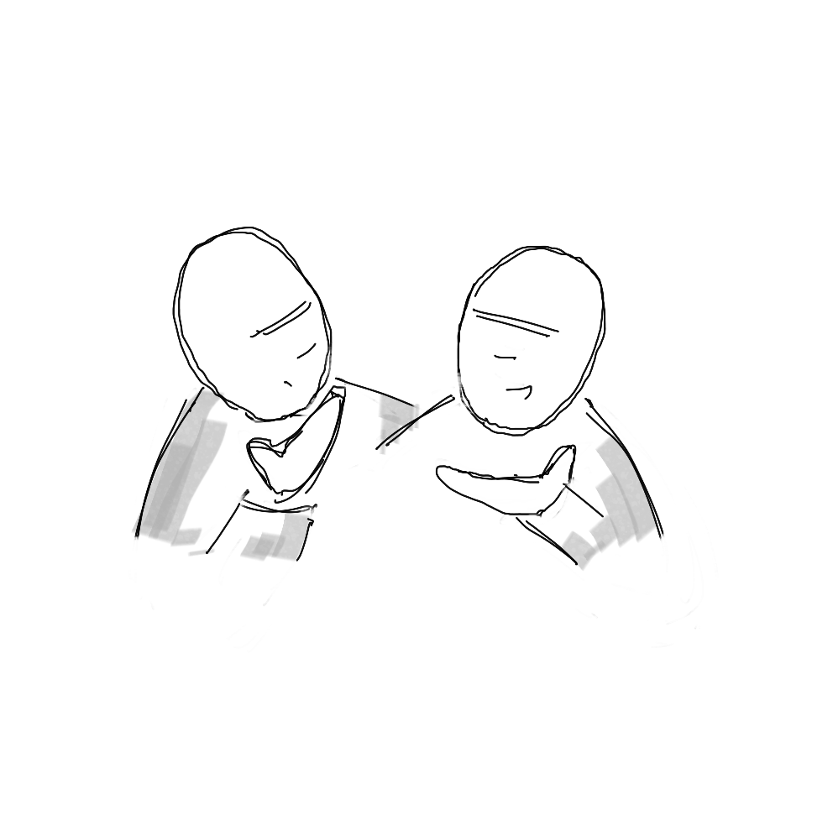
4. Consider.
This stage will ask the group to consider the possible options and resources available to them. Examples of questions which can be used in this stage are:
What do you sense the Holy Spirit/God is showing you in this moment?
What is the main insight you can be thankful for?
(Refer to chapter 6 for more in-depth explanation)

Slide 9
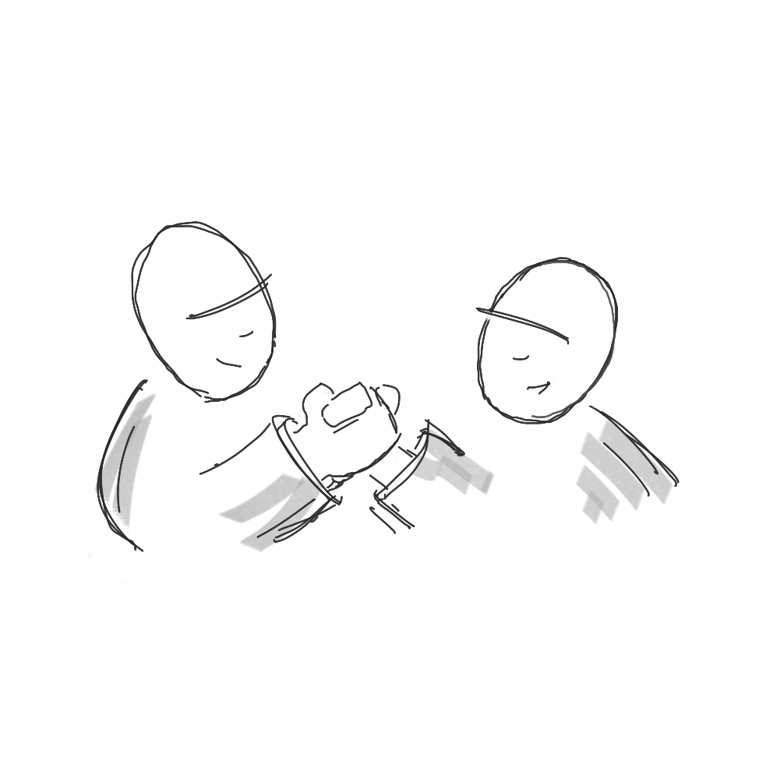
5. Check-out!.
This stage will ask the group to focus on their learning during the conversation. Examples of questions which can be used in this stage are:
How do you feel today’s group conversation has helped you?
What next step you need to take because of today’s conversation?
(Refer to chapter 7 for more in-depth explanation)

Slide 10
Going Deeper: Ready, Steady, Go!
Activity.
Using a blank copy of the powerful conversation design template (appendix 4), plan a powerful conversation for your group using the framework’s principles, stages and examples of questions. Use a resource of your choice. It could be a bible passage, a video clip, a talk or an extract of a book your group are studying etc.
Rule of thumb! Try to write down one question for each stage of the framework. No fewer than 5 questions and no more than 8. (For more examples of questions see appendices 1, 2,& 3)
(Refer to chapter 8 for more in-depth explanation)

