Slide 1
JARVIS
Just A Rather Very Intelligent System
Enterprise Management Platform for AUTOWORLD Group
Internal Presentation | March 2026

Slide 2
Agenda
01
What is JARVIS?
Purpose, vision & target users
02
Platform Overview
Architecture & technology stack
03
Accounting Module
Invoices, statements, e-Factura, Bilant
04
CRM Module
Clients, deals, imports, statistics
05
HR Module
Events, bonuses, structure
06
Marketing Module
Projects, budgets, KPIs, OKRs
07
DMS Module
Documents, signatures, parties, Drive sync, RAG
08
AI Agent
Multi-LLM, RAG, 24 tools, page context
09
Approval Engine
Workflows, conditions, delegations
10
Tags & Notifications
Smart tagging, real-time alerts
11
Key Benefits & Roadmap
Business value & what's next

Slide 3
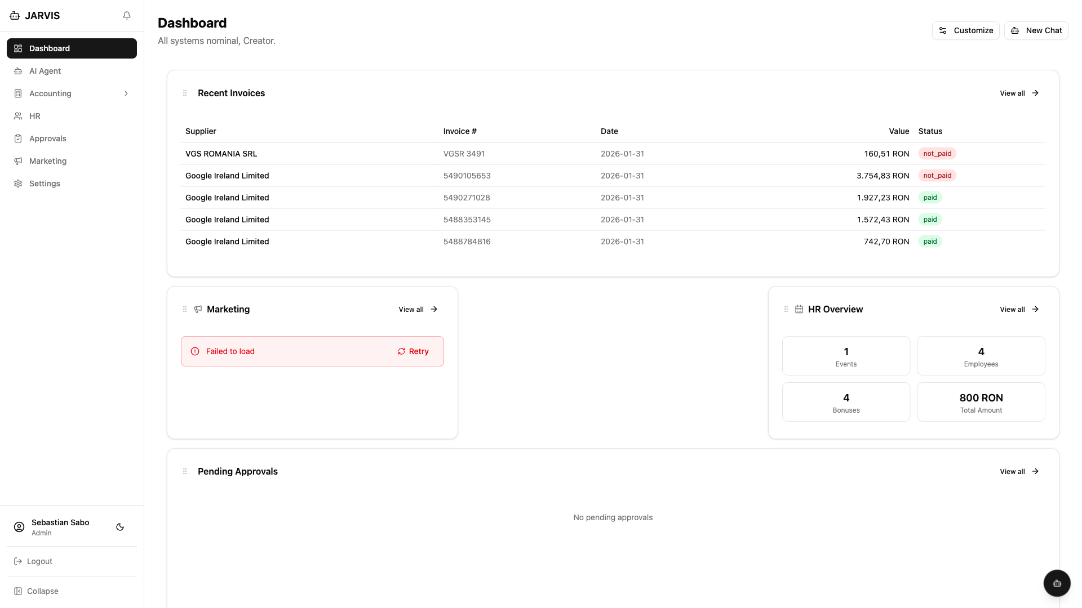
What is JARVIS?
JARVIS is a centralized enterprise management platform built specifically for AUTOWORLD — Romania's leading multi-brand car dealership group.
▸ Replaces fragmented spreadsheets, manual processes & disconnected tools
▸ Single source of truth for Accounting, HR, Marketing & Operations
▸ AI-powered assistance for data analysis, anomaly detection & reporting
▸ Role-based access control with granular permissions per module
▸ Multi-company support across all AUTOWORLD entities
▸ Romanian e-Factura (ANAF) integration for tax compliance
▸ Real-time approval workflows with configurable business rules

Slide 4
Platform at a Glance
772+
0+
169+
923
API Endpoints
Database Tables
React Components
Tests Passing
29
82+
4
24
Flask Blueprints
Repository Classes
AI Providers
AI Tools
Built with Flask + PostgreSQL + React 19 + TypeScript + Tailwind CSS Deployed on DigitalOcean App Platform with auto-deploy from Git

Slide 5
Architecture & Tech Stack
Frontend
Deployment
React 19 + TypeScript + Vite + Tailwind 4 + shadcn/ui
▸ DigitalOcean App Platform (Frankfurt)
▸ Multi-stage Docker (Node 22 + Python 3.11)
▸ Gunicorn: 3 workers x 3 threads
▸ Auto-deploy on push to staging branch
▸ PostgreSQL managed cluster (1vCPU/2GB)
▸ Connection pool: 8/worker, 47 max
▸ Response time: 90-160ms (warm)
State
Zustand (app state) + React Query (server state)
API Layer
Flask RESTful + 20+ Blueprints + 300+ endpoints
Services
Business logic layer (InvoiceService, ProjectService, etc.)
Integrations
Repositories
▸ ANAF e-Factura (OAuth2 + UBL 2.1 XML)
▸ Google Drive (file storage)
▸ Claude, OpenAI, Groq, Gemini (AI)
▸ BNR Exchange Rates (multi-currency)
45+ BaseRepository classes with connection pooling
Database
PostgreSQL 14+ with pgvector, pg_trgm, 100+ indexes

Slide 6
Module Overview
Accounting
Bank Statements
e-Factura
Invoices, allocations, Bilant, multi-currency, VAT subtraction
Upload, parse, transaction linking, vendor mappings
ANAF integration, XML parsing, supplier mappings, sync
70+ endpoints
11 endpoints
30+ endpoints
CRM
HR
Marketing
Clients, car deals (NW/GW), imports, stats, de-duplication
Events, bonuses, employees, company structure, export
Projects, budgets, KPIs, OKR, team, events, dashboard
22+ endpoints
18 endpoints
57 endpoints
DMS
AI Agent
Approvals
Documents, signatures, parties, Drive sync, WML extraction, RAG
4 LLM providers, RAG, streaming, 24 tools, analytics
Multi-step flows, conditions, delegations, audit trail
35+ endpoints
10 endpoints
22 endpoints
Tags & Notifications
Auto-tag rules, AI suggest, in-app alerts, email
21 endpoints
Plus: Settings (11 tabs) | User Profile | Dashboard | Roles & Permissions | Organization Management

Slide 7
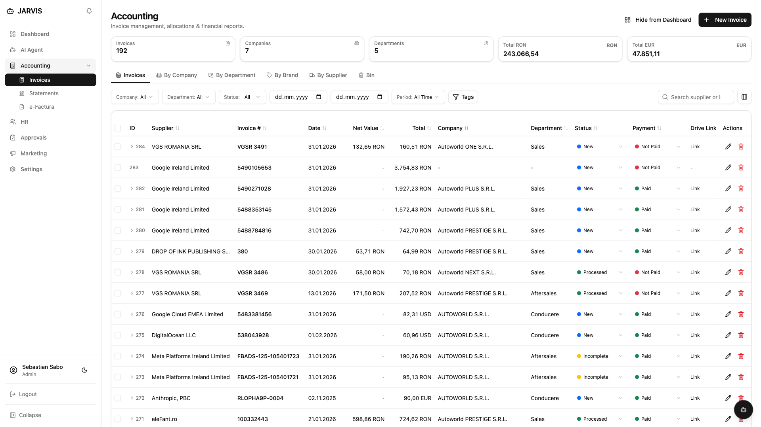
Accounting Module
▸ Invoice CRUD with multi-currency support (RON/EUR/USD)
▸ AI-powered invoice parsing via Claude Vision
▸ Line item extraction with campaign matching
▸ Allocation system: split invoices across departments & brands
▸ VAT subtraction with configurable rates (19%, 9%, 5%, 0%)
▸ Duplicate detection (exact + AI fuzzy matching)
▸ Bank statement import & transaction linking
▸ Multi-destination reinvoicing with lock & tracking
▸ Bilant (Balance Sheet) generator with ANAF XML export
▸ Chart of accounts, CT formula autocomplete, balanta.txt export
▸ Column management: reorder, show/hide, resize
▸ Filter presets: save & restore custom views

Slide 8
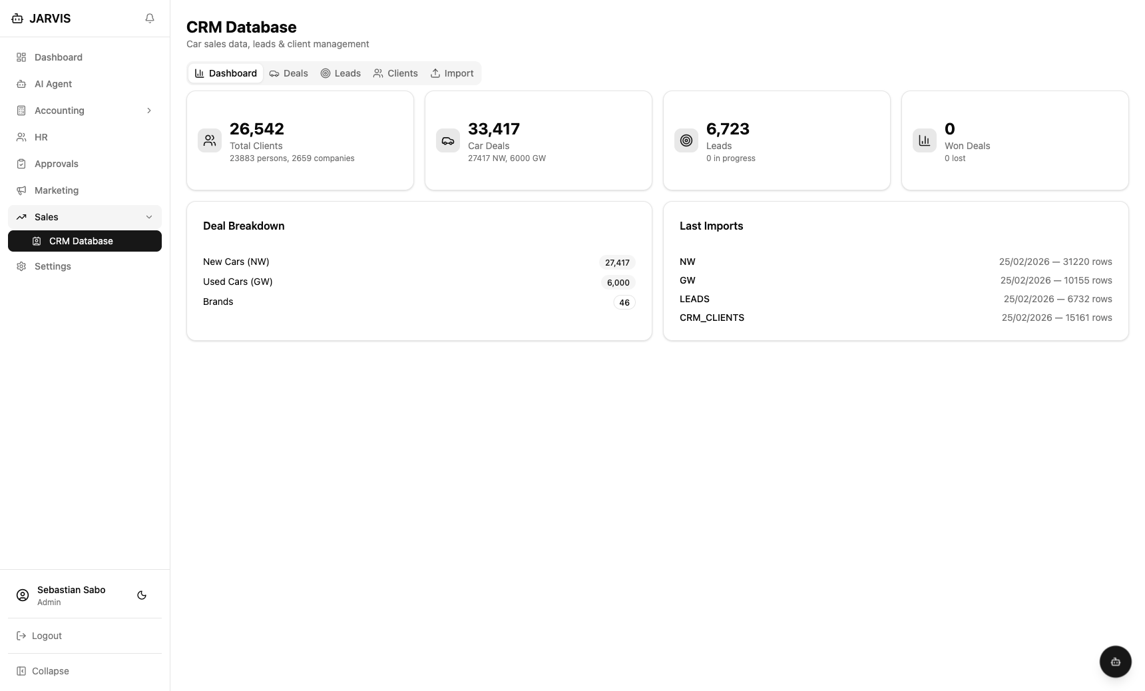
CRM Module
▸ Client management: persons & companies with contact data
▸ Car deal tracking: New (NW) and Used (GW) vehicles
▸ Dashboard: client stats, deal breakdown by brand, import history
▸ Sales tab: browse dossiers with brand/model/status/buyer filters
▸ Statistics: deals by brand, dealer, salesperson, month & region
▸ Client de-duplication & merge tool
▸ Data import: parse NW, GW & client files with validation
▸ Trade register (Nr. Reg) extraction from client names
▸ Client-deal linking with profit & pricing data
▸ AI-integrated: 5 CRM search tools in AI Agent
▸ Contact coverage analysis & data quality metrics

Slide 9
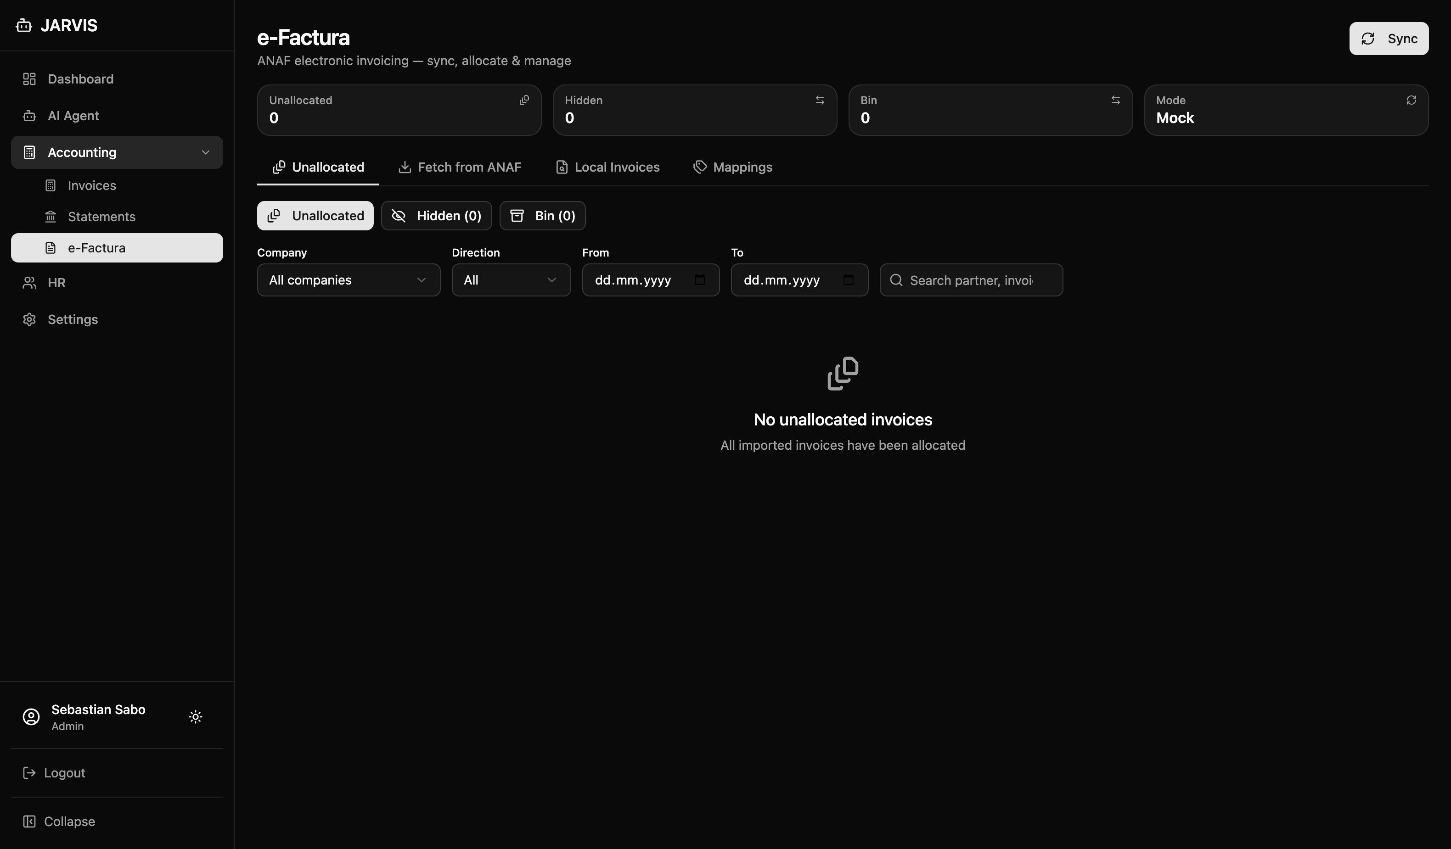
e-Factura Integration
▸ OAuth2 authentication with ANAF (Romanian Tax Authority)
▸ UBL 2.1 XML parsing for Romanian e-invoices
▸ Automated message sync with ZIP handling
▸ Supplier mapping with type categorization
▸ Duplicate detection & correction tracking
▸ Allocation status: Unallocated / Hidden / Allocated
▸ Rate limiting: 150 requests/hour compliance
▸ Sync history with error tracking & retry
▸ Auto-link with internal invoices
▸ "Hide Typed" filter for focused processing

Slide 10
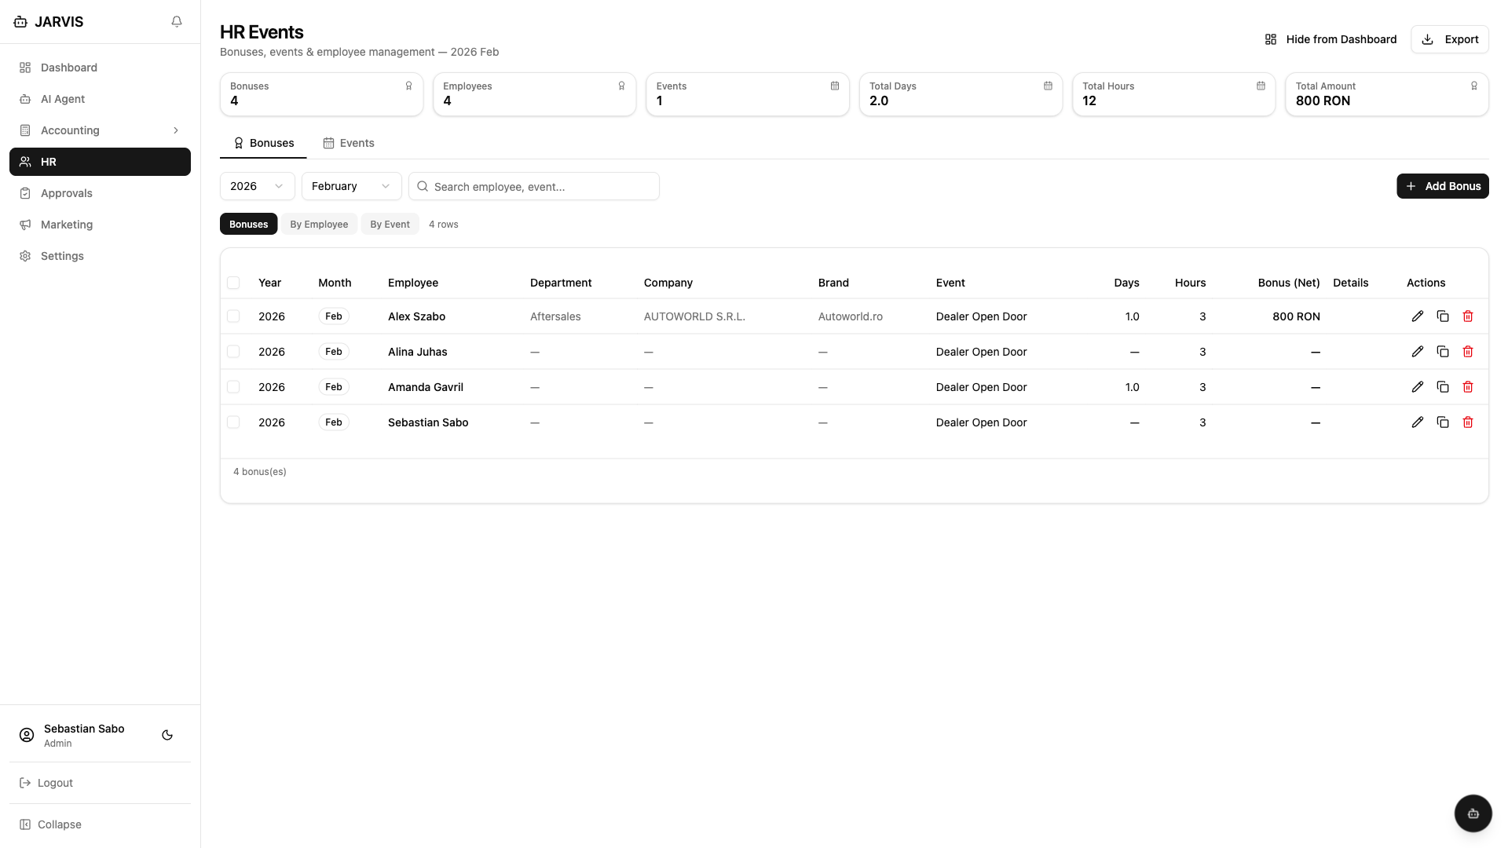
HR Module
▸ Employee event management with date ranges
▸ Bonus tracking per user with configurable types
▸ Lock schedule: bonuses lock on 5th of month
▸ Company structure hierarchy (managers, contacts)
▸ Excel export with aggregated bonus data
▸ Multi-company employee management
▸ Event-to-marketing project linking
▸ Skeleton loading states & keyboard navigation

Slide 11
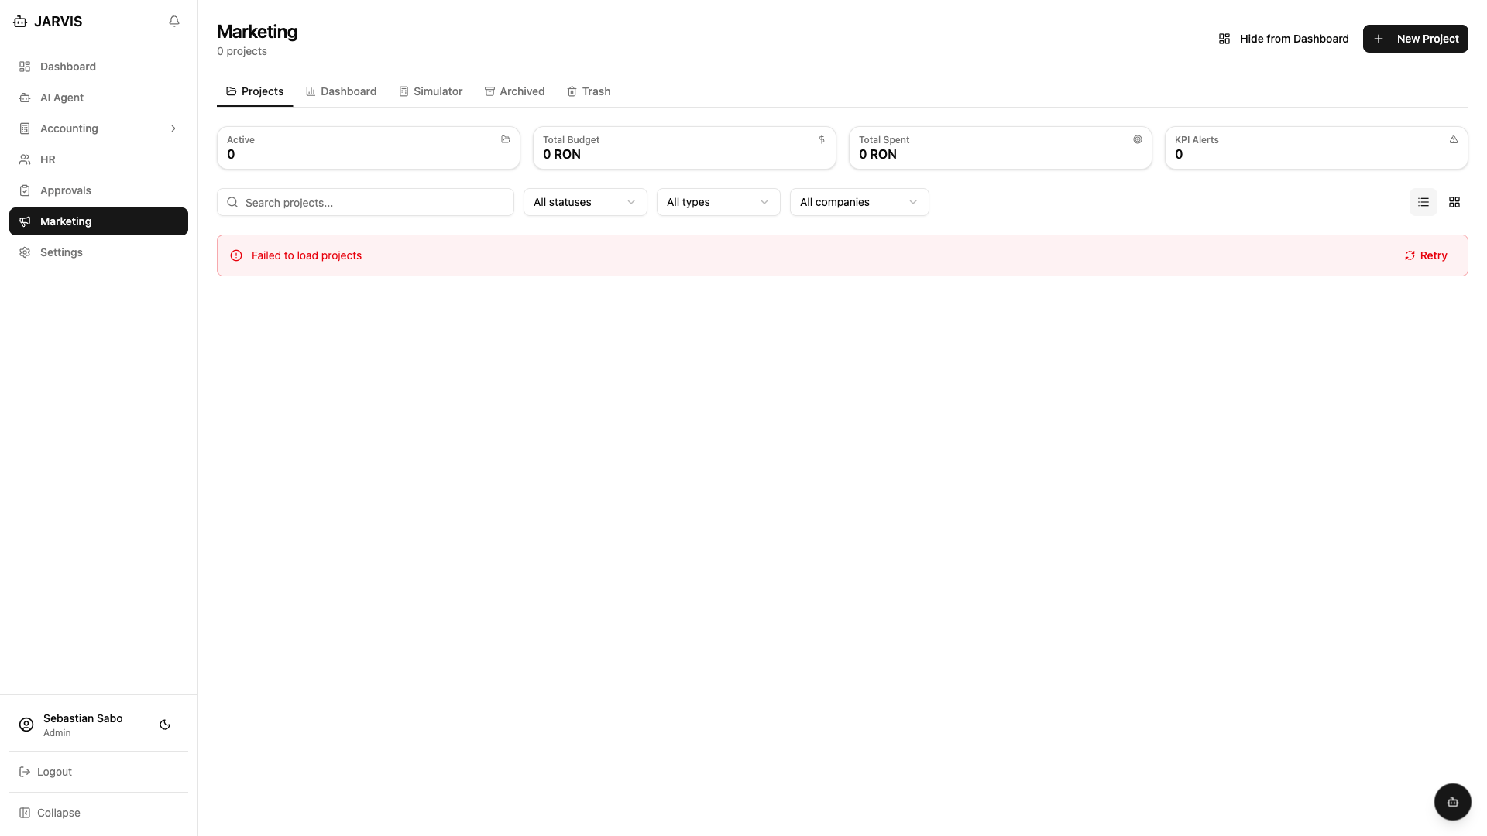
Marketing Module
▸ Campaign project management with 8-tab detail view
▸ Multi-company, brand & department project allocation
▸ Budget line tracking with invoice linking & utilization bars
▸ KPI system: targets, progress bars, snapshot history & sparklines
▸ OKR System: Objectives + Key Results with KPI linking
▸ Team management with role assignment
▸ Threaded comments with internal notes toggle
▸ File attachments per project
▸ HR event linking for campaign execution
▸ Approval workflow integration (context approver)
▸ Dashboard: stat cards, Budget by Channel, KPI Scoreboard matrix
▸ Reports: Budget vs Actual, Channel Performance, CSV export

Slide 12
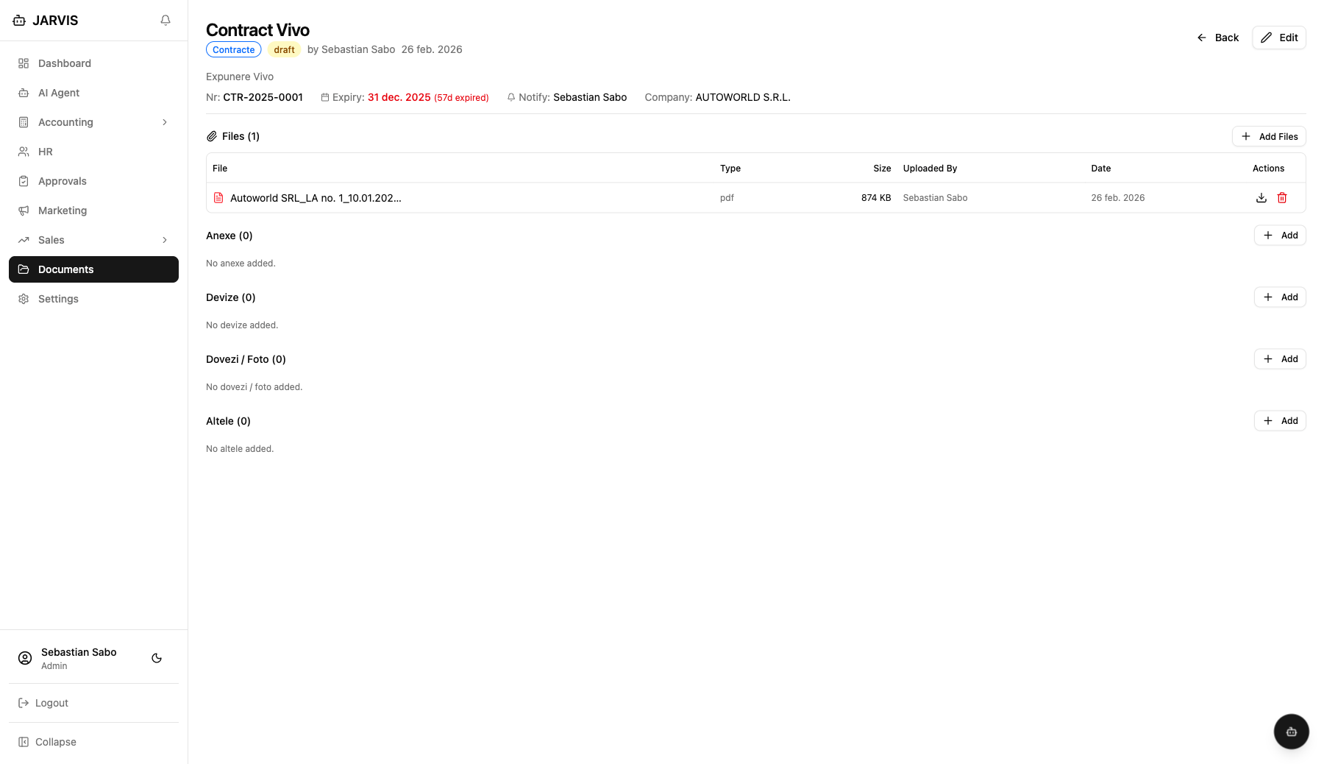
DMS Module
Document Management
▸ Category & subcategory system with role-based visibility
▸ File upload (PDF, DOCX, images) with version tracking
▸ Document expiry tracking with color-coded alerts
▸ Parent-child relationships with dynamic link types
▸ Master supplier management with 3-source suggest
▸ Party mapping: document-to-supplier inline CRUD
▸ Tag support with category-level permissions
Intelligence Layer
▸ Signature management (manual mode, 5 status columns)
▸ Google Drive sync per category with auto-folder structure
▸ WML extraction from DOCX with heading-aware chunking
▸ RAG search: keyword + full-text chunk search (4 AI tools)

Slide 13
AI Agent
4 LLM Providers
Key Capabilities
▸ Claude (Anthropic) — Primary, vision-capable
▸ GPT-4 (OpenAI) — Alternative reasoning
▸ LLaMA (Groq) — Fast inference
▸ Gemini (Google) — Multi-modal
▸ SSE streaming for real-time responses
▸ 24 callable tools (search, create, update, export, CRM, DMS...)
▸ Page context awareness — AI knows which page you're on
▸ Invoice/transaction/CRM/DMS analytics with markdown tables
▸ Smart Alerts: KPI thresholds, budget utilization, invoice anomalies, e-Factura backlog
▸ Automated daily digest emails
▸ AI tag suggestions for entities
▸ AI KR suggestions for OKR objectives
▸ Multi-provider embeddings with batch indexing
▸ Per-provider model selection in Settings
RAG: 9 Data Sources
▸ Invoices, Companies, Departments
▸ Employees, Transactions, CRM Deals
▸ e-Factura records, HR Events
▸ DMS Document Chunks (WML + FTS)

Slide 14
Approval Engine
Workflow Features
User Experience
▸ Multi-step approval flows with conditions
▸ 10 condition operators (gte, lt, eq, in, contains...)
▸ 4 approver types: user, role, dept. manager, context
▸ Escalation & timeout handling
▸ Delegation with date ranges
▸ Full audit trail per request
▸ Configurable in Settings → Flow Builder
▸ 49 automated tests, zero known issues
▸ Approval queue with pending count badge
▸ Quick approve / reject from list view
▸ Detail dialog: context, steps, decisions, audit
▸ Entity widget: shows approval status inline
▸ Integrated into: Invoices, e-Factura, Marketing
▸ Real-time notifications on status changes
▸ Delegation management tab
▸ Hourly scheduler: timeouts, reminders, expiry
Submit → Step 1 (Conditions) → Step 2 (Escalation) → Approved / Rejected → Notification + Hook

Slide 15
Tags & Notification Center
Smart Tagging System
Notification Center
▸ Global (admin) + private (user) tags with groups
▸ 6 entity types: invoices, e-Factura, transactions, employees, events, marketing projects
▸ Auto-tag rules: condition builder with 11 operators
▸ "Run Now" to apply rules to existing entities
▸ AI Suggest: LLM-powered tag recommendations
▸ Tag filters on all major pages
▸ Integrated with filter presets
▸ In-app notifications with unread badge
▸ Real-time polling (every 30 seconds)
▸ Bell icon popover with scrollable list
▸ Click-to-navigate to linked entity
▸ Email + in-app for critical events
▸ Approval event notifications (6 types)
▸ Smart alerts: KPI, budget, anomaly, backlog
▸ 30-day auto-cleanup via scheduler

Slide 16
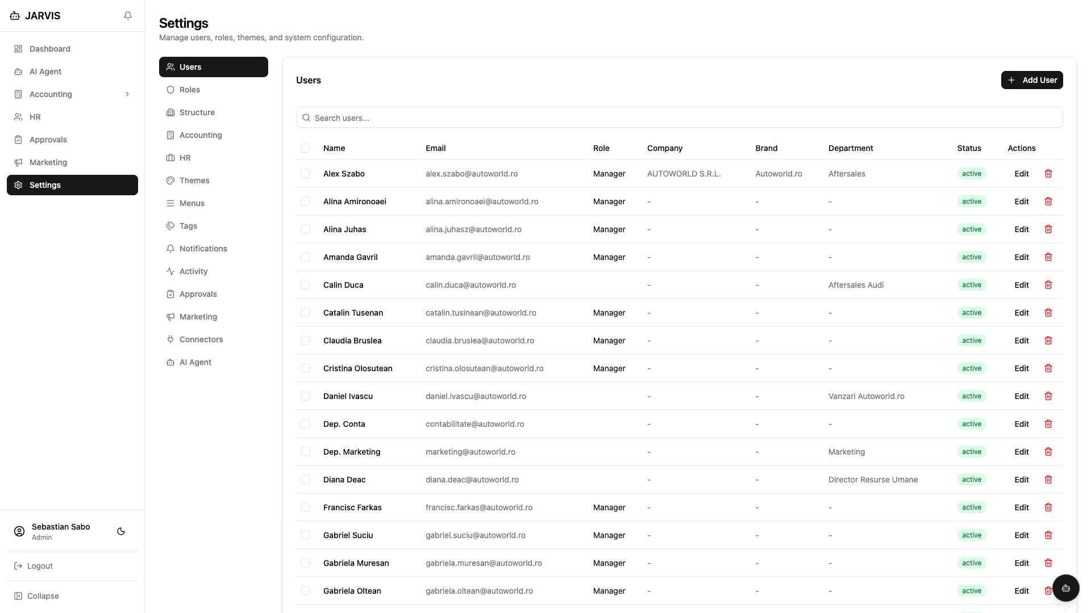
Roles & Permissions
Permission Model (V2)
Default Roles
▸ Format: module.entity.action + scope
▸ Scopes: all | own | department
▸ Modules: accounting, hr, marketing, ai, approvals, tags
▸ Actions: view, create, edit, delete, export, manage
▸ 8 marketing + 8 approval + 7 AI permissions
▸ Configurable per role in Settings → Roles tab
▸ Admin — Full access to all modules & settings
▸ Manager — Department-scoped access + approvals
▸ User — Own data access + basic operations
▸ Viewer — Read-only access across modules

Slide 17
User Interface
Accounting
CRM
e-Factura
HR Events
Marketing
DMS

Slide 18
Key Benefits
Centralized Operations
Single platform replacing 5+ disconnected tools — accounting, HR, marketing, approvals all in one place
AI-Powered Insights
4 LLM providers analyze invoices, detect anomalies, suggest tags, generate reports & daily digests automatically
Tax Compliance
Built-in ANAF e-Factura integration ensures Romanian e-invoicing compliance with automated sync & duplicate detection
Process Automation
Configurable approval workflows, auto-tagging rules, smart notifications & scheduled tasks reduce manual work
Multi-Company Support
Manage all AUTOWORLD entities from one dashboard — invoices, budgets & permissions scoped per company
Real-Time Visibility
Live dashboards, KPI tracking with sparklines, budget utilization monitoring & instant notification alerts

Slide 19
Security & Quality
Security
Code Quality
▸ Session-based authentication with secure cookies
▸ Password hashing (bcrypt) with reset tokens
▸ Role-based access control (RBAC) with scopes
▸ Permission checks on every API endpoint
▸ CSRF protection on all forms
▸ SQL injection prevention (parameterized queries)
▸ Rate limiting on e-Factura API (150/hr)
▸ 923 automated tests (100% pass rate)
▸ TypeScript strict mode across all frontend code
▸ BaseRepository pattern for consistent data access
▸ Service layer for business logic separation
▸ Comprehensive error handling & validation
▸ 90-160ms average response time
▸ Connection pooling with health checks

Slide 20
What's Next
Completed (Feb 2026)
Potential Next Steps
▸ ✅ Full React migration (9 phases)
▸ ✅ CRM module: clients, deals, imports, stats, AI tools
▸ ✅ AI Agent with 4 providers + RAG + 24 tools
▸ ✅ Marketing module (6 phases + OKR + Dashboard)
▸ ✅ Approval engine (6 phases + context approver)
▸ ✅ DMS: documents, signatures, parties, Drive sync, RAG
▸ ✅ Bilant (Balance Sheet) with ANAF XML export
▸ ✅ Notification center + smart alerts
▸ ✅ Tagging system with AI suggest
▸ Frontend test coverage (0% → target 60%+)
▸ Marketing module test coverage
▸ Security hardening (CSP, HSTS, X-Frame-Options)
▸ IDOR remediation on user endpoints
▸ Accessibility improvements (WCAG 2.1 AA)
▸ Mobile-responsive optimizations
▸ Reporting module with export capabilities
▸ API documentation (OpenAPI/Swagger)

Slide 21
JARVIS
One Platform. All Operations. AI-Powered.
772+ APIs · 0+ Tables · 923 Tests · 4 AI Providers 8 Modules · Multi-Company · Real-Time Approvals
Built for AUTOWORLD | March 2026

