Slide 1
Non-linear dimensionality reduction for indoor localisation of mobile agents
Sebastian Wehkamp
Notes:
In recent years an increasing amount of research has been done on the development of indoor positioning systems for mobile agents. Despite it being a challenging subject there is a large demand in services they can provide. An example of such a service, warehouse inventory management, is the service which inspired this thesis.
Outdoor positioning of mobile agents can be done using GPS which is not always available and precise enough for indoor positioning. Current research for indoor positioning systems focuses on approaches using SLAM in combination with cameras or specialised hardware. In addition to this large repetitive environments, like warehouses, limit the accuracy of these methods.
This thesis proposes a method which uses a dimensionality reduction approach to solve the problem. Wireless networks are present in most indoor environments so they are a cost effective approach. The high dimensional signal strengths are mapped to 2-dimensional grid positions. Supervised, unsupervised, and semi-supervised approaches are tested resulting in high accuracies. The thesis is concluded with possible project refinements and extensions to improve the system further.

Slide 2
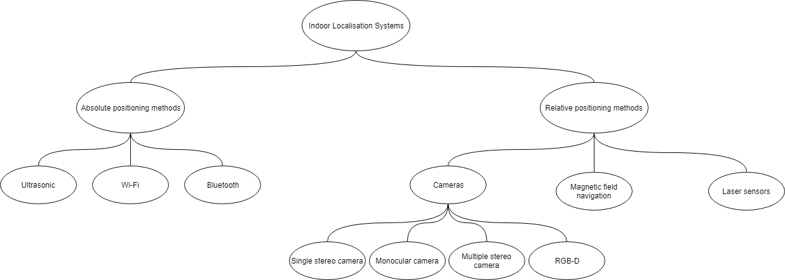
Indoor localisation systems
Notes:
As I said previously, some research has been done on indoor localisation which I will discuss first. Most of the current research focusses on using SLAM, which is simultaneous localisation and mapping, in combination with specialised hardware. The idea of SLAM is that an agent is placed in an unknown environment and then tries to built a map of said environment while simultaneously localising itself.
The required sensors can be split into two types, relative and absolute positioning systems. Relative positioning systems use sensors located on the agent while absolute positioning systems make use of external beacons.

Slide 3
Inertial measurement unit
Gyroscopes
Accelerometers
Magnetometers
Notes:
A popular relative positioning sensor which is often used as the base sensor is the Inertial Measurement Unit. Which is a sensor which can include an accelerometer, gyroscope, and magnetometers. Because of their small size, low cost, and low power consumption they are often used as a basis in combination with another sensor.

Slide 4
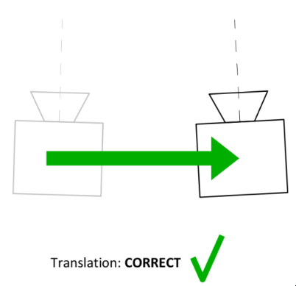
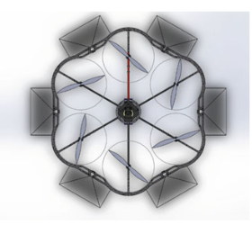
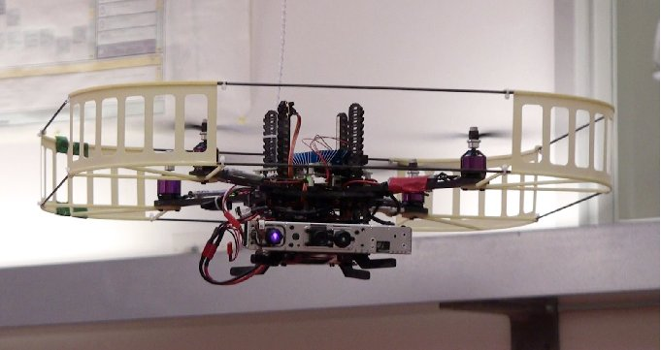
Camera
Monocular camera
Stereo camera
Omni-directional camera
Notes:
Another relative positioning sensor is the camera. Their wide-availability, low weight, low cost, and low power consumption has made them very popular. Various configurations are possible like a single camera, a stereo camera, or cameras all around the agent. Depending on the requirements a suitable configuration can be chosen. For example if an agent can only move forward and must be able to estimate the depth a stereo setup would be best however if the agent can move in any direction cameras all around might be better. Another advantage of cameras is that they can be used for other purposes as well like object tracking. The processing of images however already requires quite a lot of processing power and using additional functions like object tracking would increase this even more. Another disadvantage is that they are very sensitive to light, the warehouse in question has an automated lighting system and when the lights are off the camera would be useless.

Slide 5
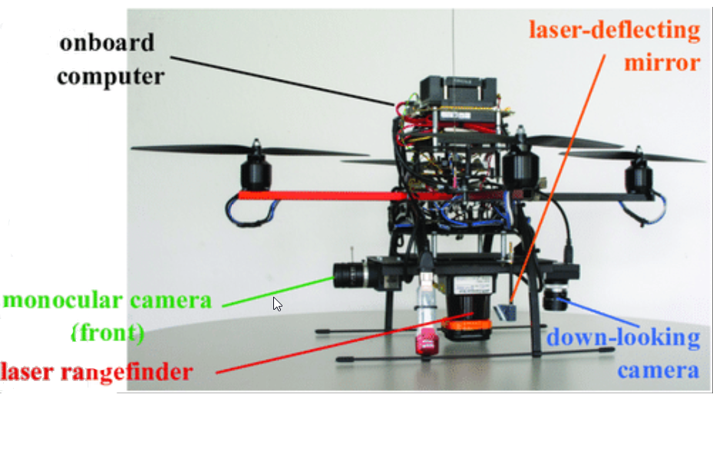
Laser sensor
Higher accuracy
Less computational power
Higher weight
Higher power consumption
Difficult navigating straight corridor environments
Notes:
Compared to the camera a laser sensor has a number of advantages which are that they require less computational resources, are more accurate, and not so sensitive to lighting conditions. They can also be used for height estimation when some of the light is deflected downwards using a mirror. The main disadvantage is that they require more power and have a higher weight which is inconvenient for flying agents. They also have difficulties navigating straight corridor environments, like the warehouse in question, since there are not many unique structural features.

Slide 6
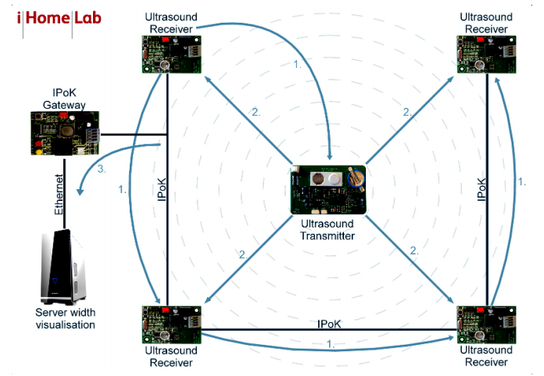
Ultra-sound positioning
Multiple configurations using Time of Flight
New research uses Time Difference of Flight
Sensitive to noise
Notes:
A popular absolute positioning system is an ultrasound system. This type of absolute positioning system is popular because they are simple, inexpensive, and accurate. There are various methods about how such a positioning systems can be implemented but they all depend on the time of flight ToF. .Examples of ultrasound positioning systems are the bat system, the cricket system, or the dolphin system. The difference between these methods mainly being the distribution of the emitters and receivers, and the type of signal transmitted. In recent studies research has been done on using the time difference of flight TDoF instead of ToF. The advantage of using the TDoF is that it only measures the arrival times of signals thus it removes the need of synchronisation between the transmitters and receivers. A disadvantage of ultrasound positioning is the sensitivity to noise. In environment with a high amount of noise the accuracy of the positioning will drop or might fail completely. Therefore using ultra sound positioning for the use case at hand, a warehouse with heavy machinery, is not feasible.

Slide 7
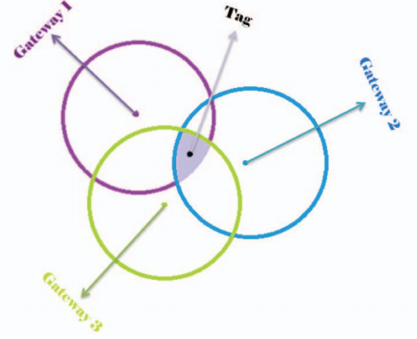
Bluetooth
Popular since Bluetooth Low Energy
Low and High precision version
Notes:
With the release of Bluetooth Low Energy, an energy efficient version of Bluetooth, Bluetooth localisation turned out to be a very practical localisation method. The recent release of Bluetooth 5.0 improves this localisation method even further since a maximum range of 400 meters can be obtained depending on the transmitting power and the environment. Because Bluetooth equipment is readily available on inexpensive commodity devices it is a very cost efficient localisation method. There are two ways to perform Bluetooth localisation, a low precision and a high precision version. The difference is the usage of the Received Signal Strength indicator or RSSI in short. In the low precision version the value of the RSS indicator is not used, the only concern is whether the receiver receives the signal or not. Because the maximum range of the transmitters is known a circle can be drawn around each transmitter. Once one of the signals is received that circle is highlighted. When more than one signal is received the overlapping region will be highlighted. In contrast to the low precision version, the high precision version does use the RSS value to scale the circles. This results in much smaller regions.

Slide 8
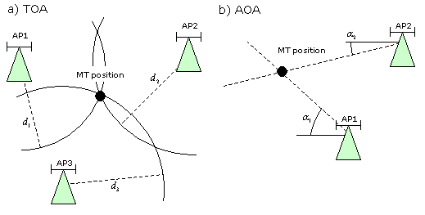
Wireless networks
Four available methods:
RSSI value
Fingerprinting
Time of Arrival
Angle of Arrival
Notes:
Several different techniques using wireless networks for localisation can be identified. The first technique is based on the RSS indicator which is measured for several different access points. This indicator is combined with a propagation model to the determine the distance to the access point. Trilateration is then used to estimate the location of the device. This method is one of the easiest and cheapest to implement but it does not provide very good accuracy which is in the range of 2-4m because the RSS indicator values fluctuate according to changes in the environment.
The second method also uses the RSS indicator but combines it with a database of known coordinates and the respective RSS indicator values which is called a fingerprint. The database of fingerprints is created during an offline phase. In the online phase an unknown RSS indicator vector is matched against the database of fingerprints and the closest match is returned as the estimated user location. Such a system provides an accuracy in the range of 0.6-1.3m. The main disadvantage is that you have to update the database of fingerprints when the environment changes.
The third wireless network localisation technique to be discussed is based on the ToF. This approach uses timestamps provided by the wireless interfaces in order to calculate the ToF. The wireless signals propagation speed is close to the speed of light which remains constant in most propagation media. Therefore this method is not as susceptible to environment changes as the RSS indicator based techniques. The time stamps and the propagation speed are then used to estimate the distance to the wireless access points after which trilateration is used to estimate the position of the device. The result provides an accuracy of 2m. The difficulties for this approach are clock synchronisation, noise sampling artefacts, and multipath channel effects.
With the development of Multiple Input Multiple Output (MIMO) Wi-Fi devices, which use multiple antennas, it became possible to use the AoA of a signal received at the antenna array to apply triangulation instead of trilateration and estimate the the location. Though in principal the accuracy of this method is higher than the accuracy of the other methods it may require special hardware like an array of six to eight antennas. The result is a method with a median accuracy of 0.4m.

Slide 9
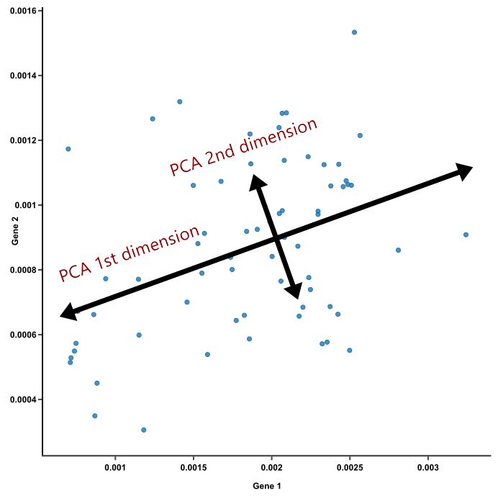
Traditional dimensionality reduction
Principal Component Analysis
T-SNE
Euclidean distance insufficient
Mahalanobis performs better
Notes:
So there are various solutions available but most of them are not suitable for application inside a warehouse or their accuracy is too low. This is why a new solution is desired. This is why we started looking into a dimensionality reduction approach.
Various existing dimensionality reduction approaches exist the most popular of which is Principal Component Analysis. By using two principal components you would achieve the goal of dimensionality reduction. Although it is appealing because of its simplicity, this was already found in prior research to be insufficient in the task of localising a mobile agent indoors.
Another common probabilistic approach is the t-SNE. T-SNE aims to represent high dimensional datapoints as lower dimensional datapoints and position them such that similar points in the higher dimension are similar in the lower dimension, while dissimilar points are positioned further away. The dissimilarity metric can vary but a popular metric is Euclidean distance. In prior research however it was found that this did not work very well and that using the Mahalanobis distance was much more suitable for the job. The mahalanobis distance measures how similar a point P is to distribution D. If a point is at the mean of D then the distance is 0. The results were however still insufficient for the task at hand.

Slide 10
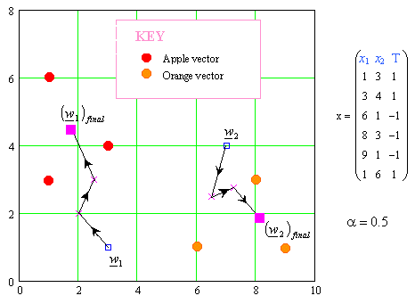
Supervised approaches
LVQ
GLVQ
GMLVQ
LGMLVQ
Notes:
To solve the problem other algorithms had to be considered like unsupervised and supervised algorithms. The supervised algorithms assign a position label to data based on the (dis)similarity of the trained prototypes. A popular supervised algorithm is Learning Vector Quantisation. The algorithm has been improved several times over the recent years where the most important improvement is the development of Generalized Learning Vector Quantization (GLVQ) which introduces a cost functions which is optimised. Since at a random point in the warehouse some received signal strengths are very high and others signal strengths are very low relevance learning would be convenient. Relevance learning extends normal techniques with a relevance vector containing weights for every dimension. This was introduced with Generalised Matrix LVQ. This was then further extended to include local relevances based on each prototype or class which is called LGMLVQ. Both GMLVQ and LGMLVQ have been considered in similar research and it was concluded that LGMLVQ produces the best results for indoor localisation.

Slide 11
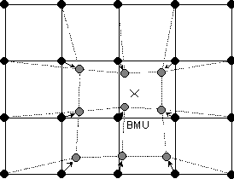
Unsupervised approaches
Self organising Map (SOM)
Generative Topographic Mapping (GTM)
Notes:
For the unsupervised approaches the Self Organising Map algorithm seems very suitable. In a self-organising map you define a low dimensional grid and to each grid point a high dimensional prototype is attached.
Explain SOM
A probabilistic version of this called Generative topographic mapping was tested in previous research but due to difficulties with initialisation the non-probabilistic version might still be better.

Slide 12
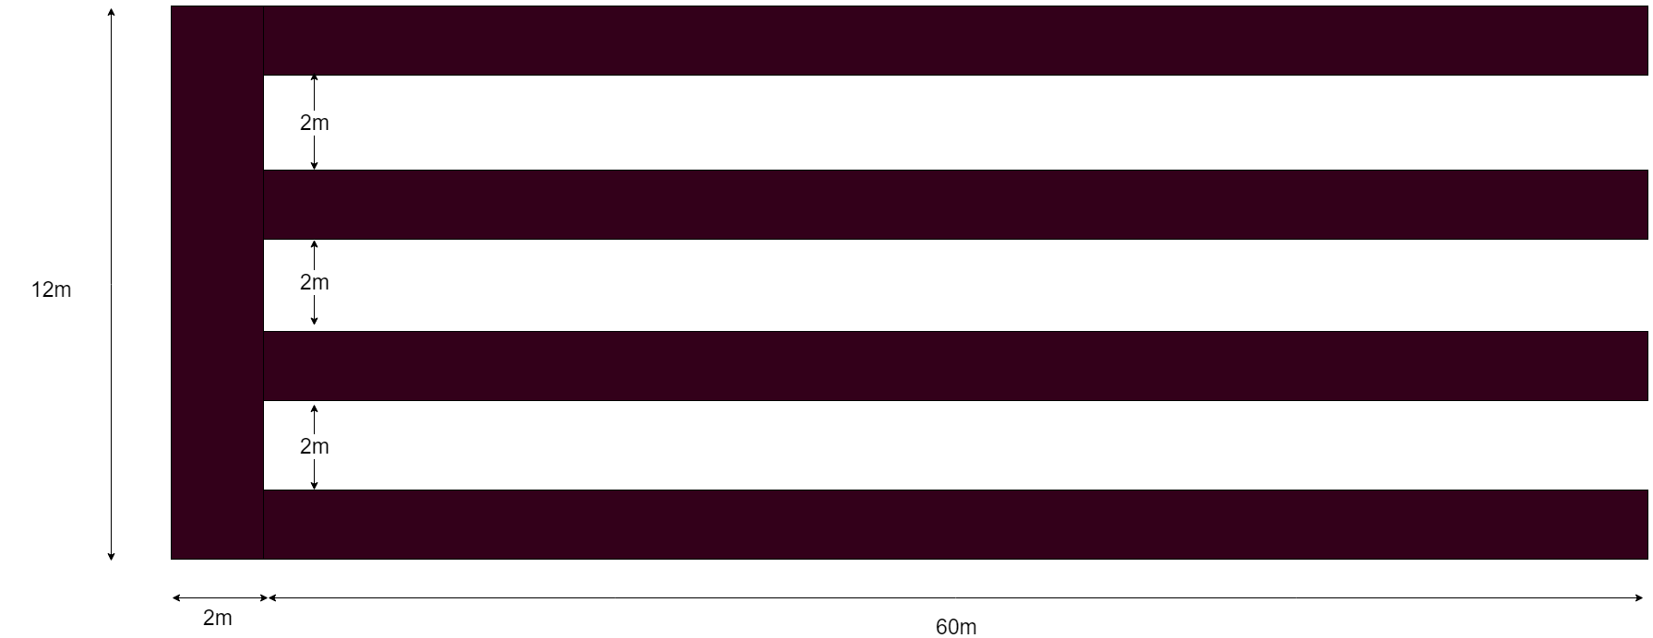
Warehouse floorplan
Notes:
The data used consists of signal strength indicators at various locations inside the warehouse. These measurements are the higher dimensional data which should be mapped to a low dimensional floor plan. To make the data as similar as possible to the real world data features of the real world had to be simulated. These features are based on the real world warehouse where some data was gathered. This real world data was gathered in 4 aisles of the warehouse each with a length of 60m and a total width of 12m. There is also pathway aisle of 2 metres wide.

Slide 13
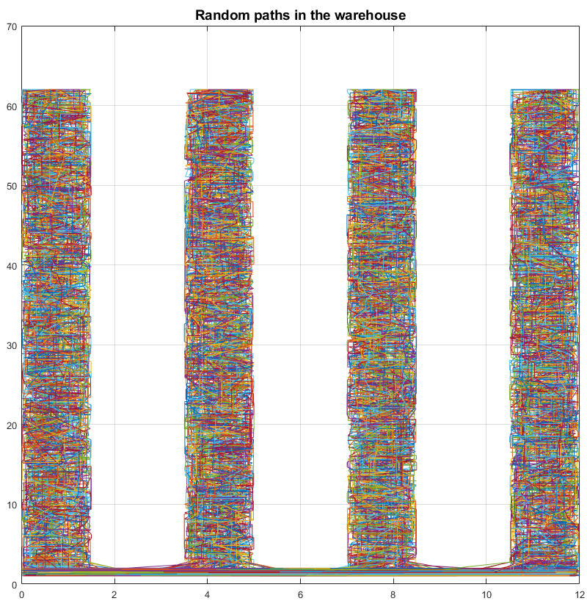
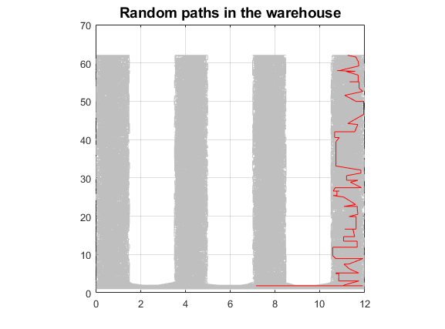
Data simulation
All random paths
Single random path
Notes:
The location at which the measurements are taken are simulated using random paths through each aisle. At the end of each aisle 100 paths start with with a maximum step size of 200. The paths can go either left, right, or down randomly.

Slide 14

Signal strength calculation
Calculation using industry standard
Non-linearly scaled to range between 0-1
Z-score transform
Notes:
At each location the signal strength is calculated using this formula where the parameters are tweaked in such a way that the final data is similar to the real world data. In this formula d is the distance from the point to a access point, d0 is a reference distance with the signal strength of L(d_0). This was calculated using free-space propagation. Lf is the term which accounts for multiple floors. Since the warehouse is a single floor environment this was set to 0. And N can be modified in order to resemble the real world data and was set to 20. The label information is based on which aisle the point is in so there are five possible classes.
Some preprocessing was done, after the generation the scale ranges from -90 to 0 where 0 in decibel. Where 0 is the highest and -90 the lowest possible signal strength. This was non-linearly scaled to range from 0 to 1 after which a z-score transformation was applied.

Slide 15
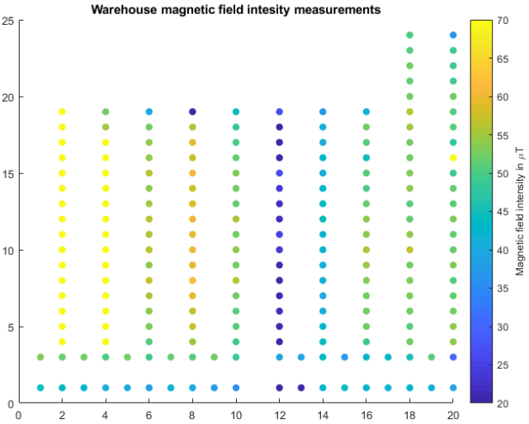
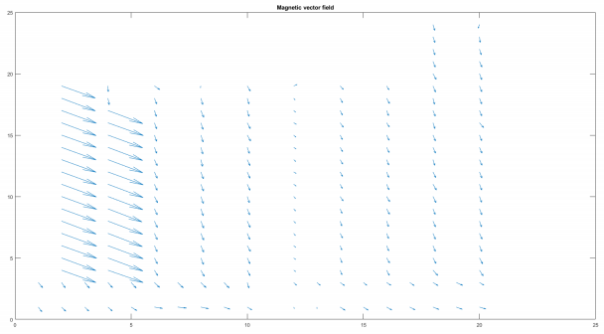
Magnetic field information
Notes:
One of the research suggestions of previous research on this topic was to incorporate magnetic field information. The idea is that large magnetic structures, which are present in a warehouse, refract the earths magnetic field. These interferences could be detected and could add a new dimension to the project. In order to collect this information the idea was to mount an android tablet on a forklift and leave it there for a couple of weeks. After about two weeks I wanted to match the timestamps of the magnetic field measurements to the warehouse inventory systems which keeps track of when a forklift is at a certain location. This way I could produce a magnetic field map of the warehouse. To collect this information a custom android application was made for me which should sent the information to a server. The warehouse company purchases a new tablet with the correct magnetic field sensor in it however when I wanted to install the app it immediately crashed even though it was working on my old phone. As it turned out Android 9 severely limits wifi scans which caused the application to crash. To get an idea of what the magnetic field would look like I did manually make a small map of the warehouse which looks like this. The left five aisles are aisles on the actual left of the warehouse. After this small gap the aisles are in the centre. The longer two aisles are aisles in a large concrete structure which they called the bunker. As you can see the intensities between aisles very a low but inside the aisles the intensities are relatively consistent, the same goes for the direction of the magnetic field. Since I did not collect enough information to be included in the project I did not use it but it does look like it could be a good improvement.

Slide 16
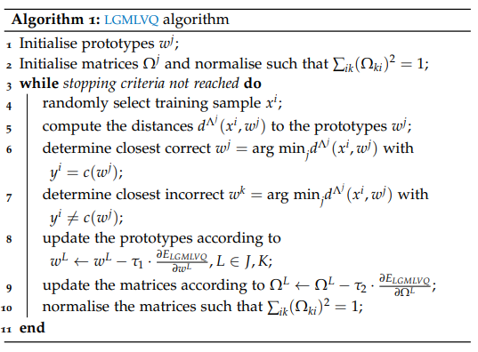
LGMLVQ
Notes:
I tested several Unsupervised, supervised, and semi supervised methods. The first supervised method which was implemented is LGMLVQ in order to compare the results to the previous research. The algorithms works as follows, the prototypes and local matrices are initialised. Until the stopping criteria is reached a random data point is selected and the distance is computed using the local matrices. The closest correct and incorrect prototypes are selected and the prototypes and matrices are updated.

Slide 17
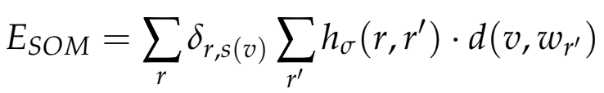

Self-organising map
Cost function:
Update rule:
Notes:
The next method implemented was the normal Self organising map algorithm. The cost function is just the normal SOM cost function in which epsilon is the learning rate, h defines the neighbourhood relationship, and this is the derivative of the dissimilarity metric.

Slide 18

Semi-supervised SOM
Modify the cost function to include a supervised term:
New update rule:
Update rule with neighbourhood information:
Notes:
This algorithm was then modified from and unsupervised to a semi-supervised algorithm. The main idea of semi supervision is that a small amount of supervised information drastically improves the results of an unsupervised algorithm. In order to do this an additional term was added to the cost function which moves for some grid locations the prototype towards the true location. This is what is represented in P. Using this cost function you would get the following update rule where alpha and beta represent the influence of both the unsupervised and supervised term. This however would mean that every iteration only a single grid point would move towards the correct location but we could also include the neighbourhood influence here. When doing this you get the following update rule.

Slide 19
Supervised SOM
Use the LGMLVQ matrices for the (dis)similarity computation
Derivative:
New update rule:
Notes:
The next improvement on SOM was to make it a supervised algorithm by using the supervised local matrices of the LGMLVQ algorithm in the dissimilarity metric. Omega is the matrix belonging to the closest prototype and is then used to update the weights.

Slide 20

Local linear t-SNE
Provide an explicit mapping function:
Notes:
Another supervised method unrelated to SOM which I tested is Local linear t-SNE mappings. This is a different approach to dimensionality reduction. Most traditional dimensionality reduction techniques like normal t-SNE provide a one time mapping for a given set of input points. This means that if you want to consider a new sample you would have to do a lot of additional effort. This method proposes a general principle to obtain an explicit method function. This means that if you have a new sample point you input it into the function and it outputs a mapping. Although the principle works with many different methods t-SNE was used since traditional t-SNE provided somewhat good results and its derivation was already there.

Slide 21
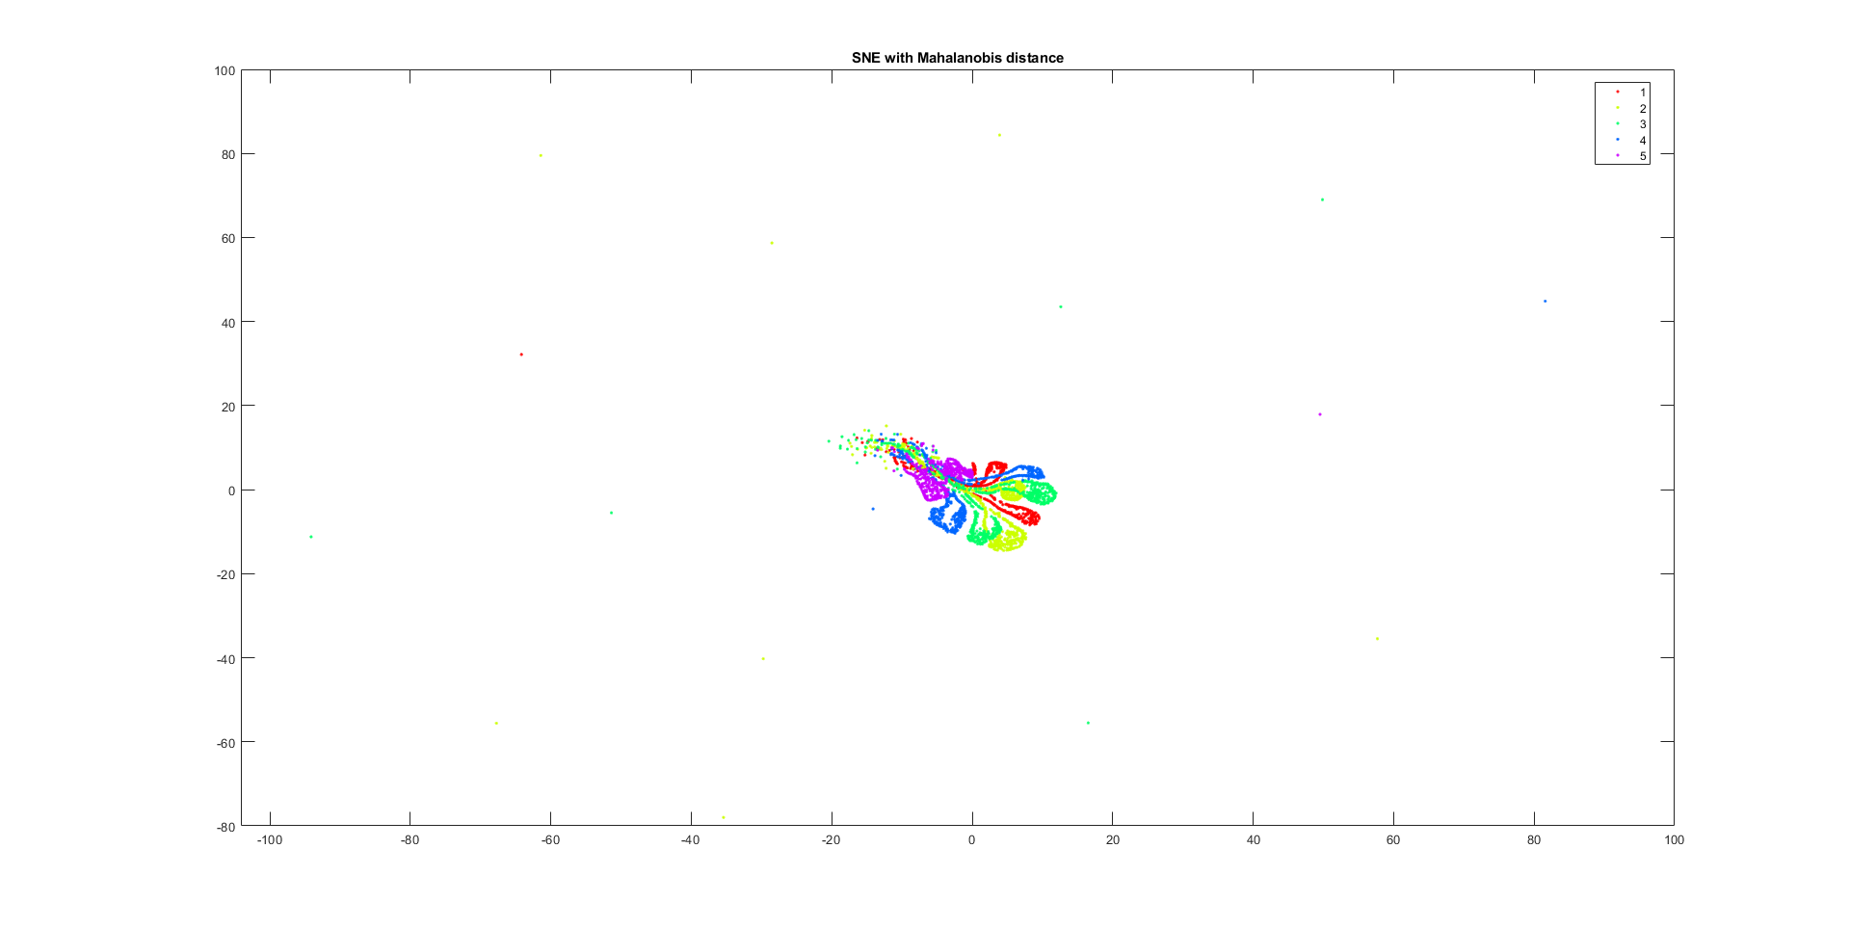
Traditional methods: SNE
Notes:
First the traditional methods were performed which are normal SNE and t-SNE. SNE was tested because we hoped that it would separate the results better than t-SNE in this case but that was not what happened. There are some points all around the results which show that it has not properly converged yet. I did try multiple perplexities but nothing seemed to help. The pathway aisle is located orthogonal with respect to the other 4 aisles. The red aisle on the inside is the first aisle, the second aisle is on both sides of that, the third aisle is on the outside of that, and the last aisle is again on the outside of that. Although some information remains it is not very useful.

Slide 22
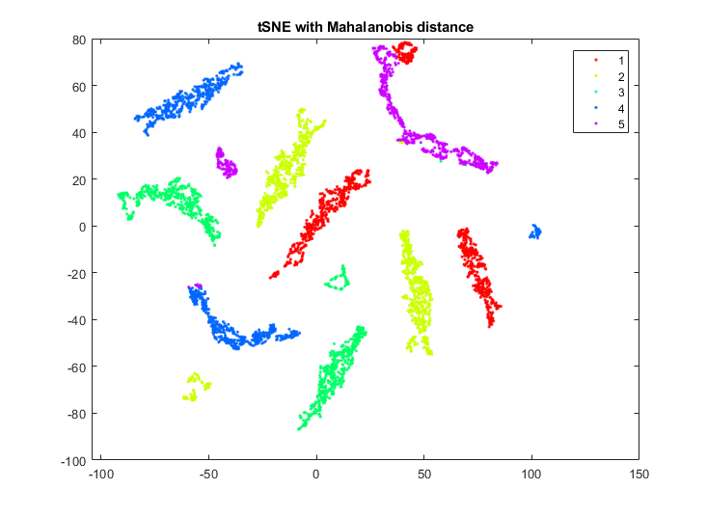
Traditional methods: t-SNE
Notes:
The next step was to test t-SNE again with mahalanobis distance. This shows a much clearer separation compared to SNE but not much positional information remains. Every aisle seems to be split into multiple smaller parts. The path way aisle is split into two small parts and the other aisles into three parts each.

Slide 23
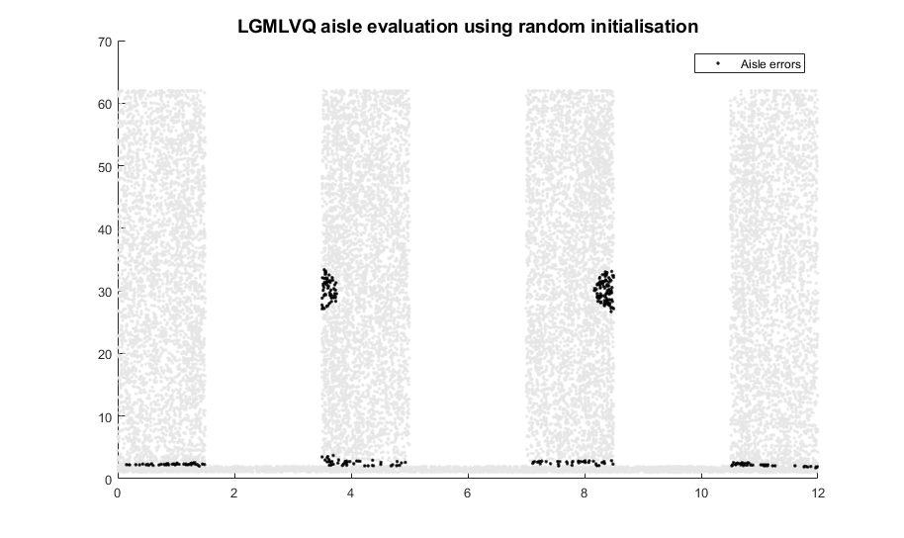
LGMLVQ results
Notes:
Next up are the LGMLVQ results. These results show the correctly classified points in grey compared to the incorrect points in black. These results look very promising by itself since pretty much all points are correctly classified except for those on the border of each aisle with the pathway aisle. This makes of course sense since those are the difficult parts. There are also two semi circles in the centre two aisles which are incorrectly classified on mirrored location. I have not been able to find out why those semi circles are there except for that those locations are very similar to each other.

Slide 24
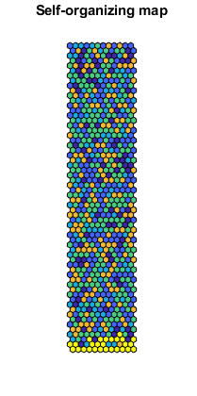
Normal SOM results
Aisle 1: Orange
Aisle 2: Light blue
Aisle 3: Green
Aisle 4: Blue
Aisle 5: Yellow
Notes:
The next results are the Self organising map results in its normal form. The map itself is made of a 12 by 62 grid in order to represent the warehouse dimensions properly. The map itself looks very chaotic except that the pathway aisle is clearly located at the bottom which is correct.

Slide 25
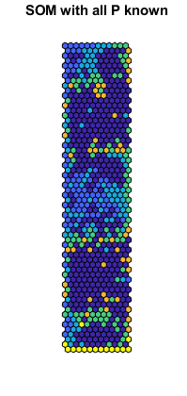
Semi-supervised SOM
Aisle 1: Orange
Aisle 2: Light blue
Aisle 3: Green
Aisle 4: Blue
Aisle 5: Yellow
Notes:
These are the semi supervised results. First a test was done with all P known in order to get an idea of how it works but this would make it supervised. The pathway aisle is located again at the bottom at the correct location and the other are more clustered than previously but there are no aisle like structures which we would expect.

Slide 26
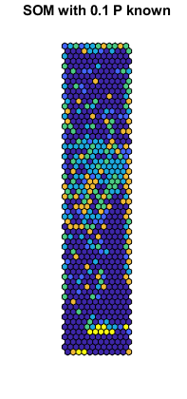
Semi-supervised SOM
Aisle 1: Orange
Aisle 2: Light blue
Aisle 3: Green
Aisle 4: Blue
Aisle 5: Yellow
Notes:
Although the results are not exactly what we would expect I also tested it with only 10% of P known. This results is more chaotic than the previous one and no useful results are there.

Slide 27
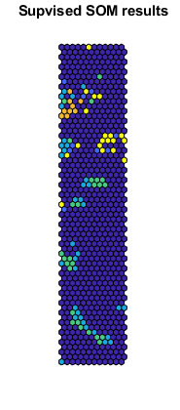
Supervised SOM
Aisle 1: Orange
Aisle 2: Light blue
Aisle 3: Green
Aisle 4: Blue
Aisle 5: Yellow
Notes:
Although there is some clustering present the aisle like structures are not present in the lower dimensional space. The middle two aisles, 3 and 4, are often clustered together. Most of the grid is however represented by empty grid cells.

Slide 28
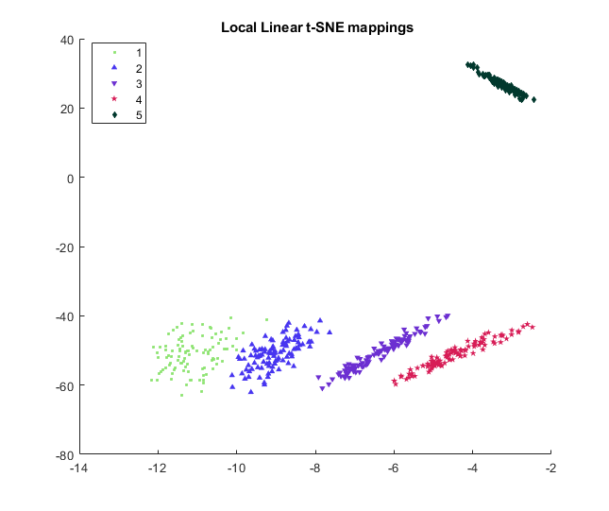
Local linear t-SNE mappings
Notes:
The last test was the local linear t-SNE mappings which can be seen here. These results are the best results so far. There are clear aisle like structures present and each of the aisles is nicely clustered. All of the aisles are located orthogonally to the pathway aisle they are just not connected yet.

Slide 29
Conclusion
LGMLVQ is able to correctly classify the aisle with a high level of accuracy.
Local linear t-SNE mappings preserve a lot of information in the lower dimension.
Unsatisfactory SOM results
Notes:
To conclude, the LGMLVQ and local linear t-SNE mappings are the best results obtained this far. LGMLVQ performs the classification with a high level of accuracy and the local linear t-SNE mappings keeps a lot of the positional information in the dimensionality reduction mapping.

Slide 30
Further research
Refinements:
Semi-supervised SOM improve hyperparameters
Extensions
Magnetic field information
Explicit mapping function with SOM
Timeseries information
Notes:
There are various extensions and refinements which can be considered in addition to this work. The difference between an extension and a refinement being that in a refinement improve tasks which were carried out in this project while extensions consider new possibilities From these results you could conclude that the semi supervision of SOM does not seem to work however it was one of the last methods which was tried and there are quite a lot of hyper parameters to tweak. Especially the influence of both terms on the results could be fine-tuned which was not done due to time constraints. Also only the version with the neighbourhood influence incorporated was tested since it was hypothesised that this version would provide the best results.
There are three ways to extend this project, one of which was shortly discussed in this thesis. This is the incorporation of magnetic field information into the algorithms. Due to difficulties during the gathering of this data and time constraints this was not done in this project. The information on its own is not enough to perform localisation however the sample collected looks promising to improve the existing results. Various aisles have different strengths and within the aisle there are some minor differences as well. The incorporation of this new information can be considered an additional dimension with alternative characteristics compared to the wireless network information.
The second possible extension is not yet discussed in this thesis but is an interesting direction take nonetheless. The local linear t-SNE approach was one of the best performing algorithms yet. The problem is however that you cannot put constraints on the data even though you know what the general result should look like. Something which is possible with SOM. The general dimension reduction framework discussed in could be applied to SOM. This however has not been done as of yet. It was attempted during this thesis but due to difficulties concerning the derivatives this part was dropped. It remains an interesting yet difficult rese arch direction especially since the t-SNE version performed very well.
The last suggested extension for this thesis is the usage of timeseries information. This could improve the results of the mentioned algorithms since the locations which are incorrectly classified are surrounded by places which are correctly classified and the only way to move from one aisle to the other aisle is by using the pathway aisle.

Slide 31
Thank you for your attention!

Slide 32
References
https://helloacm.com/a-short-introduction-to-learning-vector-quantization/
https://ivape3.blogs.uv.es/2015/03/15/self-organizing-maps-the-kohonens-algorithm-explained/

