Slide 1


Designing a model for the cost-optimal decommissioning and refurbishment investment decision of gas networks Application on a real test-bed in Austria until 2050
17th IAEE European Energy Conference
The Future of Global Energy Systems
28.03 - 01.04.2022
Sebastian Zwickl-Bernhard, Antonia Golab, Hans Auer
Corresponding author/Presenter: zwickl@eeg.tuwien.ac.at
This presentation is licensed under a Creative Commons Attribution 4.0 International License

Slide 2
Todays‘ agenda
Background / Motivation
Core objective
Materials and methods
Results of a real test-bed (federal state Vorarlberg, Austria, until 2050)
Conclusions and outlook

Slide 3
Background and motivation
Adherence to the remaining CO₂ budget of the 1.5°C / 2.0°C climate target requires rapid defossilization of the energy system
Concrete measures include, among others, the substitution of natural gas in the provision of energy services by sustainable alternatives
Substantial challenge since natural gas is currently used for energy supply of a wide range of energy service needs
Uncertain role of green gases (e.g., synthetic gas, hydrogen) related to their economic viable quantities / potentials and penetration time
…but there are far-reaching gas transmission / distribution networks

Slide 4
Core objective / main research questions
The core objective of this work is to investigate the cost-effective trajectory of gas networks from a systemic point of view under a long-term planning horizon
In view of necessary refurbishment investments in existing gas network infrastructure and pipelines due to their technical lifetimes, the main research question is of which decommissioning and refurbishment investment decision result in a cost-effective gas networks by 2050.
Equally important in the analysis is the trade-off decision from the network operator’s perspective whether available gas demands within the network area are supplied or not as the decommissioning of existing gas pipelines can be cost-effective, but at the same time results in not supplied gas demands.

Slide 5
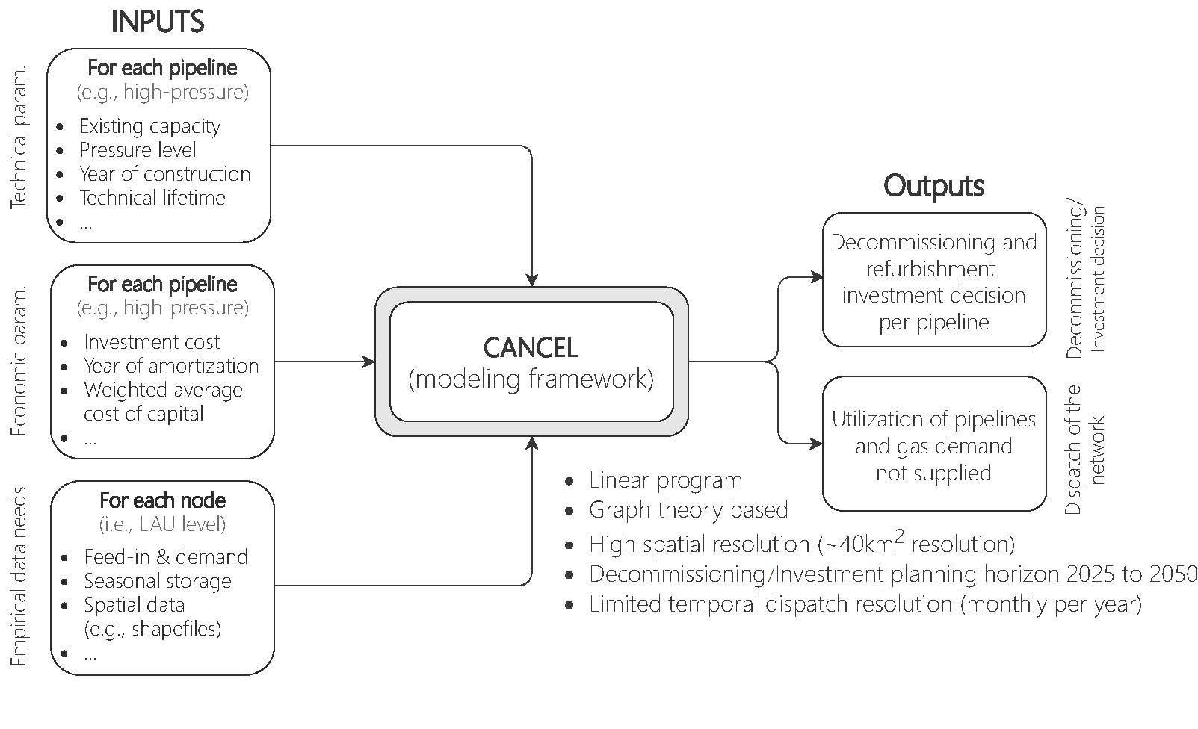
Introduction into the model

Slide 6
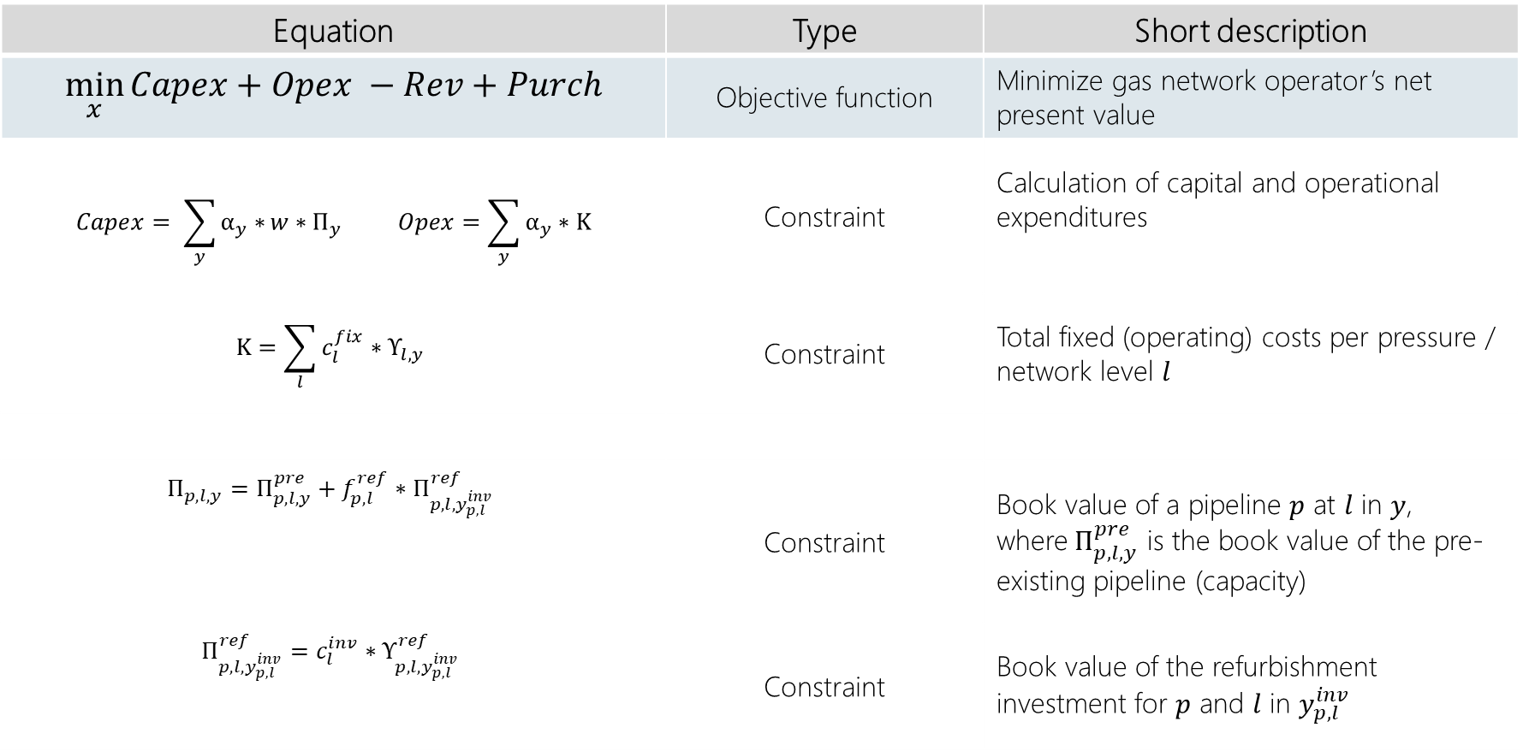
Mathematical formulation (selection) 1 / 2
Equation | Type | Short description
$$\min_{x}{Capex+Opex −Rev+Purch}$$ | Objective function | Minimize gas network operator’s net present value
$$Capex= \sum_{y}{α_{y}∗}w∗Π_{y} Opex=\sum_{y}{α_{y}∗Κ}$$ | Constraint | Calculation of capital and operational expenditures
$$Κ=\sum_{l}{c_{l}^{fix}∗Υ_{l,y}}$$ | Constraint | Total fixed (operating) costs per pressure / network level $l$
$$Π_{p,l,y}=Π_{p,l,y}^{pre}+f_{p,l}^{ref}∗Π_{p,l,y_{p,l}^{inv}}^{ref}$$ | Constraint | Book value of a pipeline $p$ at $l$ in $y$, where${ Π}_{p,l,y}^{pre}$ is the book value of the pre-existing pipeline (capacity)
$$Π_{p,l,y_{p,l}^{inv}}^{ref}=c_{l}^{inv}∗Υ_{p,l, y_{p,l}^{inv}}^{ref}$$ | Constraint | Book value of the refurbishment investment for $p$ and $l$ in $y_{p,l}^{inv}$

Slide 7

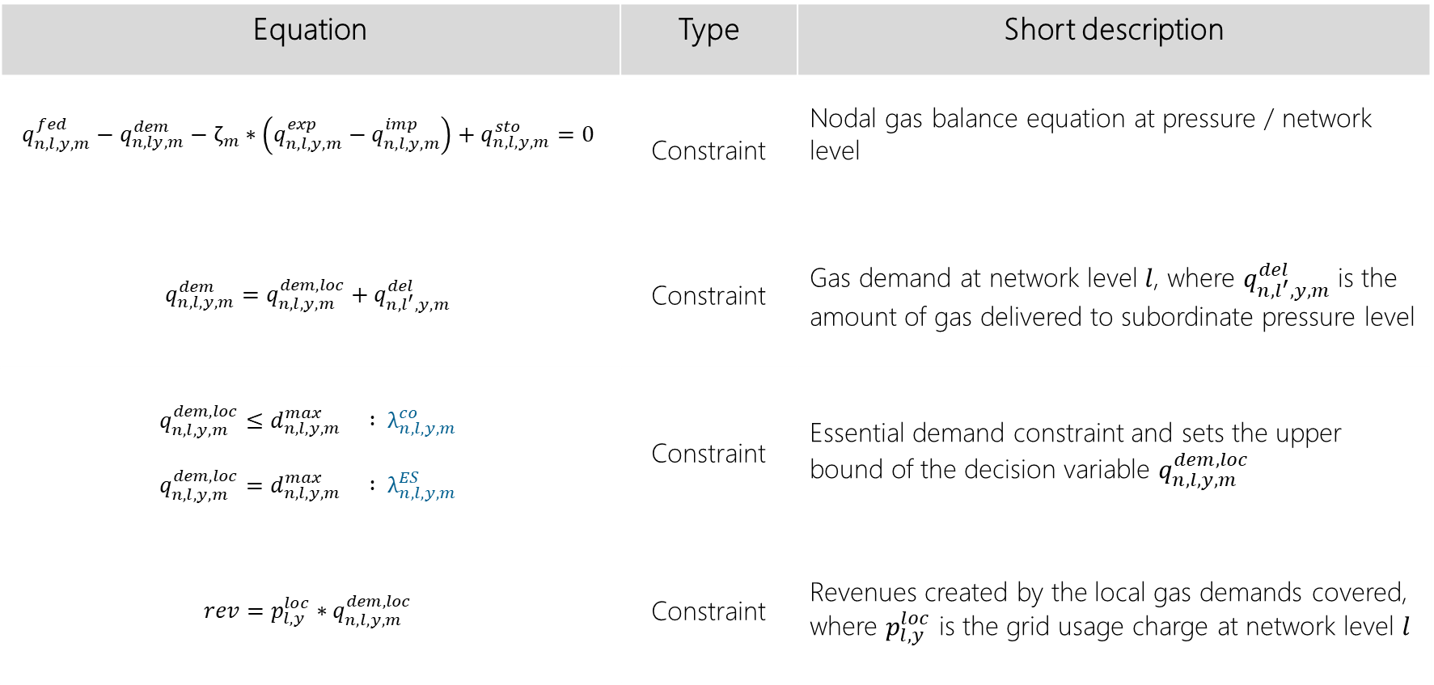
Mathematical formulation (selection) 2 / 2
Equation | Type | Short description
$$q_{n,l,y,m}^{fed}−q_{n,ly,m}^{dem}−ζ_{m}∗\left(q_{n,l,y,m}^{exp}−q_{n,l,y,m}^{imp}\right)+q_{n,l,y,m}^{sto}=0$$ | Constraint | Nodal gas balance equation at pressure / network level
$$q_{n,l,y,m}^{dem}=q_{n,l,y,m}^{dem,loc}+q_{n,l^{′},y,m}^{del}$$ | Constraint | Gas demand at network level $l$, where $q_{n,l^{′},y,m}^{del}$ is the amount of gas delivered to subordinate pressure level
$$q_{n,l,y,m}^{dem,loc}≤d_{n,l,y,m}^{max} : λ_{n,l,y,m}^{co}$$ $$q_{n,l,y,m}^{dem,loc}=d_{n,l,y,m}^{max} : λ_{n,l,y,m}^{ES}$$ | Constraint | Essential demand constraint and sets the upper bound of the decision variable $q_{n,l,y,m}^{dem,loc}$
$$rev=p_{l,y}^{loc}∗q_{n,l,y,m}^{dem,loc}$$ | Constraint | Revenues created by the local gas demands covered, where $p_{l,y}^{loc}$ is the grid usage charge at network level $l$

Slide 8
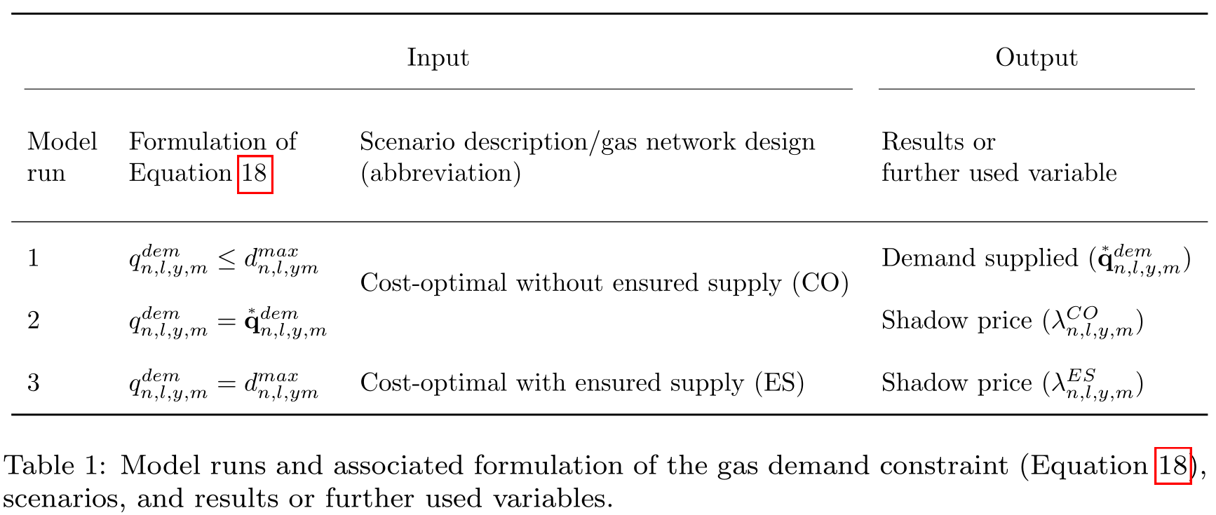
Implication of demand constraint dual variables

Slide 9
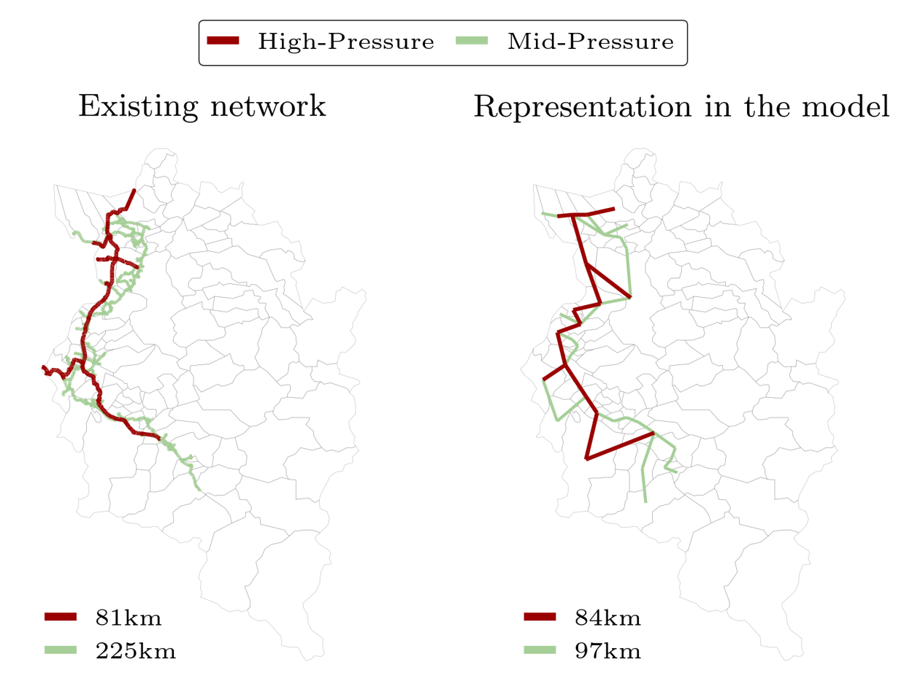
Test-bed in Vorarlberg, Austria
Source [57]: Vorarlberg Netz, Das Erdgasnetz: Allgemeines zum Erdgas-Verteilnetz, https://www.vorarlbergnetz.at/erdgasnetz.htm

Slide 10
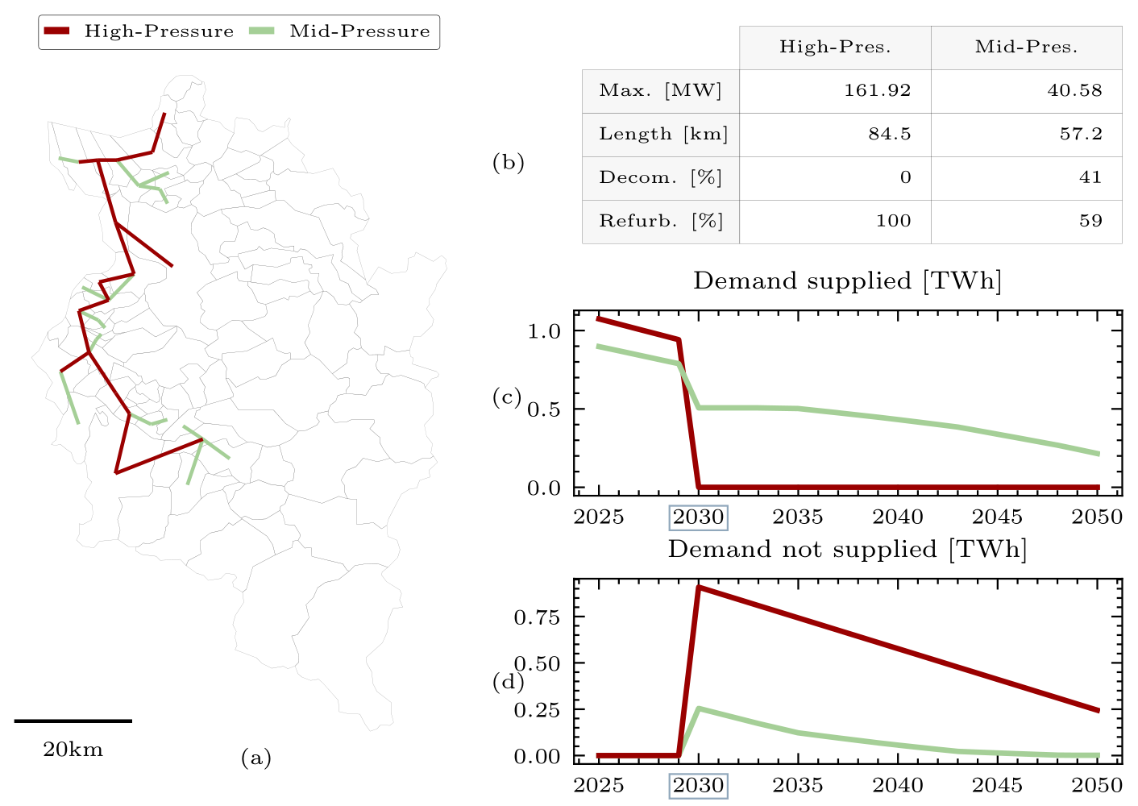
Cost-optimal network without ensured supply (CO)

Slide 11
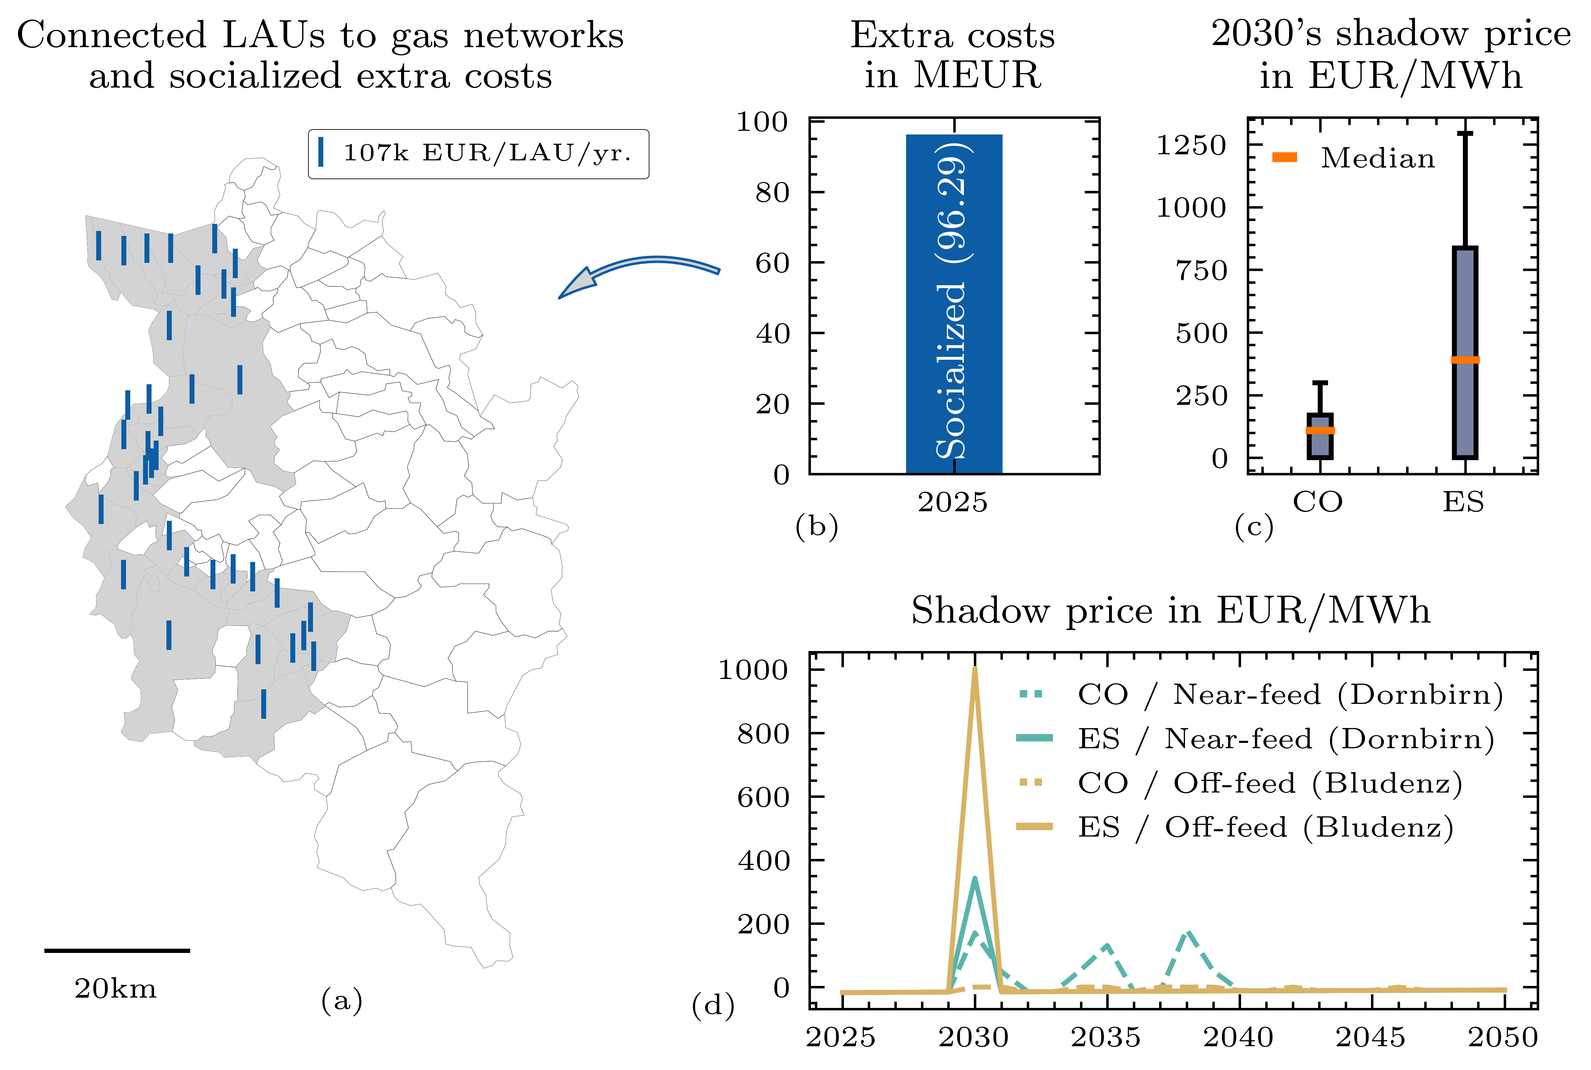
Comparison of network w/ ensured supply (CO & ES)

Slide 12
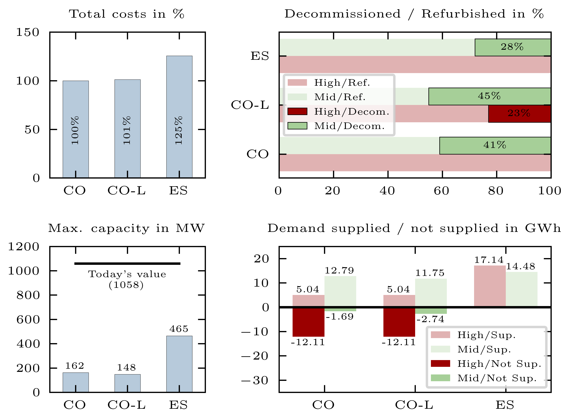
Overview: CO, ES and cost-optimal with lumpiness (CO-L)

Slide 13
Conclusions and recommendations
In the future, smaller gas networks in both capacity and length will be necessary (regardless of secured supply) resulting from irreversible defossilization of energy services
Wide range of network design between cost-optimal gas networks w/ ensured supply reveal crucial trade-off decisions for network operators in the future on how to deal with existing / available demands (i.e., decommissioning despite possible demands)
Shadow prices of local gas balance constraints indicate that network operator should strike a balance between cost-optimal gas network design w/ ensured supply (e.g., flexibility and management of unexpected changes in (peak) gas demands)
Increased network operator’s total costs in case of ensured supply need to be socialized to a few consumers in the future (primarily at subordinate network / pressure levels)
Influence of socialized grid / network costs on economic viability and profitability of sustainable alternatives substituting natural gas-based energy service needs and related trade-off decisions

Slide 14
Sebastian Zwickl-Bernhard
PhD Candidate Energy Economics Group (EEG)
Technische Universität Wien (TUW) Karlsplatz 13, 1040 Wien, Austria
zwickl@eeg.tuwien.ac.at
https://github.com/sebastianzwickl
https://orcid.org/0000-0002-8599-6278
Hans Auer
Associate Professor Energy Economics Group (EEG)
Technische Universität Wien (TUW) Karlsplatz 13, 1040 Wien, Austria
auer@eeg.tuwien.ac.at
https://orcid.org/0000-0002-9111-9941
This presentation is licensed under a Creative Commons Attribution 4.0 International License

