Slide 1


Equitable decarbonization of heat supply in residential multi-apartment buildings Optimal subsidy allocation between the property owner and tenants
FUTURE OF ENERGY – Innovationen für eine klimaneutrale Zukunft
17. Symphosium Energieinnovationen
Sebastian Zwickl-Bernhard, Hans Auer*, Antonia Golab
18.02.2022
Corresponding author/Presenter: auer@eeg.tuwien.ac.at
This work has received funding from the European Union’s Horizon 2020 research and innovation programme undere grant No. 835896
This presentation is licensed under a Creative Commons Attribution 4.0 International License

Slide 2
Todays‘ agenda
Background and motivation
Methodology
Case study set up and scenarios
Results
Conclusions and outlook

Slide 3
Background and motivation
Fit for 55 package by the European Commission outlines the pathway until 2030 to reduce greenhouse gas emissions by 55%
Need for energy justice with the manner of “no one left behind”
The residential building sector calls for particular attention
High shares of fossil fuels in the provision of heat service needs
Inefficient ways of delivering heat demand caused by low standards of both building stock and heating devices
Complex building ownership structures and the property owner/tenant nexus in rented apartments or dwellings
Buildings are responsible for 40% of EU energy consumption and 36% of the greenhouse gas emissions in 2021
75% of EU’s buildings are energy inefficient and 35% are older than 50 years
Source: European Commission, Energy performance of buildings directive

Slide 4
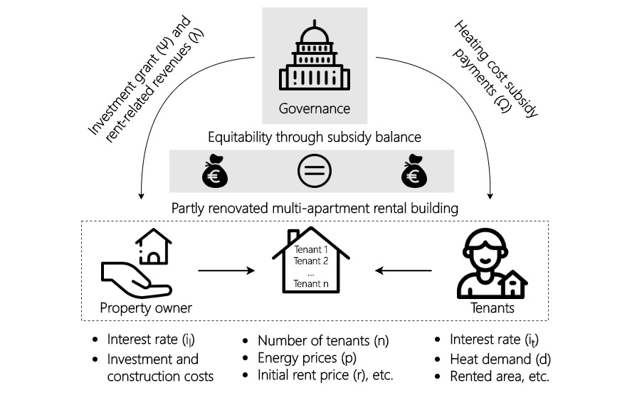
Sketch of the approach

Slide 5
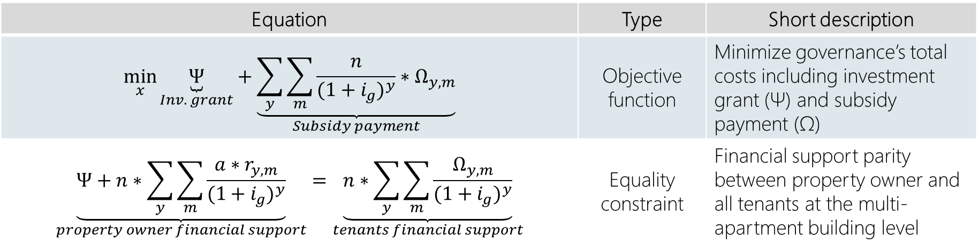
Mathematical formulation of the model
Equation | Type | Short description
$$\min_{x}{\underset{Inv. grant}{\underbrace{Ψ}}+\underset{Subsidy payment}{\underbrace{\sum_{y}{\sum_{m}{\frac{n}{{(1+i_{g})}^{y}}∗Ω_{y,m}}}}}}$$ | Objective function | Minimize governance’s total costs including investment grant (Ψ) and subsidy payment (Ω)
$$\underset{property owner financial support}{\underbrace{Ψ+n∗\sum_{y}{\sum_{m}{\frac{a∗r_{y,m}}{{(1+i_{g})}^{y}}}}}}=\underset{tenants financial support}{\underbrace{n∗\sum_{y}{\sum_{m}{\frac{Ω_{y,m}}{{(1+i_{g})}^{y}}}}}}$$ | Equality constraint | Financial support parity between property owner and all tenants at the multi-apartment building level
Zwickl-Bernhard, S., Auer, H. (2022). Equitable decarbonization of heat supply in residential multi-apartment buildings: Optimal subsidy allocation between the property owner and tenants. Energy and Buildings, forthcoming.

Slide 6
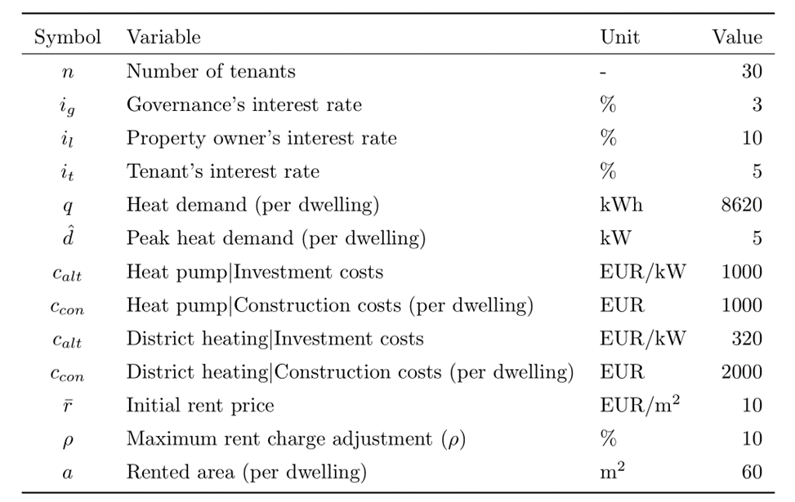
Case study set-up and scenario description
Partially renovated and natural gas-fired heating system in an old building (privately owned) in Vienna, Austria
Multi-apartment building (including all dwellings) is privately owned by the property owner
The decarbonization of the existing heating system can be realized by a connection to district heating or the installation of an air-sourced heat pump
Energy and CO₂ prices from European decarbonization scenarios in line with the remaining European CO₂ budget of the 1.5/2.0°C climate target¹
¹Results from the Horizon 2020 project openENTRANCE (https://openentrance.eu/)

Slide 7
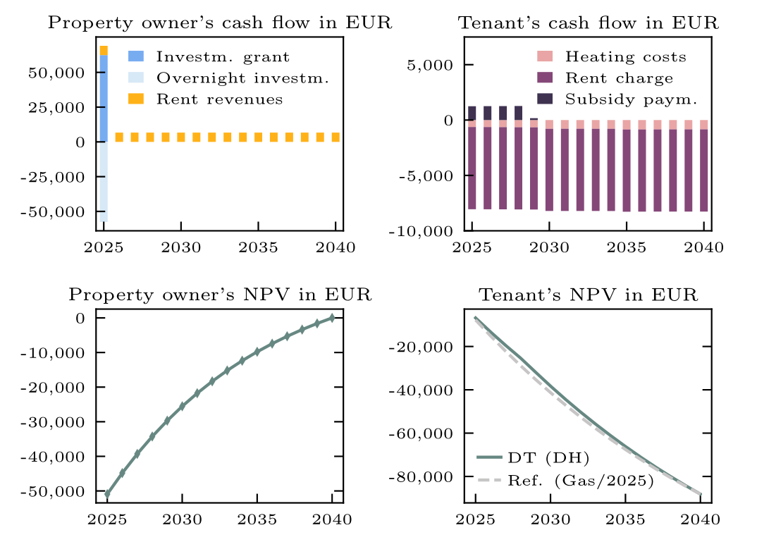
Results (1/4) – District Heating

Slide 8
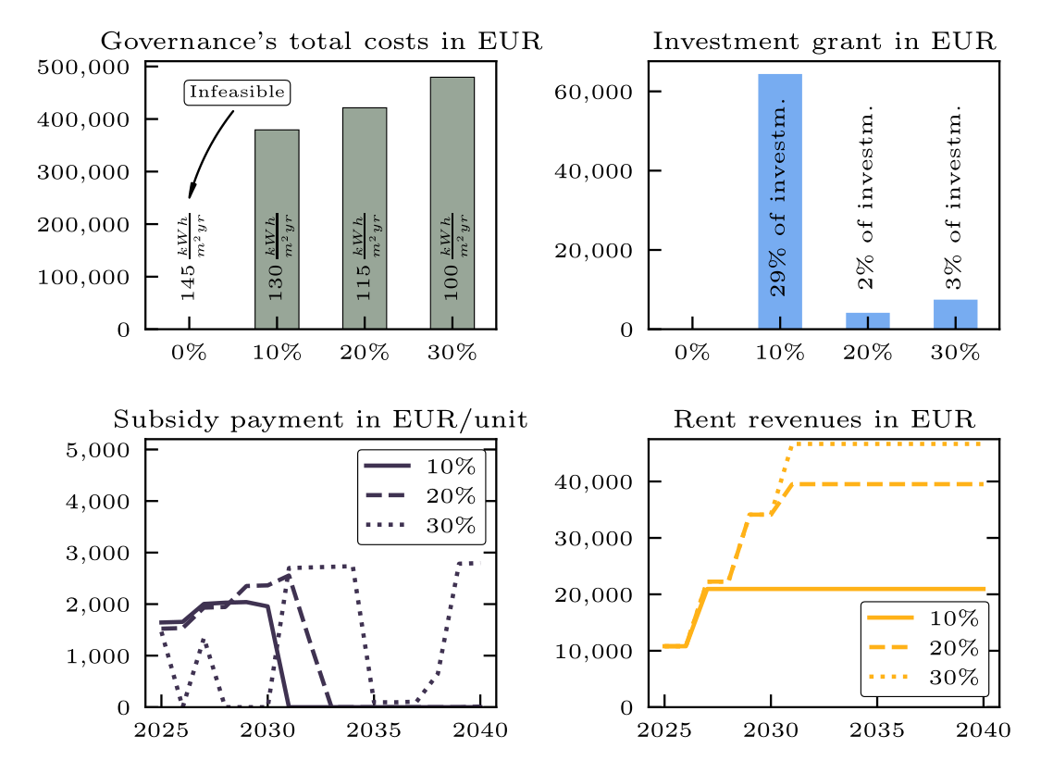
Results (2/4) – Heat Pump

Slide 9
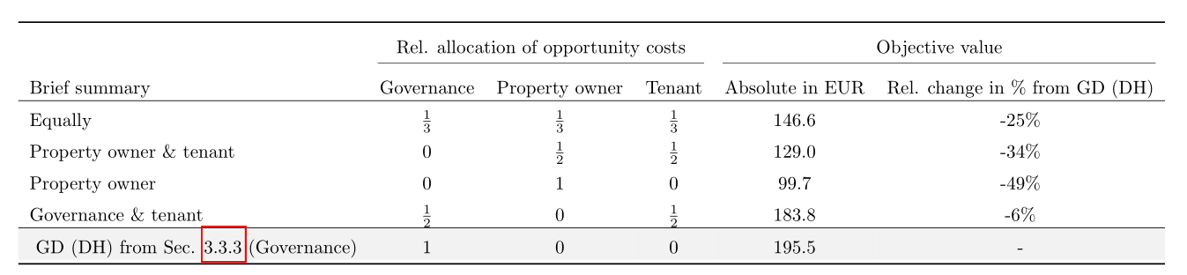
Results (3/4) – Allocation of opportunity costs

Slide 10
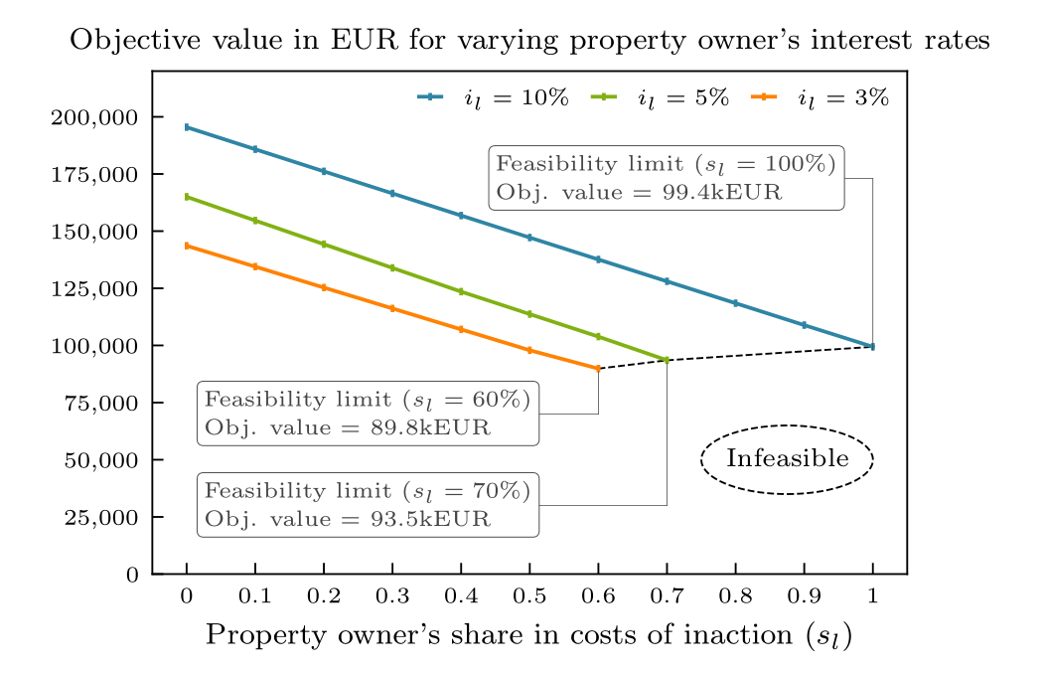
Results (4/4) – Varying property owner‘s interest rate

Slide 11
Conclusions and outlook
Rapid and equitable decarbonization of the heat sector in buildings is an indispensable cornerstone in a sustainable society
Special attention is needed for the rented buildings sector since an investment decision is in the property owner’s hands
A fair and equitable switch to a sustainable heat system is possible but with massive public subsidy payments
Heat pump alternative is not competitive in supplying heat service needs in partly renovated old buildings (equitability constraint)
Allocating the costs of inaction between the governance, the property owner, and the tenants is an important lever and can reduce the required subsidy payments
Future work: active/passive building renovation measures as a necessary precondition for subsidy payments; tenant’s diversification within the building (e.g., different willingness to pay to contribute to CO₂ mitigation)
Notes:
CO2 price is the key determining parameter.

Slide 12

Sebastian Zwickl-Bernhard
PhD Candidate – Energy Economics Group (EEG)
Technische Universität Wien (TUW) Karlsplatz 13, 1040 Wien, Austria
zwickl@eeg.tuwien.ac.at
https://github.com/sebastianzwickl
https://orcid.org/0000-0002-8599-6278
Hans Auer
Associate Professor– Energy Economics Group (EEG)
Technische Universität Wien (TUW) Karlsplatz 13, 1040 Wien, Austria
auer@eeg.tuwien.ac.at
https://orcid.org/0000-0002-9111-9941
https://openentrance.eu/
This work has received funding from the European Union’s Horizon 2020 research and innovation programme undere grant No. 835896
This presentation is licensed under a Creative Commons Attribution 4.0 International License

