Slide 1




Impact of microgrids on the price elasticity of electricity demand in Lebanon (draft title)
Sebastian Zwickl-Bernhard^{1,2}, Anne Neumann^{2,3}, Majd Olleik^{4,} Haytham Dbouk⁵
¹Energy Economics Group (EEG), Technische Universität Wien, Gußhausstrasse 25-29/E370-3, 1040 Wien, Austria
²Department of Industrial Economics and Technology Management, The Norwegian University of Science and Technology, Sentralbygg 1, 946, Gløshaugen, Trondheim, Norway
³Center for Energy and Environmental Policy Research, Massachusetts Institute of Technology, Cambridge, MA, USA
⁴Department of Industrial Engineering and Management (IEM), American University of Beirut, Lebanon
⁵Phoenicia University, District Of Zahrani, Lebanon
Internal Meeting / 29 July 2024 / Online
Contact: zwickl@eeg.tuwien.ac.at

Slide 2
Recap: demand elasticity in the proposal (1 of 2)
Comprehensively mentioned in Subsection 3.3
“We incorporate price elasticity of demand for various categories of demand centers.”
“Part of the research will be the estimation of price elasticity of demand for each type.”
For household consumers, we will use the historical monthly bills of diesel generator subscribers.
Independent variables: electricity price in the previous month, temperature, average availability of electricity from the central grid, and variables on the socio-economic status of subscribers.
We use the subscription type (2.5 Amperes, 5 Amperes, 10 Amperes, 15 Amperes or beyond) reflecting the socio-economic status of the households as independent variable.
For household prosumers, we plan to employ surveying techniques to estimate the price elasticity of their suppressed demand that can be served by the microgrid.
A similar approach will be employed for the specific institutional prosumers considered.

Slide 3
Recap: demand elasticity in the proposal (2 of 2)
Once the price elasticity of demand of each type is estimated and demand functions with respect to the price are derived, Models 1 and 2 will be made use of through an iterative approach as follows:
Set the demand levels of the various market players to their base case levels as surveyed or reported in the most recent data
Run Models 1 and 2 based on the defined demand levels.
Compute the resulting electricity price.
Determine the new demand levels of market players using the resulting electricity price and the derived demand functions.
Verify if the new demand levels are similar to the defined demand levels used in Step 2. If Yes, the algorithm has converged and the solution is reached. If No, go to Step 2 using the new demand levels.

Slide 4
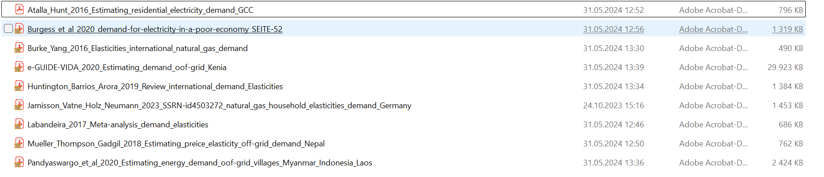
What has happened so far…
Started with thorough literature review (Sebastian & Anne)
Dicussion on the applied methodology (will build on Ruhnau et al. (2022)¹)
“We use an econometric model to identifiy…”
“Model parameters are estimated with an ordinary least squares estimator using heteroscedasticity and autocorrelation robust standard errors.”
For household consumers, we will use the historical monthly bills of diesel generator subscribers.
To be decided: how we include the impact of inflation on the demand elasticity
¹10.1038/s41560-023-01260-5

Slide 5
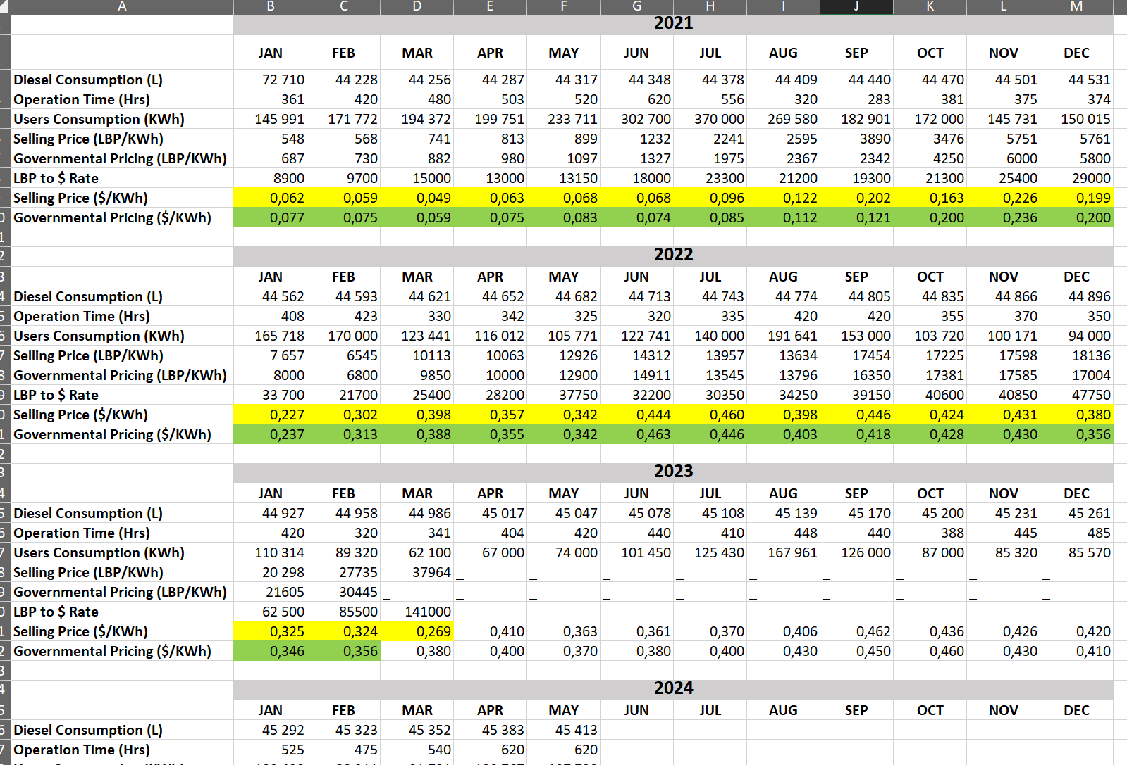
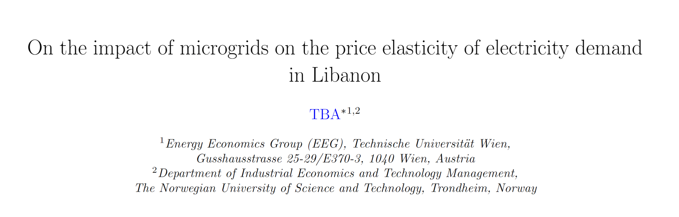
DE of Household consumers is de facto available already
Measured values
Could be relatively soon incorporated in the models 1 and 2
However,…
➔ Households consumer vs. Household prosumers

Slide 6
Next steps
Focus on working on the publication (submission by end of the year)
Therefore, soonish decide on the main focus
(A) Focus only on identifying household consumers demand elasticity
(B) Focus on the comparison, then the question is how we get and when we have the values for household prosumers…?
As close as possible to the available data that we have…
Have you changed your behavior?
Literature available regarding “from survey” to elasticities?

