Slide 1
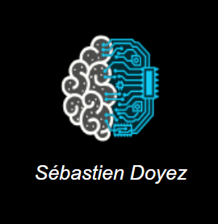
My AI assistant

Slide 2
Demo:

Slide 3
AI authentification:

Slide 4
Basics interactions

Slide 5
Advanced interactions:
Analysis with agents (Langchain)

Slide 6
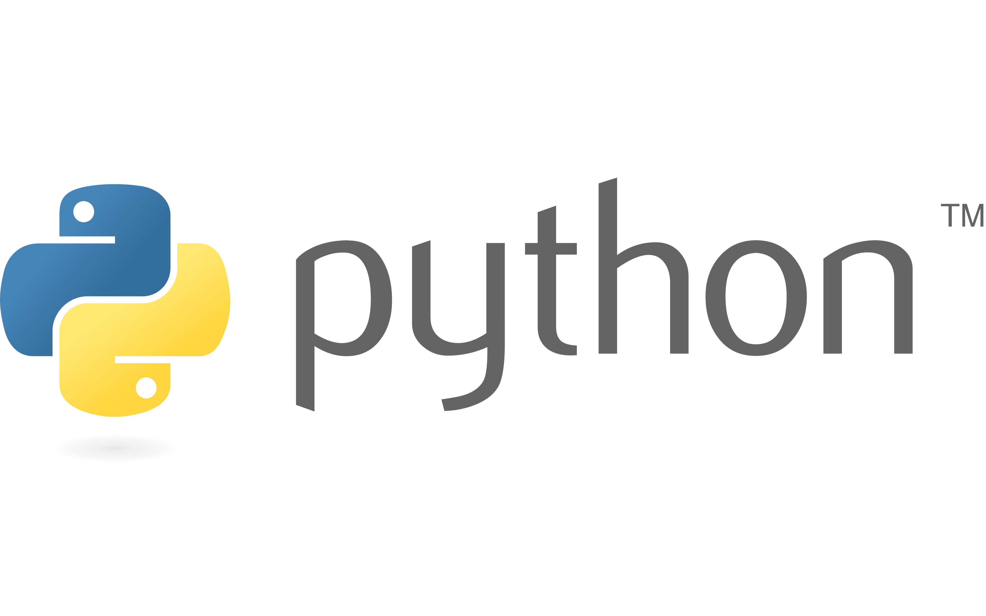




Back End
AI model (CNN)
main.py
Authentification
Part 1
While true :
Part 2
Speech recognition
SQL
AI agents (langchain)
Database
Front End

Slide 7

Thank you for watching!
Sébastien Doyez

