Slide 1
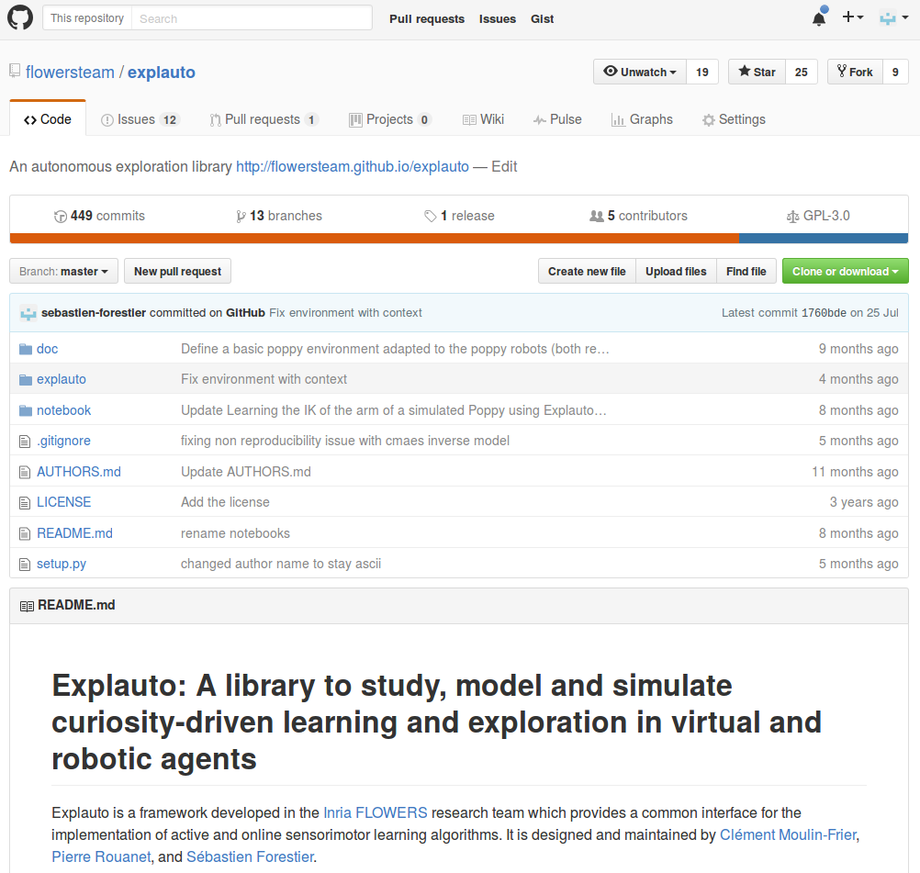
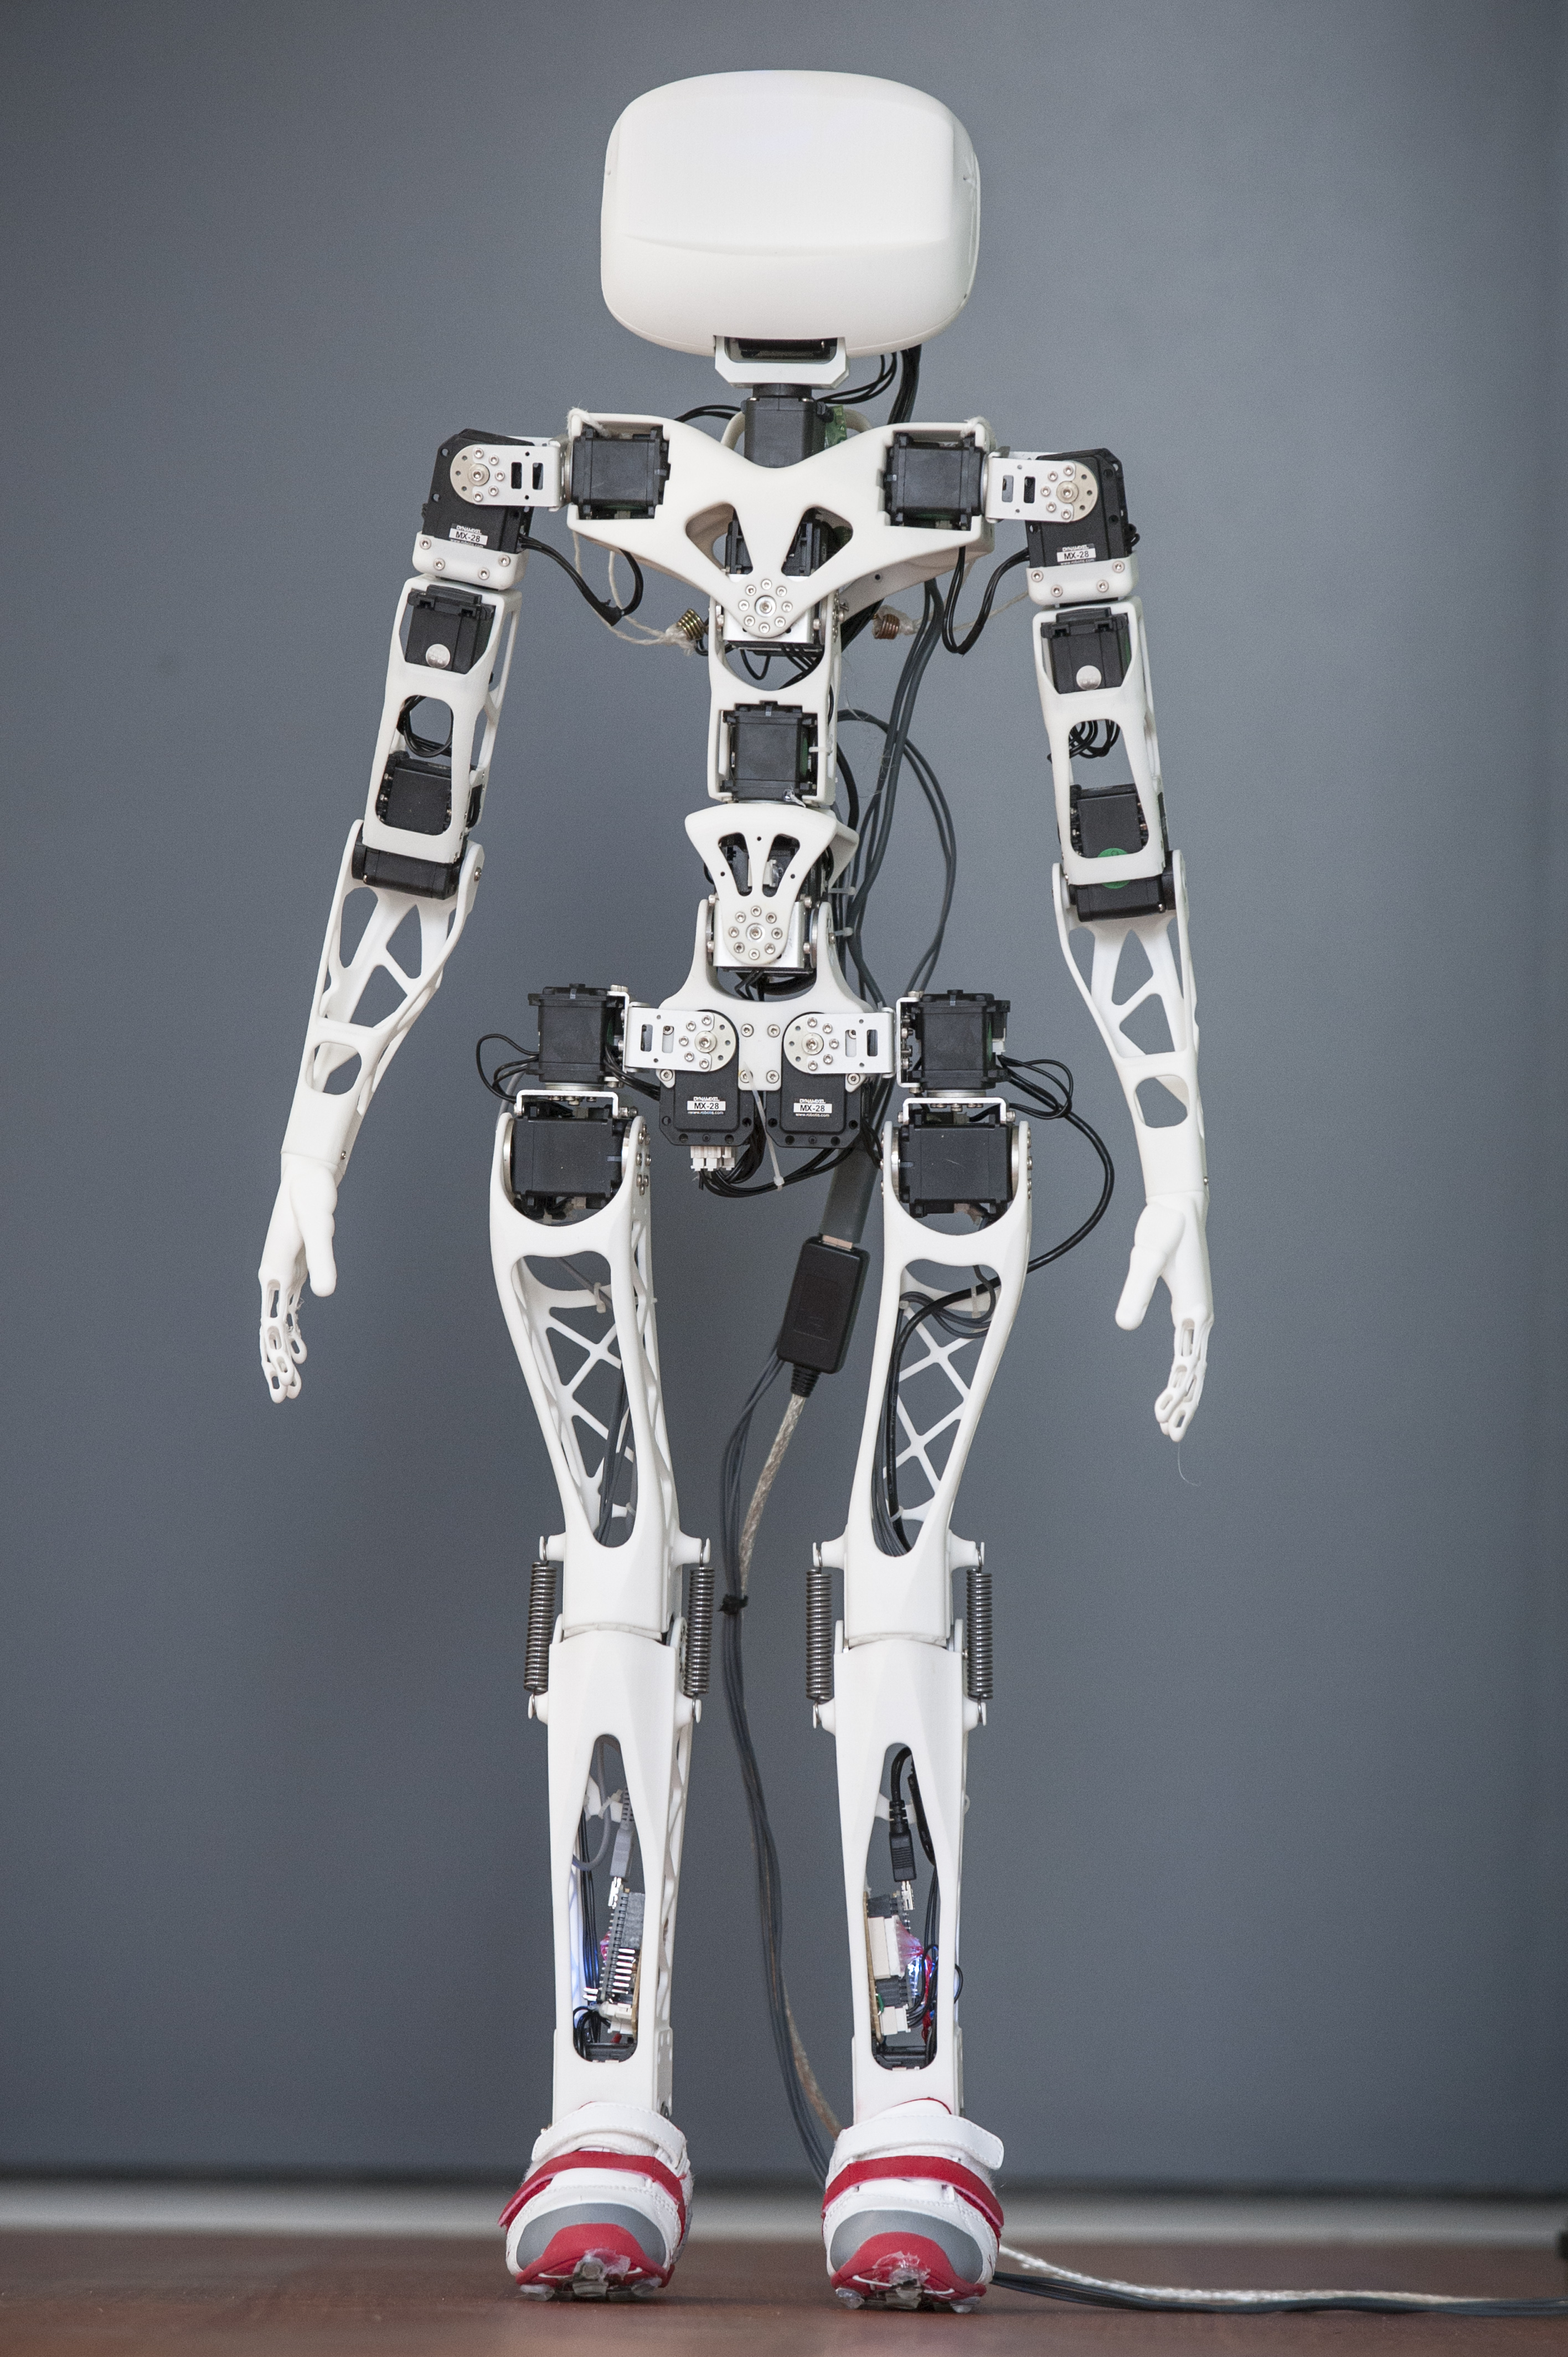

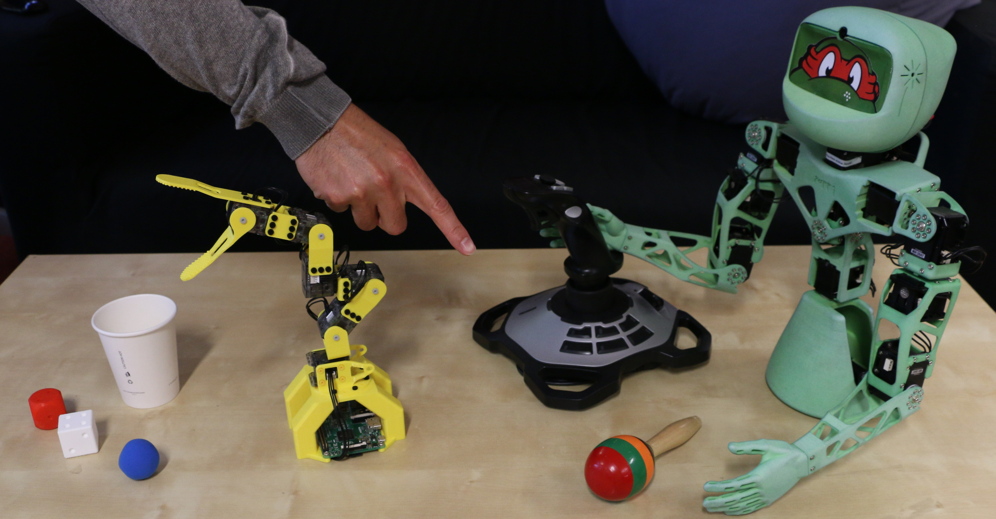
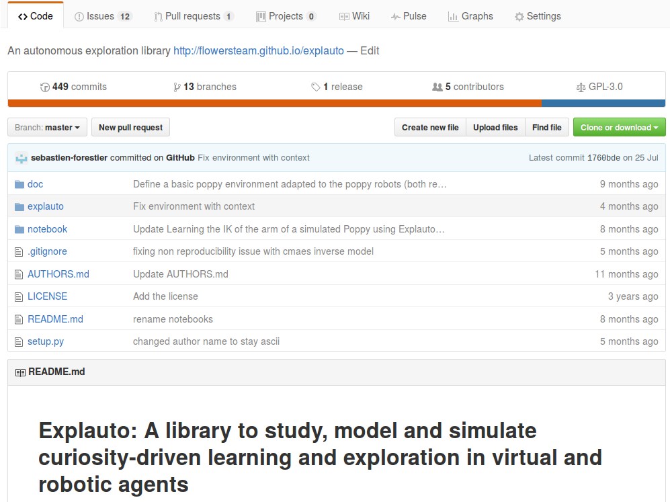
Autonomous exploration, active learning and human guidance with
open-source Poppy humanoid robot platform and Explauto library
Sébastien Forestier^{1,2}, Yoan Mollard^{1,3}, Damien Caselli, Pierre-Yves Oudeyer^{1,3}
¹Inria Bordeaux, ²Bordeaux University, ³Ensta Paristech, France
An open platform Poppy robots + Explauto library, to:
Allow non-roboticists researchers to conduct
learning experiments with robots
Benchmark algorithms for active multi-tasks
policy learning with robots
github.com/flowersteam/explauto

Slide 2
Active Model Babbling
Motor
Hand
Motor
Joystick
1 motor space
7 effect spaces
Motor
Ball
→ Goal Space selection based on learning progress

Slide 3
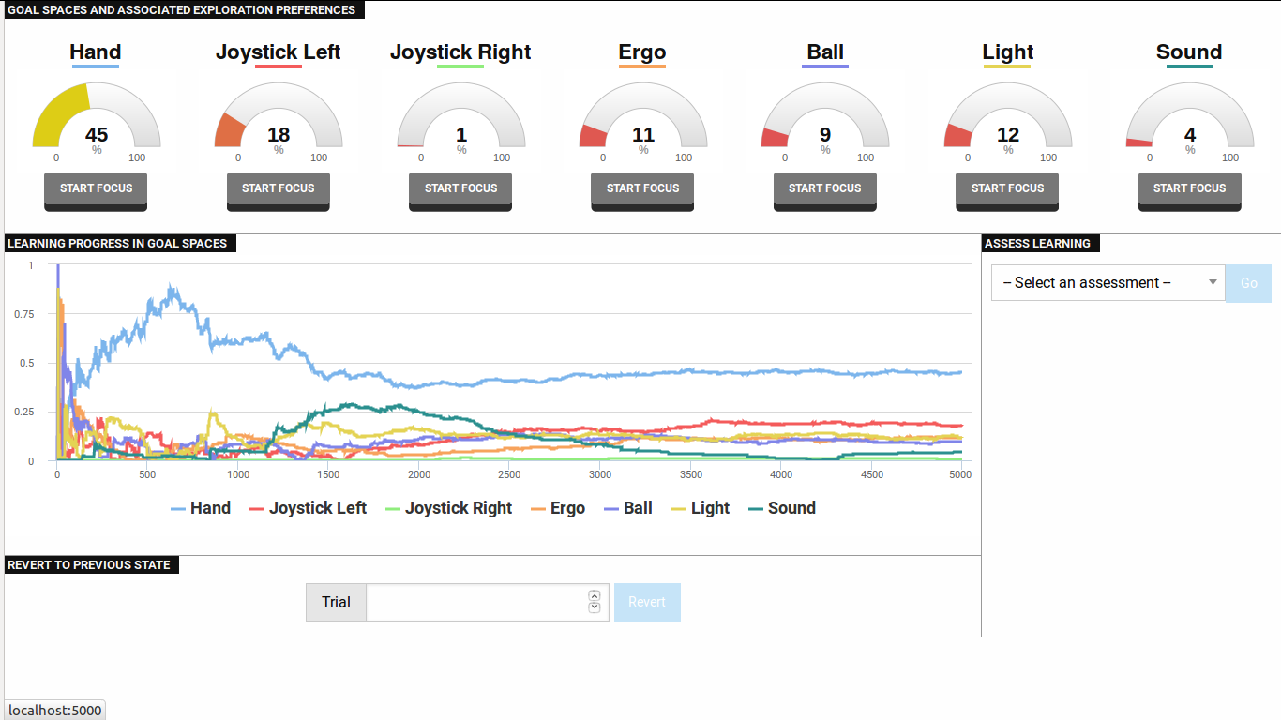
Results: interest of modules

Slide 4
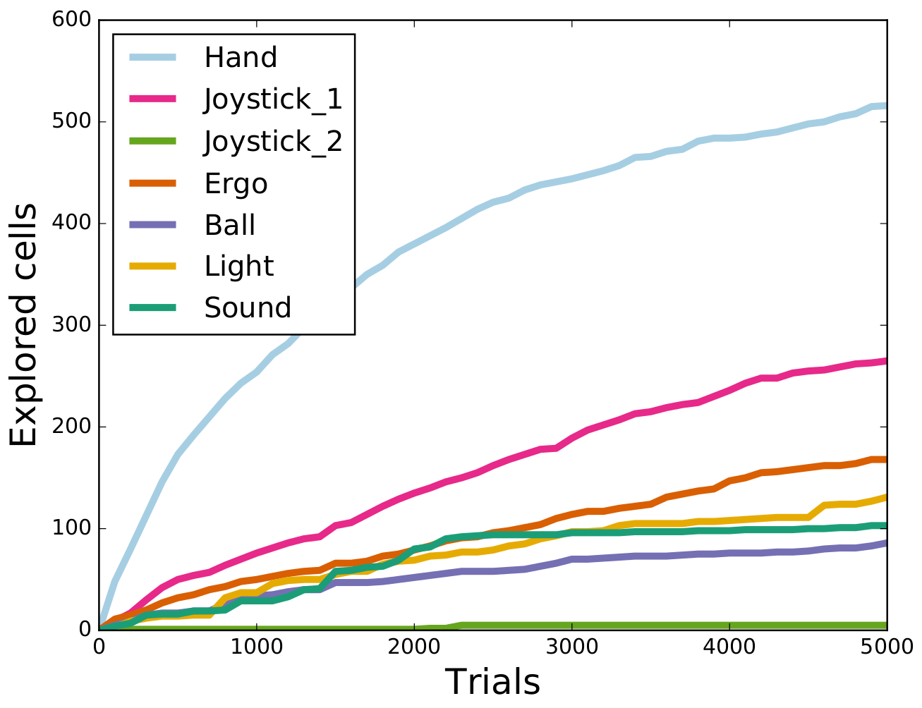
Results: Object exploration

Slide 5
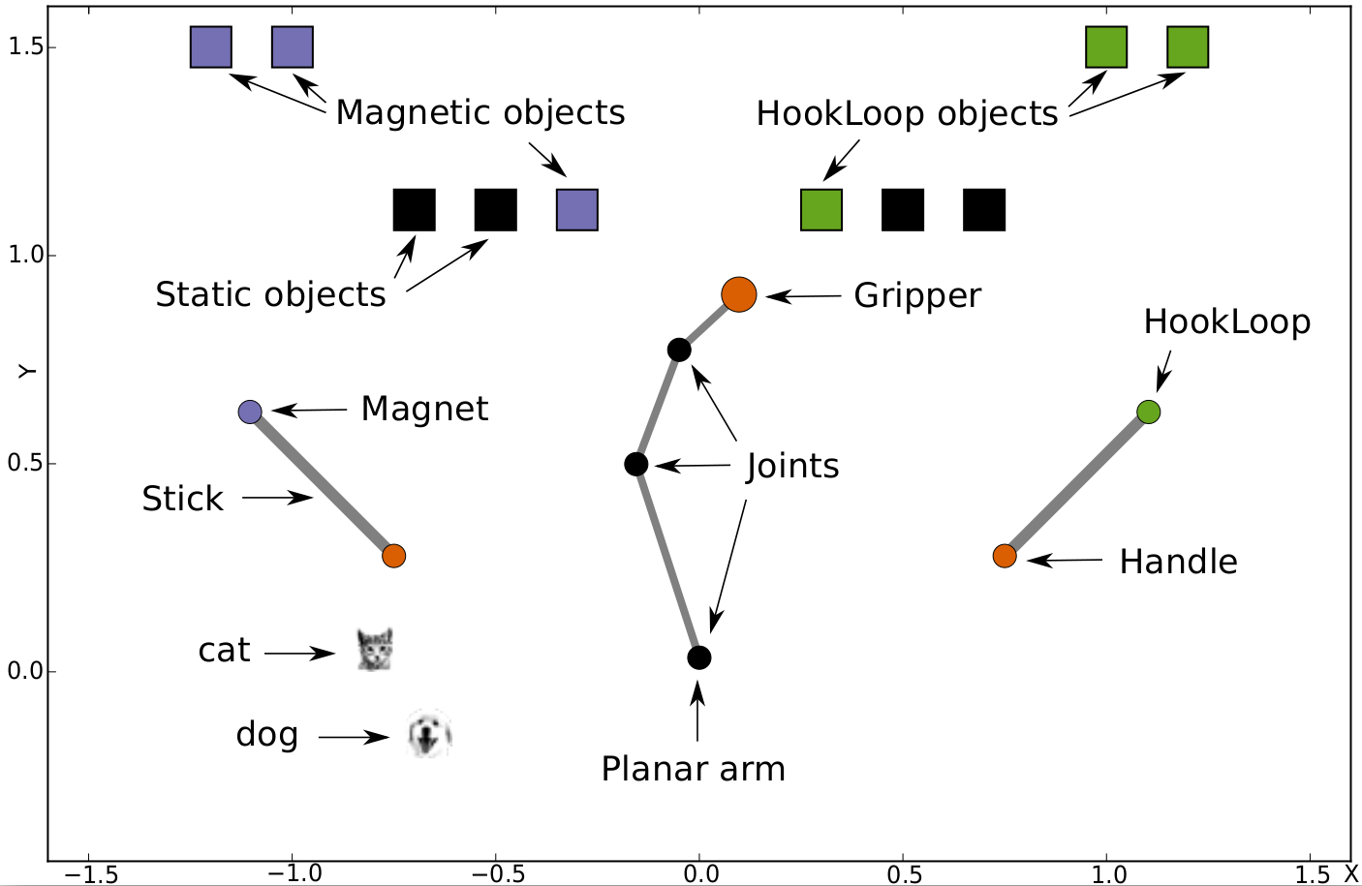
Simulated Robotic setup
5
M: 12D
S: 93D
Modular Active Curiosity-Driven Discovery of Tool Use

Slide 6
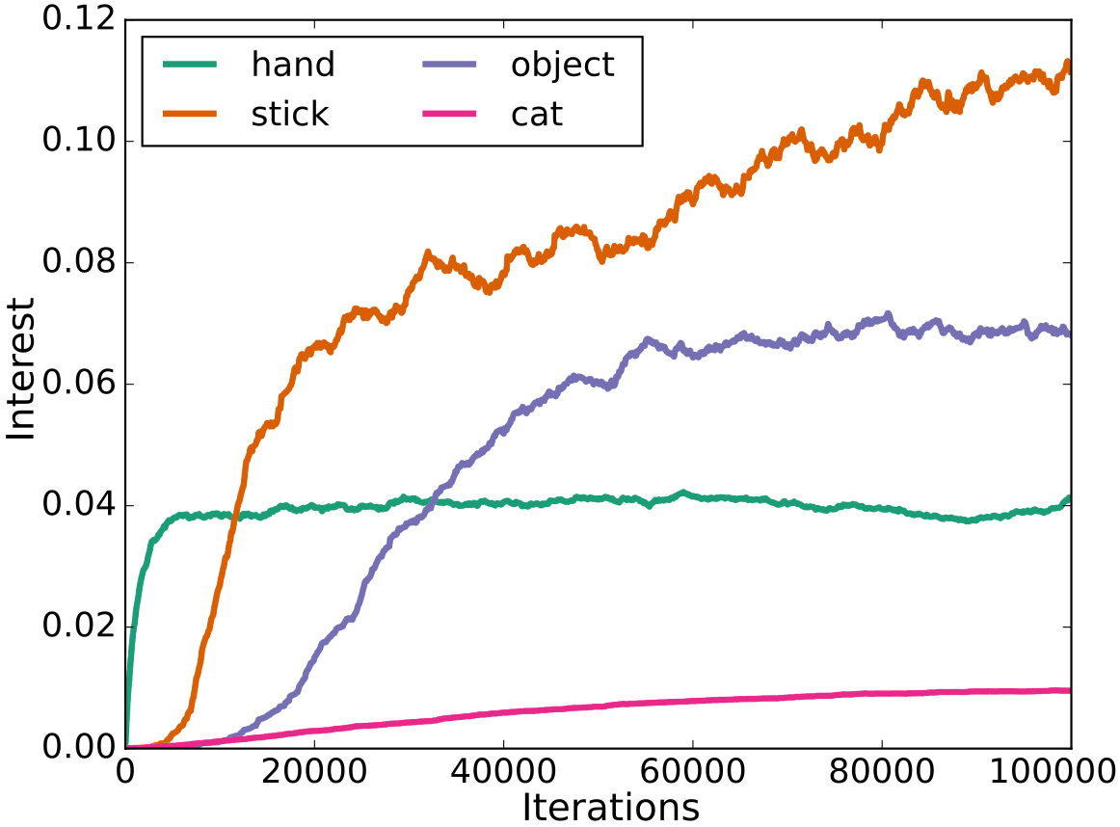
Results: interest of modules
8
Modular Active Curiosity-Driven Discovery of Tool Use

Slide 7
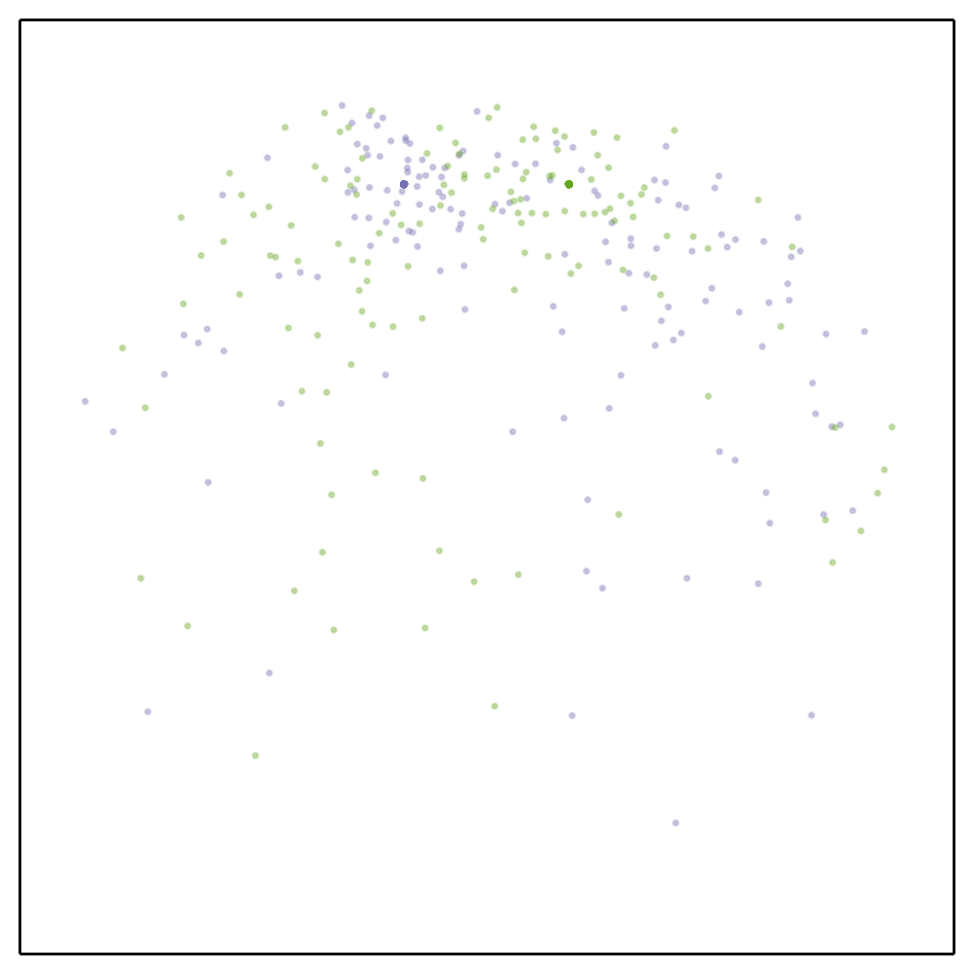
Results: Object exploration
9
Random Motor Babbling
Modular Active Curiosity-Driven Discovery of Tool Use

Slide 8

Results: Object exploration
10
Random Goal Babbling
Flat Architecture
Modular Active Curiosity-Driven Discovery of Tool Use

Slide 9
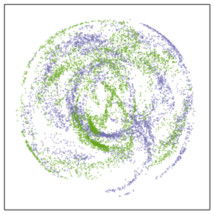
Results: Object exploration
11
Random Model Babbling
Modular Architecture
Modular Active Curiosity-Driven Discovery of Tool Use

Slide 10
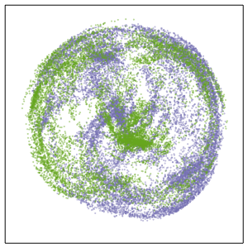
Results: Object exploration
12
Active Model Babbling
Modular Architecture
Modular Active Curiosity-Driven Discovery of Tool Use

Slide 11
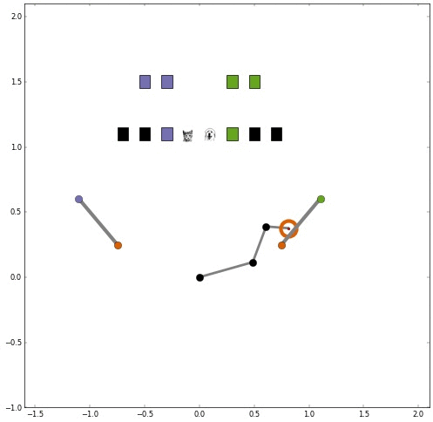
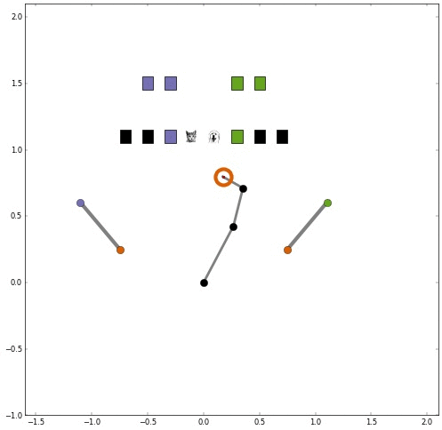
Videos
- Motor Babbling
- Active Model Babbling
13
Modular Active Curiosity-Driven Discovery of Tool Use

Slide 12
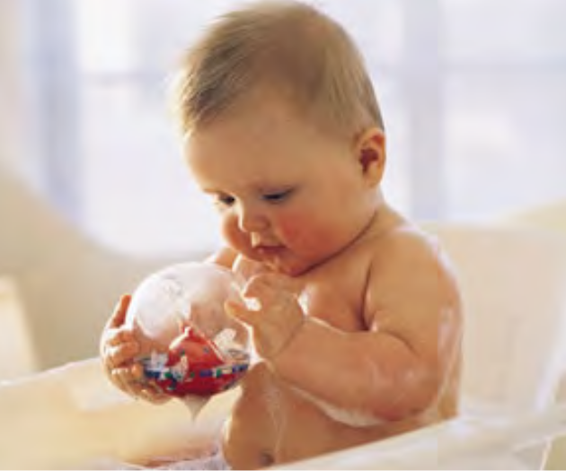
Intrinsic motivation, curiosity
2
Intrinsic drive to experience
  novelty,
  surprise,
  to reduce uncertainty,
  to resolve cognitive dissonance
  (Gottlieb 2013)

Slide 13
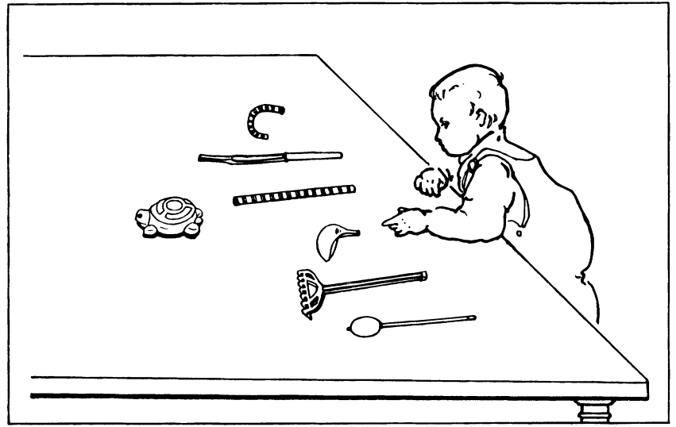
Computational models of intrinsic motivations
3
Object of Intrinsic Motivation:
  Actions
  Problems
  Spaces

Slide 14
Computational models of intrinsic motivations
3
Object of Intrinsic Motivation:
  Actions
  Problems
  Spaces

Slide 15
Computational models of intrinsic motivations
3
Object of Intrinsic Motivation:
  Actions
  Problems
  Spaces

Slide 16
Computational models of intrinsic motivations
3
Object of Intrinsic Motivation:
  Actions
  Problems
  Spaces

Slide 17
Computational models of intrinsic motivations
3
Object of Intrinsic Motivation:
  Actions
  Problems
  Spaces

Slide 18
Computational models of intrinsic motivations
3
Object of Intrinsic Motivation:
  Actions
  Problems
  Spaces

Slide 19
Computational models of intrinsic motivations
3
Object of Intrinsic Motivation:
  Actions
  Problems
  Spaces

Slide 20
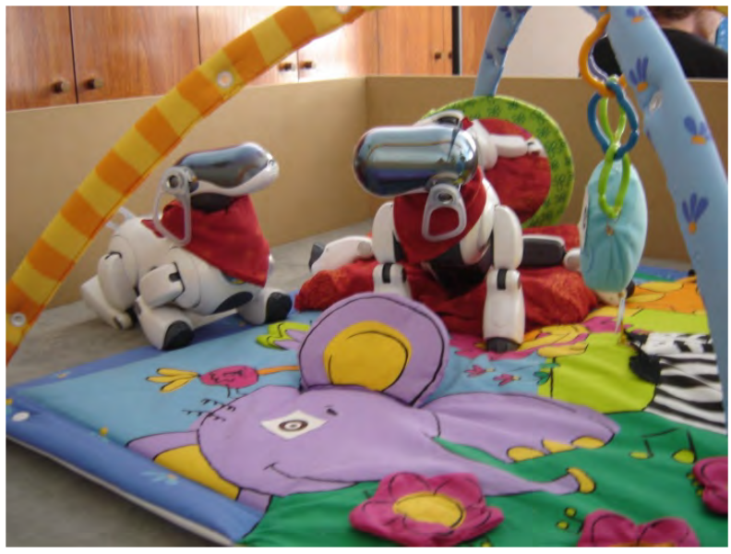
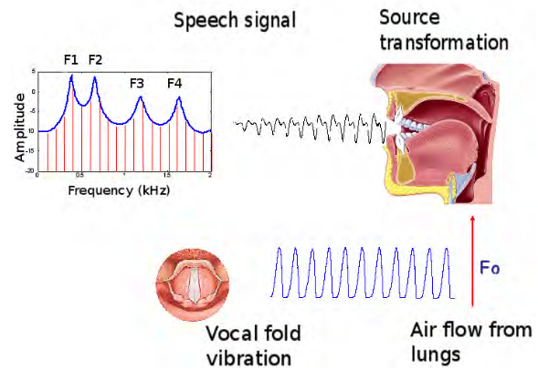
Computational models of intrinsic motivations
4
→ Self-organization of developmental trajectories
The Playground Experiment, Oudeyer 2007
Vocal development, Moulin-Frier 2014

