Slide 1





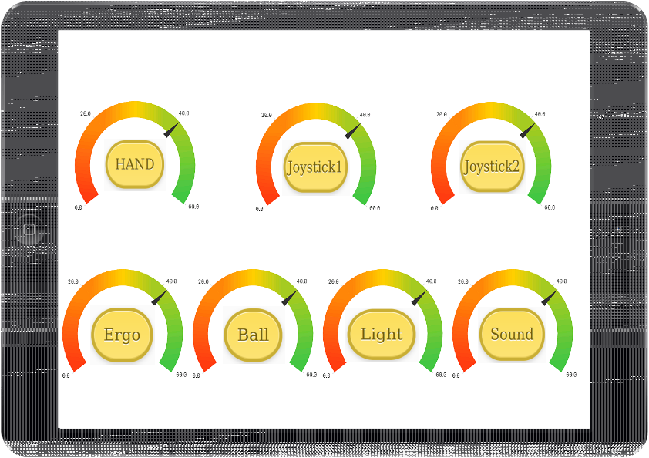
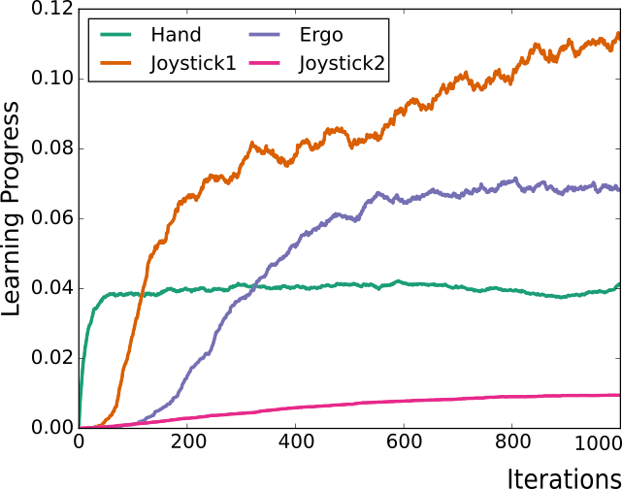

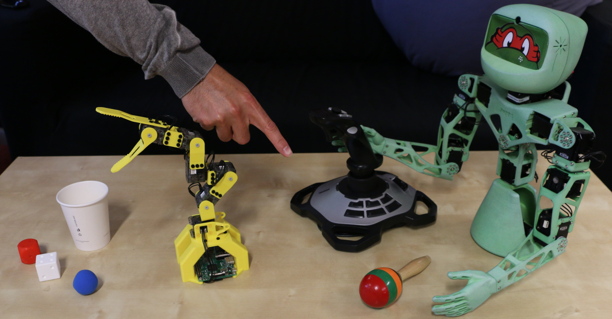

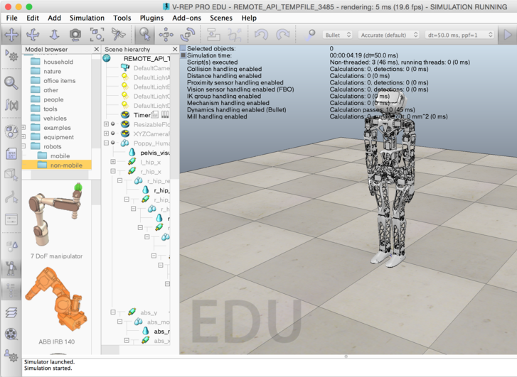
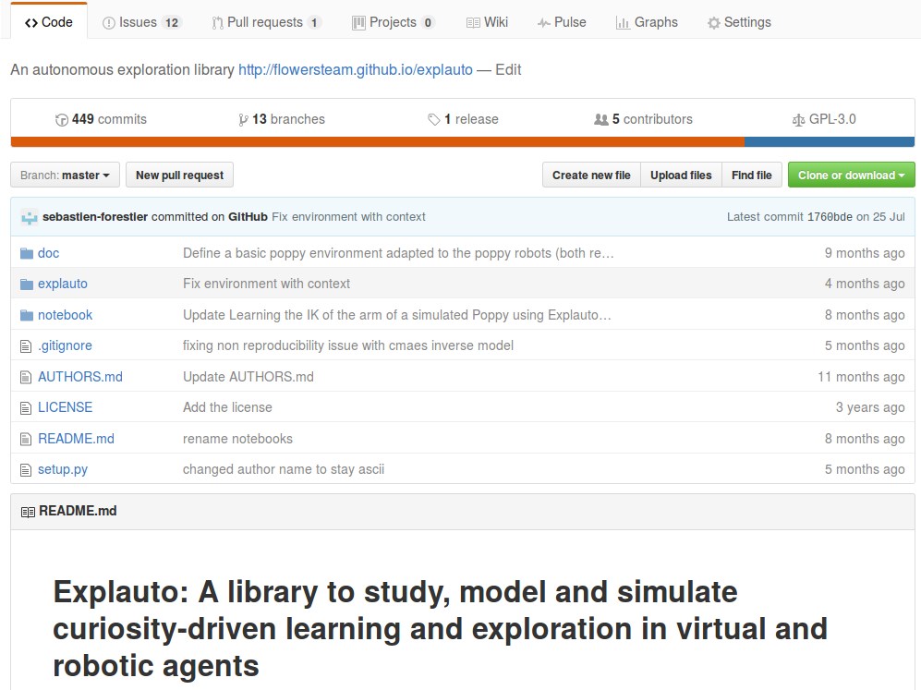
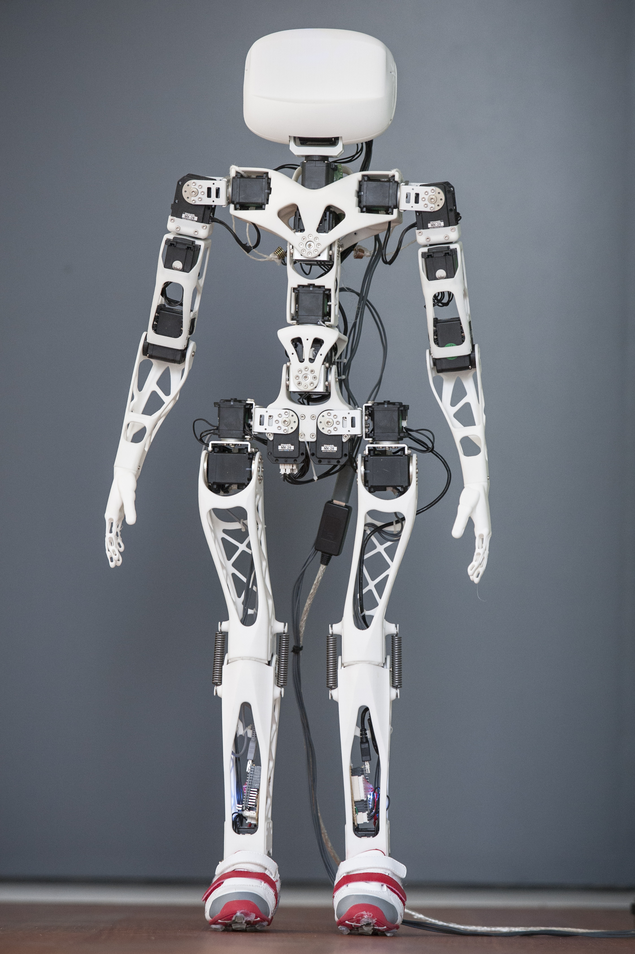
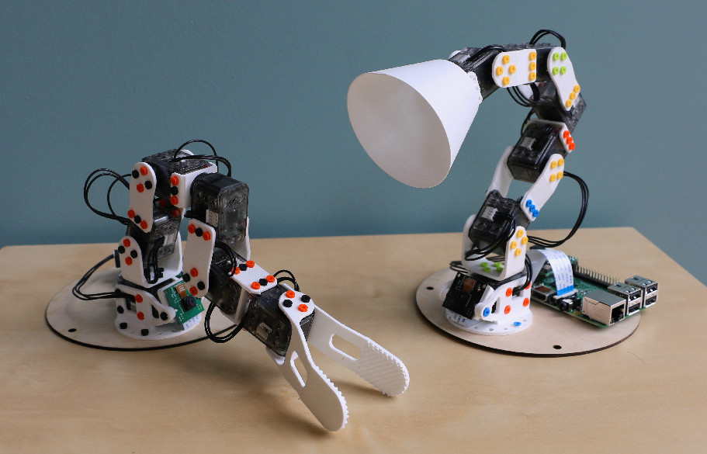
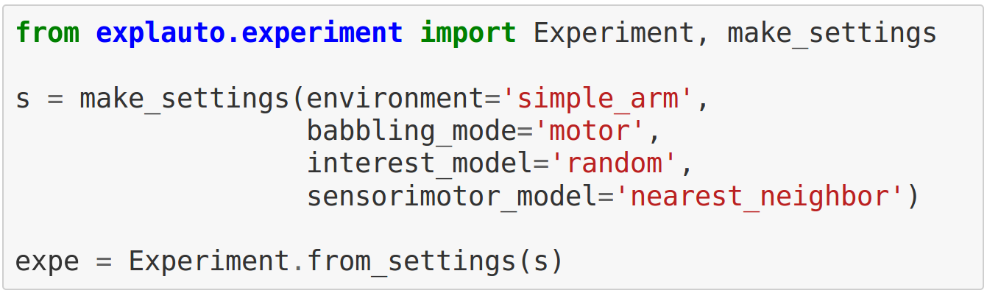

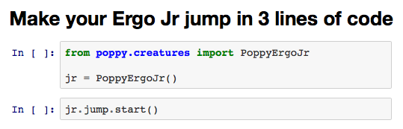
Sébastien Forestier Yoan Mollard Damien Caselli Pierre-Yves Oudeyer
Forestier, S. and Oudeyer, P.-Y. (2016). Modular active curiosity-driven discovery of tool use. In 2016 IEEE/RSJ International Conference on Intelligent Robots and Systems (IROS), Daejeon, Korea.
Autonomous exploration, active learning and human guidance with
open-source Poppy humanoid robot platform and Explauto library
Flowers Team, Inria Bordeaux, France
Email: sebastien.forestier@inria.fr
The Demonstration
The Torso robot learns how to move its arm to control the ball, light and sounds!
Interact to help him:
On the Tablet, click an element to focus on (sound, light, ball pose...)
Push the Demo Button and then demonstrate a motion:
      Move Torso's left arm to show him how to control the joystick
      Move the left joystick to show him how to teleoperate the Ergo robot
An open platform Poppy robots + Explauto library, to:
Allow non-roboticists researchers to conduct
learning experiments with robots
Benchmark algorithms for active multi-tasks
policy learning with robots
github.com/sebastien-forestier/NIPS2016
Intrinsically Motivated Multi-Task
Reinforcement Learning
Intrinsically motivated RL allows:
To learn parameterized policies
To solve families of parameterized problems
Problems structured in spaces that can be
organized in a hierarchy of reusable skills
github.com/sebastien-forestier/ExplorationAlgorithms
OR
OR
High-dimensional (>100D)
continuous effect space
Human guidance
Joystick
Ergo
Hand
Poppy: an experimental platform for science
Explauto: a library to study learning in robotics agents
Explauto provides a high-level Python API for an
easy definition of:
Real and simulated robotics setups
Incremental learning of parametrized policies
Active selection of parametrized RL problems
github.com/flowersteam/explauto
High-dimensional
continuous motor space
Ball
Toy
“Make scientific outputs openly accessible,
reproducible and cumulative”
Poppy robots are accessible in terms of cost
and complexity, allowing researchers to
share hardware and experimental details
Fast design, building and experimentation of alternative morphologies: 3D printing and rapid prototyping techniques now make it possible!
poppy-project.org
Robot simulator
Humanoid
Poppy Humanoid Poppy Ergo Junior

