Slide 1
Agenda
Time | Topic | Speaker
5 Minutes | Opening Remarks & Introductions
10 Minutes | CSA Section 405(d)’s Mandate, Purpose, and Desired Goals | Julie Anne Chua
15 Minutes | HICP Overview | Julie Anne Chua
15 Minutes | Using HICP and Supporting Resources | Erik Decker
10 Minutes | HICP’s Value and Benefits | Erik Decker
10 Minutes | HICP Pretesting with Industry | Erik Decker
5 Minutes | Looking Forward | Julie Anne Chua
5 Minutes | Upcoming HICP Engagements | Julie Anne Chua
15 Minutes | Questions

Slide 2
CSA Section 405(d)’s Mandate, Purpose, and Desired Goals

Slide 3
Cybersecurity Act of 2015 (CSA): Legislative Basis
CSA Section 405
Improving Cybersecurity in the Health Care Industry
Section 405(b): Health care industry preparedness report
Section 405(c): Health Care Industry Cybersecurity Task Force
Section 405(d): Aligning Health Care Industry Security Approaches

Slide 4

CSA Section 405(d): Legislative Language (1/2)
Authority: Cybersecurity Act of 2015 (CSA), Section 405(d), Aligning Health Care Industry Security Approaches
The Secretary shall establish, through a collaborative process with the Secretary of Homeland Security, health care industry stakeholders, the Director of the National Institute of Standards and Technology, and any Federal entity or non-Federal entity the Secretary determines appropriate, a common set of voluntary, consensus-based, and industry-led guidelines, best practices, methodologies, procedures, and processes that:

Slide 5
CSA Section 405(d): Legislative Language (2/2)
Serve as a resource for cost-effectively reducing cybersecurity risks for a range of health care organizations;
Support voluntary adoption and implementation efforts to improve safeguards to address cybersecurity threats;
Are consistent with—
The standards, guidelines, best practices, methodologies, procedures, and processes developed under section 2(c)(15) of the National Institute of Standards and Technology Act (15 U.S.C. 272(c)(15));
The security and privacy regulations promulgated under section 264(c) of the Health Insurance Portability and Accountability Act of 1996 (42 U.S.C. 1320d-2 note); and
The provisions of the Health Information Technology for Economic and Clinical Health Act (title XIII of division A, and title IV of division B, of Public Law 111-5), and the amendments made by such Act; and
Are updated on a regular basis and applicable to a range of health care organizations.

Slide 6




Industry-Led Activity to Improve Cybersecurity in the Healthcare and Public Health (HPH) Sector
WHAT IS THE 405(d) EFFORT?
WHO IS PARTICIPATING?
An industry-led process to develop consensus-based guidelines, practices, and methodologies to strengthen the HPH-sector’s cybersecurity posture against cyber threats.
The 405(d) Task Group is convened by HHS and comprised of over 150 information security officers, medical professionals, privacy experts, and industry leaders.
HOW WILL 405(d) ADDRESS HPH CYBERSECURITY NEEDS?
WHY IS HHS CONVENING THIS EFFORT?
With a targeted set of applicable & voluntary practices that seeks to cost-effectively reduce the cybersecurity risks of healthcare organizations.
To strengthen the cybersecurity posture of the HPH Sector, Congress mandated the effort in the Cybersecurity Act of 2015 (CSA), Section 405(d).

Slide 7
HICP Publication Overview

Slide 8

Document Objective and Development
Objective
The CSA 405(d) document aims to raise awareness, provide vetted practices, and foster consistency in mitigating the most pertinent and current cybersecurity threats to the sector. It seeks to aid the HPH sector organizations to develop meaningful cybersecurity objectives and outcomes.
Development
Leverage Existing Information
HPH Sector Public-Private Collaboration
National Pretesting
Existing information and guidance (e.g., NIST Cybersecurity Framework) was leveraged across the public and private domains to provide a tailored approach for the healthcare industry. It does not create new frameworks, re-write specifications, or “reinvent the wheel.”
To ensure a successful outcome and a collaborative process, HHS reached out to a diverse set of healthcare and cybersecurity experts from the public and private sectors. Participation is open and voluntary.

Slide 9
Document Development Detail
Identified ~110 members.
Convened 6 times from May 2017 to March 2018
Task Group Recruitment & Management
Supporting the Authoring of 405(d) Document
Assess the Process: After Action Review
Assess the Input: Peer Review Roundtables
Co-Authoring & Design of 405(d) Document
Assess the Output: Nationwide Pretesting
Who Are They: Stakeholder Mapping & Analysis
Existing Attitudes: Medical Community Baselining
Administrative Support and Writing Counsel
Qualitative Research to Establish Level of Awareness and Prioritization
Version 1.0 Five Threats and Ten Practices
Writing Committee
Quantitative and qualitative knowledge-base for HPH Sector.
4 Subgroups collaboratively developed 96 page annotated outline
Group interviews with medical professionals and HPH CIOs/CISOs.
3 Focus Group Assessments
19 total participants including healthcare and CIOs/CISOs
Deliberation and consensus resulting in Writing Committee’s new 34 page format
35 One-on-One Interviews with Task Group Members

Slide 10

Document - Content Overview (1/2)
After significant analysis of the current cybersecurity issues facing the HPH Sector, the Task Group agreed on the development of three documents—a main document and two technical volumes, and a robust appendix of resources and templates:
The main document examines cybersecurity threats and vulnerabilities that affect the healthcare industry. It explores five (5) current threats and presents ten (10) practices to mitigate those threats.
Technical Volume 1 discusses these ten cybersecurity practices for small healthcare organizations.
Technical Volume 2 discusses these ten cybersecurity practices for medium and large healthcare organizations.
Resources and Templates provides mappings to the NIST Cybersecurity Framework, a HICP assessment process, templates and acknowledgements for its development.
The 5 current threats identified in healthcare:
Email Phishing Attacks
Ransomware Attacks
Loss or Theft of Equipment or Data
Internal, Accidental, or Intentional Data Loss
Attacks Against Connected Medical Devices that May Affect Patient Safety

Slide 11
Document - Content Overview (2/2)
The document identifies ten (10) practices, which are tailored to small, medium, and large organizations and discussed in further detail in the technical volumes:
1
Email Protection Systems
2
Endpoint Protection Systems
3
Access Management
4
Data Protection and Loss Prevention
5
Asset Management
6
Network Management
7
Vulnerability Management
8
Incident Response
9
Medical Device Security
10
Cybersecurity Policies

Slide 12
Using HICP and Supporting Resources

Slide 13
Introduction and Executive Summary
HICP is…
A call to action to manage real cyber threats
Written for multiple audiences (clinicians, executives, and technical)
Designed to account for organizational size and complexity (small, medium and large)
A reference to “get you started” while linking to other existing knowledge
Aligned to the NIST Cybersecurity Framework
Voluntary
HICP is not…
A new regulation
An expectation of minimum baseline practices to be implemented in all organizations
The definition of “reasonable security measures” in the legal system
An exhaustive evaluation of all methods and manners to manage the threats identified
You might have other practices in place that are more effective than what was outlined!
Your guide to HIPAA, GDPR, State Law, PCI, or any other compliance framework

Slide 14

HICP is a Cookbook!
So you want a recipe for managing phishing?
5 oz of Basic E-Mail Protection Controls (1.M.A)
A dash of Multi-Factor Authentication (1.M.B)
2 cups of Workforce Education (1.M.D)
1 cup of Incident Response plays (8.M.B)
1 tsp of Digital Signatures for authenticity (1.L.B)
Advanced and Next General Tooling to taste (1.L.A)
Preheat your email system with some basic email protection controls necessary to build the foundation of your dish. Mix in MFA for remote access, in order to protect against potential credential theft.
Let sit for several hours, while providing education to your workforce on the new system, and how to report phishing attacks. While doing so, ensure to provide education on how digital signatures demonstrating authenticity of the sender. When finished baking, sprinkle with additional tooling to provide next level protection.
Just like with any cookbook the recipes provide the basic ingredients to making a meal. It does not:
Instruct you how to cook
Instruct you on what recipes to use
Limit your ability for substitutions
The skill of the cook is what makes the dish!

Slide 15
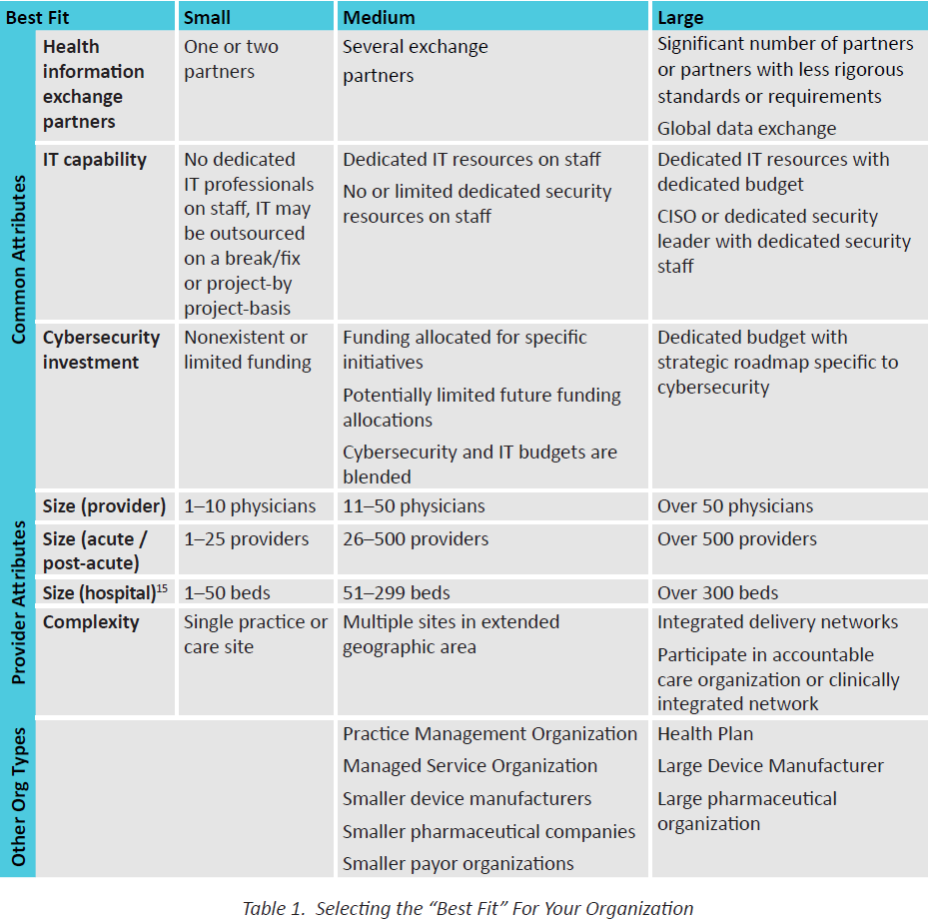
How to Evaluate Your Organization’s Size
HICP is designed to assist organizations of various sizes implement resources and practices that are tailored and cost effective to their needs.
How “large and complex an organization you might be relates to several factors:
Health Information Exchanges
IT Capability
Cybersecurity Investment
Size (provider)
Size (acute/post-acute)
Size (hospital)
Complexity
Determining where you fit is your decision
Main Document, p. 11
Medium

Slide 16
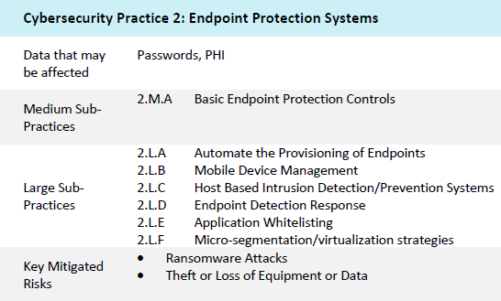
How to Use Practices and Sub-Practices
There are a total of 10 Cybersecurity Practices, and 89 Sub-Practices.
Each Cybersecurity Practice has a corresponding set of Sub-Practices, risks that are mitigated by the Practice, and suggested metrics for measuring the effectiveness of the Practice
Medium Sized orgs can review the Medium Sub-Practices
Large Sized orgs can review the Medium and Large Sub-Practices
Each Practice is designed to mitigate one or many threats
Sample Metrics
Percentage of endpoints encrypted based on a full fleet of known assets, measured weekly.
Percentage of endpoints that meet all patch requirements each month.
Percentage of endpoints with active threats each week.
Percentage of endpoints that run non hardened images each month.
Percentage of local user accounts with administrative access each week.

Slide 17
Suggested Assessment Process
Step 1
Enumerate and Prioritize Threats
Step 2
Review Practices Tailored to Mitigate Threats
Step 3
Determine Gaps Compared to Practices
Step 4
Identify Improvement Opportunity and Implement
Step 5
Repeat for Next Threat
Resources and Templates, p. 39

Slide 18
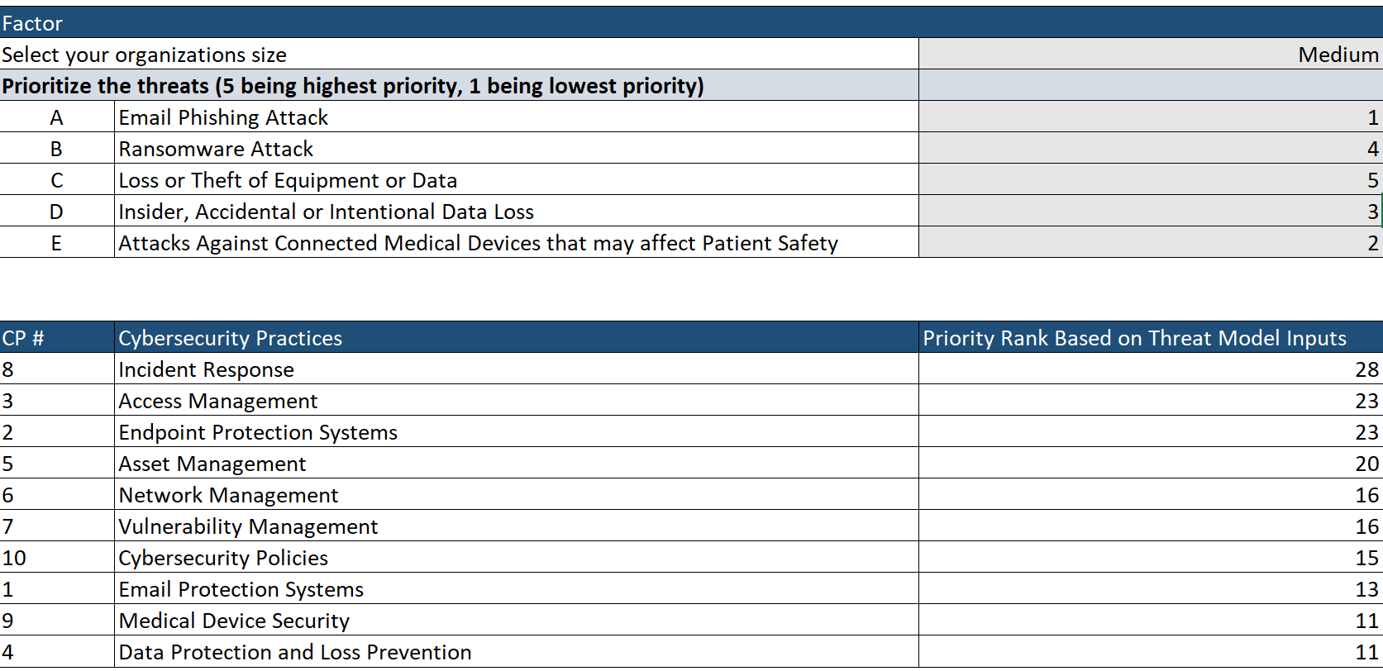
Prioritize Your Threats (with Example)
Implementing all Practices within HICP could be daunting, even for a Large Sized Organization
Recommendation: Review the threats and implement the most impactful practices first
A toolkit will be released shortly to assist with this process

Slide 19
Self-Assessment to Practices (with Example)
Continuing with the example previously, we have selected the top 3 practices and sub-practices to help mitigate Loss or Theft of Equipment or Data
FULL LISTING OF CYBERSECURITY SUB-PRACTICES BASED ON ORGANIZATION SIZE SELECTED |  |  | Self Assessment
SP# | Cybersecurity Sub-Practice Title | Short Description | Current State | Gaps | Action Plan | Priority
2.M.A | Basic Endpoint Protection Controls | Basic endpoint security controls to enable | Encryption at 80%, AV in place, baseline image, all users with admin rights | Encryption gaps and admin rights | Finish encryption, remove admin rights | High
3.M.A | Identity | Establish a unique identifier for all users, leveraging systems of record | All users provided accounts, not tied to ERP | No identity, can allow for orphaned accounts and failure to term | Establish identity program | Me
3.M.B | Provisioning, Transfers, and De-provisioning Procedures | Provision user accounts based on identity; ensure de-provisioning upon termination | User accounts created directly into Active Directory manually, when requested | Access rights might cumulate and administrators might fail to terminate access | Establish accounts based upon identity, automate provisioning and de-provisioning | Med
3.M.C | Authentication | Implement and monitor secure authentication for users and privileged accounts | Authentication bound to central authentication source | No gaps | No gaps | N/A
3.M.D | Multi-Factor Authentication for Remote Access | Implement multi-factor authentication for remote access to resources | VPN access available, no MFA | No MFA enabled, which can allow for a theft of credentials to access sensitive data | Implement MFA | Med
8.M.A | Security Operations Center | Establish a SOC to prevent, discover and respond to cyber attacks | Dedicated team to manage and respond to cyber incidents | No gaps | No Gaps | N/A
8.M.B | Incident Response | Establish formal incident response playbooks for responding to cyber attacks | Playbooks exist, but no playbook for lost/stolen device | In the case of a stolen device teams might not execute investigation properly | Establish playbook for stolen devices, get approval from leadership | High
8.M.C | Information Sharing and ISACs/ISAOs | Join security communities to share best practices and threat information | Not a current member of an ISAC/ISAO | By not participating in ISAC/ISAOs cyber teams might be missing out on leading practices | Join ISAC/ISAO | High
Cybersecurity Practices Assessment Toolkit

Slide 20
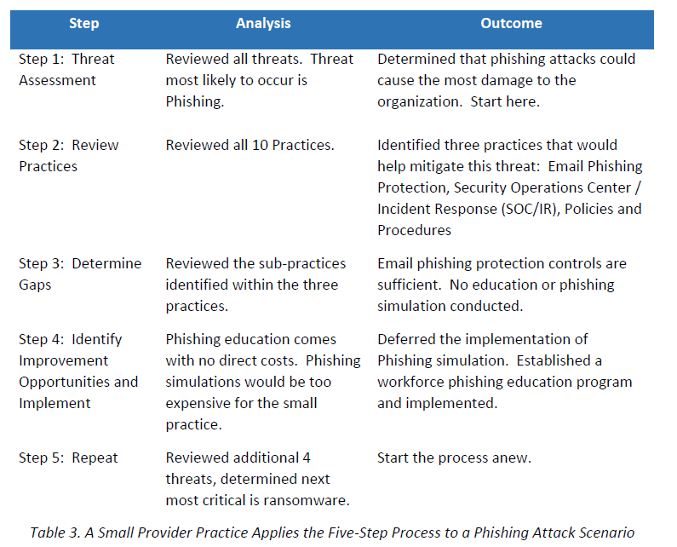
Example Assessment (Appendix E)
Resources and Templates, p. 41

Slide 21
Value and Benefits

Slide 22
Healthcare and Public Health (HPH) Sector Benefits
This joint HHS- and industry- led initiative aims to increase awareness and foster consistency with cybersecurity practices for a wide range of stakeholders.
Executives
Practitioners
InfoSec
Users
Sector Benefits
Aimed for use across varied audiences
Information sharing among differing cybersecurity maturity levels and needs
Cybersecurity Awareness
Enterprise Risk Management
Small, medium, and large healthcare organizations can vary in their level of cybersecurity maturity and needs
It is critical for uninterrupted care delivery and patient safety
Cybersecurity should be treated as an enterprise issue, not just an IT issue

Slide 23
Cybersecurity: An Enterprise Issue
HHS continues to institutionalize cybersecurity as a key priority and is actively advocating the culture shift to treat cybersecurity as an enterprise issue.
Information Security & Privacy
Leadership Engagement & Support
CFO Community Engagement
HHS has Healthcare and Public Health (HPH) Sector-Specific Agency responsibilities for all hazards including cybersecurity and public-private partnerships.
Continued engagement with the Enterprise Risk Management (ERM) community and senior/executive leadership on cybersecurity activities, strategies, and risk management.
As ERM matures within the healthcare industry, continued support is needed to operationalize cybersecurity and information security risks as part of our strategic, mission, and business risk management decisions across HHS and the HPH sector.
Notes:
CFO community impacts and relevance

Slide 24
Pretesting Findings

Slide 25

Pretesting Background
Pretesting of the 405(d) document consisted of facilitated focus group discussions assessing the practicality, usability, and what impact this document can have. Stakeholder groups included Medical Professionals, HPH CIOs/CISOs, and other HPH staff.
Pretesting sessions were both in-person and virtual, and feedback was gathered with focus groups of 9-15 participants via roundtable discussion. Comments were well received and incorporated into the initial publication, if applicable. Outstanding comments have been captured for future reference.

Slide 26
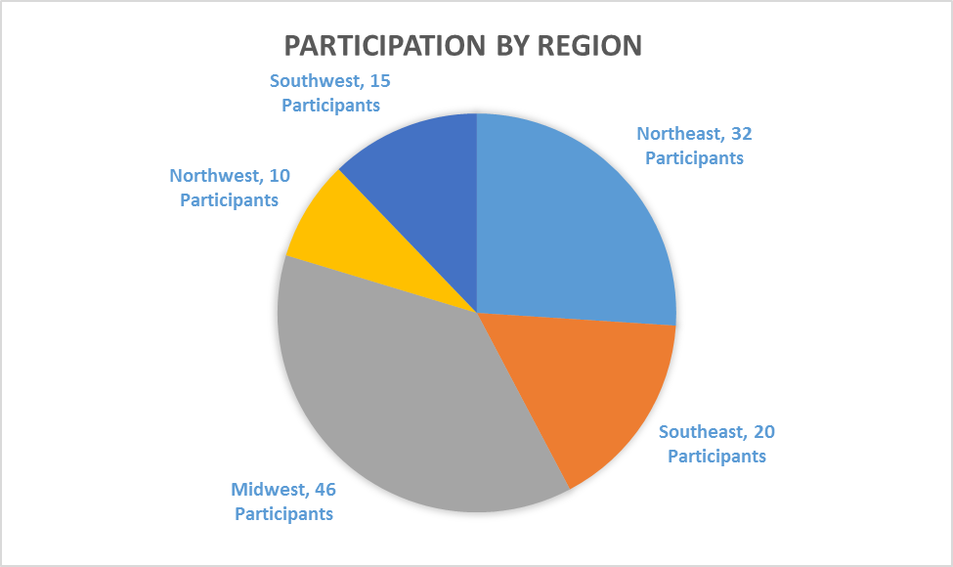
Pretesting: By Region
Notes:
Key Stats
In-Person – 87 participants
Virtual – 36 participants
Avg Per Group – 8 participants
Total – 123 participants
In-Person Pretests – 12 via roundtable discussion
Virtual Pretests – 4 via WebEx roundtable discussion
Totals Pretests – 16
Cities: Chicago, IL; Duluth, GA; Long Island, NY; NYC, NY; Ocala, FL; Seattle, WA; Columbus, OH
70+ Organizations
--------------------------------------
Position Breakdown
Practitioners – 12 participants
Hospital/Practice Admin – 10 participants
CIOs – 5 participants
CISOs – 13 participants
Executive Level – 18 participants
Medical Device Professionals – 8 participants
IT Professionals - 12 participants
InfoSec Professionals – 45 participants
---------------------------------------
Regions Represented
Northeast – 32 participants
Southeast – 20 participants
Midwest – 46 participants
Northwest – 10 participants
Southwest – 15 participants

Slide 27
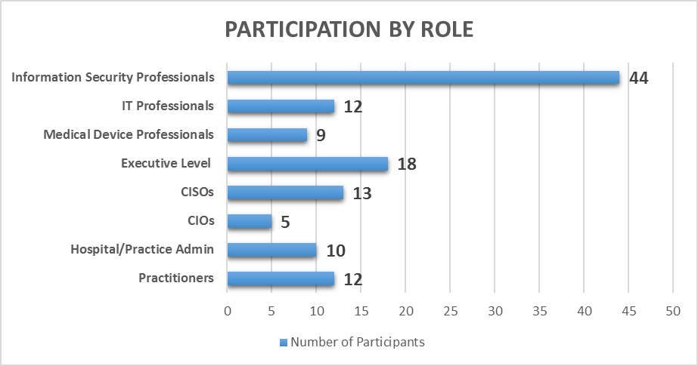
Pretesting: By Role
*123 Total Participants
Notes:
Key Stats
In-Person – 87 participants
Virtual – 36 participants
Avg Per Group – 8 participants
Total – 123 participants
In-Person Pretests – 12 via roundtable discussion
Virtual Pretests – 4 via WebEx roundtable discussion
Totals Pretests – 16
Cities: Chicago, IL; Duluth, GA; Long Island, NY; NYC, NY; Ocala, FL; Seattle, WA; Columbus, OH
70+ Organizations
--------------------------------------
Position Breakdown
Practitioners – 12 participants
Hospital/Practice Admin – 10 participants
CIOs – 5 participants
CISOs – 13 participants
Executive Level – 18 participants
Medical Device Professionals – 8 participants
IT Professionals - 12 participants
InfoSec Professionals – 45 participants
---------------------------------------
Regions Represented
Northeast – 32 participants
Southeast – 20 participants
Midwest – 46 participants
Northwest – 10 participants
Southwest – 15 participants

Slide 28
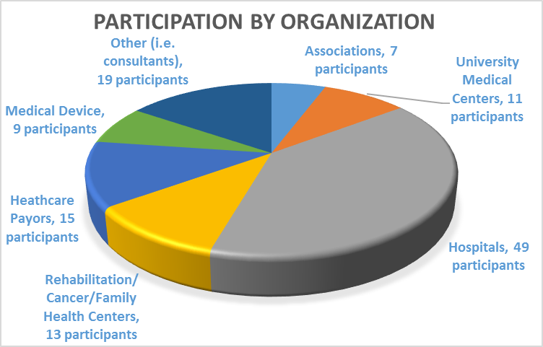
Pretesting: By Organization
Notes:
Key Stats
In-Person – 87 participants
Virtual – 36 participants
Avg Per Group – 8 participants
Total – 123 participants
In-Person Pretests – 12 via roundtable discussion
Virtual Pretests – 4 via WebEx roundtable discussion
Totals Pretests – 16
Cities: Chicago, IL; Duluth, GA; Long Island, NY; NYC, NY; Ocala, FL; Seattle, WA; Columbus, OH
70+ Organizations
--------------------------------------
Position Breakdown
Practitioners – 12 participants
Hospital/Practice Admin – 10 participants
CIOs – 5 participants
CISOs – 13 participants
Executive Level – 18 participants
Medical Device Professionals – 8 participants
IT Professionals - 12 participants
InfoSec Professionals – 45 participants
---------------------------------------
Regions Represented
Northeast – 32 participants
Southeast – 20 participants
Midwest – 46 participants
Northwest – 10 participants
Southwest – 15 participants

Slide 29
Looking Forward

Slide 30

Looking Forward
CSA 405(d) aims to be the leading collaboration center of OCIO/OIS, in partnership with HHS Divisions, and the healthcare industry focused on the development of resources that help align health care cybersecurity practices
Immediate Next Steps
Over the course of the next year the 405(d) Team plans to continue to develop awareness of the HICP publication and engage with stakeholders by:
Building additional supporting materials/resources to spotlight the HICP publication and related content
Develop means to collect feedback and implementation of HICP practices and methods
Hosting additional outreach engagements

Slide 31
Questions

Slide 32
Thank you for Joining Us
Visit us at: www.phe.gov/405d
Contact Us at: CISA405d@hhs.gov

